Slide 1
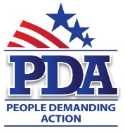

Voter Access Protection/
Election Integrity
Special Guests: Mimi Kennedy, PDA Advisory Board Chair
DC Shadow Senator Michael Brown

Slide 2
Intro/Welcome
Call will be recorded; recording will be published on the Voter Access Protection/Election Integrity page - http://www.pdamerica.org/issues/voter-access-protection-election-integrity
Powerpoint will be available on People Demanding Action Downloads section
Powerpoint is also available from the Share button in the room

Slide 3
Our Mission
Voter Access/Election Protection
Comprehensive Campaign Finance Reform
Elimination of Electronic Voting Machines/Return to Verifiable Paper Ballots
Mandatory Audits of Elections
Restoration of Voting Rights for those with past felony convictions
Public Financing of Election/Free TV time for Candidates
Instant Runoff Elections

Slide 4
Endorsed Legislation
Democracy Restoration Act (Cardin/Conyers)
Voter Empowerment Act (Lewis)
Voting is a Constitutional Right (Pocan)
Voting Rights Advancement Act (Leahy/Sewell)
New Columbia Admissions Act (Carper/Norton)
Same Day Registration Act (Ellison)
Voter Access Protection Act (Ellison)

Slide 5
Update on Alabama
Previously closed DMV offices are now open one day per month
Schedule of office openings is posted on the Web
Local organizing to get people their Photo ID

Slide 6
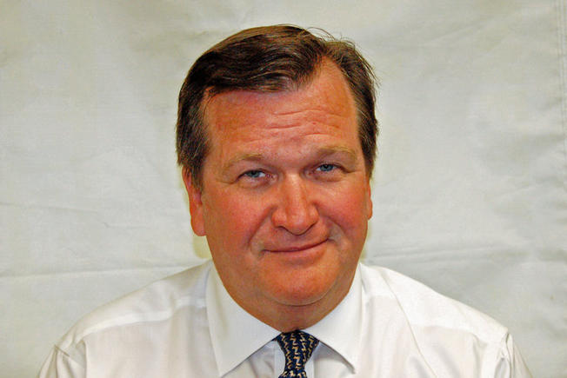
DC Shadow Senator Michael Brown
Receives no pay or benefits from the government
Cannot vote on any Senate matters
Lobbies for DC Statehood
Works with District’s Delegate, Mayor and City Council
Originally elected in 2006

Slide 7
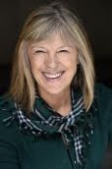
Mimi Kennedy/Election Integrity
PDA Advisory Board Chair
Member National Election Integrity Coalition
Lobbies for Election Integrity

Slide 8
What’s Wrong in Kentucky?
The county voting system map is by www.VerifiedVoting.org
Statewide, Kentucky has mixed systems: paper ballots opti-scanned by Hart InterCivic;
Diebold/Premier/Dominion; ES&S/Dominion, and DREs with no Voter Verified Paper Audit Trails (VVPAT) from
Danaher, Hart InterCivic, Premier/Diebold/Dominion, ES&S, and Microvote, a machine that lost 3,800 votes in one county in 2012. STATE AUDIT LAW: 3-5% randomly-selected precincts must be recounted per county but no guidance given for auditing paperless DREs. Non-photo ID required at polls. Felon voting rights restored by executive pardon or permanently lost.

Slide 9
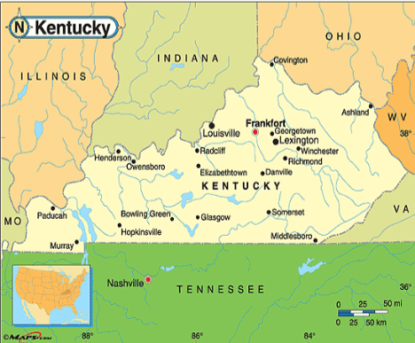
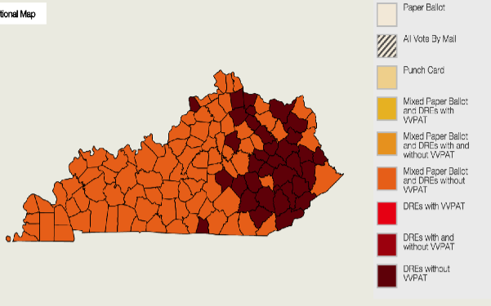
Kentucky Voting

Slide 10
Iowa Caucus – Feb. 1
Iowans don’t use their voting systems for the primary, but the map is instructive anyway. Paper ballots opti-scanned by same mix as Kentucky along with Unisyn, which is also a worldwide leader in making racetrack betting machines and has been subsumed by Berjaya, a Malaysian company dealing in real estate, resorts and casinos.) No state audit law. VERIFIABLE BUT NOT VERIFIED. No Photo ID law. Felons’ voting rights restored after incarceration/parole/probation.

Slide 11
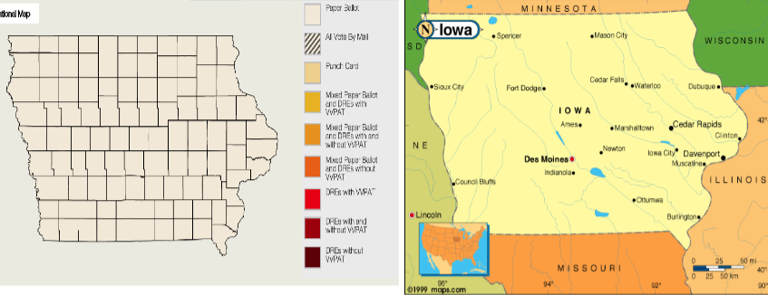
Iowa Voting

Slide 12
New Hampshire – Feb. 9
Statewide voting systems used in primary. Paper ballots opti-scanned at precinct by Diebold, briefly sold to ES&S, then became Premier/Dominion. Some places count ballots by hand in the precinct after polls close. No state audit law. Results are WHOLLY VERIFIABLE BUT ONLY PARTLY VERIFIED. No photo ID law. Felons’ voting rights restored after incarceration.

Slide 13
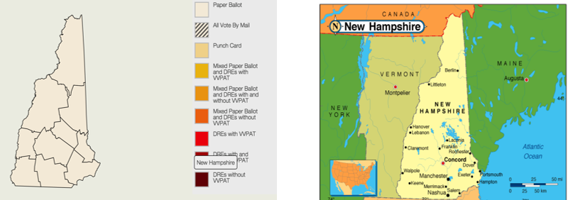
New Hampshire

Slide 14
South Carolina – Feb. 20
Statewide voting system used for Republican (20) and Democratic (27) primaries. DREs w/o VVPAT (ES&S/Dominion). NO STATE AUDIT LAW. UNVERIFIABLE AND UNVERIFIED. Photo law passed but voided by state supreme court as unconstitutional. Felons’ vote restored after incarceration/probation/parole.

Slide 15
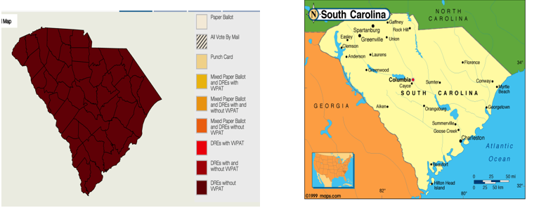
South Carolina

Slide 16
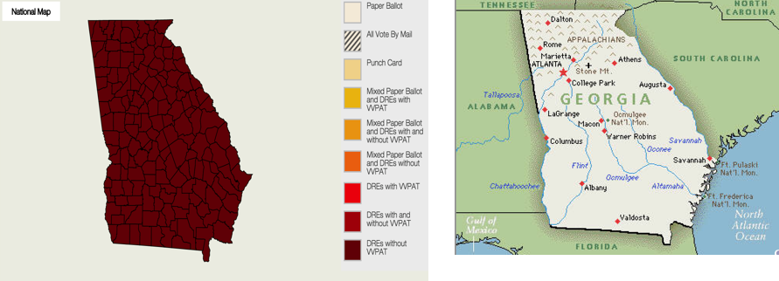
Georgia – March 1 (Super Tuesday)
Georgia – Voters use statewide system: DREs w/o VVPAT (Diebold/Premier/Dominion). NO STATE AUDIT LAW. UNVERIFIABLE AND UNVERIFIED. Photo ID required at the polls. Felons’ rights restored after incarceration, parole, and probation.

Slide 17
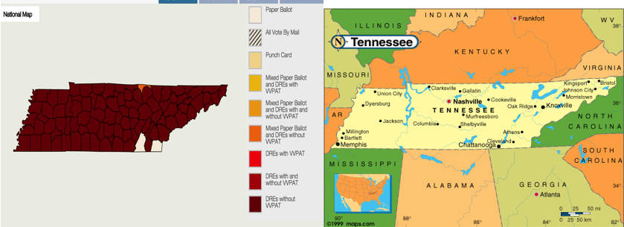
Tennessee – March 1 (Super Tuesday)
TENNESSEE - Mixed voting systems statewide; DREs w/o VVPAT (Diebold/Premier/Dominion; HartIntercivic; other vendors.) Paper ballots opti-scanned by ES&S. STATE AUDIT LAW NOT YET FULLY IMPLEMENTED mandates recount of 3% early voting ballots and recount of 3% randomly chosen precincts in each county. Guidance for paperless DRE audit unclear. MOSTLY UNVERIFIABLE, SLIGHTLY VERIFIED. Felons lose right to vote permanently or must

Slide 18
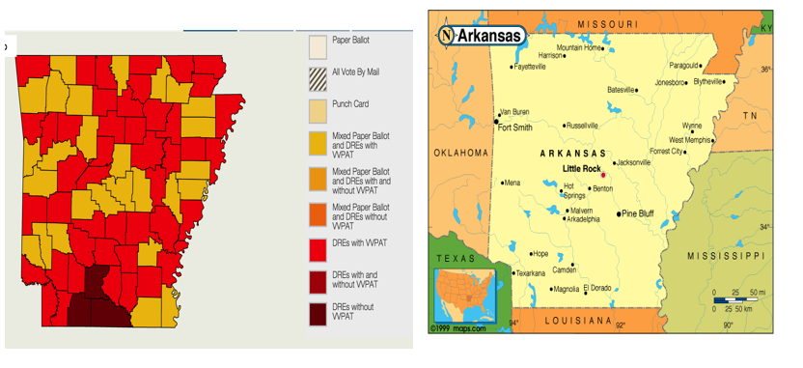
Arkansas – March 1 (Super Tuesday)
ARKANSAS-. Voters use DREs w/o VVPAT (Danaher Shouptronic) and DREs w/VVPAT (ES&S IVotronic). State law passed mandating DREs with paper trail if purchased after 2006, but many counties have old paperless DREs. NO STATE AUDIT LAW. SLIGHTLY VERIFIABLE, WHOLLY UNVERIFIED. Photo ID law passed but state supreme court struck it down in 2014. Felon voting rights restored after incarceration, parole, and probation.

Slide 19
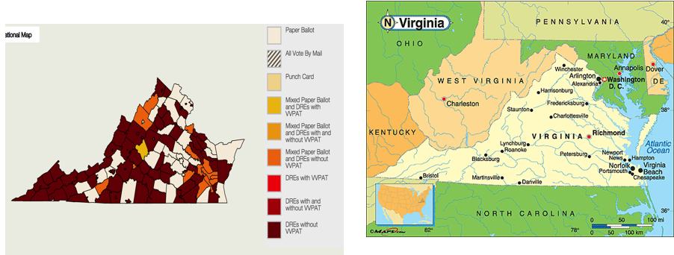
Virginia – March 1 (Super Tuesday)
VIRGINIA - Voters use 60% DREs w/o VVPAT. Remainder DRE w/VVPAT (various vendors) and opti-scanned paper ballots. NO STATE AUDIT LAW. SLIGHTLY VERIFIABLE, WHOLLY UNDVERIFIED. Photo ID required at polls (law passed 2014 under Gov. Bob McDonnell, convicted since on unrelated charges of bribery & corruption.) Some felons may lose vote permanently; restoration is upon appeal not always granted.

Slide 20
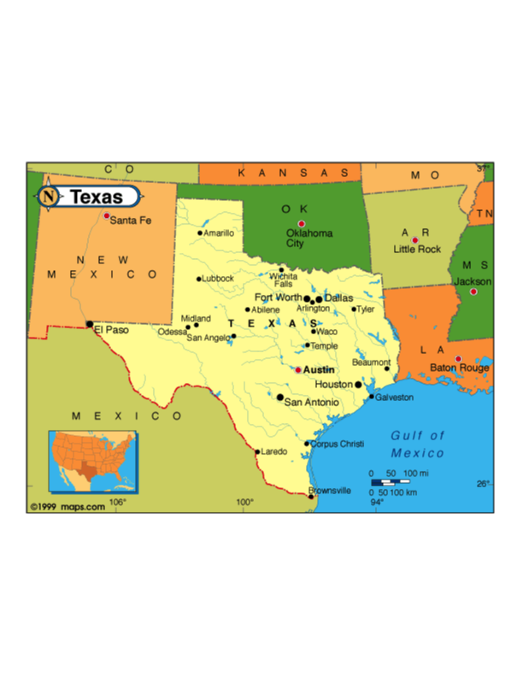
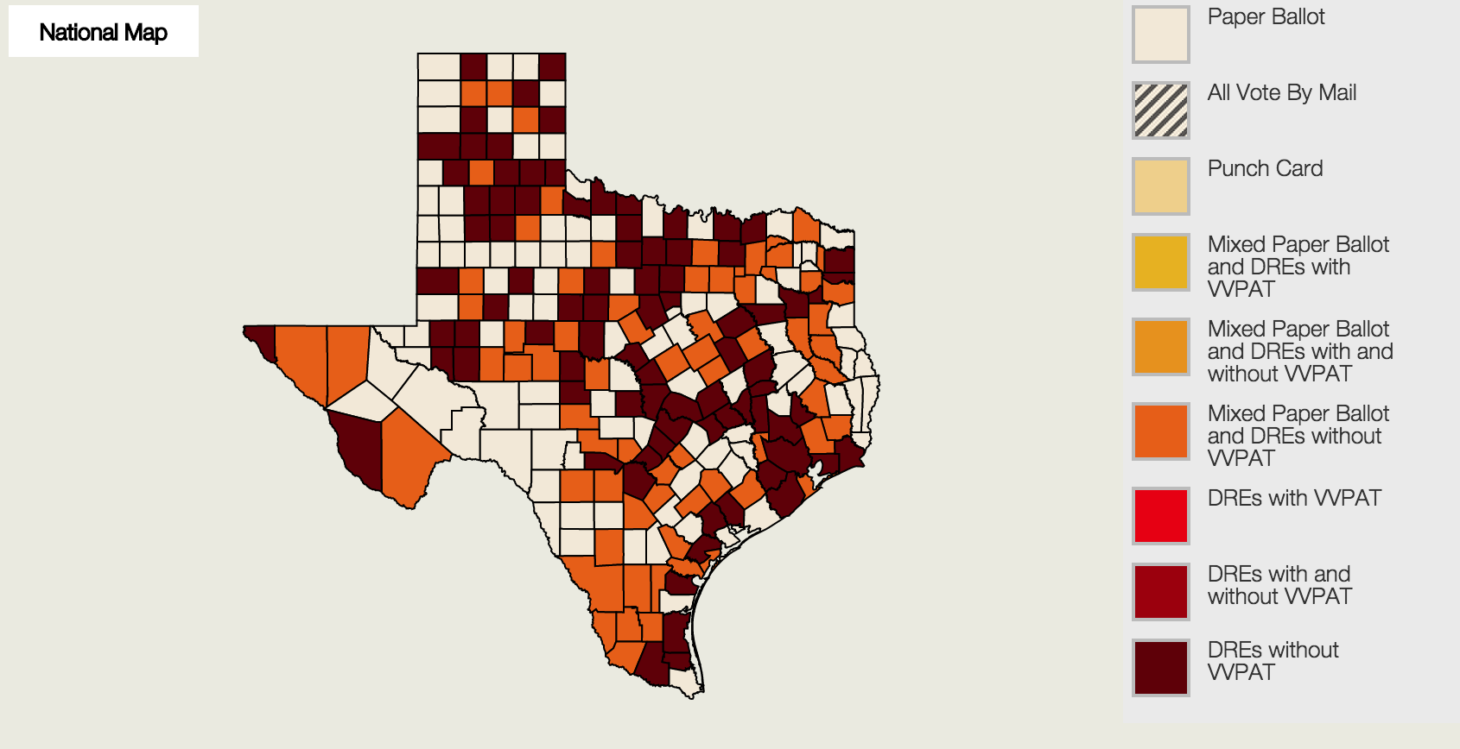
Texas – March 1 (Super Tuesday)
TEXAS - Voters use 60% paperless DREs. STATE AUDIT LAW requires post-election recount of 1% of randomly chosen precincts in counties using electronic voting. But Secretary of State can waive this requirement. 40% VERIFIABLE, MOSTLY UNVERIFIED. Felon voting rights restored after term served, parole, and probation.

Slide 21
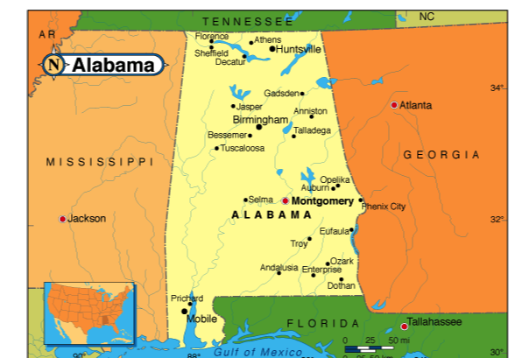
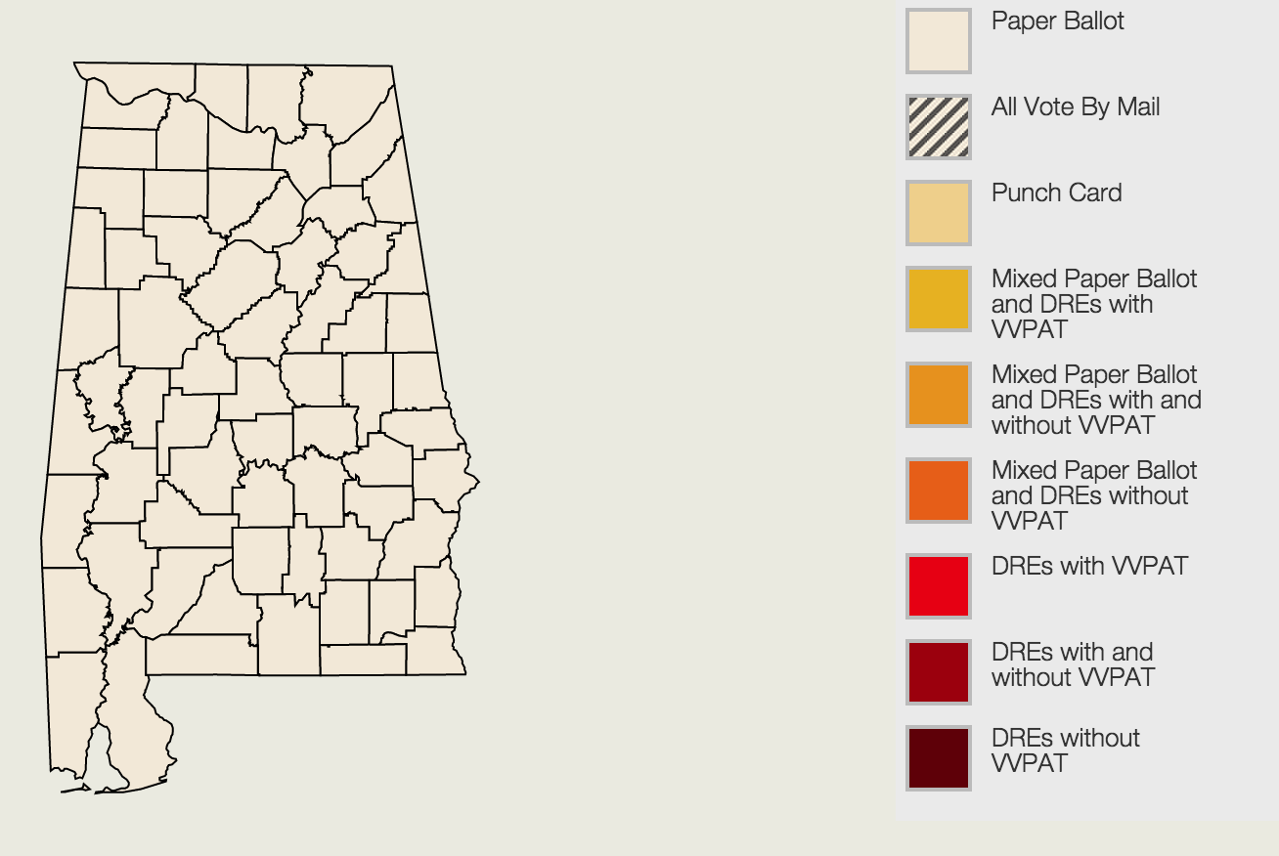
Alabama – March 1 (Super Tuesday)
ALABAMA - Voters use paper ballots counted by ES&S opti-scan statewide. 100% VERIFIABLE, 100% UNVERIFIED. Photo ID law. Some felons lose vote permanently (http://felonvoting.procon.org/sourcefiles/alabama-pardons-voter-restoration-2012.pdf). Others are granted restoration on appeal after incarceration, parole, and probation.

Slide 22
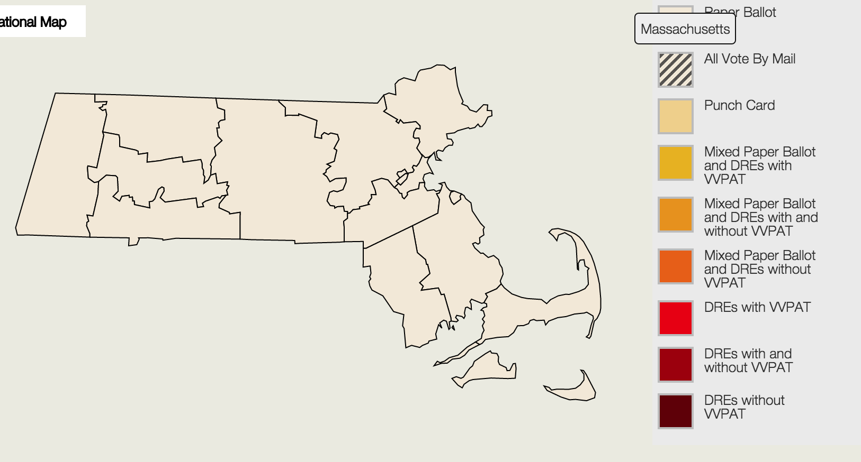
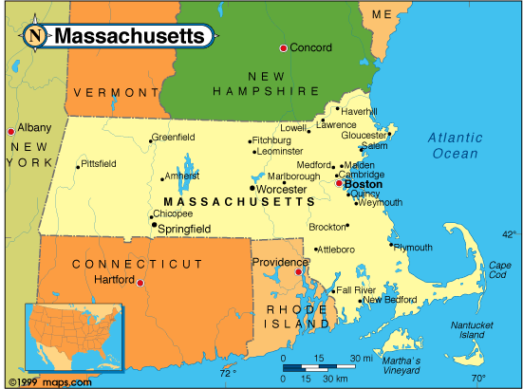
Massachusetts – March 1 (Super Tuesday)
MASSACHUSETTS - Voters use paper ballots statewide, opti-scanned by Diebold/Premier/Dominion, Dominion, and ES&S. ES&S tech service provided by LHS and ASS (!) NO STATE AUDIT LAW. WHOLLY VERIFIABLE, MOSTLY UNVERIFIED. Felon voting rights restored after incarceration.

Slide 23
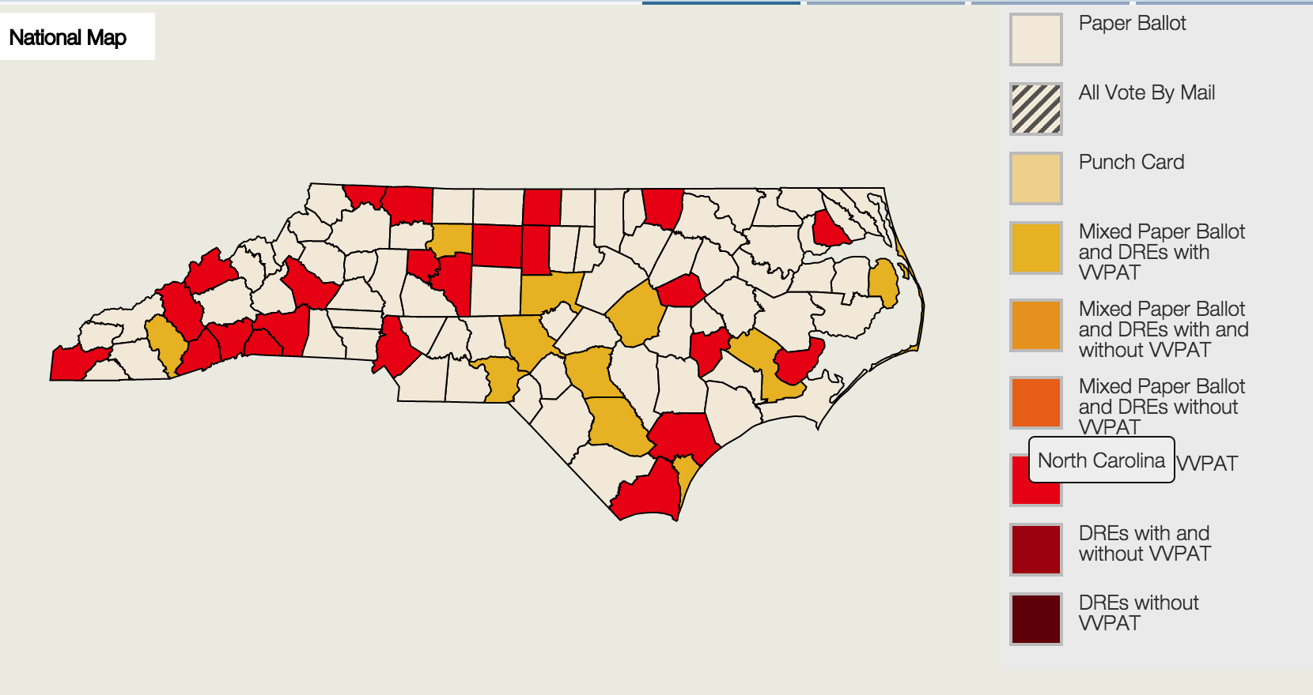
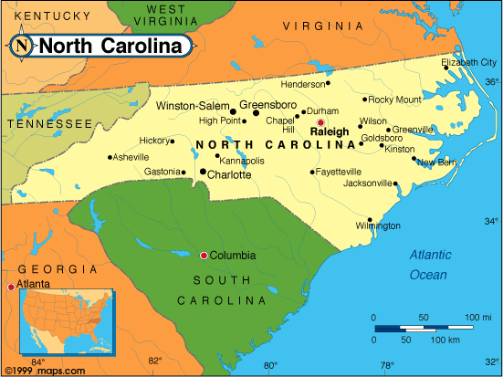
North Carolina – March 1 (Super Tuesday)
NORTH CAROLINA - Voters use either paper ballots scanned by ES&S or DREs w/VVPAT. STATE AUDIT LAW allows statisticians to determine necessary percentage of ballots to manually audit by county. VERIFIABLE; MOSTLY VERIFIED. Felon voting rights restored after incarceration, parole, and probation.
.

Slide 24
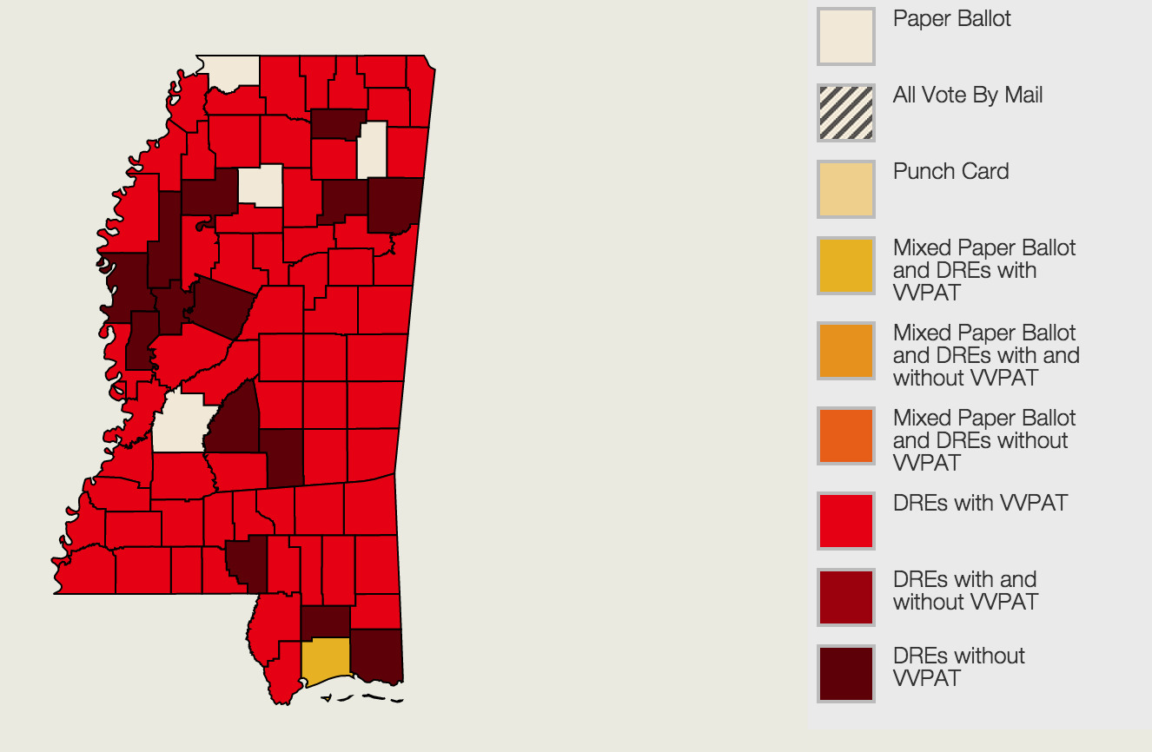
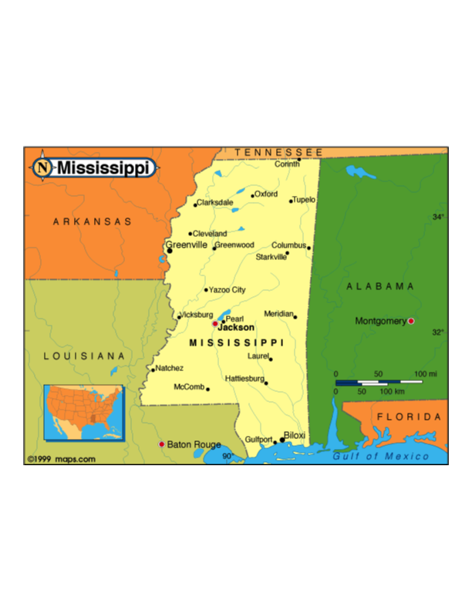
Mississippi – March 8
MISSISSIPPI - Voters use 90% DREs statewide mostly w/o VVPAT. NO STATE AUDIT LAW. MOSTLY UNVERIFIABLE , WHOLLY UNVERIFIED. Some felons lose vote permanently; some must appeal for restoration; others restored after incarceration, parole, and probation.
.

Slide 25
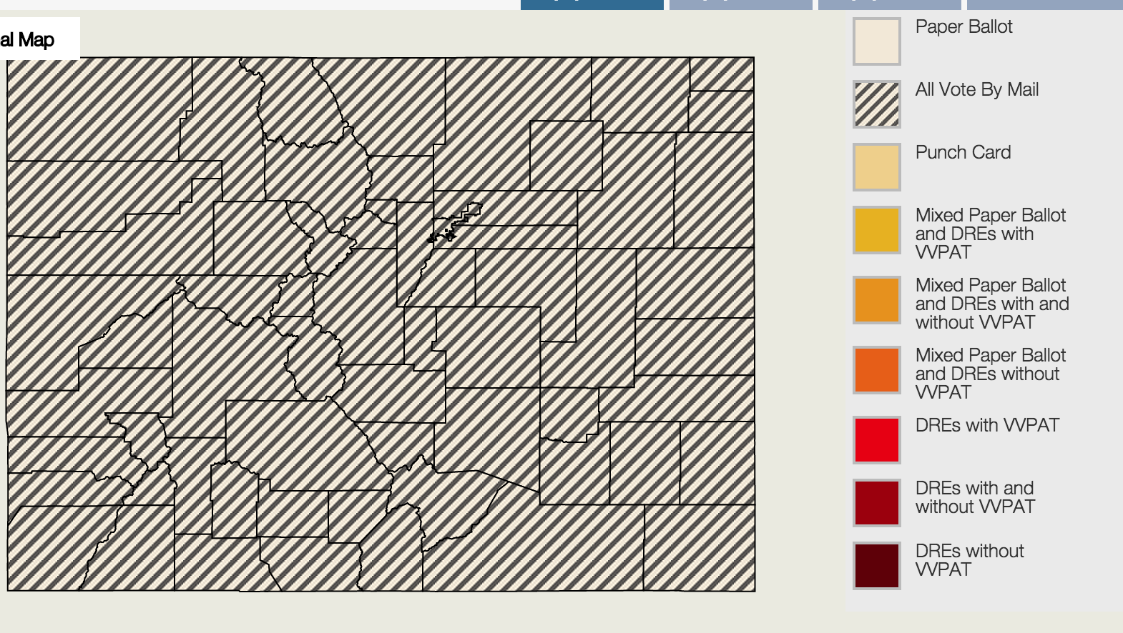
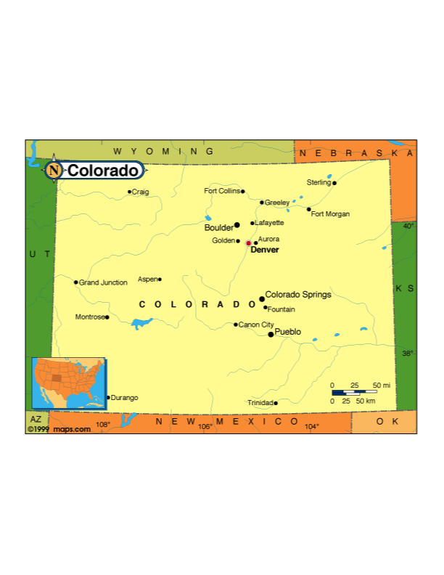
Colorado Caucus – March 8
COLORADO CAUCUSES - Precinct meetings of party members. VERIFIABLE AND VERIFIED by public vote-casting (show of hands, standing in groups) or public counting and announcement of secretly-cast ballots. Voting system not used, but here it is: All Vote By Mail!
.

Slide 26
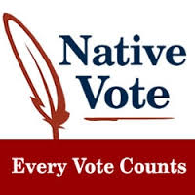
Review of Tester Bill S1912
Possible Constitutional issues as it relates to Preclearance – Section 5 of the Voting Rights Act
No severability clause
Brings attention to an issue that has otherwise gone unnoticed by Congress and the public
Work with Sen. Tester’s office to fix the problem in the 115th Congress since there is little chance of it passing in the current Congress

