Slide 1
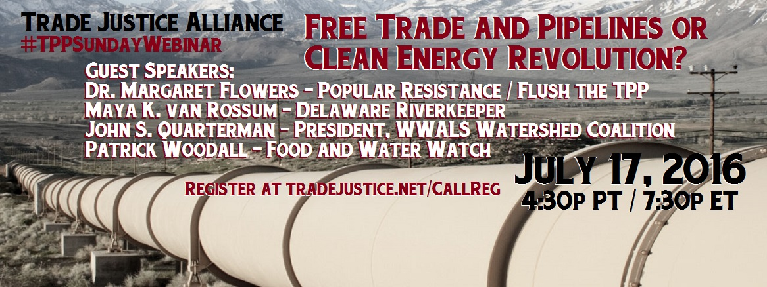
Free Trade and Pipelines or Clean Energy Revolution?
Guest speakers:
Maya K van John S. Quarterman-President WWALS Watershed Coalition
Dr. Margaret Flowers-Popular Resistance / Flush the TPP
Patrick Woodall / Food and Water Watch

Slide 2


Introduction and Welcome
Andrea Miller, Executive Director
People Demanding Action
andrea@peopledemandingaction.org
Audio is PHONE ONLY; you must call in
605-562-3140 / 802787#

Slide 3
Call Norms
Do not enable your video camera
All calls are recorded; a link is available after the call
Q & A mode: To eliminate background noise we mute everyone when we begin recording.
Press *6 (when prompted) to ask a question; say your name, your organization, if any, and location. Be courteous and brief; give others a chance to ask questions too.
Keep chat room discussions on topic and professional

Slide 4

Technical Information
Meeting Room Functions
- Chat
- Share
Use the Share button in the Meeting Room:
Visit Tradejustice.net for news stories and past webinars
After the call, go to the our Facebook page for power point and audio files:
https://www.facebook.com/groups/TradeJusticeAlliance/
Visit People Demanding Action for past webinars and legislative updates:
http://www.peopledemandingaction.org

Slide 5
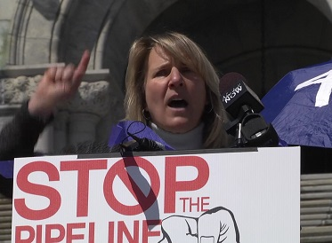
Maya K van Rossum
Maya K. van Rossum is the Delaware Riverkeeper and leader for the Delaware Riverkeeper Network. The role of the Delaware Riverkeeper is to give the Delaware River, and the communities that depend upon it and appreciate it, a voice at every decision-making table that could provide help or do harm. Delaware Riverkeeper Network has its main office in Bristol, PA and can be found on the web at www.delawareriverkeeper.org.
van Rossum, who is skilled as an environmental attorney, strategist, community organizer, facilitator, coalition builder and manager, has led DRN for over 20 years. As Delaware Riverkeeper, she organizes concerned citizens, testifies before state and national governing bodies, oversees DRN litigation, and watches over the Delaware River and all of its tributary streams. Through appointments by governors and agency heads, she has played a role in shaping water quality, quantity and habitat policies and regulation in the Delaware River watershed for nearly two decades.

Slide 6
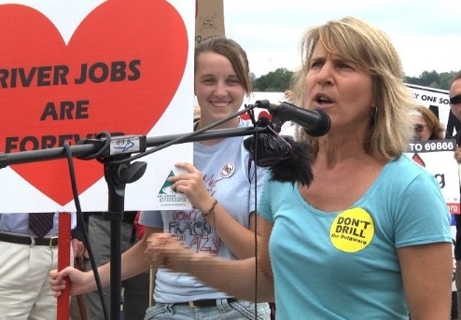
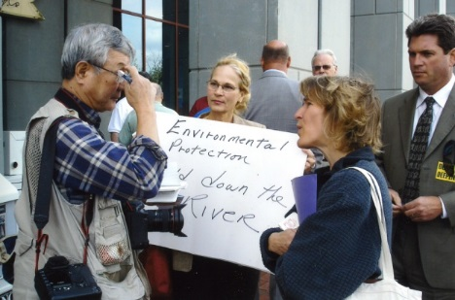
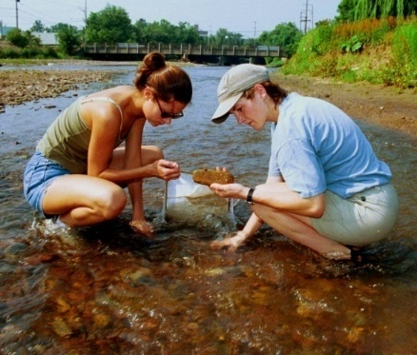
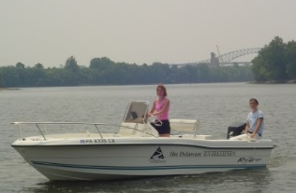

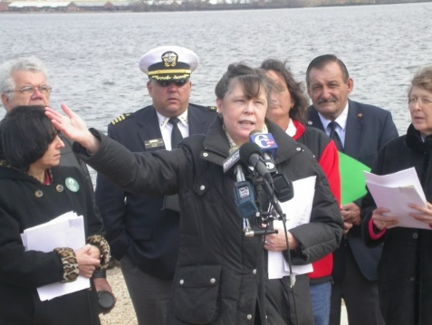
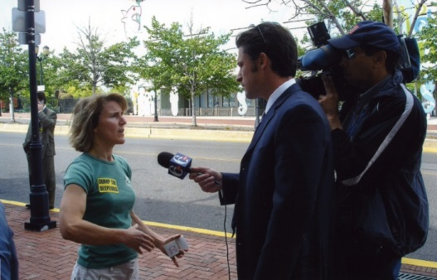
The Delaware Riverkeeper Network champions the rights of our communities to a Delaware River and tributary streams that are free-flowing, clean, healthy and abundant with a diversity of life.
www.delawareriverkeeper.org

Slide 7
Delaware River Watershed Fracking Moratorium – 2010
Fast Expanding Proliferation of Pipelines and Infrastructure
Notes:
But with so many passsing through a region or state need to be organized across regions being cut by multipel pipelines – joining forces

Slide 8
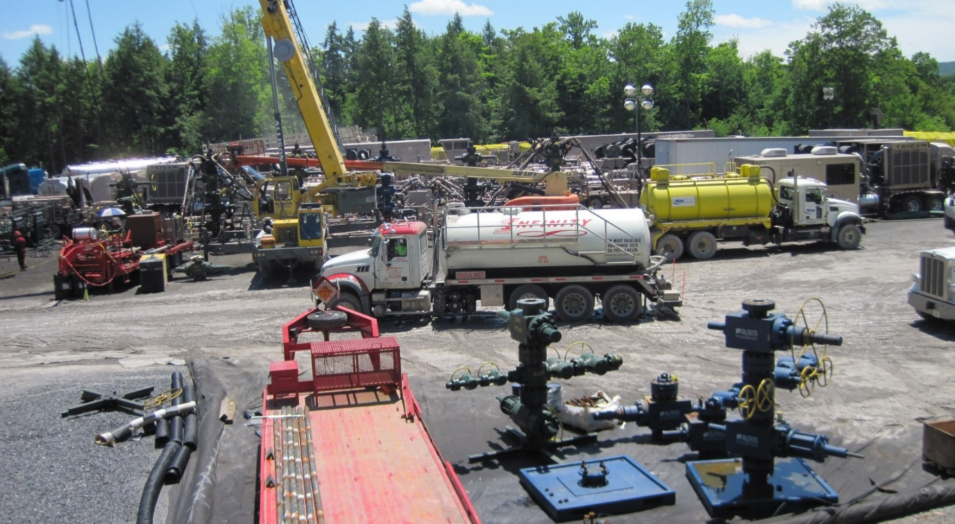
TPP Pumps Up the Pressure On Shale Gas Development, Fracking and Exporting LNG

Slide 9
Multiple Pathways by which the TPP Exposes Communities to Increased Drilling Harms
Will increase LNG exports which will translate info an Increased call for drilling and fracking
Weakens environmental laws through ISDR process also means an Increased call for drilling and fracking.
Chilling affect on passage of new laws for fear of challenge
Notes:
U.S. Enviro laws technology forcing – so by definition they will force corporations to strive to do it better which means hurdles that could impact profits and open the door to ISDR

Slide 10
How TPP Results in Increased LNG Exports
Natural Gas Act (15 U.S.C. § 717b) prohibits the import or export of natural gas, including liquefied natural gas (LNG), to or from any foreign country without receiving prior approval from the U.S. Department of Energy (DOE).

Slide 11
In order to receive approval of an application for export of natural gas to a foreign nation, Section 3 of the Natural Gas Act requires DOE to first make a determination that the proposed export of natural gas “will not be inconsistent with the public interest.”
A public interest determination includes consideration of both environmental and economic impacts.
15 U.S.C. § 717b(a).

Slide 12
BUT ….
Section 3(c) of the NGA
requires the DOE to deem as consistent with the public interest applications to authorize the export of natural gas to nations which have entered into a free trade agreement with the U.S. requiring national treatment for trade in natural gas.

Slide 13
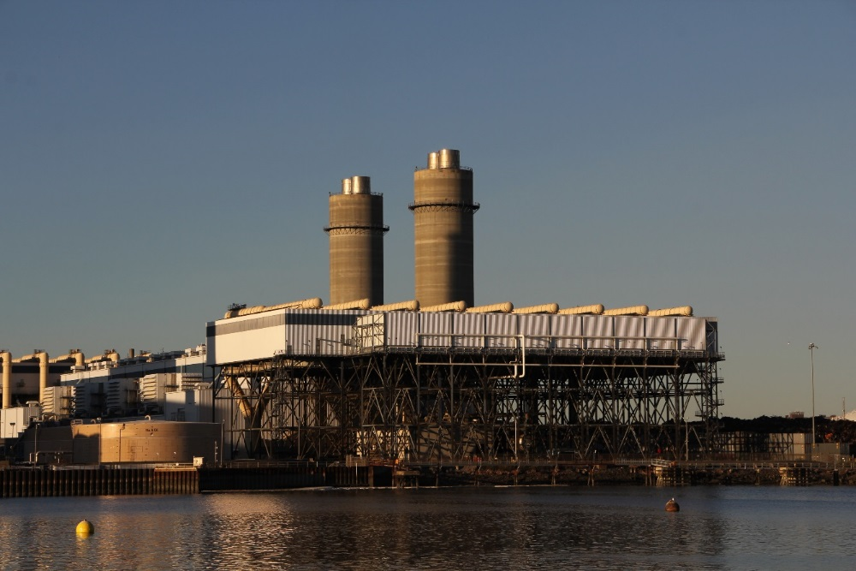
Boston LNG
Applications for authorization to export natural gas to FTA countries is required, by the NGA, to be “granted without modification or delay.”

Slide 14
TPP members will become FTA countries

Slide 15
Current FTA Countries
Australia
Bahrain
Canada
Chile
Colombia
Dominican Republic
El Salvador
Guatemala
Honduras
Jordan
Mexico
Morocco
Nicaragua
Oman
Panama
Peru
Republic of Korea
Singapore

Slide 16
Added FTA Countries Under TPP
Brunei
Japan
Malaysia
New Zealand
Vietnam
China expected

Slide 17
Docking Agreement
It can be joined by any nation willing to meet its terms.
All Will Get Automatic Approval for LNG Exports.

Slide 18
Investor-State Dispute Resolution Process (ISDR)
Allows foreign interests to sue countries, including the United States, in multi-million dollar claims for damages to their properties, investments, interests and/or profits .

Slide 19
ISDR has been used under other trade agreements for legal challenge “on the ground of non-renewal or change in the terms of a license or contract and changes in policies or regulations that the investor claims will reduce its future profits.”

Slide 20
Awards of
money damages
restitution of property and/or
attorneys fees

Slide 21
Big Hammer
for undermining environmental protection laws.
By end of 2012, corporations had initiated 514 investor-state cases against 95 governments and had launched attacks on a range of regulations, including toxic chemical bans, timber regulations, green jobs requirements, and more.
http://www.huffingtonpost.com/ilana-solomon/fracking-causes-friction-_b_2146939.html

Slide 22
TPP & ISDR Provision Undermine, Displace, Chill US Environmental Protections
Once passed TPP supersedes laws in place.
Laws left in place challenged and defeated
Chilling affect on passage of new laws for fear of challenge via ISDR
Prevention of new laws because conflict – even if new technology, science or experience dictate.
US laws technology forcing – any more?

Slide 23
U.S. law is clear:
“international agreements of the United States are law of the United States and supreme over the law of the several states.”
(sec. 111, The Foreign Relations Law
of the United States)
Notes:
The fact of the matter is, if signed on to by the President, any domestic law that contradicts the terms of the trade agreement or its promises made, would be at risk.
That means federal law, state law and local laws are all superseded by the trade agreement if signed on to by the United States. And so while these laws may still be applicable within the United States, they would not protect the U.S. from claims by foreign countries or interests that the U.S. is in violation of a trade agreement and therefore can be subject to all appropriate remedies, including assignment of damages under ISDR claims.

Slide 24
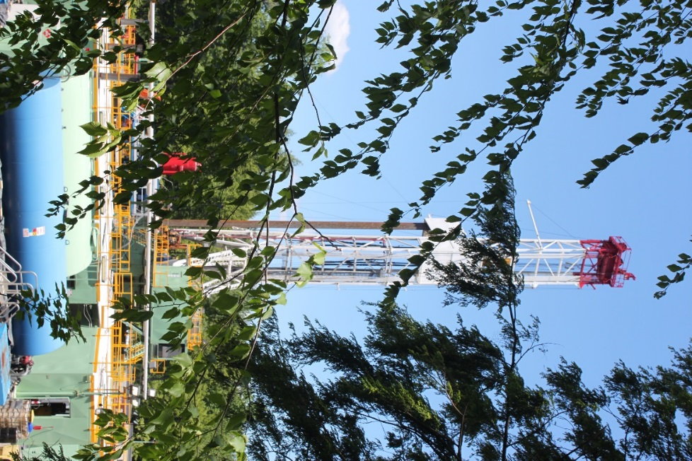
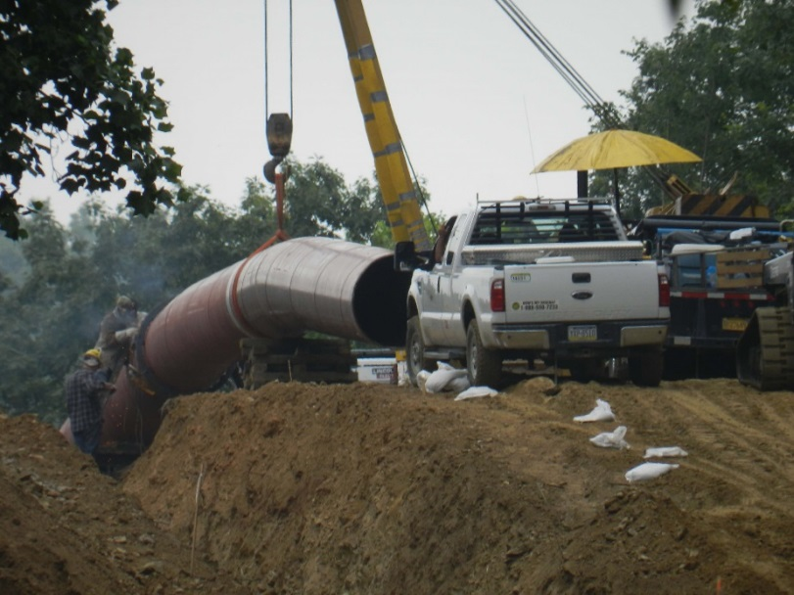
TPP Pumps Up the Pressure On Shale Gas and Fracking
=

Slide 25
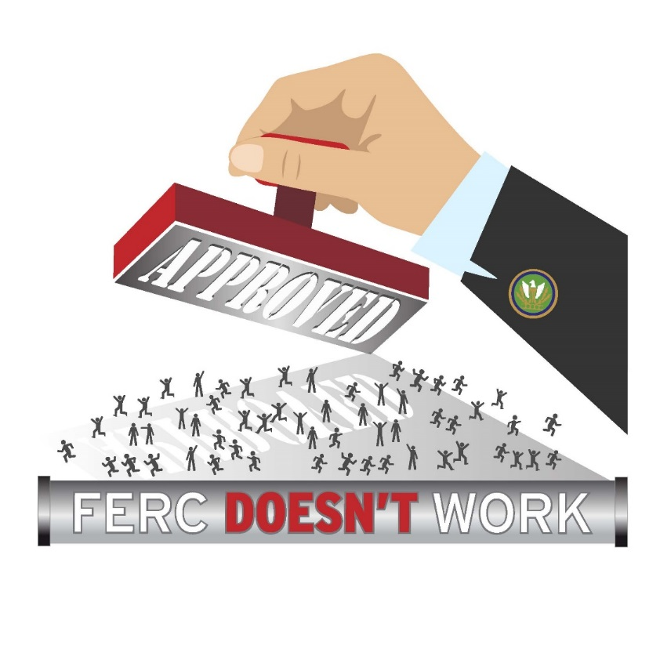
FERC is a Rubber Stamp
30 years funded
by industry
1 Denial

Slide 26
FERC Funded by Industry
1980s FERC lobbied to be funded by industries
1986 got that right
Result -- funded entirely by the companies it regulates.
Over the last decade FERC’s annual budget has grown by 51% (from sub-$200-Million in 2004 to a more than $300-Million in 2014)
From 2004 to 2014 the budget of the Department of Energy (FERC’s parent agency) only grew roughly 22 %

Slide 27
FERC Not Our Friend
Regularly turns blind eye to illegal pollution & damage inflicted by pipeline companies during pipeline construction, maintenance, & other operations
Don’t issue penalties for violations
Don’t issue stop work orders to require clean up & compliance

Slide 28
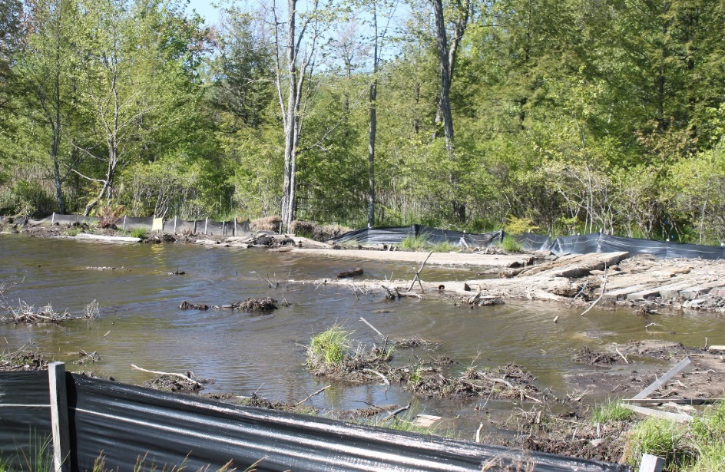
FERC Not Our Friend
Strips States of Rights
Issues Certificates without State 401 Certification

Slide 29
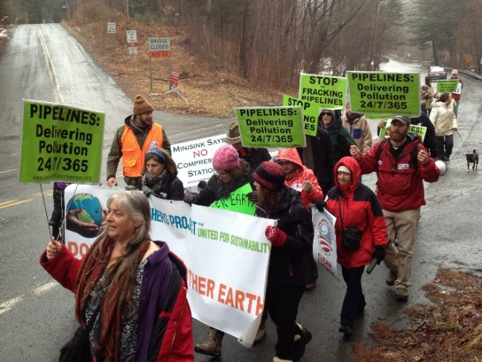
FERC Not Our Friend
Strips People of Our Rights
Abuses regs to judicial review while allowing eminent domain and construction
Rehearing requests responded to with tolling orders.
1 yr not uncommon
Too late to affect outcome
e.g. Delaware Riverkeeper Network v. FERC – July 2014

Slide 30
FERC Not Our Friend
Kept unfunded Office of Public Participation designated to help the public engage in the FERC process -- office would constitute less than 1.8% of FERC’s budget.

Slide 31
Some successes
Delaware Riverkeeper Network, NJ Sierra Club, NJ Highlands Coalition v. FERC
United States Court of Appeals for the District of Columbia
June 6, 2014
“On the record before us, we hold that in conducting its environmental review of the Northeast Project without considering the other connected, closely related, and interdependent projects on the Eastern Leg, FERC impermissibly segmented the environmental review in violation of NEPA.
We also find that FERC’s EA is deficient in its failure to include any meaningful analysis of the cumulative impacts of the upgrade projects.
Notes:
Looked at whetehr terminii logical
Independent utility
Cost independent or interdependent

Slide 32
Jordan Cove – Sign of Change?
Re Segmentation – pipeline and LNG export:
FERC’s denial is based on an extreme set of facts:
Consideration of two segments of an integrated project, neither of which had demonstrated contracts for gas customers that would use their services if built.
The decision included no consideration of environmental impacts and only discussed landowner impacts in the context of the interconnected projects for which there had been no demonstration of customers.

Slide 33
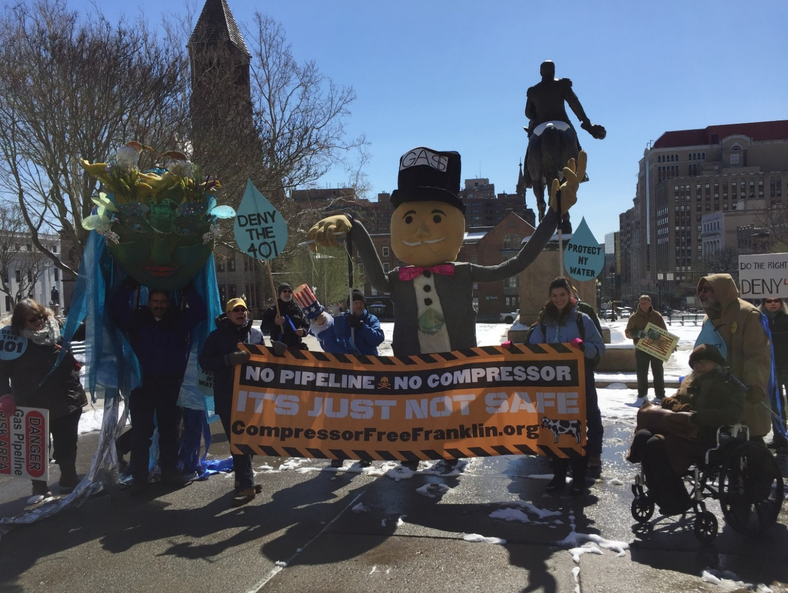
Constitution Pipeline –
401 Cert Denied

Slide 34
Strategies
To Get FERC Under Control

Slide 35
Delaware Riverkeeper Network v. Federal Energy Regulatory Commission (FERC) and its Commissioners,
United States District Court for the District of Columbia
Challenges the review and approval process of the Federal Energy Regulatory Commission for jurisdictional pipeline projects, in this case specifically the PennEast Pipeline Project, as being infected by structural bias which violates Due Process rights in violation of the Fifth Amendment of the U.S. Constitution

Slide 36
Cases Challenging FERC Certification
Prior to State 401 Cert
Delaware Riverkeeper Network for Leidy Southeast (NGA)
Stop the Pipelines for Constitution Pipeline (NGA)
Sandisfield Taxpayers Opposing the Pipeline (STOP) for Connecticut Expansion Project (CWA)

Slide 37
Federal Legislation – What Should It Look Like
Lots of piecemeal fixes
But what is really needed?
To get on the call to discuss – email me

Slide 38
Independent Investigation by GAO
Individuals sign petition at:
http://bit.ly/DRN-PetitionToReviewFERC
Organization sign on letter:
http://bit.ly/SignOnGAOReview

Slide 39


Slide 40
Ways to Get Connected
1) StopThePipelines.org
2) Pipeline Protection Google Group
Monthly Calls
Daily email dialogue
Connection with orgs from across the nation
To be joined, email:
Keepermaya@delawareriverkeeper.org

Slide 41

Website: www.delawareriverkeeper.org
Blog: delawarerivervoice@blogspot.com
Twitter:
DelRiverkeeper
Facebook:
Maya.K.van.Rossum or
Delaware.Riverkeeper.Network

Slide 42

John S. Quarterman
President,
WWALS Watershed Coalition, the Waterkeeper® Alliance Affiliate for the Upper Suwannee River in south Georgia and north Florida.
Our lands, our tea-colored rivers, and the Floridan Aquifer that is our sole source of water for drinking, agriculture, and industry are far more important than profit for companies from somewhere else.

Slide 43

WWALS Watershed Coalition, Inc.
Since 2012,
Organized two Water Trails
Bird-dogged Valdosta wastewater overflows
Discovered extensive agricultural land purchases in five WWALS counties by investors from the west coast including Bill Gates
Opposes the unnecessary, destructive, and hazardous Sabal Trail fracked methane pipeline boondoggle in both FL & GA,
And all its ugly stepsisters, too.
www.WWALS.net
contact@wwals.net
850-290-2350

Slide 44
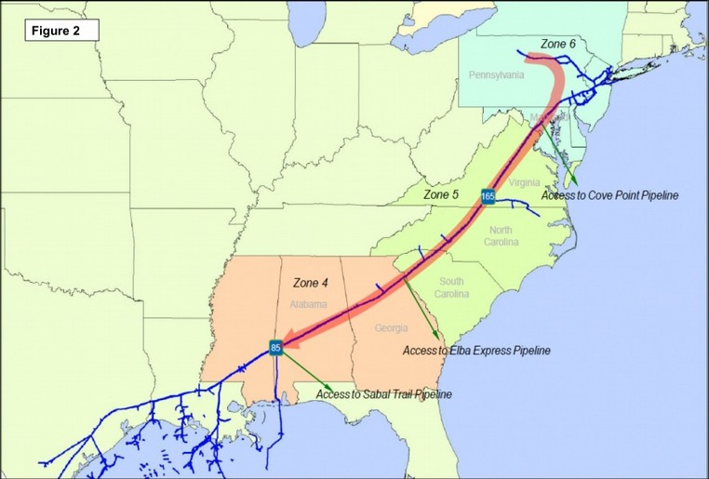
Marcellus Shale to LNG Export
Source: Williams Co.

Slide 45
Planned from the beginning
“Spectra Energy and NextEra Energy’s planned Sabal Trail natural gas pipeline ... will do more than provide additional gas-delivery capacity to Florida and the welcomed redundancy of a third pipeline to the Sunshine State. The big news is that Williams’ Atlantic Sunrise project by July 2017 will enable large volumes of Marcellus-sourced gas to be shipped south (backwards!) along the Transco pipeline all the way to Station 85. That (and Sabal Trail) will give Marcellus producers something unthinkable until now: access to major gas users as far south as Miami….”
"Miami 2017 - Marcellus Gas Heading To Florida," Housley Carr, Oil & Gas Financial Journal, 17 January 2014, http://www.ogfj.com/articles/2014/01/miami-2017-marcellus-gas-heading-to-florida.html

Slide 46
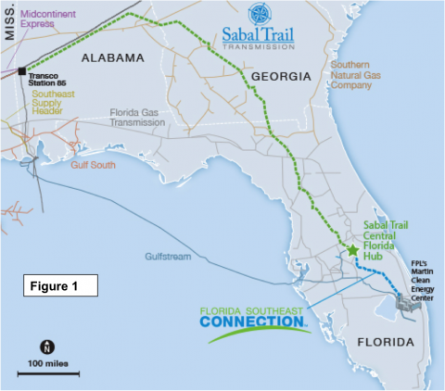
Southeast Market Pipelines Project

Slide 47
LNG Export from Florida
Kinder Morgan’s Florida Gas Transmission (FGT) Jacksonville Expansion Project (JEP) from Sabal Trail in Suwannee County to Jacksonville, FERC Docket no. CP15-144.
Crowley Maritime’s Carib Energy can export from apparently anywhere in Florida, especially Jaxport, DoE FE already approved.
AES from Port of Palm Beach, DoE FE already approved.
Goven, Martin County, based in Miami, DoE FE already approved.

Slide 48
LNG Export from Florida (cont.)
Floridian LNG (FLiNG), Martin County, DoE FE already approved.
Florida East Coast Railway (FECR), to pick up LNG from FLiNG and ship by rail as far as Miami and Jacksonville. Supported by Fortress Investment Group. DoE FE already approved.
Strom, Inc., Citrus County, next to Duke’s failed Crystal River nuke and Duke’s proposed natural gas power plant, plus permission for FECR to pick up LNG to ship via rail. DoE FE already approved.

Slide 49
Who do you believe?
Sabal Trail claims all its gas will go to Duke and FPL power plants in Florida
Strom can ramp up LNG production without any further approvals by anyone
“The large amount of natural gas in the U.S. is also creating an impetus for something that was nearly unimaginable ten or fifteen years ago, LNG export….” FERC Commissioner Tony Clark to Congress, 2013

Slide 50
LNG Export and TPP
“Hopefully, we will change that and become an exporter, especially of natural gas.
“Right now, we are in the middle of negotiating a new agreement, the Trans-Pacific Partnership or the TPP, as an opportunity for the United States to expand its trade network in the Asia-Pacific region and beyond. TPP will open trade between the United States and 11 other countries.”
--Ted Poe (R TX-02 Houston), his Congressional Committee hearing on TPP, 2013 http://spectrabusters.org/?p=1199

Slide 51
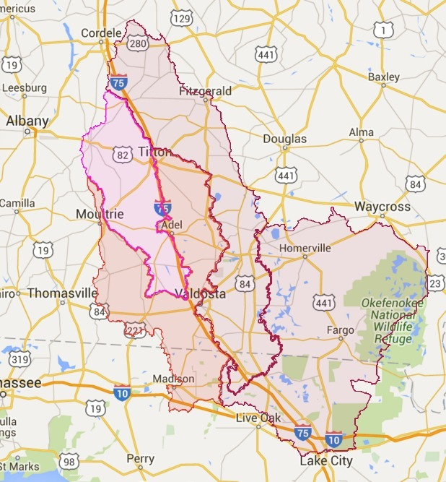
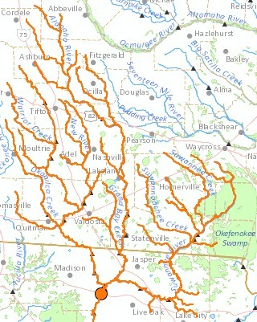
WWALS Watersheds

Slide 52
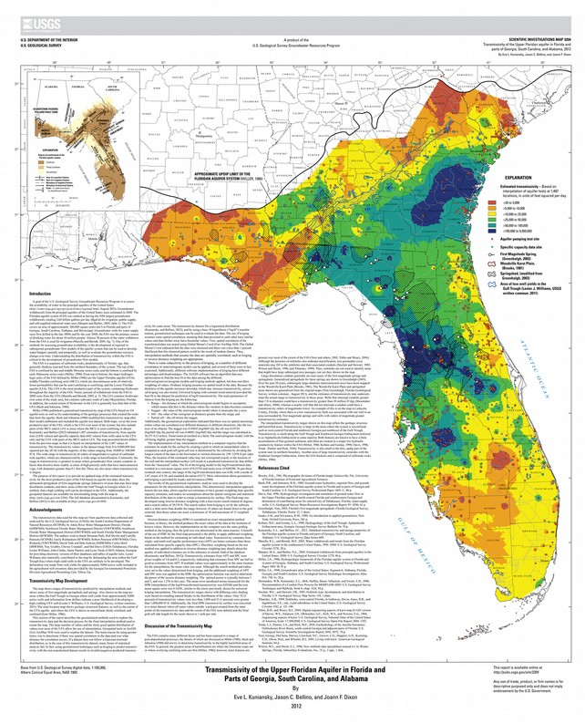
Floridan Aquifer
Source of water for drinking, agriculture, industry,
in fragile karst limestone

Slide 53
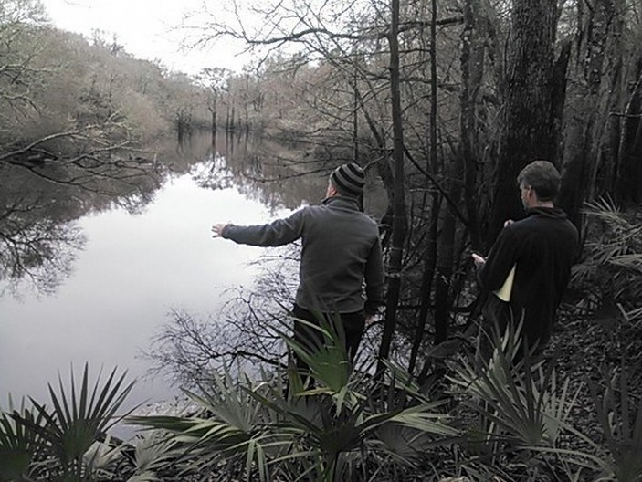
Withlacoochee River already leaks into Floridan Aquifer in Georgia
Forced Valdosta to double its water well depth

Slide 54
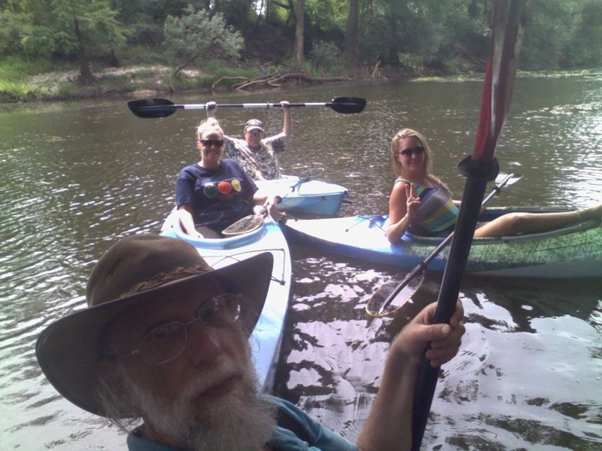
2015-08-28: Sabal Trail would cross Withlacoochee R. here above US 84

Slide 55
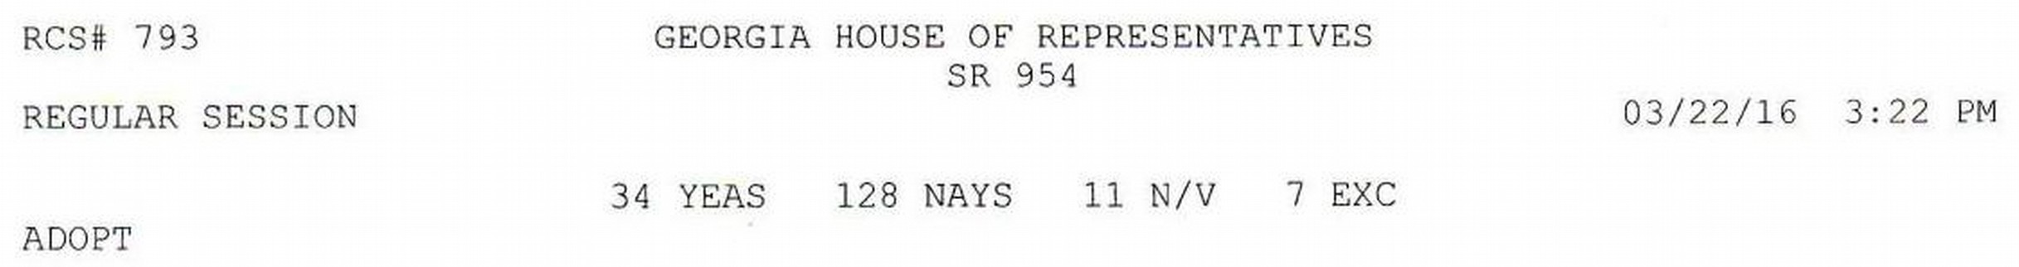
Historic March 22, 2016 Vote
Against Sabal Trail river-drilling easements
Georgia Water Coalition, including Greenlaw, Sierra Club Georgia, Flint Riverkeeper, Chattahoochee Riverkeeper, and WWALS

Slide 56
No GA,AL Section 401 Permits
Same Clean Water Act permit that New York State denied to Williams Co. Constitution Pipeline, currently stymying that boondoggle.
So maybe this will be enough to stop Sabal Trail.
Or not: we don't have a silver bullet.
Just silver buckshot.
Eventually one or more will work.

Slide 57
Ask USACE for SEIS
Sanford Bishop GA-02 wrote to
U.S. Army Corps of Engineers, asked for
Supplemental Environmental Impact Statement (SEIS)
to evaluate new evidence.
So did WWALS, Gulf Restoration Network,
Hamilton, Suwannee, Marion Counties, FL.
No response except from Sabal Trail,
Which claims it already answered everything.

Slide 58
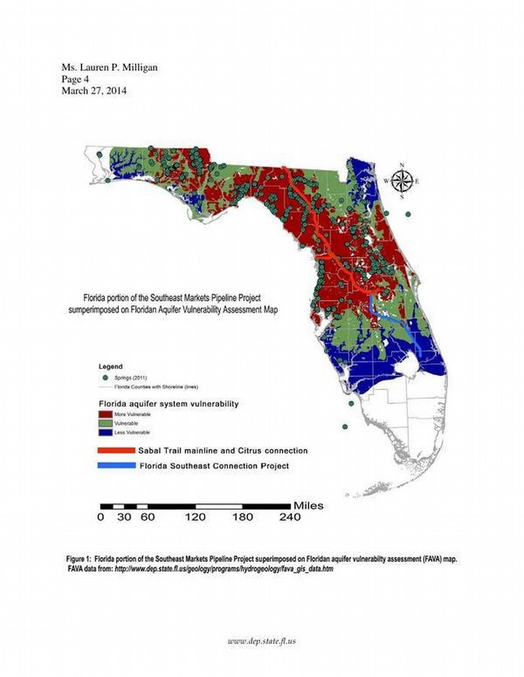
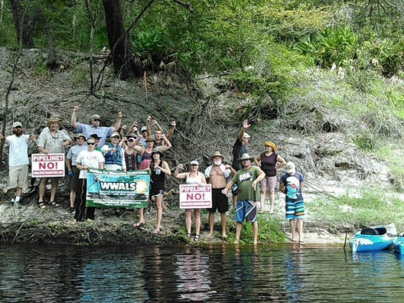
Sabal Trail Pipeline, Floridan Aquifer
2015-08-15 Suwannee River

Slide 59
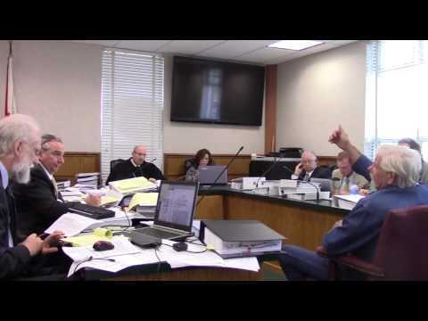
2015-10-19,20,21
WWALS v. Sabal Trail & FL-DEP

Slide 60
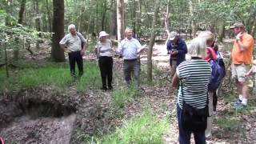
Increasing Opposition Groups
WWALS
Our Santa Fe River
SpectraBusters
Sierra Club (FL, GA, AL)
Earth Ethics
Gulf Restoration Network
Environment Florida
Environment Georgia
Clean Water Network
Madison Co. FL Garden Club
2015-05-15 Elected Officials Hike, sinkholes, Sabal Trail crossing, Suwannee River State Park
Ted Yoho FL-03 reneged on asking USACE for SEIS

Slide 61

Among many opposition events:

Slide 62
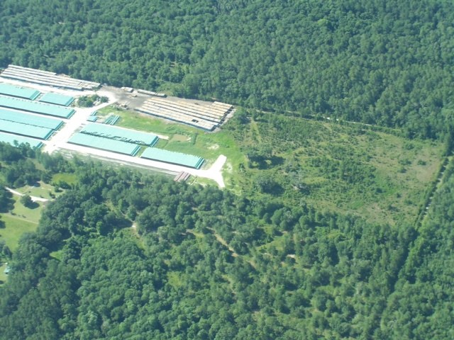
Sabal Trail unregistered pipe yard in wetlands n. of Lake City, FL?
Thanks to Southwings for flying WWALS 2016-06-21

Slide 63
More Silver Buckshot
At county commissions and city councils
At Water Management Districts
With state legislators
Jurisdictional wetlands violation to USACE
Lobbying USACE for SEIS
With members of Congress
Supporting Delaware Riverkeeper's call for GAO audit of FERC
Lobbying for solar power in the Sunshine State
And more; stay tuned

Slide 64
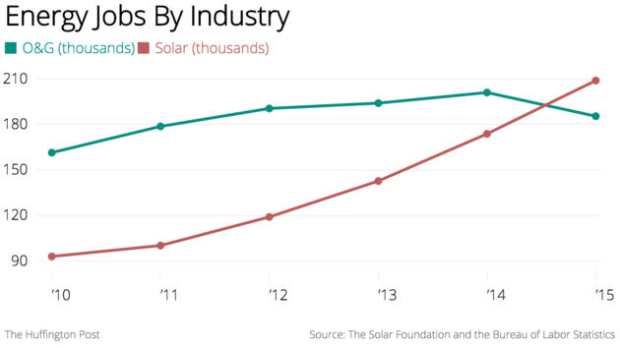
Solar has already won
“There Are Now More Solar Jobs In America Than Oil Extraction Jobs”, by Shane Ferro, Huffington Post, 14 January 2016, http://www.huffingtonpost.com/entry/solar-jobs-rising_us_569409e5e4b0cad15e65be87

Slide 65
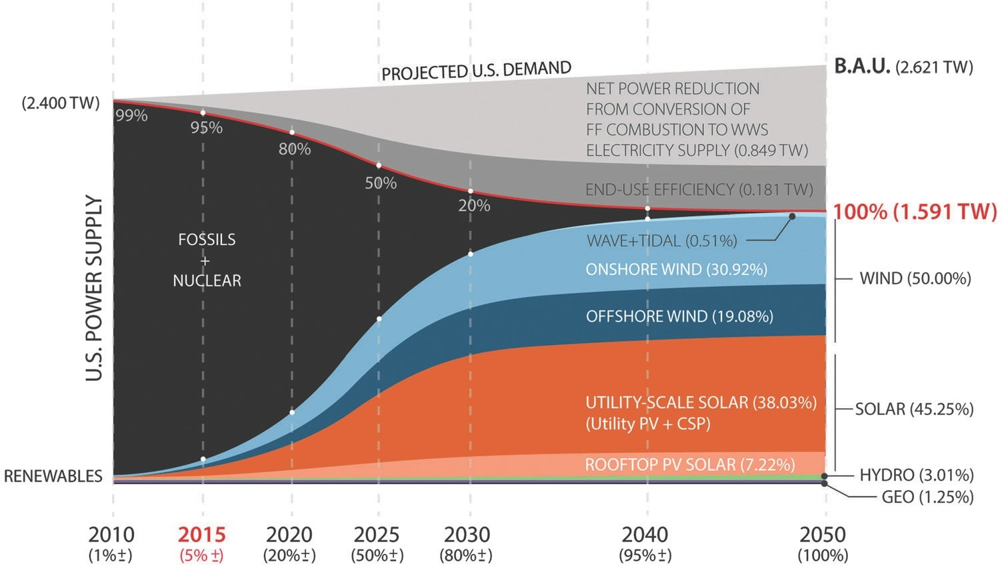
100% solar by 2050
Mark Z. Jacobson, solutionsproject.org

Slide 66
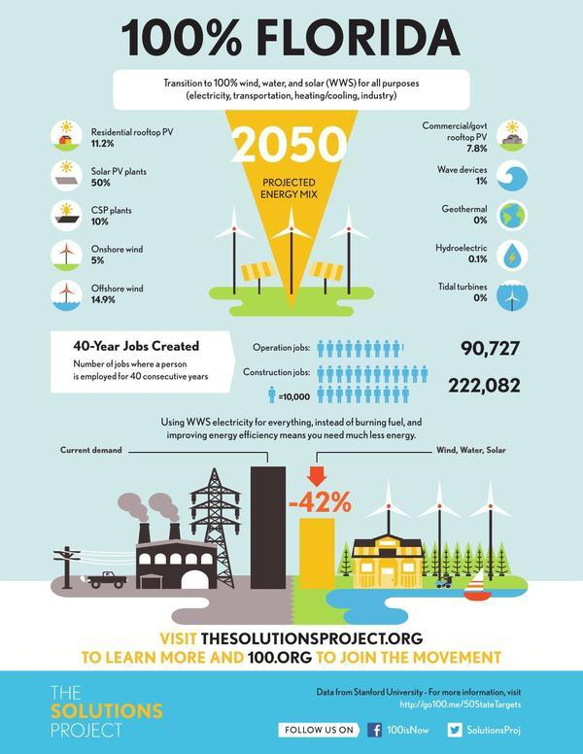
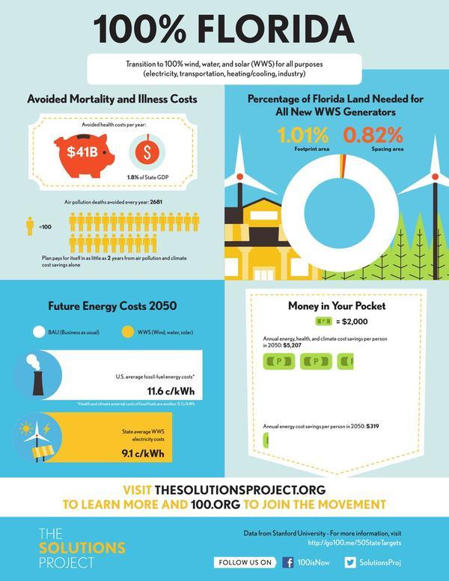
Sun, wind, water mix for each state

Slide 67

Floridians for Solar Choice flsolarchoice.org

Slide 68
No more fossil fuel projects
How many pipelines do we want?
None!
When do we want them?
Never!
Let the sun rise.

Slide 69
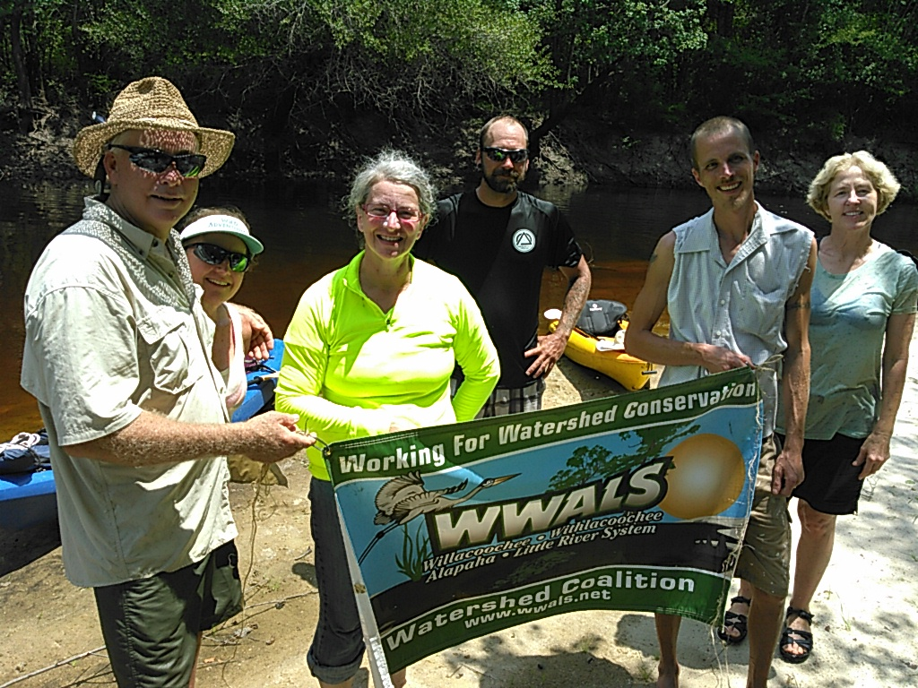
Contact
-jsq
John S. Quarterman, President
WWALS Watershed Coalition, Inc.
the WATERKEEPER® Affiliate
for the upper Suwannee River
Member:
National River Network
Georgia River Network
Georgia Water Coalition
Florida Springs Council
229-242-0102
wwalswatershed@gmail.com
www.wwals.net
PO Box 88, Hahira, GA 31632

Slide 70

Q & A With Maya van Rossum and John S Quarterman

Slide 71
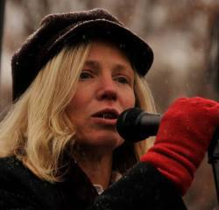
DR. MARGARET FLOWERS
Dr. Margaret Flowers is Co-Director Popular Resistance and the Flush the TPP Campaign
Popular Resistance (www.popularresistance.org)
TPP Campaigns: www.flushthetpp.org

Slide 72
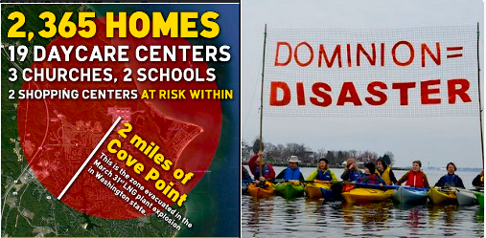
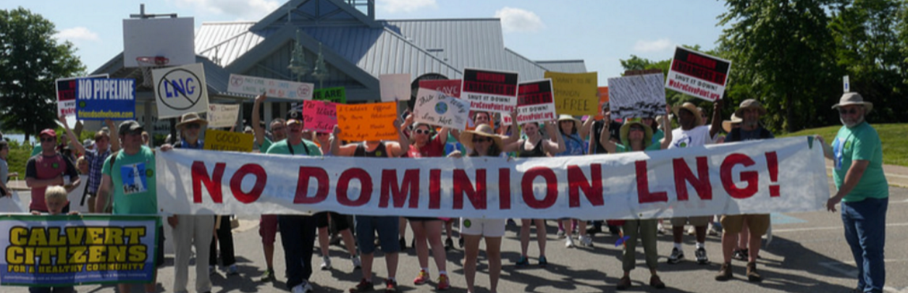
Dominion’s Project: Cove Point

Slide 73
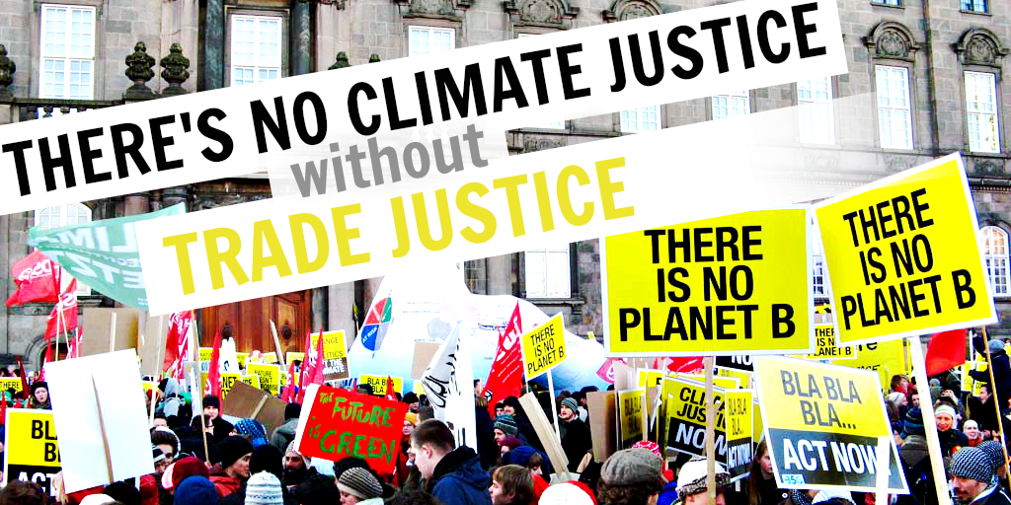
Climate Treaty vs TPP

Slide 74
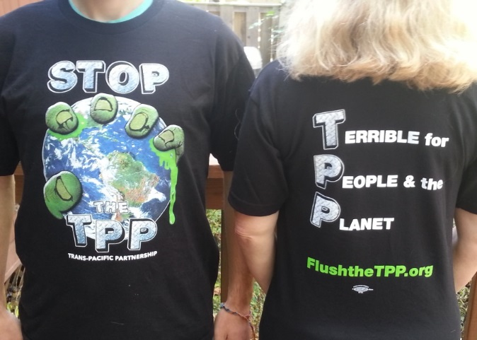
#StopTPP Now
March for a Clean Energy Revolution - CleanEnergyMarch.org
Sunday, July 24, noon, City Hall, Philadelphia
Stop the TPP Contingent
Other actions – Follow Flush the TPP on FB, twitter
T shirts and OccuCards

Slide 75

#NoLameDuck Uprising

Slide 76
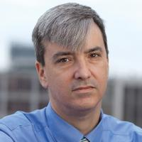
Patrick Woodall
Patrick Woodall is the Research Director and Senior Policy Advocate at the national advocacy organization, Food & Water Watch.
Mr. Woodall has been a public policy analyst, researcher and advocate on trade, agriculture and economic justice issues in Washington for two decades.
Patrick was on the steps of Congress when NAFTA passed, worked to stop a host of free trade agreements, and is the co–author of Whose Trade Organization? A Field Guide to the World Trade Organization (New Press, 2004) as well as dozens of reports and articles on agriculture, food, globalization, water and other policy issues.

Slide 77
Free Trade and Pipelines
or Clean Energy Revolution
Patrick Woodall
Research Director/Senior Policy Advocate
Food & Water Watch
Trade Justice Alliance
Sunday TPP Webinar
July 2016

Slide 78
Democratic Platform Silent on Fracking
What the platform DID NOT include:
National ban on fracking
Moratorium on fossil fuel infrastructure
Ban fracked oil “bomb trains”
Halt fossil fuel extraction on public lands
Rejecting fracking as clean energy or bridge fuel
Specific rejection of the TPP

Slide 79
Final Climate Platform Does Include
Declared climate a global emergency
WWII-scale mobilization on climate
Rejected all-of-the-above strategy
50% clean energy in decade, 100% by 2050
Incentivizes renewables over gas-fired plants; fracking regulation amendment
Reject future projects that significantly impact climate

Slide 80
Trade Policy in Platform
Rejected “diversity” of views on trade
Rejected trade deals with corporate investor suits (ISDS) — covers TPP/TTIP
Did not reject TPP specifically
Did set metrics that TPP cannot meet
Will not affect TPP vote

Slide 81
Total Investor-State Cases 1987-2014
Investors have won two-fifths of the cases and been awarded $3.6 billion in damages
Source: UNCTAD

Slide 82
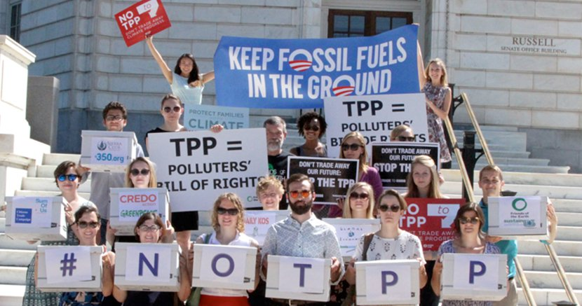
TransCanada NAFTA Suit Over KXL
TransCanada officially filed its $15 billion NAFTA investor suit against the United States after Pres. Obama blocked the high-carbon Canadian tar-sands oil.
TransCanada is demanding payment for its investment and lost future profits.

Slide 83
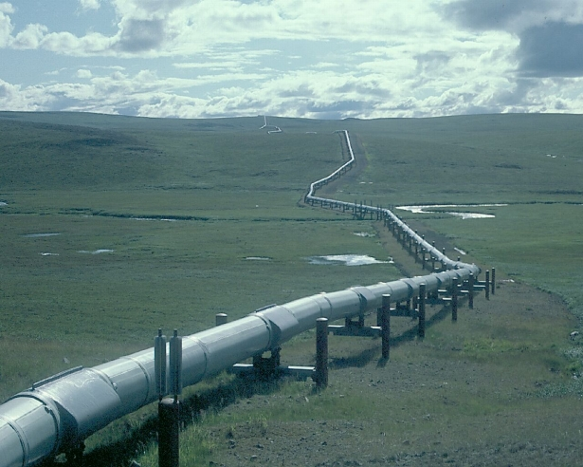
TransCanada’s NAFTA KXL Case Basics
3 Ds: Delay, Denial and Discrimination
Arbitrary and “political”
Stranded investments and lost expected revenues
Worse treatment than other fossil fuel investments
Suffolk University

Slide 84
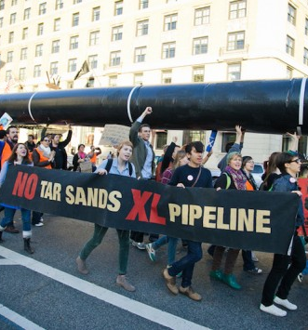
TransCanada’s NAFTA KXL Case Timing
90-days to pick panel
Jurisdiction = 1 year
Merits/damages = 3 years
World Bank (ICSID)
Limited/voluntary transparency
Tar Sands Action

Slide 85
ISDS and Selected Pending Interstate Pipelines

Slide 86
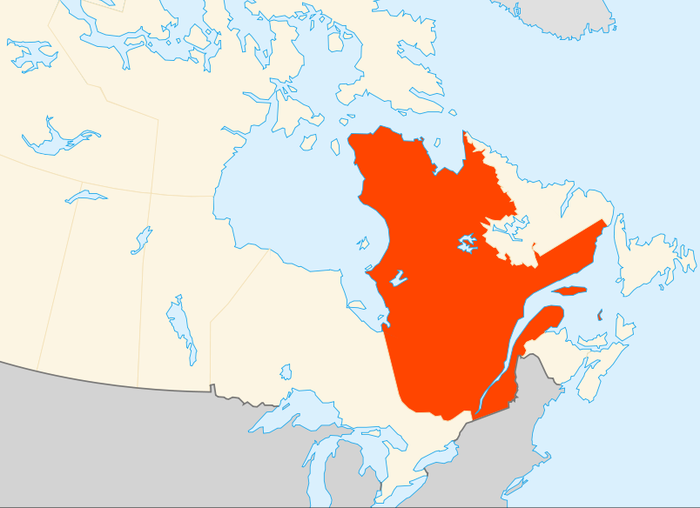
Lone Pine NAFTA Case over Fracking Moratorium
Lone Pine Resources NAFTA challenge against Quebec suspending oil and gas exploration permits below the St. Lawrence river, where Lone Pine already had permits.
Lone Pine is asking for $119 million in pending case.

Slide 87
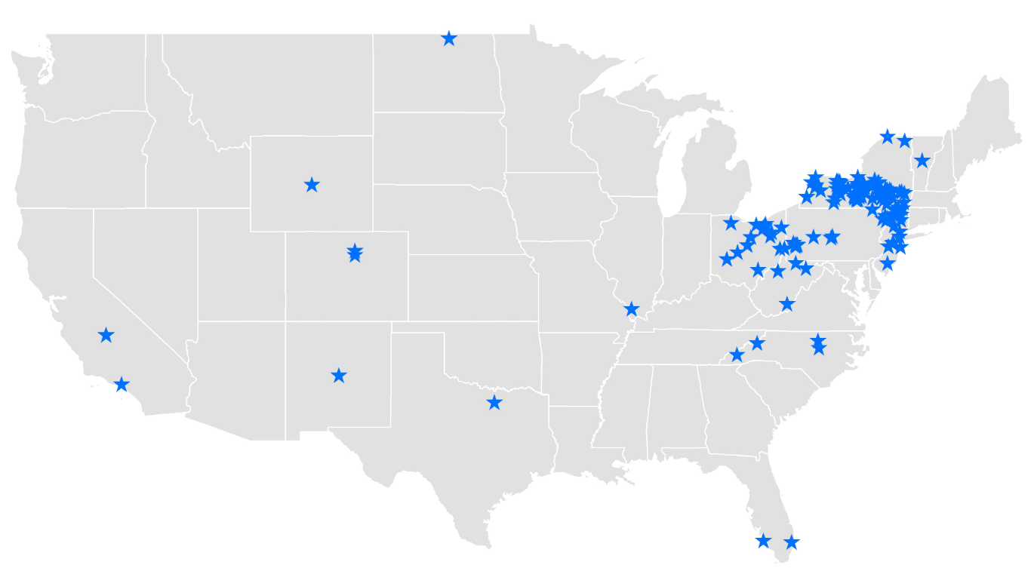
Local Fracking Bans and Moratoriums

Slide 88

STOP the
TPP

Slide 89
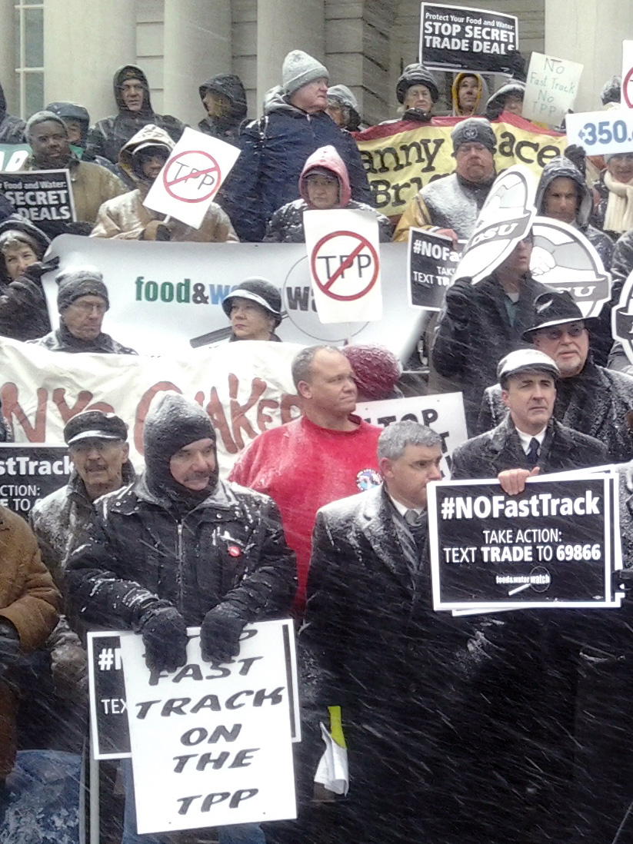
Take Action
Send a message, call and visit your Representative’s office
Text TRADE to 69866
Call 877-852-4710 to get connected to your Representative’s office
Tell them:
“Vote NO on the TPP!”

Slide 90
Q & A With Dr. Margaret Flowers and Patrick Woodall

Slide 91
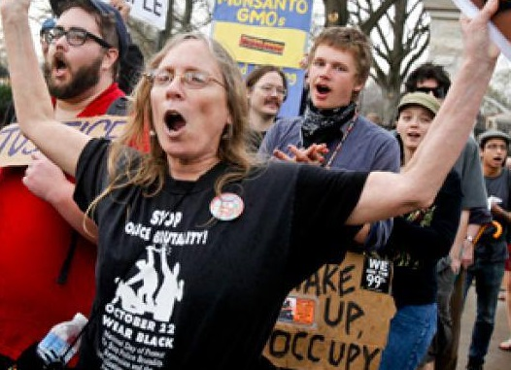

Trade Justice Alliance News
Susie Chasnoff and Adam Weissman

Slide 92
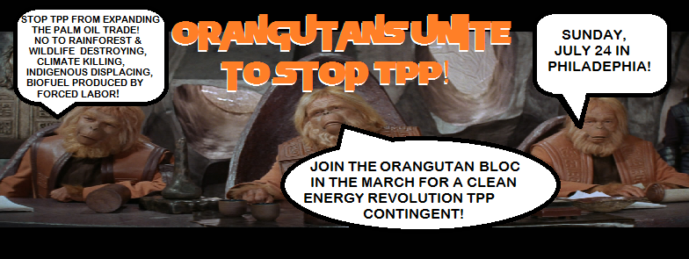

Slide 93
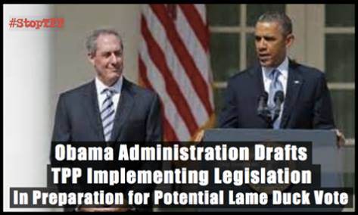
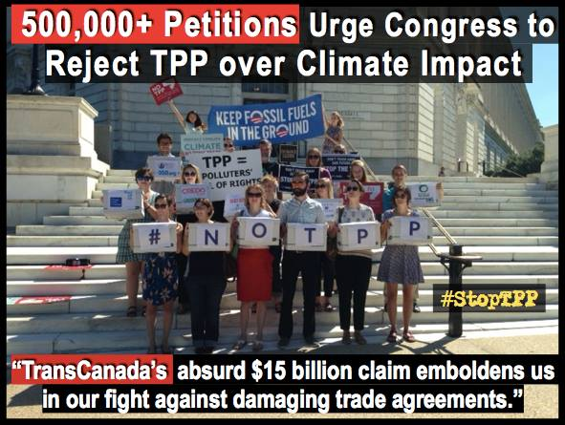
Trans-Pacific Partnership (TPP) News
White House Working With Congress on Language to Implement TPP, Froman Says (Morning Consult, 6/20/16)
CONGRESS RECEIVES OVER HALF A MILLION PETITIONS TO REJECT TPP OVER CLIMATE IMPACTS
(Sierra Club, 6/29/16)

Slide 94



REPUBLICAN TPP NEWS
GOP platform strikes tough anti-TPP language but remains more skeptical on trade
(Washington Post, 7/11/16)
Obama’s trade agenda losing critical support as McConnell calls TPP passage unlikely (Washington Post, 7/12/16)

Slide 95


Mike Pence Walks Back Prior Positions to Stand With Trump on Muslims, Wall, TPP (ABC News, 7/16/16)
Wall Street groups throw support behind Pacific trade deal
(The Hill, 7/13/16)

Slide 96


Transatlantic Trade and Investment Partnership (TTIP) News
TTIP: UK will be powerless against trade deal outside EU, say campaigners (Independent, 6/22/16)
BREXIT IS A REJECTION OF THE EU, TTIP AND THE POLITICAL CASTE (War on Want, 6/26/16)
Brexit Clouds TTIP Negotiations But May Not Scupper Deal (Chatham House, 7/11/16)
Beleagured Brussels: US cools interest in trade deal without UK as EU chief enrages China (7/15/16)
MAYDAY! MAYDAY!
Brexit free-trade deals planned with the USA and Australia (The Telegraph, 7/16/16)

Slide 97


TTIP ‘doesn’t respect EU interests’: French PM Valls says ‘non’ to transatlantic treaty (RT, 6/26/16)
Now EU faces ANOTHER referendum: Irish demand vote on controversial trade deal Sunday Express, 6/16/16)

Slide 98



TTIP Negotiating Round 14
Brussels, Belgium, July 11-15
EU negotiators were expected to “propose an institutional body for regulatory cooperation during talks with the U.S. next week, sources inside the EU’s Transatlantic Trade and Investment Partnership advisory group told POLITICO.”
“Critics of the trade pact argue that such an institution — where regulators from both sides comment on new legislation at an early stage — will undermine the power of [governmental bodies] because stakeholders could influence laws or water them down.”
EU will propose joint regulatory body in TTIP talks (Politico Pro, 7/7/16)
Actvists Hijack Electronic Billboard in Brussels with Anti-TTIP Messages (Ander Europa, 7/12/16)
Learn more about the TTIP Game Over campaign at ttipgameover.net
Leaked TTIP energy proposal could 'sabotage' EU climate policy
(The Guardian 7/11/16)

Slide 99

Trade in Services Agreement (TISA)
Commission rejects MEPs’ request for full ban on ratchet and standstill clauses in TiSA (EU Trade Insights via FlushtheTPP.org, 7/1/16)

Slide 100

Nina Macapinlac
Nina Macapinlac is an activist with BAYAN USA, an alliance of 20 progressive Filipino organizations in the United States.
Bayan USA is the overseas chapter of BAYAN in the Philippines which is fighting for the national liberation of the Philippines

Slide 101


Slide 102



Slide 103



NEXT STEPS

Slide 104

NEXT STEPS

Slide 105



Tell the DNC to Flush the TPP in Orlando
Protest at the Staged Platform Committee July 8-9

Slide 106

Trade Justice Alliance Future Webinars
Trade Justice Alliance Future Webinars

Slide 107







TRADE JUSTICE ALLIANCE TEAM
Andrea Miller
Celeste Drake
Linda Brewster
Tom Hocking
Mara Cohen
Your Picture
Here
Kerri Marks
Harriet Heywood
Adam Weissman
Lisa Oldendorp

