Slide 1



TRADE JUSTICE ALLIANCE WEBINAR MAY 15, 2016
THE NEW CONFESSIONS OF AN ECONOMIC HIT MAN
WITH JOHN PERKINS
Additional Speakers:
Celeste Drake, AFL-CIO
Dr. Margaret Flowers, Popular
Resistance / FlushtheTPP.org
Stacy Cosey, Spokane Activist Campaign

Slide 2


Introduction and Welcome
Andrea Miller, Executive Director
People Demanding Action
andrea@peopledemandingaction.org
Call Structure and Norms:
Audio is PHONE ONLY; you must call in
Do not enable your video camera
All calls are recorded; a link is available after the call
Q & A mode: To eliminate background noise we mute everyone when we begin recording.
Press *6 (when prompted) to ask a question; say your name, your organization, if any, and location. Be courteous and brief; give others a chance to ask questions too.
Keep chat room discussions on topic and professional

Slide 3


Technical Information
Audio is available only via phone
DIAL IN: 605 562 3140 ACCESS CODE: 802787#
Meeting Room Functions
- Chat
- Share
Use the Share button in the Meeting Room:
After the call, click the unique link below to download this week's PowerPoint, recording link and other materials: http://www.peopledemandingaction.org/downloads/tpp/trade-justice-call-5-15-2016

Slide 4

Technical Advisor/Facebook Page Manager
Trade Justice Alliance Team
Tom Hocking, Technical Advisor
MoveOn, PA
TWHocking@Gmail.com
*Pre/Post Call Technical Questions
*Global TPP Team Facebook Page Manager
Facebook:
https://www.facebook.com/groups/GlobalTPPTeam

Slide 5
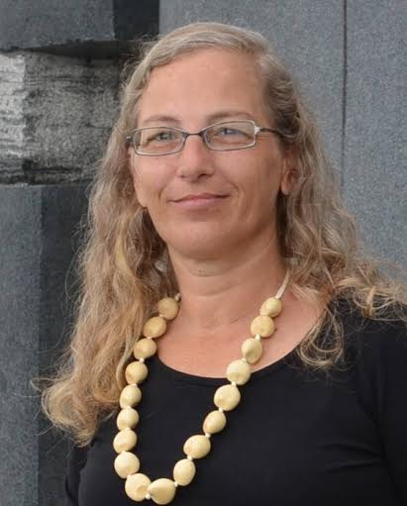
Trade Justice Alliance Team
Kerri Marks
Trade Justice Alliance Outreach Team
Social Media Development Coordinator
Citizen journalist with Occupy Hawaii and Iowa99Media
YouTube Channel Publicity Tech

Slide 6
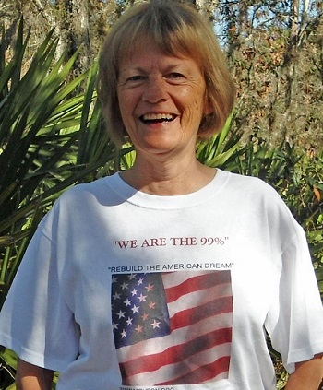
Call Planning Team
Harriet Heywood
harrietheywood@gmail.com
Call Co-Organizer
Speaker Recruitment
Call Planning Team Core Member
Florida State Leader –
People Demanding Action

Slide 7

Trade Justice Alliance Team
Lisa Oldendorp
MoveOn, New York
oldendorpl@gmail.com
*Chat Host
*New York TPP Activist

Slide 8

Call Planning Team
Linda Brewster
LindaJBrewster@msn.com
*Call Planning Team Core Member
*Information and event sharing
*MoveOn Organizer (WA)

Slide 9
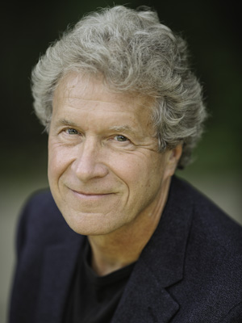
JOHN PERKINS
John Perkins was an Economist at a major international consulting firm, where he advised the World Bank, IMF, United Nations, U.S. Treasury Department, Fortune 500 corporations, and leaders of countries in Africa, Asia, Latin America, and the Middle East in the “art of what he calls the global death economy. His former career positioned him well in his future life as a beacon of truth, exposing the corporate purpose behind the World Bank, the IMF, and “free trade.”
A prolific author, John Perkins’ well known book, Confessions of an Economic Hit Man, was on the New York Times bestselling list for 73 weeks, His most recent, New Confessions of an Economic Hit Man, is “an updated version of his original work with added strategies to transform the global death economy into a regenerative model.”
Mr. Perkins is a founder and board member of Dream Change and the Pachmama Alliance, non-profits devoted to establishing a sustainable world model.
He has lectured extensively at Harvard, Oxford, and countless international universities,
and in addition to his best-known works of non-fiction, has authored books on indigenous cultures and personal transformation. He has been featured on all major networks, and print media, including the New York Times and Washington Post.
Some of John’s classics include: Confessions of an Economic Hit Man, The Secret History of the American Empire, Hoodwinked, and his most recent, New Confessions of an Economic Hit Man, an updated, modernized version and follow-up to his international bestseller.

Slide 10
Q&A WITH JOHN PERKINS

Slide 11


Call Planning Team
Celeste Drake
Trade and Globalization Policy Specialist,
AFL-CIO
Trade Justice Alliance Speaker Recruitment
Call Planning Team Core Member
Cdrake@AFLCIO.org

Slide 12


Call Planning Team
Adam Weissman
Global Justice for Animals and the Environment
TradeJustice
www.TRADEJUSTICE.NET
*Call Planning Team Core Member
*Speaker Recruitment
*Events, news stories and actions
http://tradejustice.net/events
http://www.tradejustice.net/news
adam@tradejustice.net

Slide 13
Trade Agreements News - Excerpts
Full newsletter at http://tradejustice.net/news
TPP
President Obama: The TPP would let America, not China, lead the way on global trade (Washington Post,
5/2/16)
Clinton opposes TPP vote in the lame-duck session (The Hill, 5/6/16)
Hillary Clinton Calls For New "Trade Prosecutor" Position, Opposes TPP "In Its Current Form"
(Real Clear Politics, 5/9/16)
TPP death watch (Politico, 05/12/16)

Slide 14
Trade Agreements News - Excerpts
Colombia FTA
Colombia Fears U.S. May Reject Peace Plan To Protect Pharma Profits (Huffington Post, 5/11/16)
WTO
There’s no end yet to tuna labeling row (Mexico Daily, 5/12/16)

Slide 15
Trade Agreements News - Excerpts
TTIP
Greenpeace Netherlands releases TTIP documents (Greenpeace, 5/2/16)
TTIP trade talks 'likely to stop', warns French minister (BBC, 5/3/16)
TTIP leaks: telecoms proposals threaten net neutrality & citizens’ rights (IPTegrity, 5/6/16)
TTIP trade deal under threat after Germany claims US not making 'any serious concessions' (The Independent, 5/8/16)
Greece to block TTIP unless geographical indications are protected (Euractiv, 5/13/16)
TTIP WILL DAMAGE PUBLIC HEALTH AND CLIMATE, SAYS OFFICIAL REPORT (War on Want, 5/13/16)

Slide 16
Left Forum
NYC - May 20-22
http://leftforum.org
Neoliberalism, Globalization and the Privatization of Everything - What It Will Take to Win Back Government of the People
Session 1 Room 1.100 Sat 10:00am - 11:50am
The TPP, TTIP and the Continuing Free Trade Onslaught, the View From Canada
Session 4 Room 1.73 Sat 05:10pm - 07:00pm
Slavery Is Such an Ugly Word - We Prefer to Call It 'free Trade': How Debt Fuels the Global Economy
Session 5 1.67 Sun 10:00am - 11:50am
It's Time for Alexander Hamilton the Leftist: Hamilton's American System of Political Economy Is the Key to Defeating Wall Street and Finally Organizing an Economic Recovery Starting With Infrastructure
Session 5 Room 1.75 Sun 10:00am - 11:50am
Globalization for the 99%: a presentation and discussion on whether free trade agreements can work for all
Session 6 Room 1.85 Sun 12:00pm - 01:50pm
Environmental Struggles against Pipelines
Session 7 Room 8.69 Sun 03:40pm - 05:40pm
From Mexico: The TPP and Its Impact on Internet Freedom and Free Software
Session 7 1.90 Sun 03:40pm - 05:40pm

Slide 17
TTIP: New Reports and Resources
Complete Text of Leaks (Greenpece NL)
TRADING AWAY EU FARMERS THE RISKS TO EUROPE’S AGRICULTURE FROM THE TTIP Friends of the Earth Europe)
Trade SIA on the Transatlantic Trade and Investment Partnership (TTIP) between
the EU and the USA: Draft Interim Technical Report (European Commission)

Slide 18
Outreach vs. TPP / TTIP at March Against Monsanto
http://www.march-against-monsanto.com/
* Pass out leaflets
* Collect names and addresses on form letters
Leaflet and Form Letter

Slide 19
Q&A with Celeste Drake and Adam Weissman

Slide 20
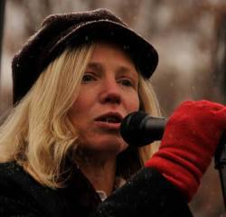
DR. MARGARET FLOWERS
Dr. Margaret Flowers is a pediatrician and co-chair of the Maryland chapter of Physicians for a National Health Program (PNHP). Margaret is also Co-Director of PopularResistance.org and It's Our Economy, Co-Organizer of Flush the TPP (flushthetpp.org).
And Green Party candidate for U.S. Senate in Maryland
Its Our Economy (www.itsoureconomy.US)
Popular Resistance (www.popularresistance.org
Democratize the Media / Forces of Greed
Radio: http://www.ClearingtheFOGRadio.org
TPP Campaigns: www.flushthetpp.org

Slide 21
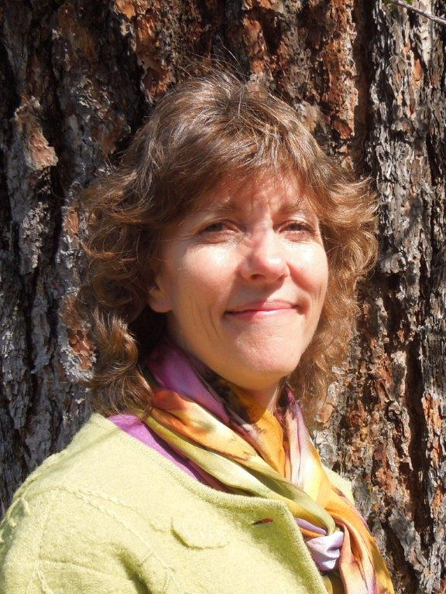
GUEST ACTIVIST: STACY COSSEY, SPOKANE
Stacy Cossey is a Washington State activist with Move to Amend and activist with the campaign to stop the TPP
Stacy and partner, William Miller worked on a great campaign and Stacy did a marathon, delivering TPPizza to 500 members of Congress in D.C. May 11

Slide 22
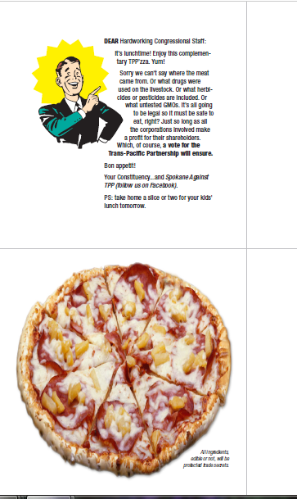

"Satire-tivism“
TPPizza Delivery

Slide 23
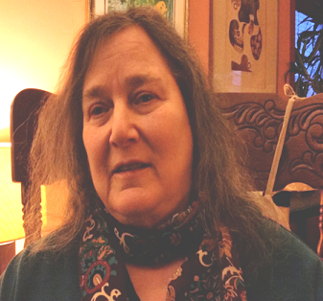
Mara Cohen
Trade Justice Alliance Planning Team Core Member
End Mass Criminalization Team
Agitator Radio
Organizers’ Resource Hub
People Demanding Action
marajai51@gmail.com

Slide 24
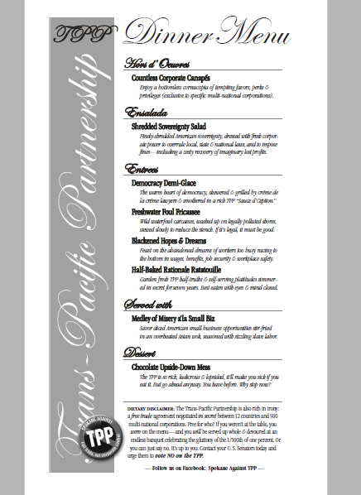
TPP DINNER MENU
Care for some Shredded Sovereignty Salad with a side of Blackened Hopes and Dreams followed by our Chocolate Upside-Down Mess?
Or perhaps another devastating TPP menu item?

Slide 25
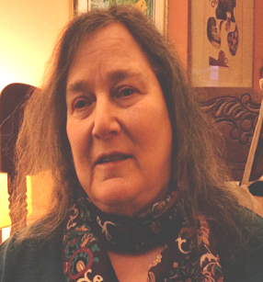
Q&A
WITH MARGARET FLOWERS, STACY COSSEY, AND MARA COHEN

Slide 26

TRADE JUSTICE ALLIANCE FUTURE CALLS
MAY 22

Slide 27

TRADE JUSTICE ALLIANCE FUTURE CALLS
JUNE 05

Slide 28
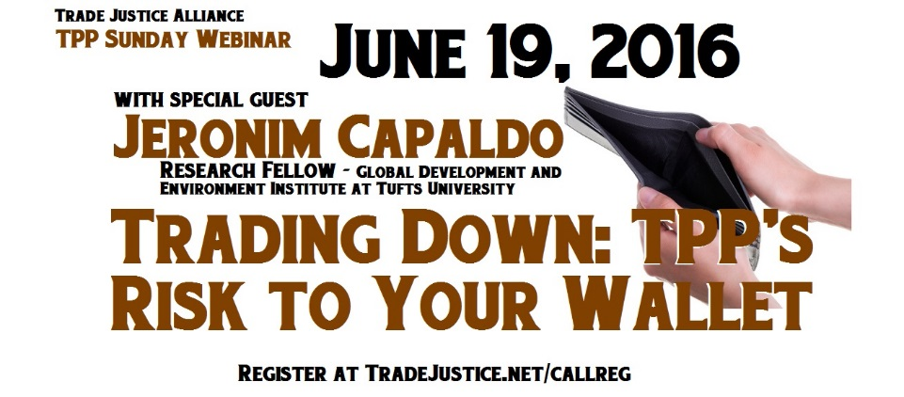
TRADE JUSTICE ALLIANCE FUTURE CALLS
JUNE 19

