Slide 1

TRADE JUSTICE ALLIANCE WEBINAR MAY 01, 2016
TPP: GOLD STANDARD FOR GLOBAL LABOR RIGHTS?
CELESTE DRAKE, AFL-CIO
ANGELLA MACEWEN, CANADIAN LABOUR CONGRESS
KHRISTYN BRIMNEIER, COALITION FOR BETTER TRADE
DR. MARGARET FLOWERS, POPULAR RESISTANCE
For Audio Dial: 605-562-3140 PIN: 802787#

Slide 2



Introduction and Welcome
Andrea Miller, Executive Director
People Demanding Action
andrea@peopledemandingaction.org
Call Structure and Norms:
Audio is PHONE ONLY; you must call in
Do not enable your video camera
All calls are recorded; a link is available after the call
Q & A mode: To eliminate background noise we mute everyone when we begin recording.
Press *6 (when prompted) to ask a question; say your name, your organization, if any, and location. Be courteous and brief; give others a chance to ask questions too.
Keep chat room discussions on topic and professional

Slide 3


Technical Information
Audio is available only via phone
DIAL IN: 605 562 3140 ACCESS CODE: 802787#
Meeting Room Functions
- Chat
- Share
Use the Share button in the Meeting Room:
After the call, click the unique link below to download this week's PowerPoint, recording link and other materials: http://www.peopledemandingaction.org/downloads/tpp/trade-justice-call-5-1-2016

Slide 4

Technical Advisor/Facebook Page Manager
Tom Hocking, Technical Advisor
MoveOn, PA
TWHocking@Gmail.com
*Pre/Post Call Technical Questions
*Global TPP Team Facebook Page Manager
Facebook:
https://www.facebook.com/groups/GlobalTPPTeam

Slide 5
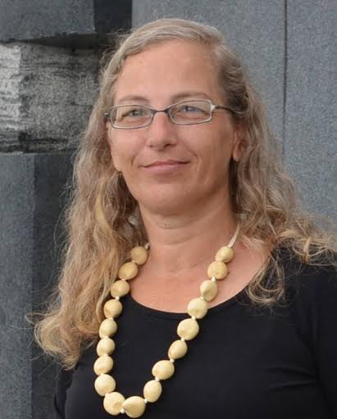
Call Planning Team
Kerri Marks
Trade Justice Alliance Outreach Team
Social Media Development Coordinator
Citizen journalist with Occupy Hawaii and Iowa99Media
YouTube Channel Publicity Tech

Slide 6
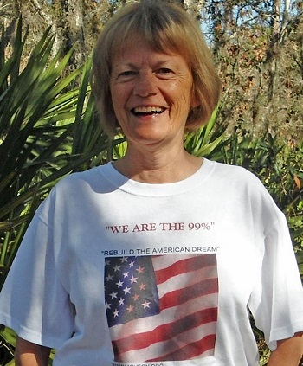
Call Planning Team
Harriet Heywood
harrietheywood@gmail.com
Call Co-Organizer
Florida State Leader –
People Demanding Action

Slide 7

Call Planning Team
Linda Brewster
LindaJBrewster@msn.com
*Call Planning
*Information and event sharing
*MoveOn Organizer (WA)

Slide 8

Chat Host/Call Planning Team
Lisa Oldendorp
MoveOn, New York
eslsk8r@optonline.net
*Chat Host
*Call Planning Team

Slide 9


Call Planning Team
Celeste Drake
Celeste Drake is a Trade & Globalization Policy Specialist at the AFL-CIO. Celeste works to improve U.S. trade policy so it doesn’t send more jobs overseas, and to improve labor rights for workers overseas so that workers globally can race to the top instead of having global corporations push us to the bottom.
Celeste has been a public school teacher (and vice president of her local) a law clerk for a federal judge, and congressional aide on Capitol Hill. While Legislative Director for Rep. Linda Sanchez (D-CA), Celeste coordinated the Labor and Working Families Caucus, one of the largest caucuses in the U.S. House of Representatives. Celeste earned a BA, a JD, and an MPP from UCLA.
Cdrake@AFLCIO.org

Slide 10
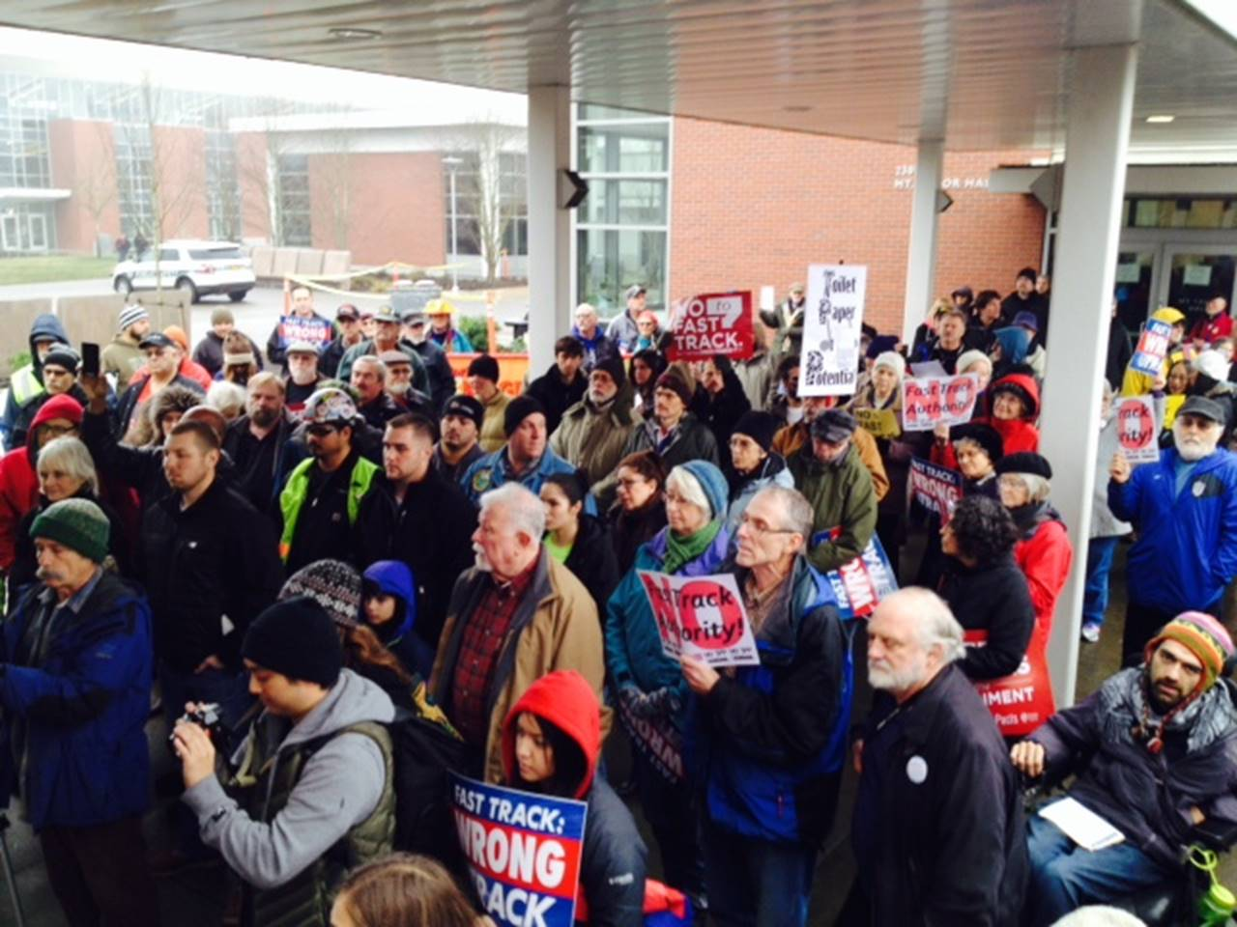
THE TPP IS NOT A GOLD STANDARD FOR WORKERS

Slide 11
The Labor Chapter, despite tiny improvements over the Bush-era provisions, won’t protect workers and, even if it were perfect, it could not counterbalance all of the harms that TPP will cause to working families.
The TPP’s labor commitments are “enforceable,” at least in theory, but its provisions don’t require governments to act on labor abuses by trading partners.
The changes to the Labor Chapter from the Bush era are minor—and left out key recommendations from the international labor movement.
It doesn’t prohibit trade in goods made with forced labor.
It doesn’t set meaningful standards for wages or on the job safety.

Slide 12
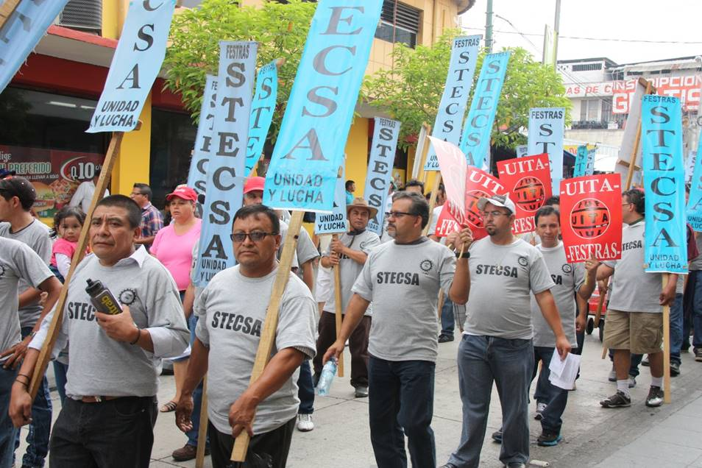
The TPP does not fix Malaysia’s human trafficking problem.
It does not eliminate discrimination in employment.
It’s not likely the U.S. or any other country will act to enforce the labor provisions.

Slide 13
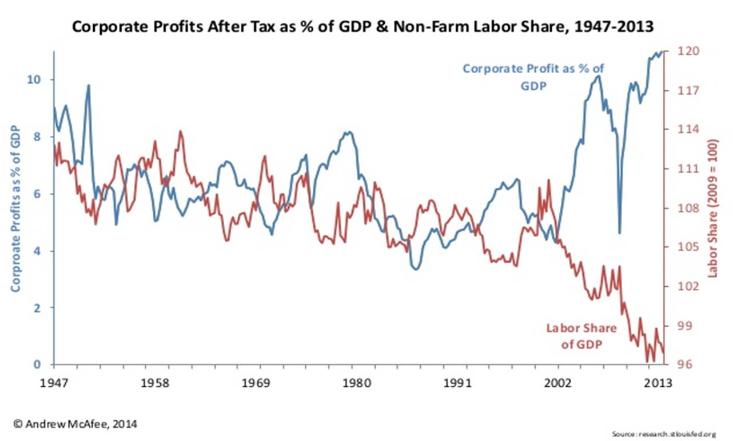
But what is likely is that workers in all countries will see a race to the bottom in wages and deteriorating working conditions.
The study Trading Down by Jeronim Capaldo predicts that the U.S. will lose 448,000 jobs and that the share of the U.S. GDP that goes to working people instead of capital will fall by 1.3%.

Slide 14
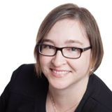
Angella MacEwen
Angella MacEwen is an economist with the Canadian Labour Congress, and a policy fellow with the Broadbent Institute.
Her areas of expertise include labour market issues and social policy analysis.

Slide 15
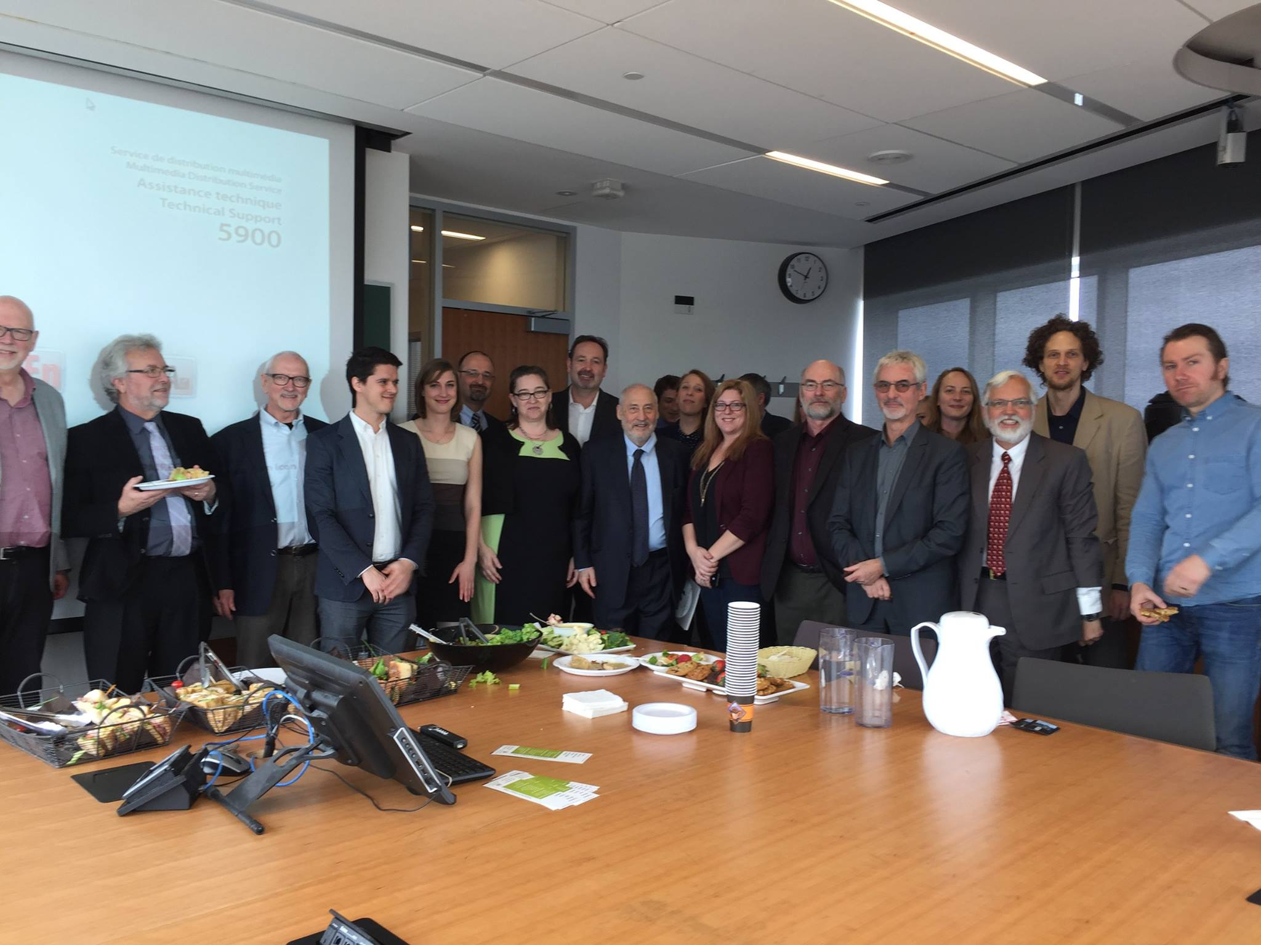
Trade Justice Network Canada
http://tradejustice.ca/en/

Slide 16

TJN is organizing around government consultations - letstalktpp.ca

Slide 17

Canada needs to stop the Trans-Pacific Partnership
http://canadianlabour.ca/stoptpp

Slide 18
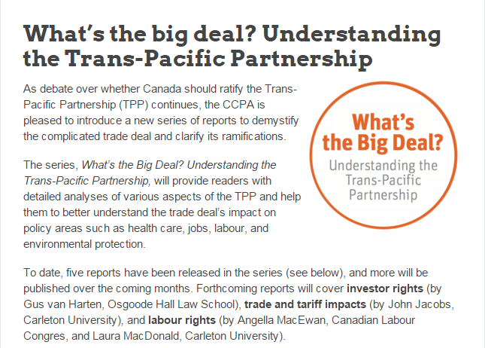
Trade and Investment Research Project
https://www.policyalternatives.ca/newsroom/updates/what’s-big-deal-understanding-trans-pacific-partnership

Slide 19
Q&A With Celeste Drake and Angella MacEwen

Slide 20
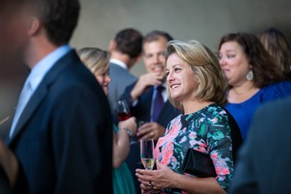
Khristyn Brimneier
Khristyn Brimneier is the Communication Director for the Coalition for Better Trade.
Khristyn began her career in politics, and her recent clients have included SpaceX, Seventh Generation, Oxfam America, the Bloomberg Foundation, Clinton Climate Initiative, and the National Governors Association.
During the 2008 election cycle, she successfully developed and executed an advocacy campaign for the Alliance for American Manufacturing built around a series of town halls that was credited by The Wall Street Journal for focusing the Obama and Clinton campaigns’ debate on trade.

Slide 21
COALITION FOR BETTER TRADE--WHO ARE WE?
The Coalition for Better Trade is a band of progressive organizations dedicated to improving trade policy and legislation to protect America's working families, environment and natural resources from short-sighted and corporate profit-driven trade deals.
Follow us on Twitter: @BetterTradeNow
Coalition Partners:
AFL-CIO
Alliance for Retired Americans
Amalgamated Transit Union
American Federation of State, County and Municipal Employees
Citizens Trade Campaign
Communication Workers of America
Public Citizen’s Global Trade Watch
International Association of Machinists and Aerospace Workers
International Brotherhood of Boilermakers
International Brotherhood of Electrical Workers
International Brotherhood of Teamsters
National Association of Letter Carriers
Sierra Club
Transport Workers of America
United Auto Workers
United Brotherhood of Carpenters
United Food and Commercial Workers
United Steelworkers

Slide 22
The Role of the Coalition
The Coalition for Better Trade serves a coordinating function for the members of the coalition on a variety of campaign activities including direct member outreach in Washington, field activities, and communications work. We hold weekly meetings for both broad coalition activity as well as a weekly communications team call.

Slide 23
Coalition Rapid Response
Recent communications activities include the following:
* Sierra Club released an interactive map and report that reveals that new proposed trade deals would threaten the climate protections
* Drafted and placed an op-ed for Louise Slaughter on International Women’s Day
* Sierra Club's Ilana Solomon authored a blog post on the 10th anniversary of the Peru Trade Deal.
* Worked with coalition members on Rapid Response efforts:

Slide 24
Q&A WITH KHRISTYN BRIMNEIER

Slide 25
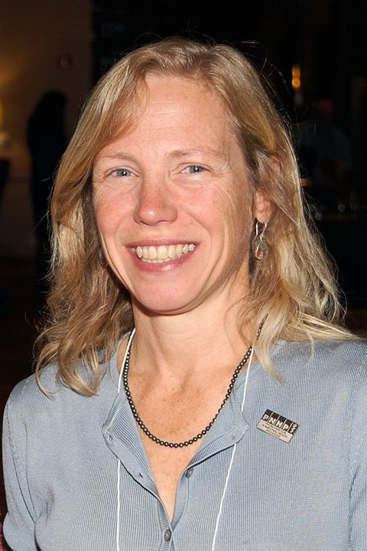
DR. MARGARET FLOWERS
Dr. Margaret Flowers is a pediatrician and co-chair of the Maryland chapter of Physicians for a National Health Program (PNHP). Margaret is also Co-Director of PopularResistance.org and It's Our Economy, Co-Organizer of Flush the TPP (flushthetpp.org).
Its Our Economy (www.itsoureconomy.US)
Popular Resistance (www.popularresistance.org
Democratize the Media / Forces of Greed
Radio: http://www.ClearingtheFOGRadio.org
TPP Campaigns: www.flushthetpp.org

Slide 26
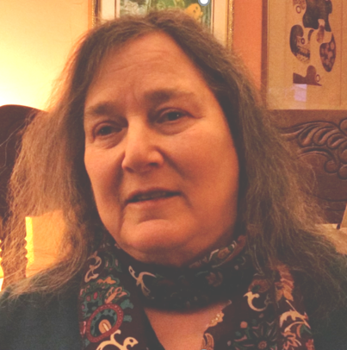
Call Planning Team
Mara Cohen
End Mass Criminalization Team
Agitator Radio
Organizers’ Resource Hub
People Demanding Action
Popular Resistance.org
marajai51@gmail.com

Slide 27
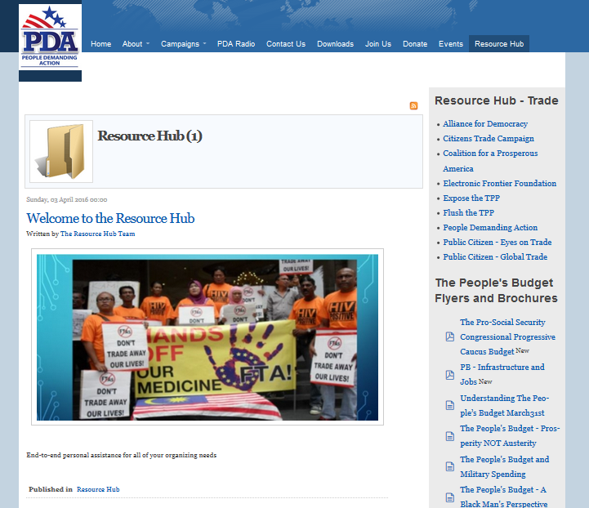

Slide 28


Call Planning Team
Adam Weissman
Global Justice for Animals and the Environment
TradeJustice
www.TRADEJUSTICE.NET
*Call Planning Team
*Speaker Recruitment
*Events, news stories and actions
http://tradejustice.net/events
http://www.tradejustice.net/news
adam@tradejustice.net

Slide 29
Q&A WITH MARGARET FLOWERS, MARA COHEN, AND ADAM WEISSMAN

Slide 30
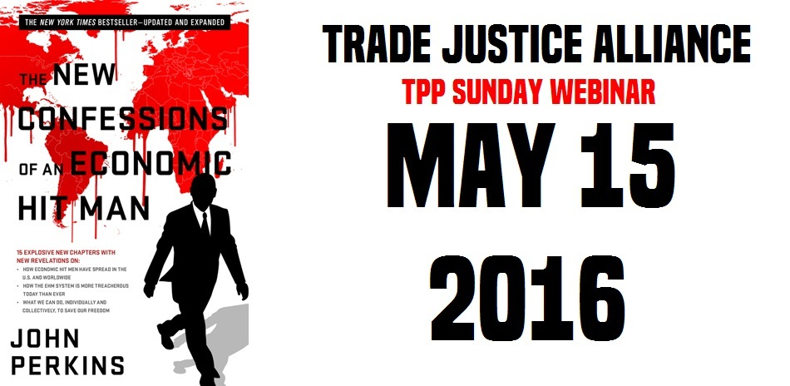
FUTURE WEBINARS

