Slide 1
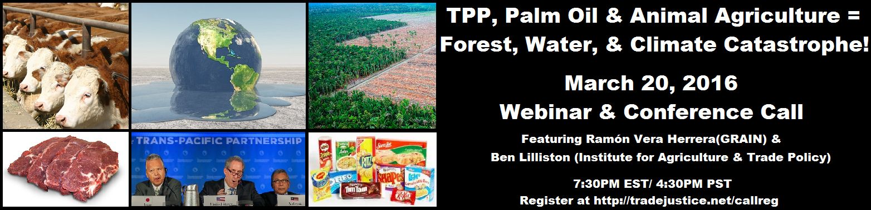
TPP, PALM OIL & ANIMAL AG = FOREST, WATER AND CLIMATE CATASTROPHE
For Audio use phone or Skype
Call: 605-562-3140
PIN: 951146#

Slide 2
Speakers
Ben Lilliston, Institute for Agriculture and Trade Policy
Ramón Vera Herrera, GRAIN staff and Editor of Biodiversidad, Sustento y Culturas
Dr. Margaret Flowers, Co-Director Popular Resistance,
Co-Organizer Flush the TPP
Adam Weissman, Global Justice for Animals and the Environment/ TradeJustice New York/

Slide 3


Introduction and Welcome
Andrea Miller, Executive Director
People Demanding Action
andrea@peopledemandingaction.org
Call Structure and Norms:
Audio is PHONE ONLY; you must call in
Do not enable your video camera
All calls are recorded; a link is available after the call
Q & A mode: To eliminate background noise we mute everyone when we begin recording.
Press *6 (when prompted) to ask a question; say your name, your organization, if any, and location. Be courteous and brief; give others a chance to ask questions too.
Keep chat room discussions on topic and professional

Slide 4


Technical Information
Audio is available only via phone
DIAL IN: 605 562 3140 ACCESS CODE: 951146#
Meeting Room Functions
- Chat
- Share
Use the Share button in the Meeting Room:
After the call, click the unique link below to download this week's PowerPoint, recording link and other materials: http://www.peopledemandingaction.org/downloads/tpp/trade-justice-call-3-20

Slide 5

Technical Advisor/Facebook Page Manager
Tom Hocking, Technical Advisor
MoveOn, PA
TWHocking@Gmail.com
*Pre/Post Call Technical Questions
*Global TPP Team Facebook Page Manager
Facebook:
https://www.facebook.com/groups/GlobalTPPTeam

Slide 6

Chat Host/Call Planning Team
Lisa Oldendorp
MoveOn, New York
eslsk8r@optonline.net
*Chat Host
*Call Planning Team

Slide 7


Call Planning Team
Celeste Drake
Trade and Globalization Policy Specialist,
AFL-CIO
Cdrake@AFLCIO.org

Slide 8

Call Planning Team
Linda Brewster
LindaJBrewster@msn.com
*Call Planning
*Information and event sharing
*MoveOn Organizer (WA)

Slide 9

Director, Social Media
@TPPMediaMarch
Twitter.com/TPPMediaMarch
Emilianne Slaydon
Every #TPPTuesday
6pm PT | 9pm ET
Tweets:
tiny.cc/TPPMediaMarch

Slide 10


Slide 11




Slide 12
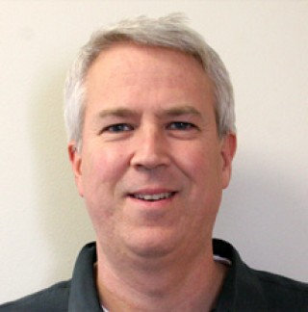

Ben Lilliston
Ben Lilliston oversees the Institute for Agriculture and Trade Policy’s climate work. He has been working and writing about international trade issues and how they intersect with U.S. agricultural and climate policy since 2000.
Mr. Lilliston recently authored a report on how the global meat industry will benefit from the Trans Pacific Partnership, and contributed to the UN Committee on Trade and Development (UNCTAD) Trade and Environmental Review 2013.
He has worked as a researcher, writer and editor at the Center for Study of Responsive Law, the Corporate Crime Reporter, and the Multinational Monitor.
Ben is a widely published writer, most recently, contributing to the book Mandate for Change (Lexington), and previously co-authored the book, Genetically Engineered Foods: A Guide for Consumers (Avalon).

Slide 13
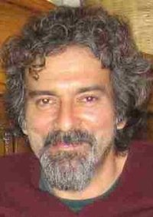

Ramón Vera Herrera
Ramón Vera- Herrera, one of the GRAIN staff, is the overall editor of Biodiversidad, Sustento y Culturas, a magazine (electronic and printed in hard copies) published by GRAIN and 8 other organizations and movements throughout Latin America: Argentina, Brazil, Chile, Colombia, Costa Rica, Ecuador, México, Paraguay and Uruguay.

Slide 14
Q&A Ben and Ramon

Slide 15


Call Planning Team
Adam Weissman
Global Justice for Animals and the Environment
TradeJustice
www.TRADEJUSTICE.NET
*Call Planning Team
*Speaker Recruitment
*Events, news stories and actions
http://tradejustice.net/events
http://www.tradejustice.net/news
adam@tradejustice.net

Slide 16
Recent News on Free Trade, Deforestation,
Climate, and Animal Agriculture
(excerpted from TradeJustice Alliance's 3/15/16 e-newsletter)
TRANS-PACIFIC PARTNERSHIP ‘FULL OF EMPTY PROMISES’ FOR THE ENVIRONMENT (Byline, 2/3/16)
Hydrocarbon-based economies must diversify, says WTO chief (Gulf Times, 3/1/16)
Investigating Peru's Illegal Timber Trade and the Failure of the US-Peru Trade Deal (Huffington Post, 3/8/16)
After WTO Battle, USDA Issues Final Rule Lifting Pork and Beef COOL Requirements (JD Supra Business Advisor, 3/3/16)
Environmental Advocates Tell Congress: Reject The TPP Think Progress, 3/9/16)
Read these and dozens more trade news stories at http://tradejustice.net/news

Slide 17
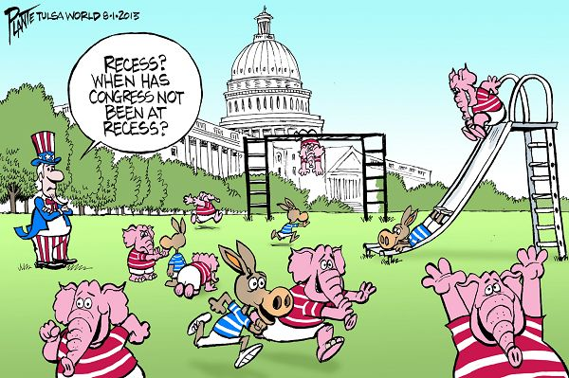
Recess & Earth Day Coming Up!
Congressional Recess - March 24-April 11
Earth Day - Friday, April 22

Slide 18
TPP is Becoming a Major Election Story
Hillary Clinton and John Kasich Win Ohio, and So Does Free Trade (Forbes, 3/15/16)
Bernie Sanders & the death of TPP: Why his stunning Michigan upset could be the final nail in the free-trade coffin (Salon, 3/15/16)
In Ohio, Hillary Clinton strengthens opposition to Trans-Pacific Partnership (The Washington Post, 3/12/16)
Hillary Clinton doesn’t get it: Paul Krugman, Bernie Sanders and the truth about the free trade scam (Salon, 3/18/16)

Slide 19
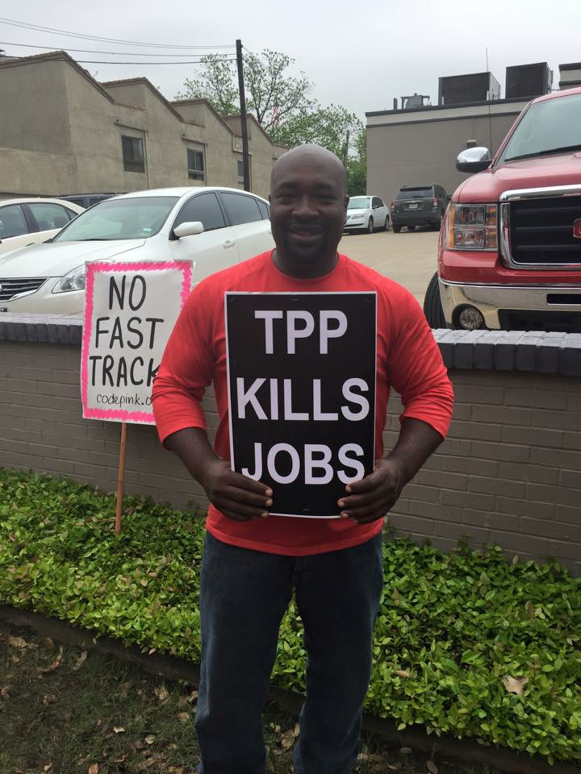
Adam's Slides
Free Trade Agreements Kill Jobs, TPP Will Kill More
Trans-Pacific Partnership, currency manipulation, trade, and jobs: U.S. trade deficit with the TPP countries cost 2 million jobs in 2015, with job losses in every state (Economic Policy Institute, 3/3/16)
Job-Killing Trade Deficits Surge under FTAs: U.S. Trade Deficits Grow 418% with FTA Countries, but Decline 6% with Non-FTA Countries (Public Citizen, 3/9/16)

Slide 20

IATP & GRAIN's Reports
Big Meat Swallows the Trans-Pacific Partnership (IATP)
Trade deals boosting climate change: the food factor (GRAIN)

Slide 21
New Reports, Letters, and Analyses on TPP and the Environment
Empty Promises and Missed Opportunities: An Assessment of the Environmental Chapter of the Trans-Pacific Partnership (Professor Chris Wold, January 4, 2016)
NEW REPORT: TRANSCANADA'S $15 BILLION USD CASE REVEALS RECKLESS TRADE PROVISIONS: Trade Rules Empower Corporations To Demand Compensation, Threaten Our Communities and Climate (Sierra Club, 2/22/16)
Re: Following Announcement of TransCanada’s Investor-State Case against the United States, Environmental Organizations Urge Opposition to Trans-Pacific Partnership (Letter from Dozens of Enviro Groups, 3/9/16)

Slide 22

*Organize a Film Screening -- or screen this webinar!
* Leaflet or table & get letters to Congress signed at Earth Day events in your community
* Invite a speaker -- live or via Skype
* Protest at the office of a member of Congress who has remained silent on TPP
* Reach out to environmental groups in your community to co-sponsor these activities

Slide 23
Videos on TPP and the Environment
The Trans-Pacific Partnership and the Environment
Global Justice for Animals and the Environment)
Trading Views TPP Forum - Environment Chapter (Ways and Means Committee hearing featuring Sierra Club and Environmental Investigation Agency reps)
TPP Impacts: On the Environment
(Workshop by Sanya Reid Smith, Public Services International)
Peril in the Pacific: No to the TPP (Friends of the Earth)
What is the TPP? (Trans-Pacific Partnership) (Sierra Club)

Slide 24

Literature on TPP, Climate,
Palm Oil, Animal Ag, etc.
http://gjae.org/tpplit

Slide 25

Links for More Info
Sierra Club TPP Page
Global Justice for Animals and the Environment TPP Page
Friends of the Earth TPP Page
Institute for Agriculture and Trade Policy Trade Page
GRAIN Trade Resources

Slide 26
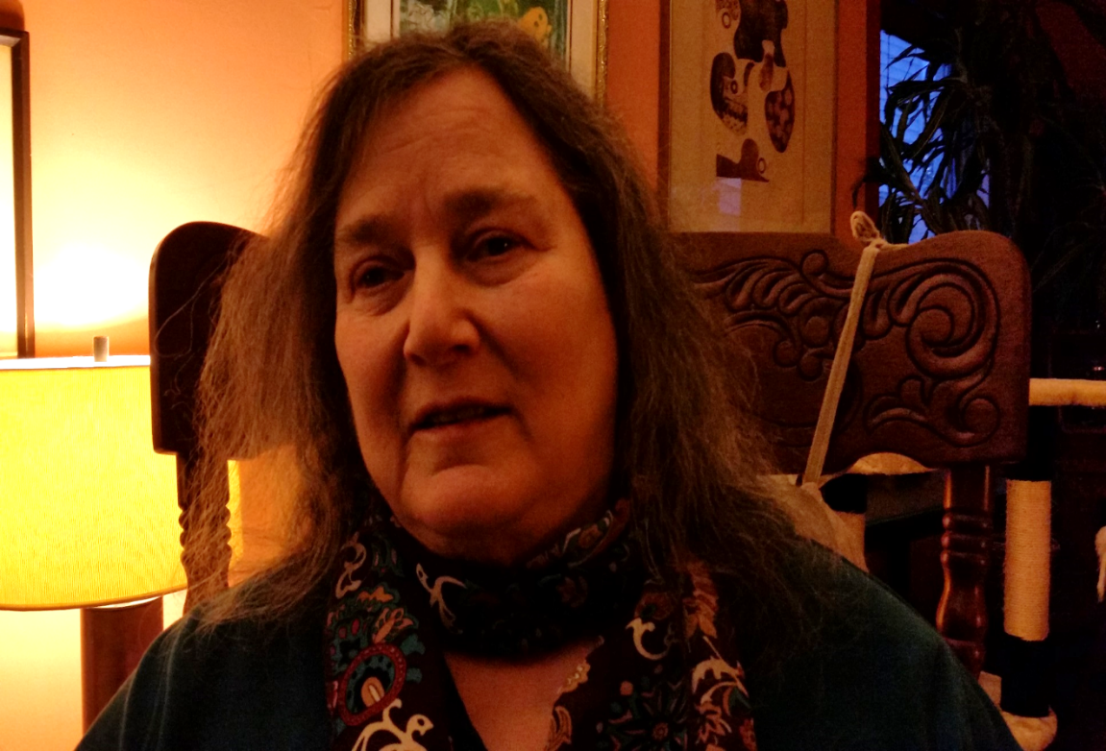
Mara Cohen
Trade Justice Alliance Planning Team
End Mass Criminalization Team
Agitator Radio
Organizers’ Resource Hub
People Demanding Action
marajai51@gmail.com

Slide 27
What Is The Resource Hub?
One stop shop for organizing your rally or event
Mentoring on all aspects of the effort
Recruitment
Preparing flyers
Contacting the media
PowerPoints
Person-to-person, email or virtual assistance

Slide 28
How To Be Part of It
Accept our help, use our materials
Provide feedback and help us improve our resources
Contribute your time to our effort
When you pull resources together for your event, let us share them on the hub
Contribute your expertise - volunteer to research, write or organize for others

Slide 29
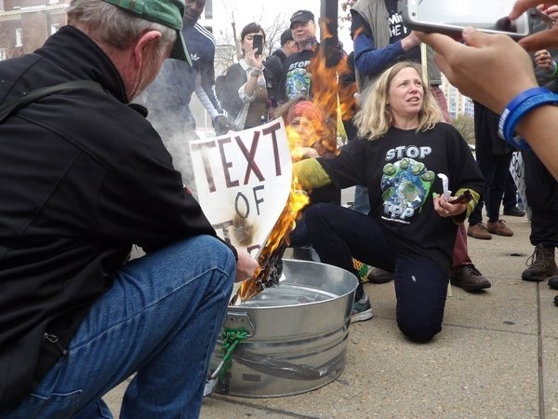
DR. MARGARET FLOWERS
Dr. Margaret Flowers is a pediatrician and co-chair of the Maryland chapter of Physicians for a National Health Program (PNHP). Margaret is also Co-Director of PopularResistance.org and It's Our Economy, Co-Organizer of Flush the TPP (flushthetpp.org).
Its Our Economy (www.itsoureconomy.US)
Popular Resistance (www.popularresistance.org
Democratize the Media / Forces of Greed
Radio: http://www.ClearingtheFOGRadio.org
TPP Campaigns: www.flushthetpp.org

Slide 30
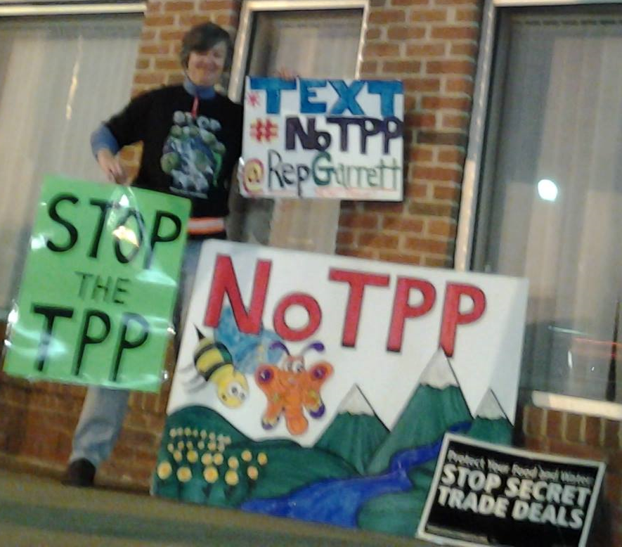
Wendie Goetz
NJ 5 Garrett Constituents Against The TPP
http://tradejustice.net/nj5

Slide 31
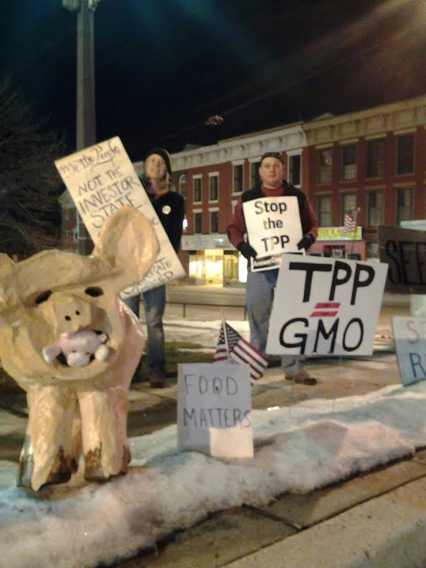
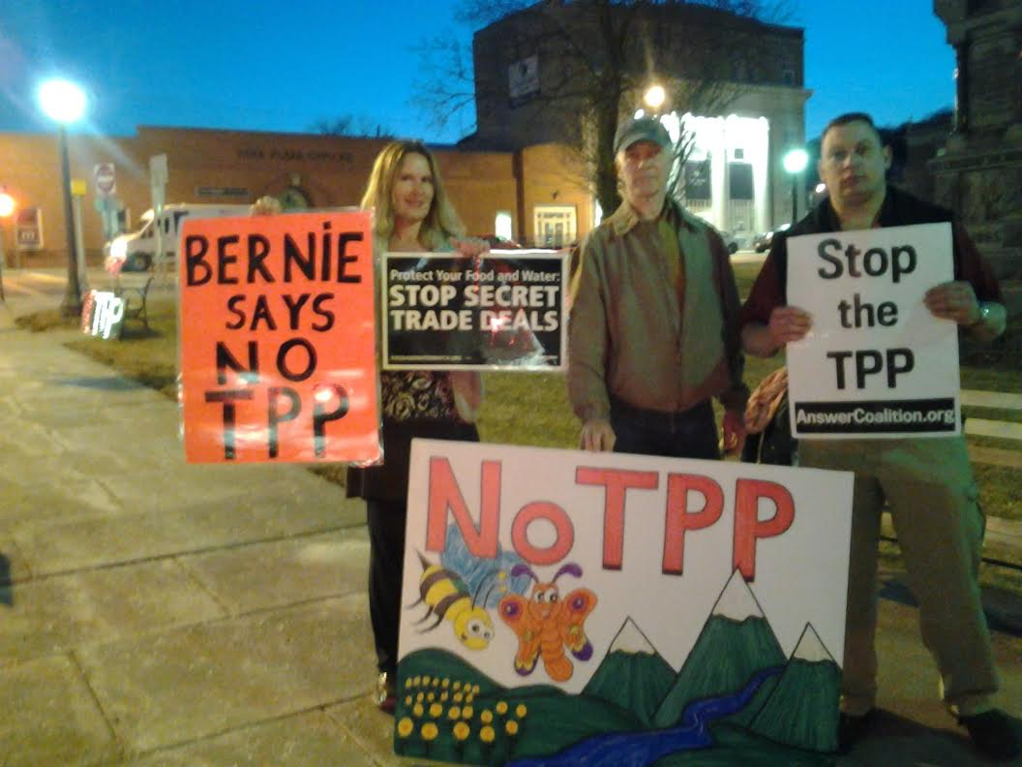

Slide 32
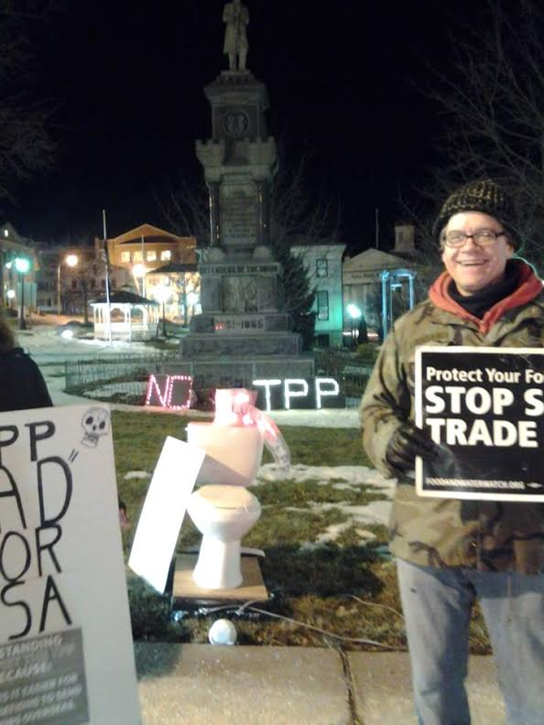
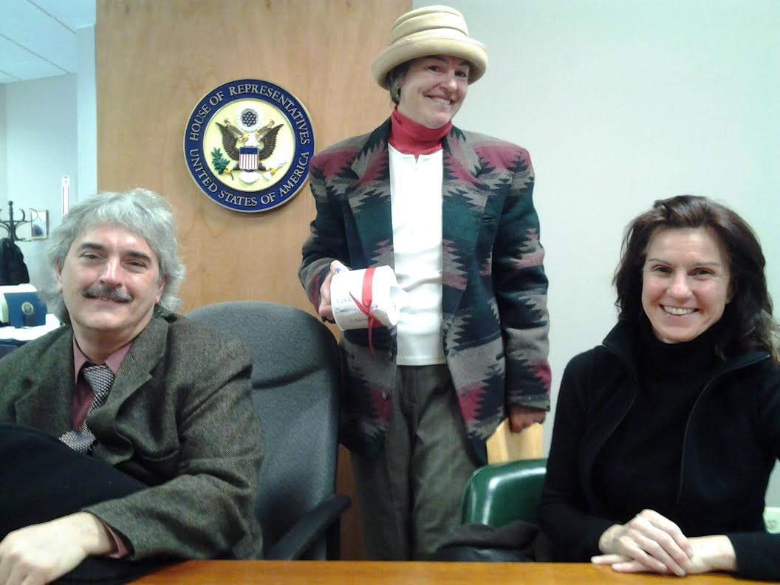

Slide 33
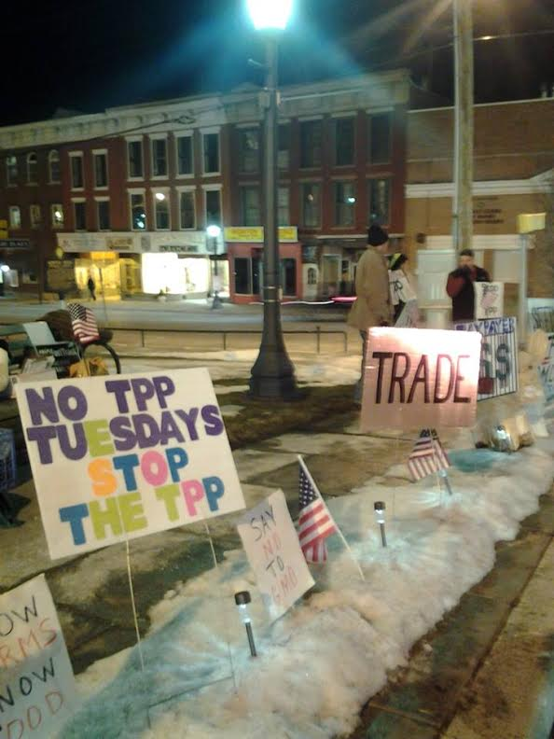
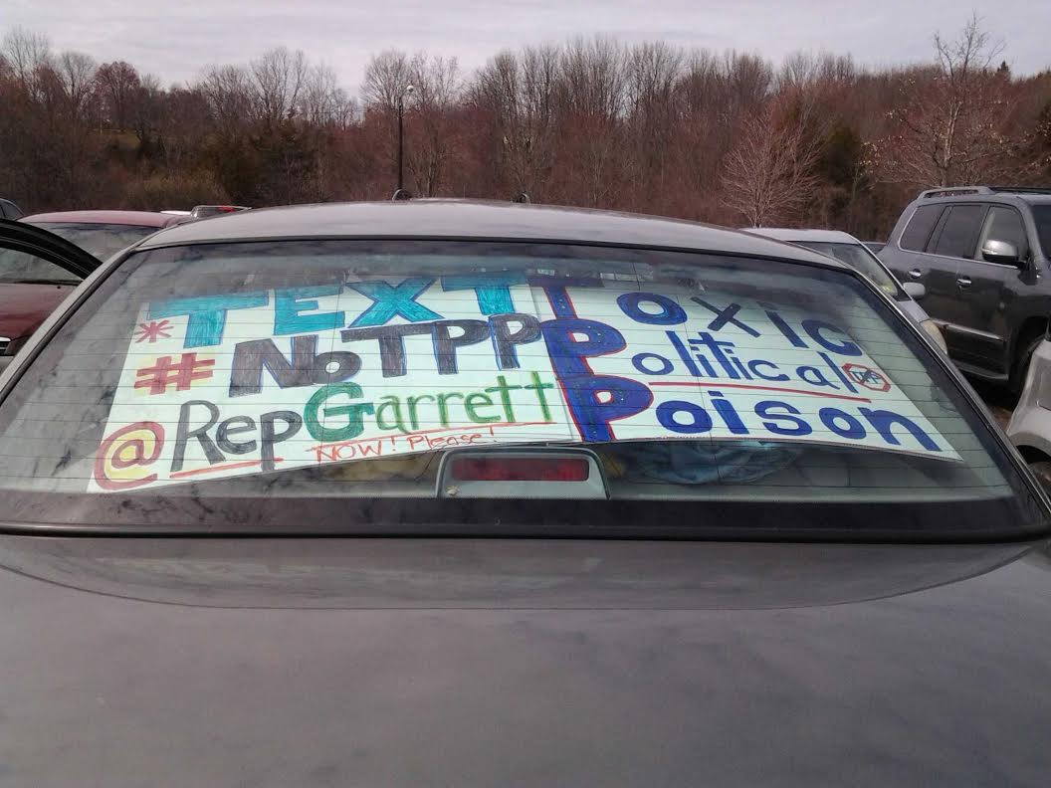

Slide 34

Call Planning Team
Harriet Heywood
harrietheywood@gmail.com
Call Co-Organizer
Florida State Leader –
People Demanding Action
TPP Free Zones (Tampa)

Slide 35
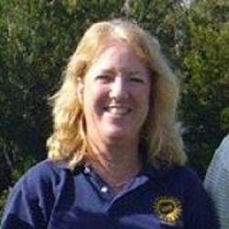
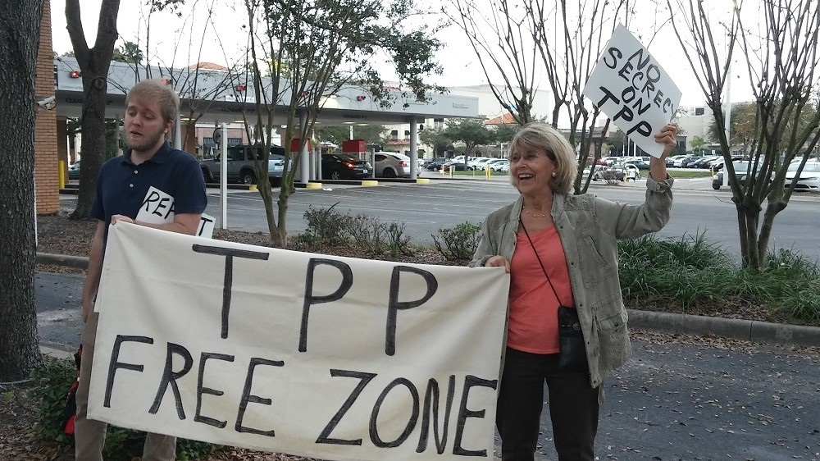
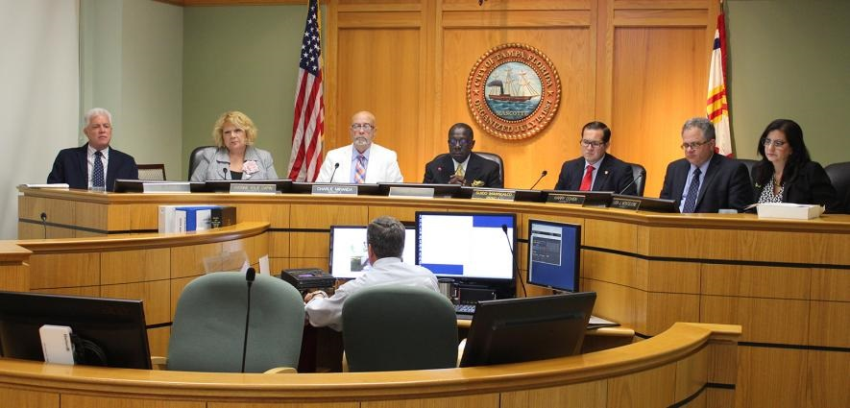
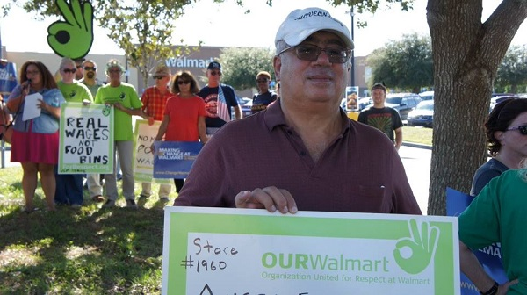
BE IT RESOLVED BY THE CITY COUNCIL
OF THE CITY OF TAMPA, FLORIDA:
Section 1. That the City Council of the City of Tampa opposes the Trans-
Pacific Partnership and urges our elected officials in the United States Senate and the
U.S. House of Representatives to reject the TPP.
Section 2. That this resolution shall take effect immediately upon its
adoption.
  PASSED AND ADOPTED BY THE CITY COUNCIL OF THE CITY OF
  TAMPA, FLORIDA, ON MARCH 17, 2016.
Cheryl Schroeder, Executive Director, West Central Florida Federation of Labor
Chris Radulich, Tampa MoveOn Council Organizer
Tampa City Council

Slide 36
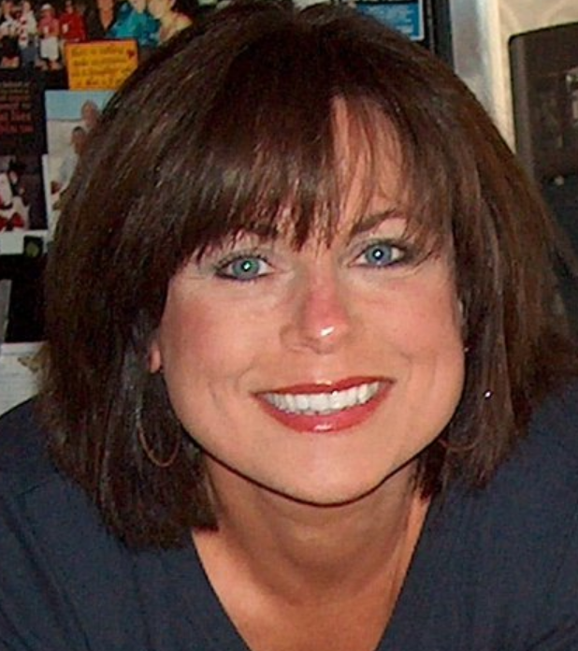
Upcoming Call
Elizabeth Warren, Communication and Outreach Director – People Demanding Action
liz@peopledemandingaction.org
April 3rd Call
Why TPP Is a Feminist Issue w/ Terry O'Neill (President, National Organization for Women)

Slide 37

Activist Q&A

