Slide 1
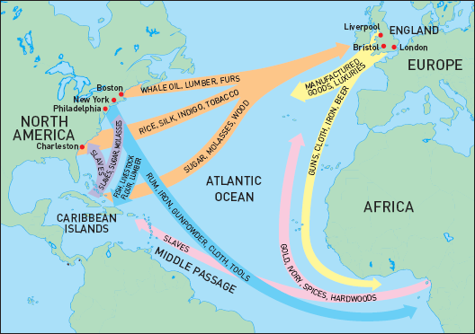
NATIONAL TPP TEAM SPECIAL REPORT
RESISTING TRANSATLANTIC CORPORATE TRADE:
TTIP under fire in Miami; negotiators dumbfounded
October 25, 2015, 7:30 p.m. ET
Phone in: 605-562-3140 Access Code: 951146#
With Guest Speakers:
William Waren, Friends of the Earth
Celeste Drake, AFL-CIO
Emilianne Slaydon, TPP Media March
Adam Weissman, TradeJustice
Harriet Heywood, MoveOn
Mackenzie McDonald Wilkins, Popular Resistance

Slide 2
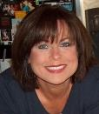

INTRODUCTION AND WELCOME
Elizabeth Warren, Communications Director
People Demanding Action tpp@peopledemandingaction.org
Call Structure and Norms:
All calls are recorded; a link and optional playback number are available after the call
Q & A mode: To eliminate background noise we mute everyone when we begin recording.
Press *6 (when prompted) to ask a question; say your name, your organization, if any, and location. Be courteous and brief; give others a chance to ask questions too.
Host Team and Speaker Introductions

Slide 3


TECHNICAL STUFF
Andrea Miller, Executive Director
People Demanding Action tpp@peopledemandingaction.org
DIAL IN: 605 562 3140 ACCESS CODE: 951146#
Meeting Room Functions
- Chat
- Share
Use the Share button in the Meeting Room:
After the call, click the unique link below to download this week's PowerPoint, recording link and other materials: http://www.peopledemandingaction.org/downloads/tpp/tpp-october-25th-call-materials

Slide 4

CALL HOST TEAM
Tom Hocking, Technical Advisor
MoveOn Regional Organizer, PA
TWHocking@Gmail.com
Facebook:
https://www.facebook.com/groups/GlobalTPPTeam
*Pre/Post Call Technical Questions
*Global TPP Team Facebook Page Manager

Slide 5

CALL HOST TEAM
Liz Amsden, MoveOn Council Organizer
Los Angeles, CA
LizAmsden@Hotmail.com
*Research/Notes/Resource Vetting

Slide 6
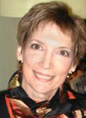
CALL HOST TEAM
Jan Swartzendruber
JanInKansas2@Gmail.com
*National Team Co-Organizer
*Campaign Updates/ Call Notes
*MoveOn Regional Organizer (KS)

Slide 7

CHAT HOST/CALL PLANNING TEAM
Mara Cohen
Marajai51@Gmail.com
*Chat Host
*PDA Mass Criminalization Team Leader
*Global Climate Convergence Leader (IL)

Slide 8

CHAT HOST/CALL PLANNING TEAM
Lisa Oldendorp
MoveOn Regional Organizer, NY eslsk8r@optonline.net
*Chat Host
*Call Planning Team

Slide 9

CALL PLANNING TEAM
Linda Brewster
LindaJBrewster@msn.com
*Call Planning
*Information and event sharing
*MoveOn Regional Organizer (WA)

Slide 10
ACTION REPORTBACKS:
Share your October and November action reports, photos and videos with fellow activists everywhere! Send your details and photos to: LindaJBrewster@msn.com

Slide 11
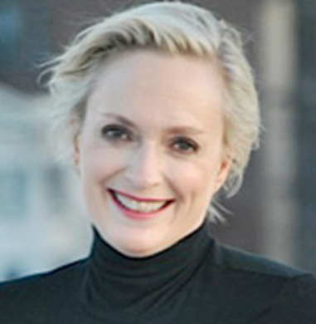
CALL PLANNING TEAM
Emilianne Slaydon
Director, Social Media @TPP Media March
TPP Tuesday Twitter Storm
6 p.m. PST / 9 p.m. EST
TPP/TTIP Tuesday Tweets:
http://www.tiny.cc/TPPMediaMarch

Slide 12


Slide 13

CALL PLANNING TEAM
Harriet Heywood
MoveOn Regional Organizer (FL)
*Call Co-Organizer
*Research and campaign status updates
*Reports from the field
This week: Pushing back in Miami
TTIP actions and press conference
harrietheywood@gmail.com

Slide 14
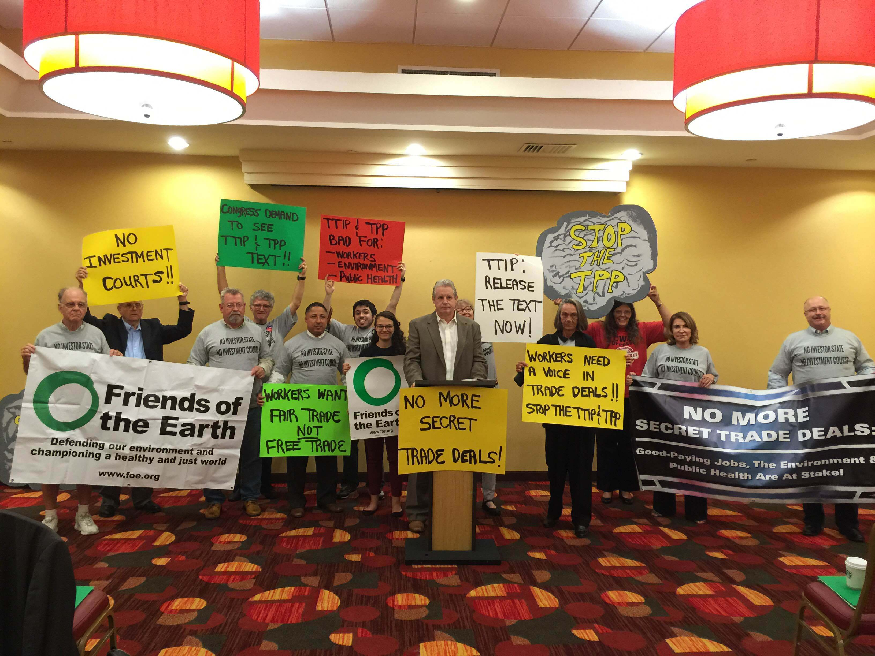
No More Secret Trade Deals Miami TTIP Press Conference

Slide 15
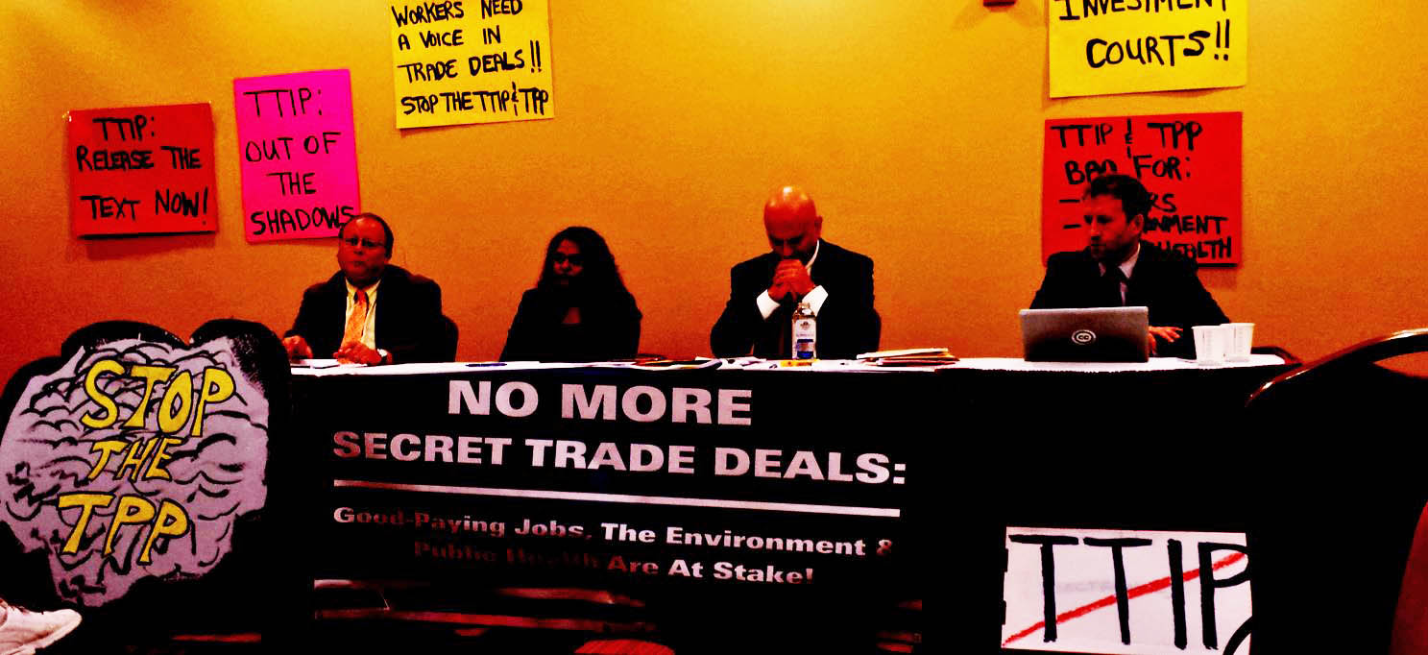
Miami TTIP Forum
Timothy Canova, Professor of Law & Public Finance, NOVA Southeastern
Cyra Choudhury, Professor and International Human Rights Scholar, Florida International University (FIU)
Joel Mintz, Professor of Law, NOVA Southeastern University
Peter Maybarduk, Director of Public Citizen Global Access to Medicines Program.

Slide 16
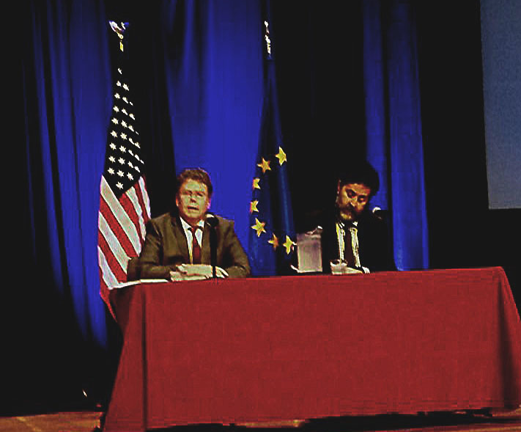
Chief Negotiators “don't understand massive EU opposition to TTIP”

Slide 17
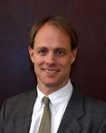

Michael Stumo, Chief Executive Officer
Coalition for a Prosperous America
A conservative perspective:
Exploring the possible impact of Paul Ryan becoming House Speaker, on the future of TPP, TTIP,
TISA and future "free trade" deals.
Q & A with Michael – press *6 on your phone when prompted, to enter the queue.
http://www.prosperousamerica.org

Slide 18


CALL PLANNING TEAM
Celeste Drake, Trade and Globalization
Policy Specialist, AFL-CIO
CDrake@AFLCIO.org
*The inside scoop: TPP, TTIP and beyond
*Legislative Actions/Updates
*Q & A with Celeste – Press *6 to enter the question queue

Slide 19
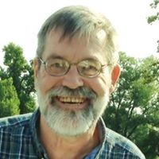

SPECIAL GUEST:
William Waren, Trade Policy Analyst
Friends of the Earth wwaren@foe.org
*TTIP: An assault on the planet
*What's at stake with TTIP, TPP, and other "free trade" deals
*Q & A with Bill: when prompted, press *6 on your phone to enter the queue www.foe.org

Slide 20
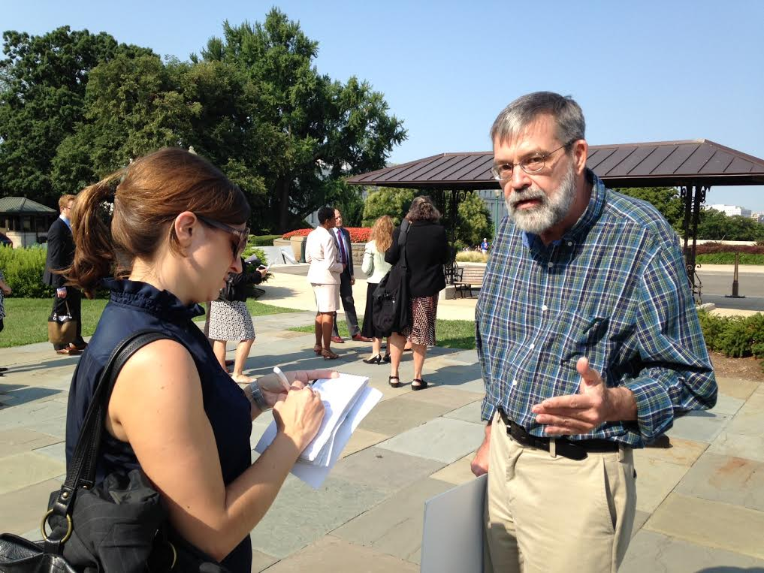

Slide 21
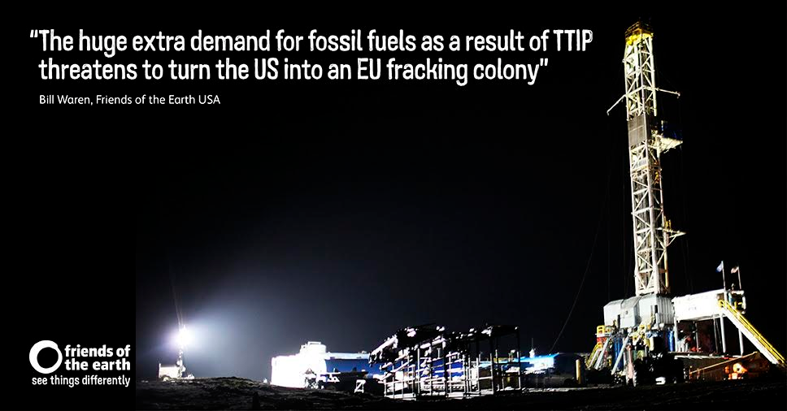

Slide 22
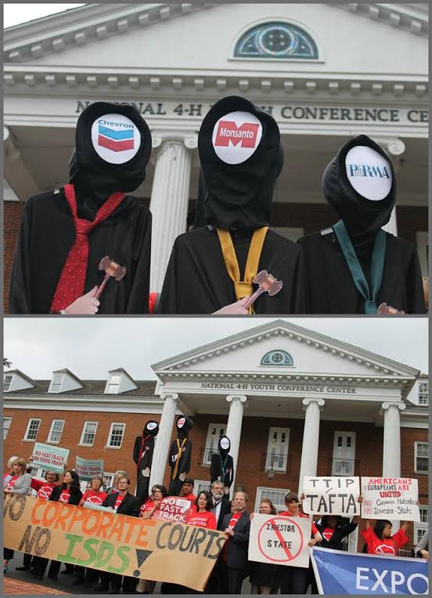
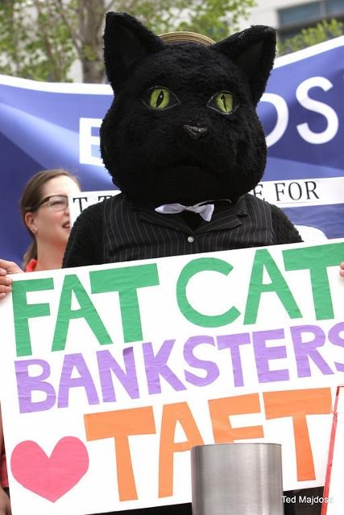

Slide 23


Slide 24


CALL PLANNING TEAM
Adam Weissman, TradeJustice
Global Justice for Animals and the Environment adam@tradejustice.net www.tradejustice.net
*Call Planning Team
*Speaker Recruitment
*Events and actions: reports and previews
Upcoming Events: http://tradejustice.net/events

Slide 25
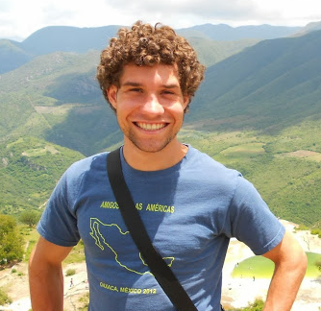
CALL PLANNING TEAM
Mackenzie McDonald Wilkins, Climate and Trade Justice Activist
Popular Resistance/Flush the TPP
Mackenzie@PopularResistance.org
Coming Up November 14-18:
D.C. days of action www.popularresistance.org www.flushthetpp.org

Slide 26
THANKS AND WRAP-UP
Stay up to date on trade and take action!
Sign up to get call announcements, post-call mailings, organizing news, information and action alerts.
Send your request to: TPP@PeopleDemandingAction.org

