Slide 1
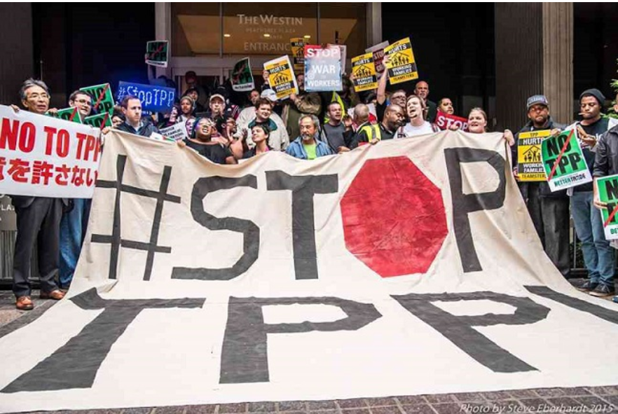
TPP Kills: Especially in an Election Year
Phone: 605-562-3140
PIN: 951146#
Speakers
SPECIAL GUEST: Lori Wallach, Director, Public Citizen
Zehara Heckscher, Atlanta Protester
Debra Dion, Citizens Trade Campaign (FL)
Mackenzie McDonald Wilkins, Flush the TPP

Slide 2
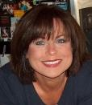

Introduction and Welcome
Elizabeth Warren
Director of Communications
People Demanding Action
tpp@peopledemandingaction.org
Call Structure and Norms
Host Team and Speakers

Slide 3


Technical Stuff
Andrea Miller
Executive Director
PDAction
DIAL IN: 605 562 3140
PIN: 951146#
Meeting Room Functions
- Chat
- Share
DOWNLOAD THE POWERPOINT:
www.peopledemandingaction.org/
downloads/tpp
Use the Share button in the Meeting Room

Slide 4

CALL HOST TEAM
Tom Hocking
Technical Advisor
Call Planning Team
MoveOn Regional Organizer (PA)
Pre/Post Call Technical Questions
Global TPP Team Facebook Page Manager
Facebook
https://www.facebook.com/groups/GlobalTPPTeam

Slide 5

Planning Notes
Liz Amsden
lizamsden@Hotmail.com
Call Planning Team
Call Reports/Notes/ Resource Vetting
MoveOn Regional Organizer (CA)

Slide 6
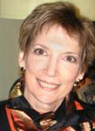
Planning/Notes
Jan Schwartengruber
janinkansas2@gmail.com
National Team Co-Organizer
Campaign Updates/ Call Notes
MoveOn Regional Organizer (KS)

Slide 7

Chat Hosts
Mara Cohen
marajai51@gmail.com
Chat Host
PDA Mass Criminalization
Team Leader
Global Climate Convergence Leader (IL)

Slide 8

Chat Hosts
Lisa Oldendorp
eslsk8r@optonline.net
Chat Host
MoveOn Regional Organizer (NY)

Slide 9

Call Planning Team
Linda Brewster
lindabrewster@msn.com
Call Planning Team
MoveOn Regional Organizer (WA)

Slide 10

Call Planning Team
Celeste Drake
Cdrake@aflcio.org
Call Planning Team
Trade and Globalization Policy Specialist, AFL-CIO
Legislative Actions/Updates

Slide 11
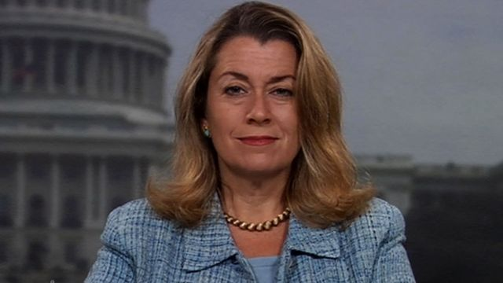

Special Guest: Lori Wallach, Director Public Citizen Global Trade Watch
- Where are we now?
- What's next for TPP?
- What you can do
- Q &A with Lori
Lori Wallach is an attorney and recognized authority on global trade. She has been interviewed on national news programs and testified countless times before Congress on the negative effects of free trade agreements.
http://www.tradewatch.org
http://www.exposethetpp.org
www.facebook.com/GlobalTradeWatch
http://www.EyesOnTrade.org

Slide 12
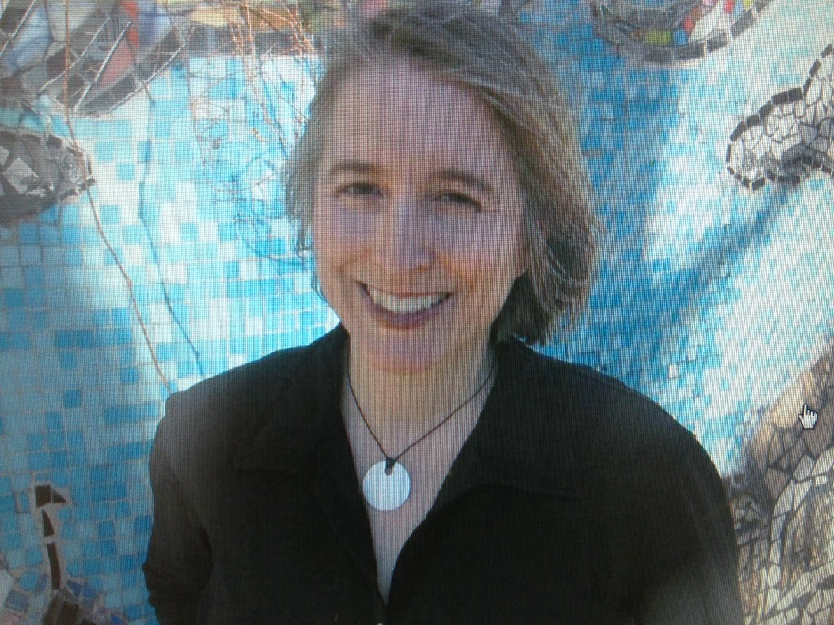
Zahara Heckscher
Zahara Heckscher is a contributing editor and columnist on volunteering abroad at Transitions Abroad. Her articles have been published in Community Jobs magazine and in the book Global Backlash: Citizen Initiatives for a Just World Economy. Heckscher resides in Washington, D.C., where she completed her M.A. in International Development at American University.

Slide 13
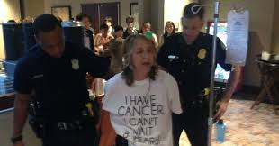
Not a Random Protest But a Strategic Action
Zahara Heckscher, Mom, wife, writer, educator, breast cancer patient… and now anti-TPP “death sentence clause” advocate.
Zehara was arrested in Atlanta, protesting the TPP “Death Sentence Clause” during the concluding TPP ministerial.
She also manages a webpage, #TPPkills.org

Slide 14


What Motivates Me:
7 Year Cancer Survivor/Cancer Thriver
Thriving thanks to access to cancer medicines
Old School Meds: 5FU chemo
Biologics (Herceptin, Xgeva, Perjeta)
Clinical trial emerging (Pablocyclib)
Hormone therapy (Tamoxofen, Ais, Faslodex)
Want everyone with cancer to be able to be a Cancer Thriver
I know what it is like to lose a mother to cancer. Don’t want other kids to suffer this loss.

Slide 15
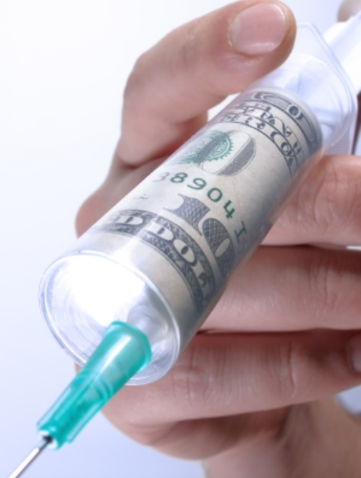
Death Sentence Clause of TPP
TPP Intellectual Property (IP) Section
Biologics (from living tissue, includes monoclonal anti-bodies)
Will lock in monopolies for 5-8 years
Prevents generics and bio-simulars
Effects are deadly
  Mexico, Peru, Vietnam, further reduce access for most
  Australia and New Zealand, health systems cannot afford
  In US, may lock in high prices, and mostly hurt women with no insurance or high deductibles, also increase taxes
Other clauses (Non-Biologics) Also Life or Death Issue
Could say “Death Sentence Clauses”

Slide 16
Lessons
“Individual” vs millions vs organization
Simplify
Power of Personal Story
Strategic Planning and Coordination
Flexibility
Media and Social Media
Props/Visuals
People care and
are touched by this issue

Slide 17

Involve cancer patients and our friends and families
We have most to lose (and gain)
Solidarity, Self Interest, Legitimacy
Creative actions, Op Eds, Congressional Meetings
Engage local survivors and groups (but know that some take funds from Pharma)
Clear message: Not Anti-Research or Anti-Innovation
Need for clear fact sheets on complex issue
“NO TPP, NO DEATH SENTENCE CLAUSE”

Slide 18

Q & A
with
Zahara Heckscher

Slide 19

Call Planning Team
Harriet Heywood
harrietheywood@gmail.com
Call Co-Organizer
MoveOn Regional Organizer
(FL)
Update on the Miami TTIP Campaign

Slide 20
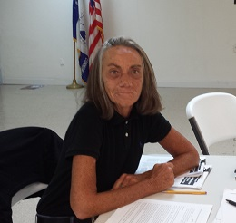
Debra Dion
Florida State Director, Citizen’s Trade Campaign, Veteran
(20 year) AFL-CIO Federal, state and local issues organizer. Instrumental in organizing the 2003 Miami FTAA and strategic organizer around WTO and CAFTA

Slide 21


Call Planning Team
Adam Weissman
adam@tradejustice.net
www.tradejustice.net
Call Planning Team
Trade Justice/Global Justice
for Animals and the
Environment
Upcoming Events: http://tradejustice.net/events

Slide 22

Tuesday Twitter Storm
Storm with us on Tuesday @ 9pm: tiny.cc/TPPMediaMarch

Slide 23
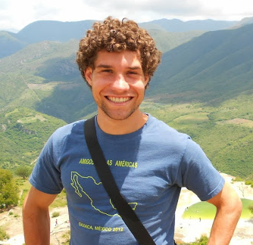
Call planning team
Mackenzie McDonald Wilkins
Mackenzie@popularresistance.org
Climate and Trade Justice Activist
Popular Resistance
Flush the TPP
www.popularresistance.org
www.flushthetpp.org

Slide 24
Actions Around the World to End Corporate Rule
October 10-17 International Week of Action:
Website: Trade4People.org
US events: People's Climate Movement on October 14th
Wednesday National Organizing Calls 9PM Eastern October 14
#FoodJustice March on October 16-17
TTIP Meetings in Miami: Resolution was passed! October 19-23

Slide 25
Actions Around the World to End Corporate Rule
November 14-18 National Mobilization to Stop TPP, TTIP, & TiSA
Website: FlushtheTPP.org/actions/
During APEC Meetings in Philippines/before Congressional Recess
Nov 14-15: Action Camp/trainings/discussions Nov 16-18: Days of Action
Logistics: Housing, transport, food, legal, lobbying, etc.

Slide 26
Thanks and wrap-up
Questions: TPP@PeopleDemandingAction.Org

