Slide 1
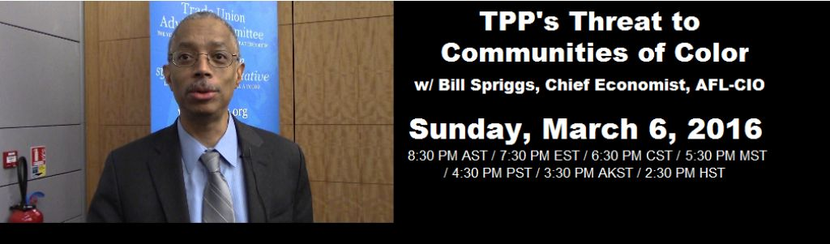
For Audio use phone or Skype
Call: 605-562-3140
PIN: 951146#

Slide 2
Speakers
Bill Spriggs, AFL-CIO Chair of the Economic Policy Working Group for the Trade Union Advisory Committee to the Organization for Economic Cooperation and Development; Board Member National Bureau of Economic Research.
Guillermo Perez, Board Member for the Labor Council for Latin American Advancement (LCLAA), labor educator with the Education and Membership Department of the United Steelworkers.
Dr. Margaret Flowers, Co-Director Popular Resistance,
Co-Organizer Flush the TPP
Adam Weissman, Global Justice for Animals and the Environment/ TradeJustice New York/

Slide 3


Introduction and Welcome
Andrea Miller, Executive Director
People Demanding Action
andrea@peopledemandingaction.org
Call Structure and Norms:
Audio is PHONE ONLY; you must call in
Do not enable your video camera
All calls are recorded; a link is available after the call
Q & A mode: To eliminate background noise we mute everyone when we begin recording.
Press *6 (when prompted) to ask a question; say your name, your organization, if any, and location. Be courteous and brief; give others a chance to ask questions too.
Keep chat room discussions on topic and professional

Slide 4


Technical Information
Audio is available only via phone
DIAL IN: 605 562 3140 ACCESS CODE: 951146#
Meeting Room Functions
- Chat
- Share
Use the Share button in the Meeting Room:
After the call, click the unique link below to download this week's PowerPoint, recording link and other materials: http://www.peopledemandingaction.org/downloads/tpp/tpp-march-6-2016-call-materials

Slide 5

Technical Advisor/Facebook Page Manager
Tom Hocking, Technical Advisor
MoveOn, PA
TWHocking@Gmail.com
*Pre/Post Call Technical Questions
*Global TPP Team Facebook Page Manager
Facebook:
https://www.facebook.com/groups/GlobalTPPTeam

Slide 6

Chat Host/Call Planning Team
Lisa Oldendorp
MoveOn, New York
eslsk8r@optonline.net
*Chat Host
*Call Planning Team

Slide 7

Call Planning Team
Harriet Heywood
harrietheywood@gmail.com
Call Co-Organizer
Florida State Leader –
People Demanding Action

Slide 8


Call Planning Team
Celeste Drake
Trade and Globalization Policy Specialist,
AFL-CIO
Cdrake@AFLCIO.org

Slide 9

Call Planning Team
Linda Brewster
LindaJBrewster@msn.com
*Call Planning
*Information and event sharing
*MoveOn Organizer (WA)

Slide 10


Call Planning Team
Mara Cohen
Marajai51@Gmail.com
*PDA Mass Criminalization Team Leader
*Popular Resistance Organizer
*Global Climate Convergence Leader (IL)

Slide 11

Emilianne Slaydon
Director, Social Media
@TPPMediaMarch
Twitter.com/TPPMediaMarch
Every #TPPTuesday
6pm PT | 9pm ET
Tweets:
tiny.cc/TPPMediaMarch

Slide 12

Go to:
Twitter.com/TPPMediaMarch htttp://tiny.cc/TPPMediaMarch

Slide 13
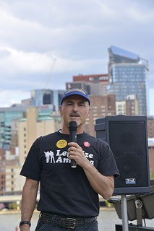
Guillermo Perez
Guillermo Perez is a Board Member for the Labor Council for Latin American Advancement (LCLAA) and works as a labor educator with the Education and Membership Department of the United Steelworkers.
Before joining the USW as a labor educator in January of 2011, Guillermo worked as a labor education specialist with the Civil Service Employees Association, AFSCME Local 1000, based in Albany, New York. He has worked as a trainer/recruiter with the AFL-CIO’s Organizing Institute and an organizer with the Service Employees International Union (SEIU).
Guillermo holds a Juris Doctor (JD) from the Illinois Institute of Technology, a Master’s in Communication from the University of Michigan, and a Bachelor’s in English Literature from the University of Chicago. He currently serves on the national executive boards of LCLAA and the United Association for Labor Education (UALE). He is also the president of the Pittsburgh chapter of LCLAA and the Co-chair of the Civil and Human Rights Committee of USW Local 3657.

Slide 14
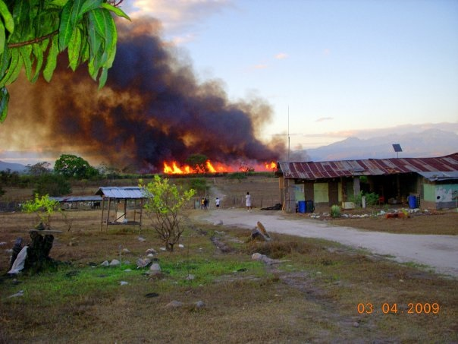
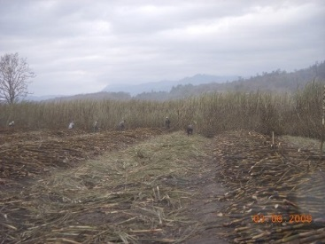
DRIVING A RACE TO THE BOTTOM
Our trade policy has been horrific for working people in the U.S. and workers in the countries that are parties to these agreements, as evidenced by NAFTA and CAFTA

Slide 15
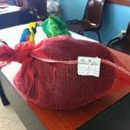
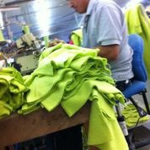
TPP threatens to be more of the same, except worse in the sense that it will drive manufacturing work from Mexico and Central America to places like Vietnam, extending the race to the bottom

Slide 16
Here in the U.S. TPP will result in the further deterioration of our manufacturing sector, a sector vital to having a successful industrialized economy
Increasing our trade deficits, exacerbating wealth and income inequality
Poorly-paying service sector jobs become all that’s available to most working families and African American and Latino working families suffer the most.

Slide 17
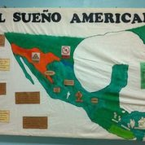
El Sueño Americano
TPP will contribute further to the violence, poverty, and exploitation that’s driving unauthorized immigration from Mexico and Central America to the U.S.

Slide 18
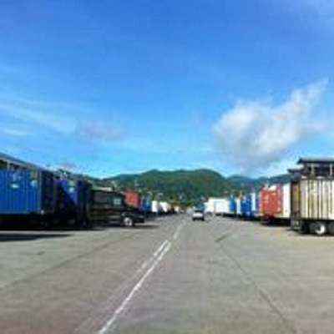
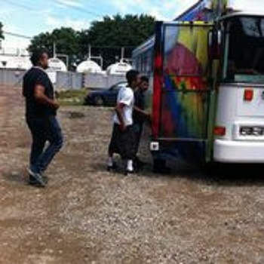

Slide 19
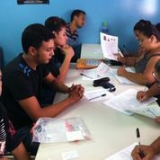


Slide 20
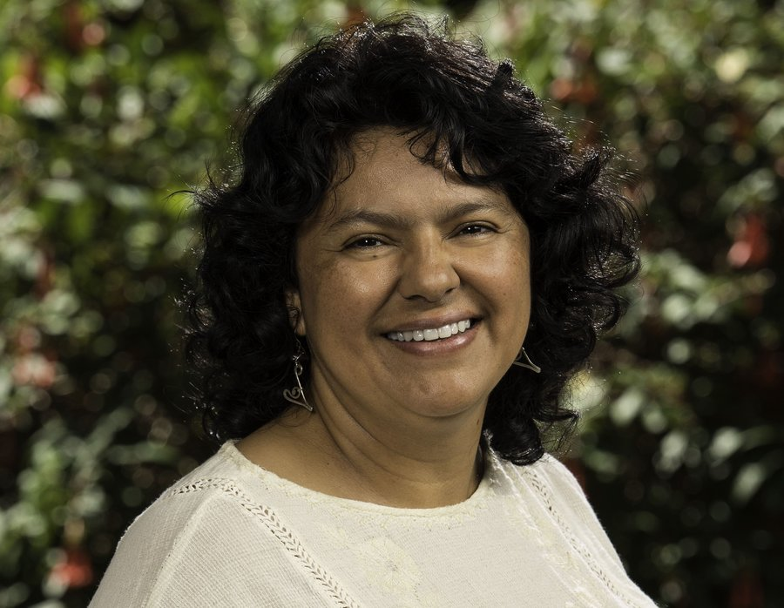
Berta Cáceres, Honduran Indigenous Rights Leader, Is Murdered in Her Bed March 3.
Berta Cáceres, a hugely influential Honduran indigenous rights activist, was killed in her hometown of La Esperenza, Intibucá, on Thursday. She would have turned 46 tomorrow.
Cáceres was awarded the Goldman Environmental Prize after she led a peaceful campaign to stop one of the world's largest dam builders from pursuing the Agua Zarca Dam, which would have cut off the ethnic Lenca people from water, food and medicine.
La Prensa of Honduras reports that Cáceres was currently working to stop a company from building a hydroelectric dam on the Gualcarque river, which the Rio Blanco community said would fundamentally change their way of life. Authorities, the paper reports, said she was killed during a robbery, but her mother said that Cáceres was killed "because of her struggle."
Berta Cáceres
4 March 1973 – 3 March 2016

Slide 21
Guillermo Perez – Q&A

Slide 22
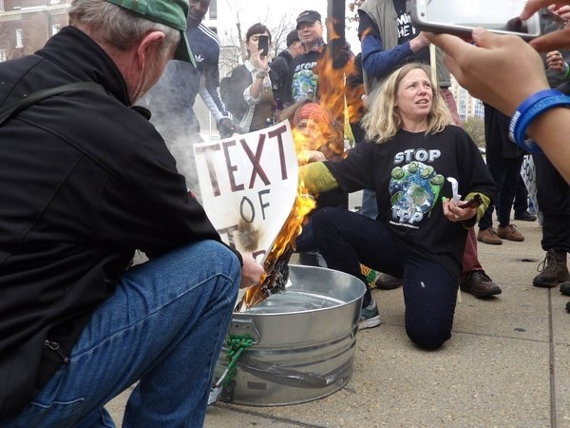
DR. MARGARET FLOWERS
Dr. Margaret Flowers is a pediatrician and co-chair of the Maryland chapter of Physicians for a National Health Program (PNHP). Margaret is also Co-Director of PopularResistance.org and It's Our Economy, Co-Organizer of Flush the TPP (flushthetpp.org).
Its Our Economy (www.itsoureconomy.US)
Popular Resistance (www.popularresistance.org
Democratize the Media / Forces of Greed
Radio: http://www.ClearingtheFOGRadio.org
TPP Campaigns: www.flushthetpp.org

Slide 23
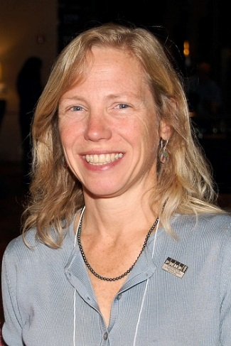
Dr. Margaret Flowers – Q&A

Slide 24
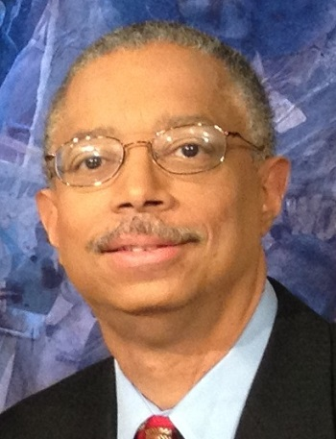
William Spriggs is a professor in, and former Chair of, the Department of Economics at Howard University and serves as Chief Economist to the AFL-CIO. In his role with the AFL-CIO he chairs the Economic Policy Working Group for the Trade Union Advisory Committee to the Organization for Economic Cooperation and Development, and serves on the board of the National Bureau of Economic Research.
From 2009 to 2012, Bill served as Assistant Secretary for the Office of Policy at the United States Department of Labor, having been appointed by President Obama, and confirmed by the U.S. Senate. He also served as chairman of the Healthcare Trust for UAW Retirees of the Ford Motor Company, and vice chair of the Congressional Black Caucus Political Education and Leadership Institute.
A few of Bill’s previously held positions include leading roles in economic policy development and research as a Senior Fellow and Economist at the Economic Policy Institute; as Executive Director for the Institute for Opportunity and Equality of the National Urban League; and as an Economist for the Democratic Staff of the Joint Economic Committee of Congress; and is former president of the National Economics Association, the organization of America’s professional Black economists, among many other positions.
Bill graduated from Williams College in Massachusetts, and holds a doctorate in economics from the University of Wisconsin-Madison. He also taught six years at Norfolk State University and for two years at North Carolina A & T State University.
WILLIAM SPRIGGS

Slide 25
The key metropolitan areas most impacted by Chinese imports, and so susceptible to impact from diversion through TPP are heavily Latino communities: Los Angeles, San Jose, San Diego.
Two of the top 15 impacted areas are places with an important share of Black manufacturing workers: Milwaukee and Chicago

Slide 26
Because of higher rates of unemployment, African Americans are the least likely to switch jobs, and so tend to have the longest tenure with their employers.
This can make them vulnerable at times of displacement.
Displacement for Black workers results in greater income loss and greater duration of unemployment than for any other group.

Slide 27
It isn't always necessary to project disparate impacts for Black or Latino workers.
It is necessary if the outcome of the policy is positive, since often it is positive for some workers and bad for others--the others most often being Black workers.
But, if the outcome is bad for workers, generally, it is impossible to imagine how it would be good for Black or Latino workers.

Slide 28
Bill Spriggs – Q&A

Slide 29


Call Planning Team
Adam Weissman
Global Justice for Animals and the Environment
TradeJustice
www.TRADEJUSTICE.NET
*Call Planning Team
*Speaker Recruitment
*Events, news stories and actions
http://tradejustice.net/events
http://www.tradejustice.net/news
adam@tradejustice.net

Slide 30
News
TTIP: US yet to approve EU investor court plan (EU Observer, 2/28/16)
Trans-Pacific Partnership, currency manipulation, trade, and jobs: U.S. trade deficit with the TPP countries cost 2 million jobs in 2015, with job losses in every state (Economic Policy Institute, 3/3/16)
Brexit better for Britain than toxic TTIP, says Joseph Stiglitz Published time (RT, 3/3/16)
Services Trade in Focus as TISA, TTIP, RCEP Aim for 2016 Conclusion (ICTSD Bridges, 3/3/16)
After WTO Battle, USDA Issues Final Rule Lifting Pork and Beef COOL Requirements (JDSupra Business Advisor, 3/3/16)
Former senior advisers to the White House Office of Science and Technology Policy: Last chance for a pro-transparency trade legacy for Obama (The Hill, 3/4/16)
isds.bilaterals.org: New ISDS Resource Website for Activists

Slide 31

Get Involved in Planning and Promoting Our Webinars!
Email adam@tradejustice.net. Indicate if you'd like to join our Call Planning Team, Call Outreach/Promotion Team, or both, and what days and times you are available for phone conferences on a weekly basis.

Slide 32

Next Call – March 16th

Slide 33
Upcoming Calls
TPP, Big AG and Meat=Climate Chaos– March 20th
Women’s Issues and the TPP – April 3rd
Privatization of Water – April 17th
International Labor Rights – May 1st

