Slide 1

Will NAFTA Destroy the KXL Victory?
For Audio use phone or Skype
Call: 605-562-3140
PIN: 951146#
Powerpoint available now at http://www.peopledemandingaction.org/downloads/tpp/tpp-january-31-2016-call-materials

Slide 2
Speakers
Bill McKibben, 350.org
Ilana Solomon, Sierra Club
Nancy Price, Alliance for Democracy
Emilianne Slaydon, TPP Media March
Dr. Margaret Flowers, Popular Resistance/Flush the TPP
Adam Weissman, Trade Justice/
Global Justice for Animals & the Environment
Harriet Heywood, People Demanding Action, Florida

Slide 3


INTRODUCTION AND WELCOME
Andrea Miller, Executive Director
People Demanding Action
andrea@peopledemandingaction.org
Call Structure and Norms:
Audio is PHONE ONLY; you must call in
Do not enable your video camera
All calls are recorded; a link is available after the call
Q & A mode: To eliminate background noise we mute everyone when we begin recording.
Press *6 (when prompted) to ask a question; say your name, your organization, if any, and location. Be courteous and brief; give others a chance to ask questions too.
Keep chat room discussions on topic and professional

Slide 4


Technical Information
Audio is available only via phone
DIAL IN: 605 562 3140 ACCESS CODE: 951146#
Meeting Room Functions
- Chat
- Share
Use the Share button in the Meeting Room:
After the call, click the unique link below to download this week's PowerPoint, recording link and other materials: http://www.peopledemandingaction.org/downloads/tpp/tpp-january-31-2016-call-materials

Slide 5

Technical Advisor/Facebook Page Manager
Tom Hocking, Technical Advisor
MoveOn, PA
TWHocking@Gmail.com
*Pre/Post Call Technical Questions
*Global TPP Team Facebook Page Manager
Facebook:
https://www.facebook.com/groups/GlobalTPPTeam

Slide 6

Chat Host/Call Planning Team
Lisa Oldendorp
MoveOn, New York
eslsk8r@optonline.net
*Chat Host
*Call Planning Team

Slide 7

Call Planning Team
Linda Brewster
LindaJBrewster@msn.com
*Call Planning
*Information and event sharing
*MoveOn Regional Organizer (WA)

Slide 8


Call Planning Team
Mara Cohen
Marajai51@Gmail.com
*PDA Mass Criminalization Team Leader
*Popular Resistance Organizer
*Global Climate Convergence Leader (IL)

Slide 9


Call Planning Team
Celeste Drake
Trade and Globalization Policy Specialist,
AFL-CIO
Cdrake@AFLCIO.org
*SOTU Report
*USITC TPP Hearing

Slide 10
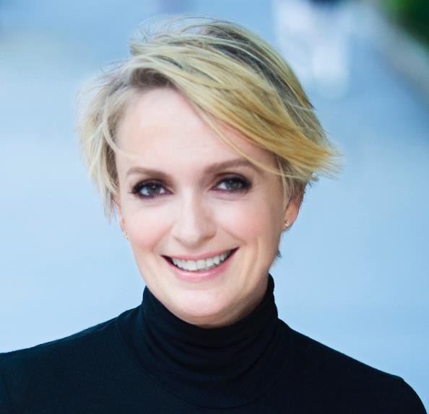
Emilianne Slaydon
Director, Social Media
@TPPMediaMarch
Twitter.com/TPPMediaMarch
Every #TPPTuesday
6pm PT | 9pm ET
Tweets:
tiny.cc/TPPMediaMarch

Slide 11
@TPPMediaMarch
Twitter STORM
The most FUN way
to raise awareness to:
#StopTPP

Slide 12
How is it fun?
We all tweet together, all at the same time!
Creating a flurry of #StopTPP action –
a Twitter STORM!

Slide 13
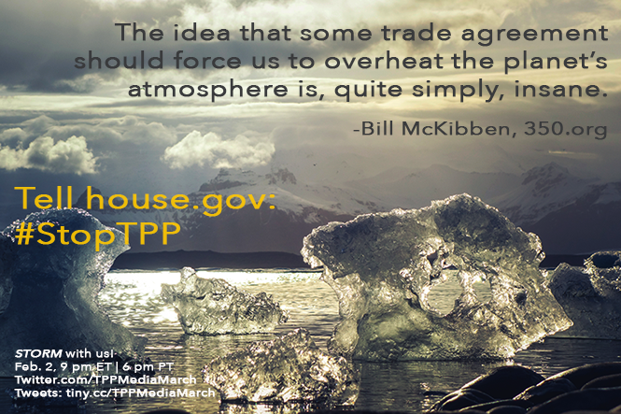
Share STORM Invite: htttp://tiny.cc/TPPMediaMarch

Slide 14
Have a social media question? em@slaydonmedia.com
“Dear Emilianne,
How do I get people to retweet (RT) me on Twitter?”
Great question!

Slide 15
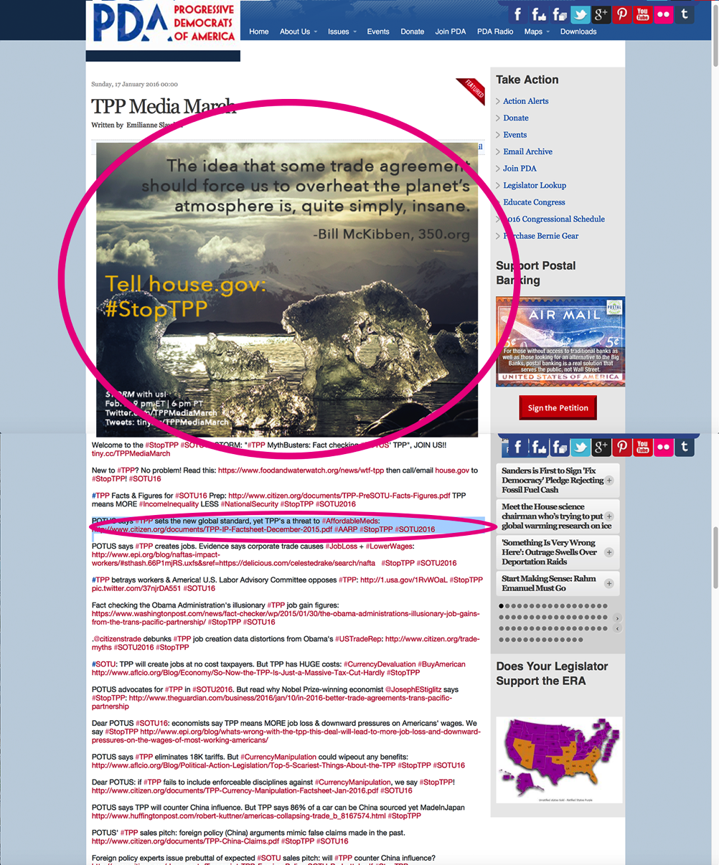
Click-n-Drag Invite to Desktop;
Post Invite on Facebook & Twitter
ON TUESDAY @
6p PT | 9p ET
Copy each tweet by highlighting it
Each tweet contains an educational link or Call-To-Action!

Slide 16

Provide VALUE in every tweet!
1) Include an image
2) Include an educational link
3) Always include #hashtags in every tweet

Slide 17
Have a social media question? em@slaydonmedia.com
“Dear Emilianne,
I don’t have a laptop. How can I participate in the Twitter Storms with an iPad?”
Great question!

Slide 18

STORM with us to: #StopTPP!

Slide 19
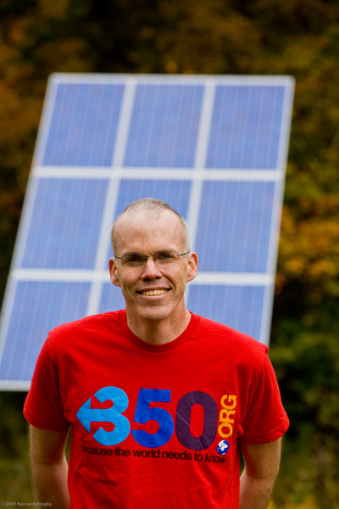
Bill McKibben
Bill McKibben is an author and environmentalist who in 2014 was awarded the Right Livelihood Prize, sometimes called the ‘alternative Nobel.’
He is a founder of 350.org, the first planet-wide, grassroots climate change movement, which has organized twenty thousand rallies around the world in every country save North Korea, spearheaded the resistance to the Keystone Pipeline, and launched the fast-growing fossil fuel divestment movement.
For more information, please visit: www.billmckibben.com

Slide 20
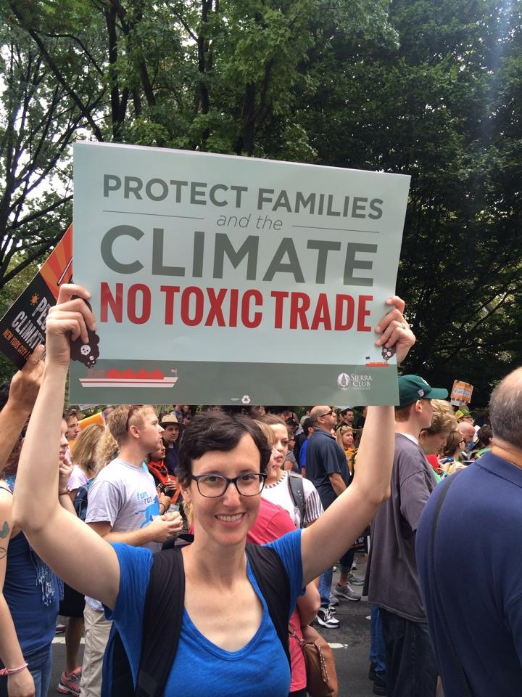
Ilana Solomon
Ilana Solomon is Director of the Sierra Club’s Responsible Trade Program
Ms. Solomon’s work centers around shedding light on the environmental threats posed by our current global trading system.
Ilana Solomon and the Sierra Club’s Responsible Trade Program work to promote broadly-shared prosperity while protecting workers and the environment, and to ensure that U.S. trade policy supports, rather than undermines, critical public interest goals, and protects the environment and climate.

Slide 21
Q&A Ilana Solomon, Emilianne Slaydon

Slide 22


Call Planning Team
Adam Weissman
TradeJustice
Global Justice for Animals and the Environment
www.TRADEJUSTICE.NET
*Call Planning Team
*Speaker Recruitment
*Events, news stories and actions
http://tradejustice.net/events
http://www.tradejustice.net/news
adam@tradejustice.net

Slide 23
News Stories
Trans-Pacific Partnership Agreement Faces a Long Road to Approval and Entry Into Force (Sidley, 10/20/16)
Government says TPPA deal won't undermine Treaty of Waitangi rights for Maori (Stuff NZ, 1/21/16)
What a Misleading Chart on U.S. Trade Looks Like (The Wall Street Journal, 1/25/16)
Trans-Pacific Trade Pact Would Lift US Incomes, but Not Jobs (The New York Times, 1/25/16)
Mulcair asks if PM often signs 'things he doesn't agree with' (Huff Post Politcs, 1/28/16)
New Zealand Police Intimidate Anti-TPP Activists in Their Homes (Telesur, 1/28/16)
Japan's 'TPP Chief' Resigns Over Corruption Scandal (The Diplomat, 1/29/16)
U.S. Will See Smallest GDP Impact From TPP, According to World Bank (Spend Matters, 1/29/16)
Bernie Sanders And Big Business Find Something They Can Actually Agree On: Neither thinks Hillary Clinton is really opposed to the TPP trade deal. (HuffPost Politics, 1/29/16)
More news stories at http://tradejustice.net/news

Slide 24
Events This Week
Thursday, February 4, 3-5 AM (yes, AM!): Richard Hoagland Interviews TradeJustice NY Metro's Adam Weissman on Other Side of Midnight Radio Program
THURSDAY, FEBRUARY 4: GLOBAL DAY OF ACTION! PROTEST TPP SIGNING IN NEW ZEALAND!!!
Location: Time: 12-1:30 PM Location: Consulate General of New Zealand, 295 Madison Ave between 40th and 41st Streets, Manhattan

Slide 25

Economic Policy Institute Event
“Trading Down: Unemployment, Inequality, and Other Risks of the Trans-Pacific Partnership Agreement.”
New Study Questions Gains from Trans-Pacific Partnership
On Feb. 2 at 9:30 am, the authors will present their findings at a public event at Economic Policy Institute, 1333 H Street NW, Suite 300, East Tower, Washington.
For further information, contact Erin Coutts, erin.coutts@tufts.edu, 617-627-6909.

Slide 26

Volunteer with the National TPP Team
Take the poll to let us know when you can attend phone meetings for our two volunteer committees
Outreach and Promotion - http://tradejustice.net/outreach131
Planning - http://tradejustice.net/planning131

Slide 27
New Resources
LAST WEEK'S WEBINAR
Webinar: TPP, TTIP, and Regulatory Cooperation: Pro-Corporate Attack on Public Interest Laws w/ Sharon Treat (National TPP Team, 1/24/16)
TPP VOTE PROCESS GUIDE
Trans-Pacific Partnership Agreement Faces a Long Road to Approval and Entry Into Force (Sidley, 10/20/16)
PAPERS
Trading Down: Unemployment, Inequality and Other Risks of the Trans-Pacific Partnership Agreement (Global Development and Environment Institute, January 2016)
New Zealand Law Foundation Expert Papers on TPP
INFOGRAPHIC
The TPP Is Not A Massive New Market for US Exports (US Business and Industry Council)

Slide 28

Scout Barbour-Evans New Zealand TPP Activist
Students for a Just World
Students Against TPP
Candidate for Office
#Scout2016

Slide 29
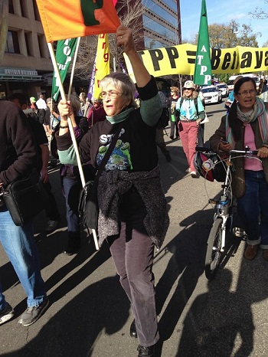
Nancy Price
Nancy Price is Co-Chair of the Alliance for Democracy and Board Member, Liberty Tree Foundation & Global Climate Convergence.
Nancy is on the Leadership Team, Earth Democracy Issue Group, for the Women's International League for Peace and Freedom, and a former Member of Move To Amend National Leadership Team.
She is also on the board of the new National Election Defense Coalition

Slide 30
NO TPP Resolution
The Alliance for Democracy, AFL-CIO,
Sierra Club and other groups are working to pass local/state resolutions. Will be announced when most opportune.
Goal of 100 resolutions; tracking 50-60
TPP-Free Zone vs. No TPP Resolution
Short list of cities/counties and resolution texts at www.tppfreezones.org
Two good examples: Richmond, CA and New York City

Slide 31
Put your city, town, county on the map with a
TPP-Free Zone Resolution
www.thealliancefordemocracy.org
www.tppfreezones.org

Slide 32

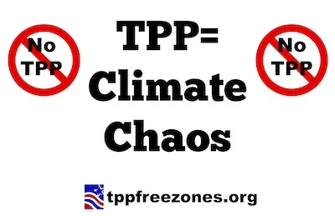
Seven Wrinkles in the Paris Climate Deal
http://www.commondreams.org/views/2015/12/15/seven-wrinkles-paris-climate-deal

Slide 33
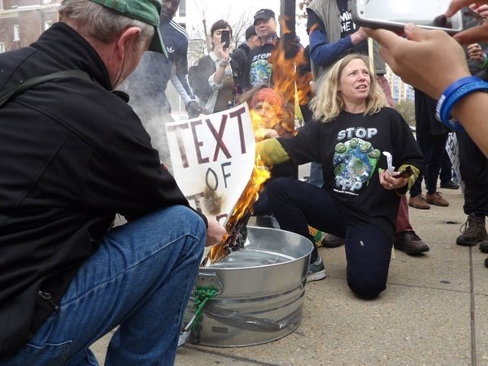
DR. MARGARET FLOWERS
Dr. Margaret Flowers is a pediatrician and co-chair of the Maryland chapter of Physicians for a National Health Program (PNHP). Margaret is also Co-Director of PopularResistance.org and It's Our Economy, Co-Organizer of Flush the TPP (flushthetpp.org).
Margaret co-organized the November #Fall Rising Days of Action in D.C.
Its Our Economy (www.itsoureconomy.US)
Popular Resistance (www.popularresistance.org
Democratize the Media / Forces of Greed
Radio: http://www.ClearingtheFOGRadio.org
TPP Campaigns: www.flushthetpp.org

Slide 34
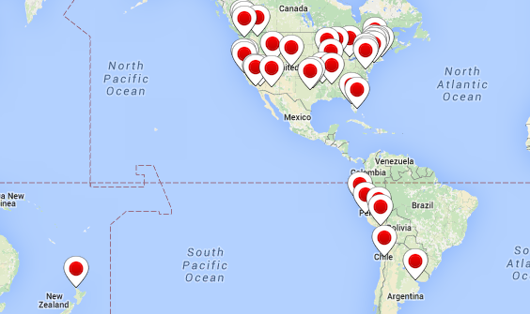
LOCAL ACTIONS IN FEBRUARY
Contact info@popularresistance.org if you are interested in organizing a local action
  Dates For Local Actions:
Feb 4- TPP Signing
Feb 14-21 President’s Day week of actions in district

Slide 35
Next TPP Resistance call Wednesday, Feb 3 at 9 pm Eastern/6 pm Pacific. Visit www.flushthetpp.org/national-tpp-resistance-calls/ for more information and to register.

Slide 36
Q&A – Nancy Price, Adam Weissman,
Dr. Margaret Flowers

Slide 37
February Letter Drops
Deliver opposition to TPP letter to Congress Members in District during recess week (February 15th through 20th)
  Download the letter
  Print the Letter
  Deliver the letter with friends and allies to Congress Member
  Report Letter delivery
Deliver TPP petitions on Capitol Hill February 3rd
Schedule your Letter Drop
https://actionnetwork.org/event_campaigns/february-letter-drop-oppose-the-tpp

Slide 38

Upcoming Call

Slide 39

Call Planning Team
Harriet Heywood
harrietheywood@gmail.com
Call Co-Organizer
Florida State Leader –
People Demanding Action
Upcoming Tampa Event

