Slide 1

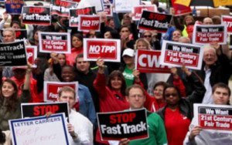
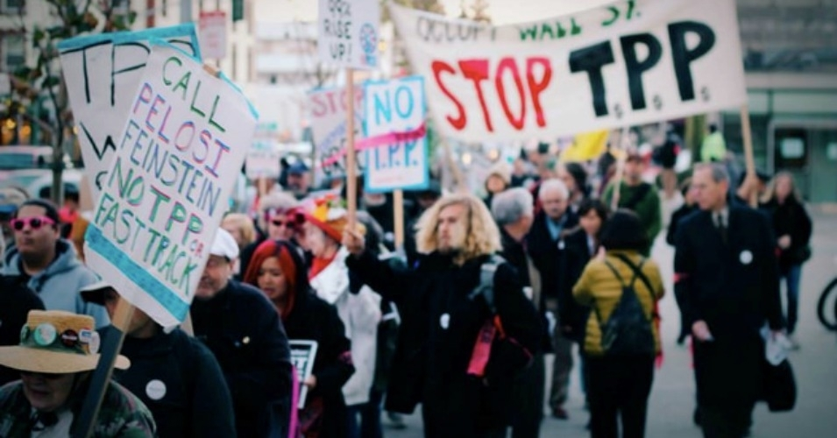
What is the
Trans-Pacific Partnership and why should I care?
Photo Credits: Occupy Bellingham, Stop FastTrack/flickr/cc
Notes:
Introduce yourself and the session.

Slide 2
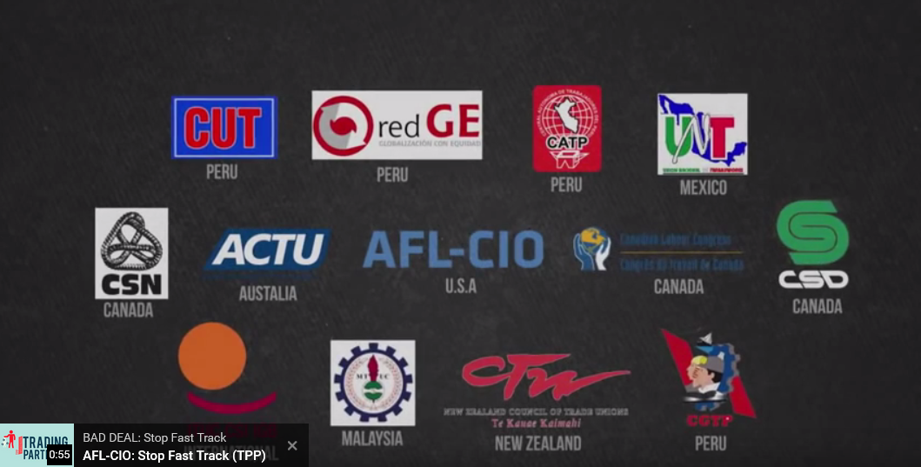
Watch this:
Click the image to play the video

Slide 3
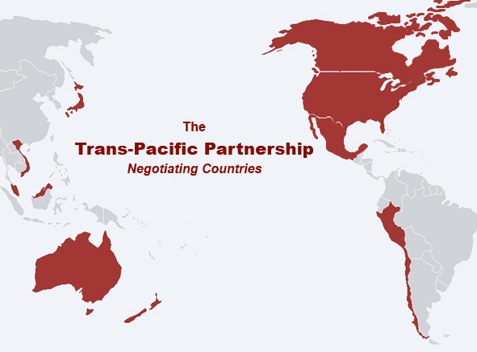
The TPP is a “trade deal” (you can think of it as a corporate outsourcing deal) between 12 countries.
Australia, Brunei, Canada, Chile, Japan, Malaysia, Mexico,
New Zealand, Peru, Singapore, U.S., Vietnam
Map Credit: Global Trade Watch
Notes:
3

Slide 4
Why has U.S. trade policy been so bad?
It has cost jobs: NAFTA= 700,00; Korea FTA= 75,000; WTO= millions
It has made it easier to offshore jobs
It has empowered global firms with special legal rights, but no obligations
It has driven a race to the bottom in wages, environmental protections, and consumer standards

Slide 5
But the debate isn’t about
“Trade versus No Trade” . . .
And it’s not really about the U.S. versus other countries, either
It’s about what the rules are and who benefits
It doesn’t have to be a rigged game that the corporations and the 1% win while workers everywhere get lower wages, fewer rights, a polluted environment, and governments that listen to companies, not people
The outcomes of trade can change, but only if the rules change

Slide 6
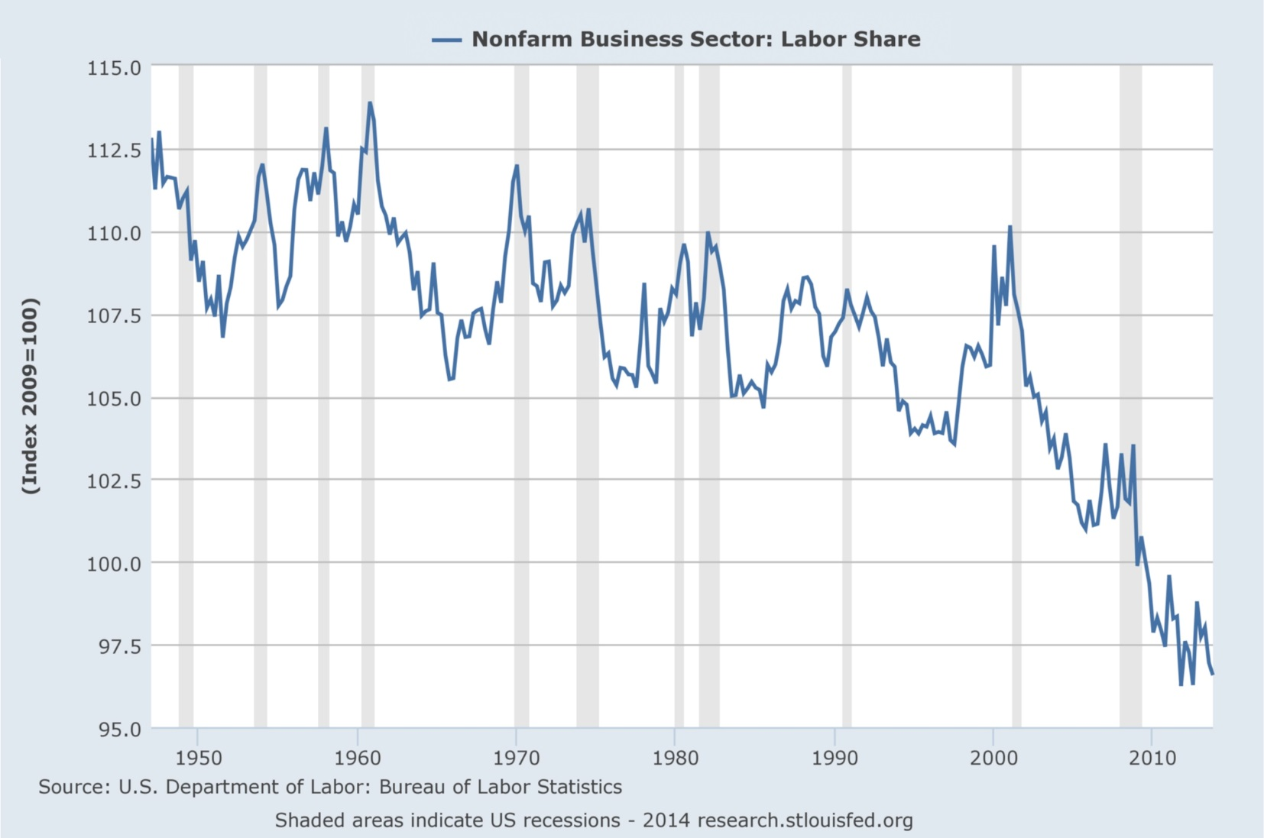
Corporate trade rules
have contributed to
more money for profits, less to workers
Workers’ Share of National Income is Shrinking (US)
Graph Credit: FRED (St. Louis Federal Reserve)

Slide 7
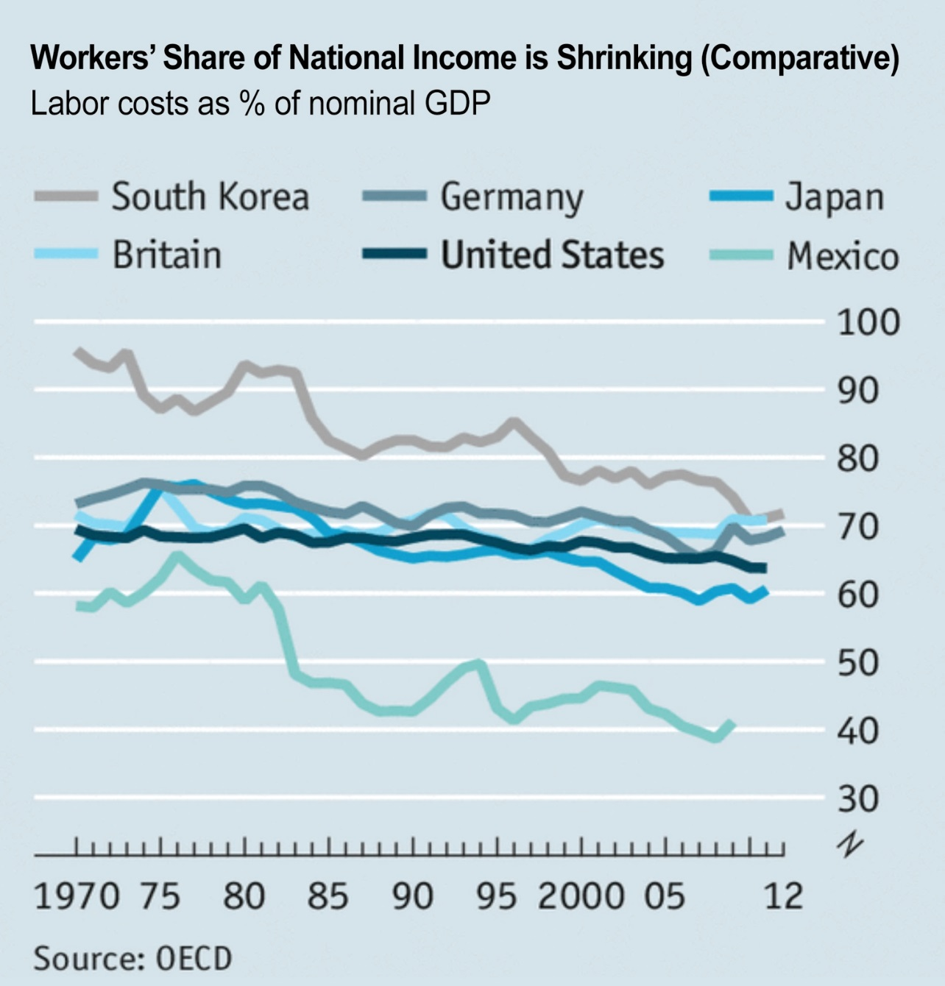
And not just in the U.S.
Chart Credit: The Economist

Slide 8
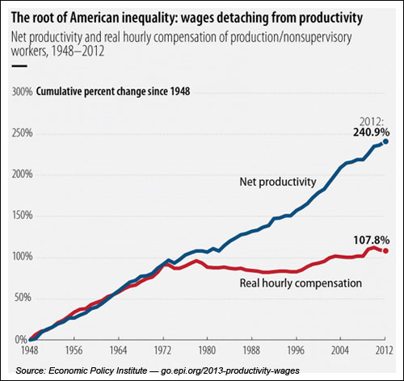
These rules have helped detach worker productivity from worker wages

Slide 9
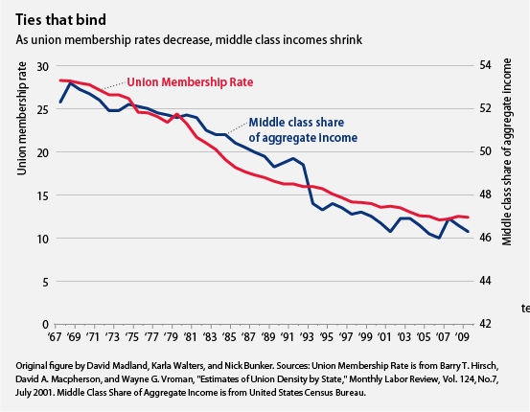
And they make it harder to form unions & bargain for better
Shrinking union density in the U.S. is due in part to deteriorating labor protections & the offshoring of union workplaces. Employers also use the threat of offshoring to discourage workers from forming new unions.
Fewer union members = shrinking middle class incomes
Notes:
.

Slide 10
Another result:
Increasing Inequality!
Off the charts!
454% rise in income*
645% rise in income*
Real family income growth
$3 million average income
117%
104%
105%
$27 million average income
98%
89%
57%
29%
16%
6%
-6%
*1973-2008
Poorest 20%
Second20%
Middle 20%
Fourth 20%
Richest 20%
Top 0.1%
Top
0.01%
*Average income includes realized capital gains.
Credit: EPI analysis of U.S. Census Bureau data.
1947-1973
1973-2009
Notes:
The trend toward inclusive growth in the economy (in which the incomes of the poorest fifth grew at this highest rates) changed in the 70s. Before that time, not Americans were able to share fairly in the growing prosperity, but the impact laws and programs include the New Deal, Social Security, and the Civil Rights Act were moving the U.S. economy in the right direction—towards social and economic justice.
However, in the 1970s, a blowback started the deliberate dismantling of the social safety net and the New Deal. The social pressures that had kept corporate executive pay in check also began to disappear. Corporate trade policies also contributed to this trend beginning in the 1990s.
As you can see, the poorest 20% have actually seen their incomes shrink in real terms since the 70s. The second, middle, and fourth quintiles saw varying degrees of modest growth. Even the top 20% did OK, but not as well as they had been doing, But the top, well, it’s almost hard to believe it’s true—a 454% rise for the top 1/10th of a percent. And the top 1/100th? Well, it’s literally off the chart.

Slide 11
If you liked NAFTA, you’ll love the TPP!
NAFTA (North American Free Trade Agreement), is the U.S.’s largest regional FTA to date. In its 20 year history, it has:
  Cost the U.S. 700,000 jobs
  Undermined labor and environmental protections in the U.S., Canada, and Mexico
  Contributed to increasing inequality and stagnant wages in all 3 countries
  Increased corporate influence in all 3 countries, particularly through “ISDS,” which are private “corporate courts” used to hold democratically-enacted policies for ransom
  Undermined job creation policies including “Buy American”
The TPP is NAFTA + 9 more countries, covers 40% of global GDP, and repeats the skewed corporate agenda of NAFTA.
See www.aflcio.org/NAFTAat20 for more!

Slide 12
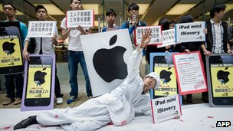
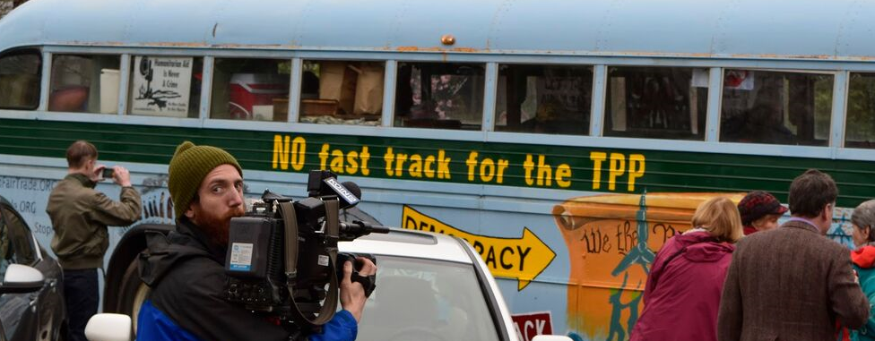
The TPP Will Be Open to New Members, So There is No Margin for Error
Like the WTO, it will allow
any country to join (e.g., China, Burma), with no limit
Like past trade deals, it can last forever and will be virtually impossible to fix
Photo Credits: Citizens Trade Campaign, AFP

Slide 13
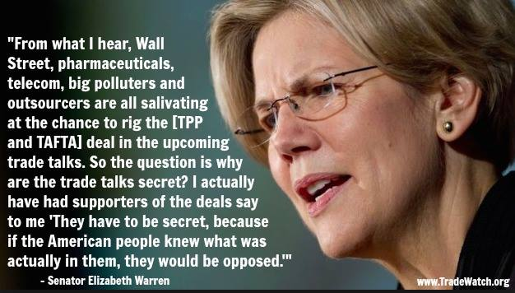
TPP Was Negotiated In Secret
The TPP was negotiated behind closed doors from 2010-2015.
The text was finally revealed on November 5, 2015.
Meme Credit: Global Trade Watch

Slide 14
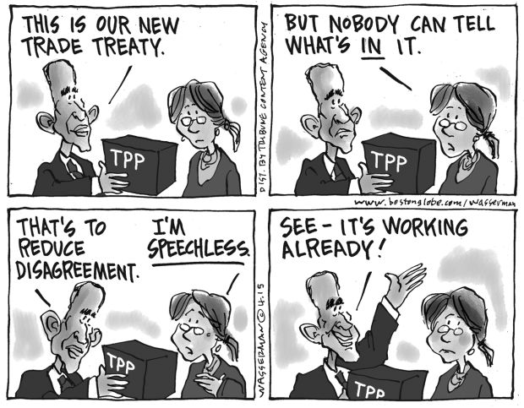
How U.S. Trade Policy is Made
The TPP is about 6,000 pages long and includes 30 chapters and many supplemental annexes. In comparison to the years it took to write, the public has only a relatively short time to review it before Congress will be asked to vote yes or no—Congress won’t be allowed to change a single word.
Cartoon Credit: Dan Wasserman, The Boston Globe

Slide 15
Most of TPP is not about traditional “trade” but domestic policy issues instead
For example, the TPP covers:
  Food, cosmetic, and medical device safety
  Environmental protections
  Wall Street/banking regulations
  Labor laws
  Government purchasing (e.g., Buy American)
  Public services, such as transportation & utilities
  Anti-Trust laws
  A private justice system (“corporate courts”) for foreign investors
  Patent & copyright laws
  Medicare’s drug coverage & pricing decisions

Slide 16
In the U.S., we are used to making these policy decisions democratically; that is, openly and with public participation.
Under the Fast Track law, all of these decisions were made behind closed doors, without meaningful public debate or citizen input. Congress will only get to vote yes or no on the final TPP. They can’t amend it or even ensure its enforcement is adequately funded.

Slide 17
TPP Threat:
ISDS -- A Threat to Jobs & Democracy
The Investor-State Dispute Settlement (ISDS) provisions of the TPP will empower foreign corporations to:
Bypass national courts
Use private “corporate courts” to seek taxpayer compensation for local, state, or federal laws & regs that threaten their “expected profits”
Attack citizen decisions on toxic chemicals, local building permits & even minimum wages
Notes:
Like NAFTA, the TPP would allow foreign corporations to sue governments over nearly any law/policy that a corporation argues would limit their “expected profits” or reduce their predictable regulatory environment.
Most international dispute settlement happens between governments. Such dispute settlement is know as “state-to-state.” These cases are called investor-to-state cases because investors, or corporations, are actually raised to the level of sovereign nation-states. They can challenge a country directly in an international arbitration tribunal that is staffed by private lawyers who rotate between acting as arbitrators and acting as private lawyers, often representing global companies in cases against other countries.
Foreign investors are the only TPP party given such expansive rights. Workers trying to exercise the labor rights promised them in the agreement cannot bring a case directly against a country. Nor can environmental advocates seeking to enforce the TPP’s environmental provisions.
Cases brought before the private tribunals do not apply U.S. law, not can parties appeal to U.S. courts if the arbitration panel issues a legally incorrect decision. The arbitrators are elected, not accountable to U.S. citizens, and cannot be impeached.
Corporations including Exxon Mobil, Dow Chemical, Cargill have launched more than 550 cases against 95 governments through other, similar (but smaller) trade pacts. Although global corporations who support ISDS that they need it because they are “oppressed and taken advantage of” by small developing countries, they have never presented any evidence of systemic bias that would justify such an outrageous departure from the fundamental democratic principle that justice must apply equally to all.
Moreover, Canada is the 6th most-sued country in the world under ISDS, and the U.S. is the 11th. Clearly, this is not a procedure only used against developing countries with unreliable justice systems. It is crony corporate giveaway that skews power in favor of global companies and against the rest of us.

Slide 18
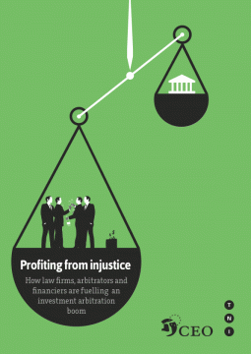
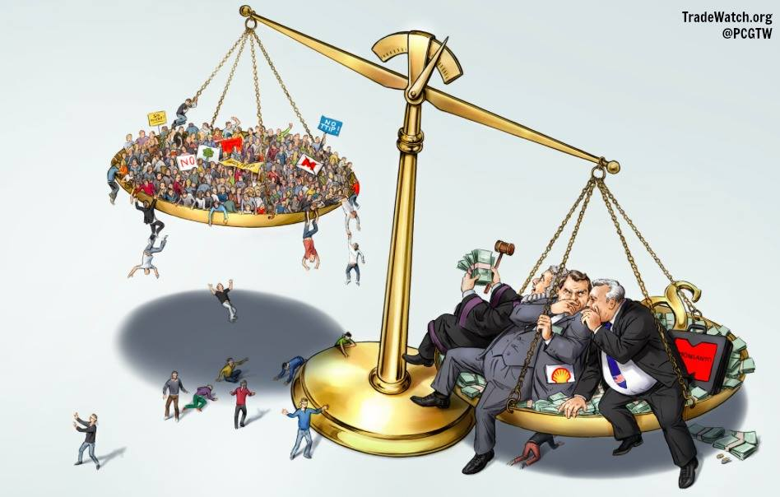
ISDS Provides
Unequal Justice for All
For more information, visit:
http://corporateeurope.org/international-trade/2012/11/profiting-injustice
Artwork Credit: Corporate Europe Observatory, Global Trade Watch

Slide 19
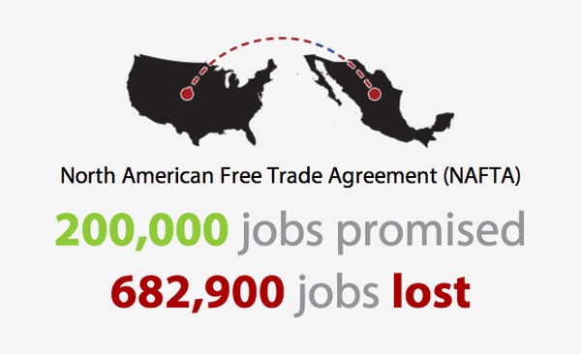
TPP Threat:
Lost Jobs, Lower Wages
Like NAFTA and the Korea FTA, the TPP will promote more off-shoring as companies with new legal rights overseas seek cheaper wages, fewer workplace regulations & lax enforcement in places like Malaysia, Brunei & Vietnam
Since China joined the WTO, the U.S. has lost more than 60,000 factories and more than 5 million manufacturing jobs
Employers use the threat of offshoring to secure pay & benefit givebacks from U.S. unions
This will continue to reduce the local tax base needed for public employees & infrastructure investment (construction jobs)
Infographic Credit: Economic Policy Institute
Notes:
19

Slide 20
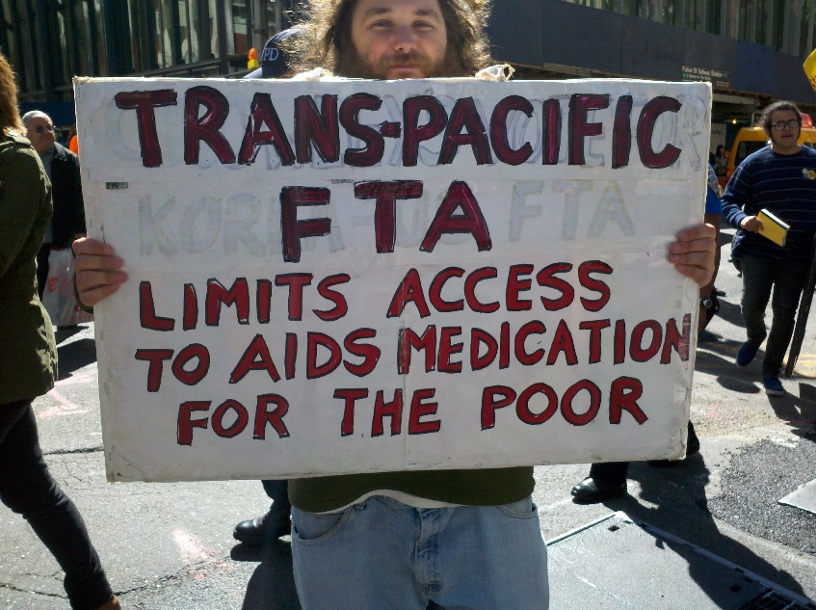
TPP Threat:
Higher Drug Costs
New monopoly rights for big drug companies, making it harder to access cheaper generic medicines
Rules that undermine cost saving measures in Medicare
Photo Credit: StopMotionSolo.net
Notes:
20

Slide 21
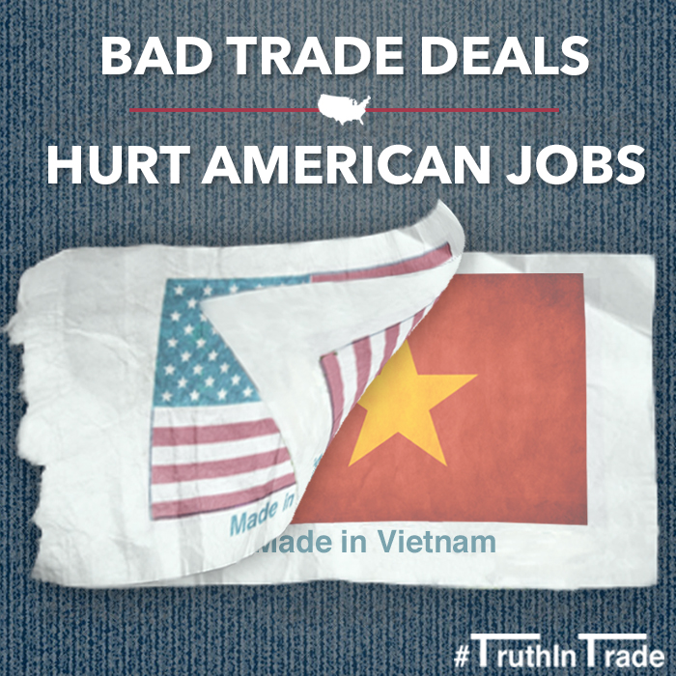
TPP Threat:
Buy American Policies
Image Credit: Rep. Mark Pocan
The TPP will limit the ability of the federal government (and eventually state & local governments) to create U.S. jobs through “Buy American” programs that ensure taxpayer monies will be used to buy U.S.-made goods and services.
Notes:
21

Slide 22
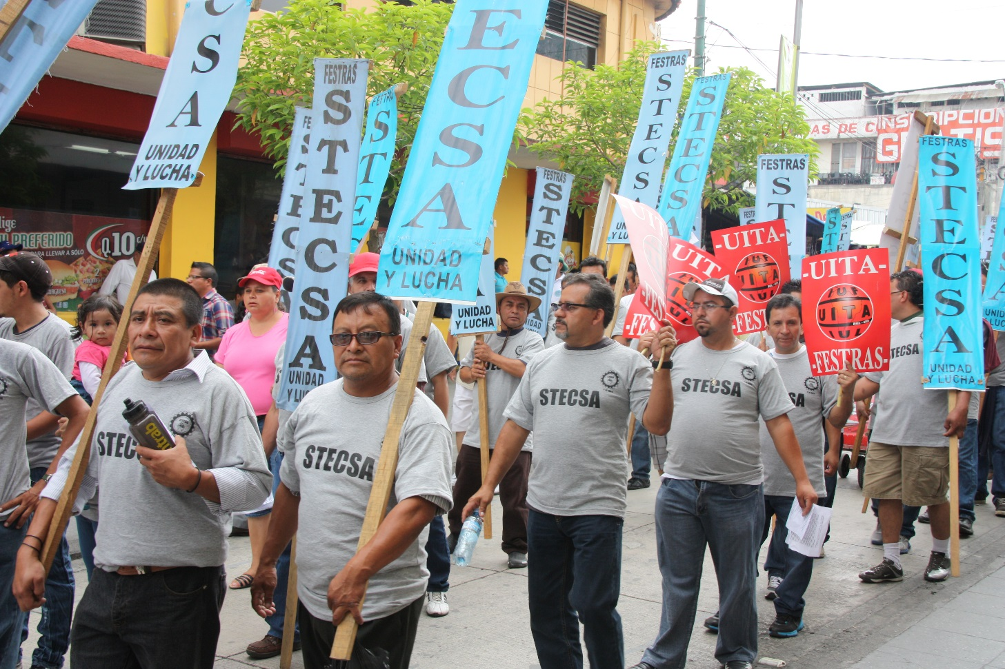
TPP Threat:
Identifying the Wrong Villain
Image Credit: Staff
Globally, economic elites will benefit from these rules while working families suffer. When good U.S. jobs disappear, they are transformed into sweatshop jobs before being sent overseas. Remember: Capital is global.
If we want to win, worker solidarity has to be global too!
Notes:
22

Slide 23
Other TPP Threats:
Deregulation of banks, food safety & product safety rules
Foreign subsidized companies (SOEs) that behave in a predatory manner & undercut U.S. private sector firms→ lost U.S. jobs
Weak rules of origin that allow China and other countries to benefit without even agreeing to the rules→ more outsourcing→ lost U.S. jobs
Continued weak & ineffective efforts to protect labor rights and ensure environmental compliance
Less local control, more corporate control

Slide 24
Here are some ways the TPP could affect your local government:
Foreign firms could use ISDS/corporate courts to challenge “Big Box” laws designed to keep abusive employers out & preserve local retailers
A foreign investor could challenge a decision to deny a permit to a dangerous/toxic facility
A foreign investor could challenge a local minimum wage increase
A foreign country could challenge state rules on the practice of medicine or insurance
Your county government might not be able to prefer products from your state when making purchasing decisions

Slide 25
So What Do I Do Now?
It’s not too late to act!
Text “TPP” to 235246
Get a local or state elected official to introduce a resolution opposing bad trade deals like TPP
Work on a campaign to pass a state or local resolution against bad trade policies like TPP
Commit to telling at least one friend or family member about the dangers of TPP
Call your Member of Congress at 1-855-712-8441 to say “The TPP hurts America, don’t support it!”
Visit aflcio.org/trade and aflcio.org/blog to learn more

