Slide 1
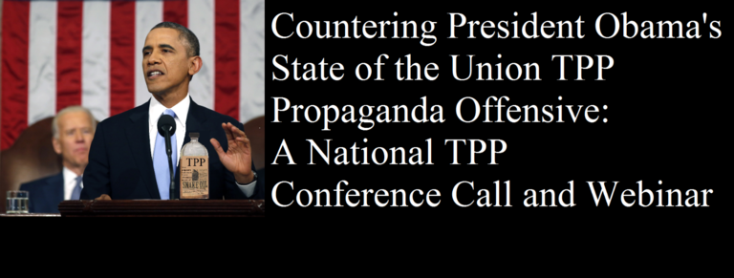
TPP Myth Busters
Emilianne Slaydon – TPP Media March
Adam Weissman – TradeJustice/Global Justice for Animals & the Environment
Michael Stumo – Coalition for a Prosperous America
Arthur Stamoulis – Citizens Trade Campaign
Dr. Margaret Flowers
Diana Ramirez – Public Citizen

Slide 2


INTRODUCTION AND WELCOME
Andrea Miller, Executive Director
People Demanding Action
andrea@peopledemandingaction.org
Call Structure and Norms:
Audio is PHONE ONLY; you must call in
Do not enable your video camera
All calls are recorded; a link is available after the call
Q & A mode: To eliminate background noise we mute everyone when we begin recording.
Press *6 (when prompted) to ask a question; say your name, your organization, if any, and location. Be courteous and brief; give others a chance to ask questions too.
Keep chat room discussions on topic and professional

Slide 3


TECHNICAL STUFF
Audio is available only via phone
DIAL IN: 605 562 3140 ACCESS CODE: 951146#
Meeting Room Functions
- Chat
- Share
Use the Share button in the Meeting Room:
After the call, click the unique link below to download this week's PowerPoint, recording link and other materials: http://www.peopledemandingaction.org/downloads/tpp/tpp-january-20-2016-call-materials

Slide 4
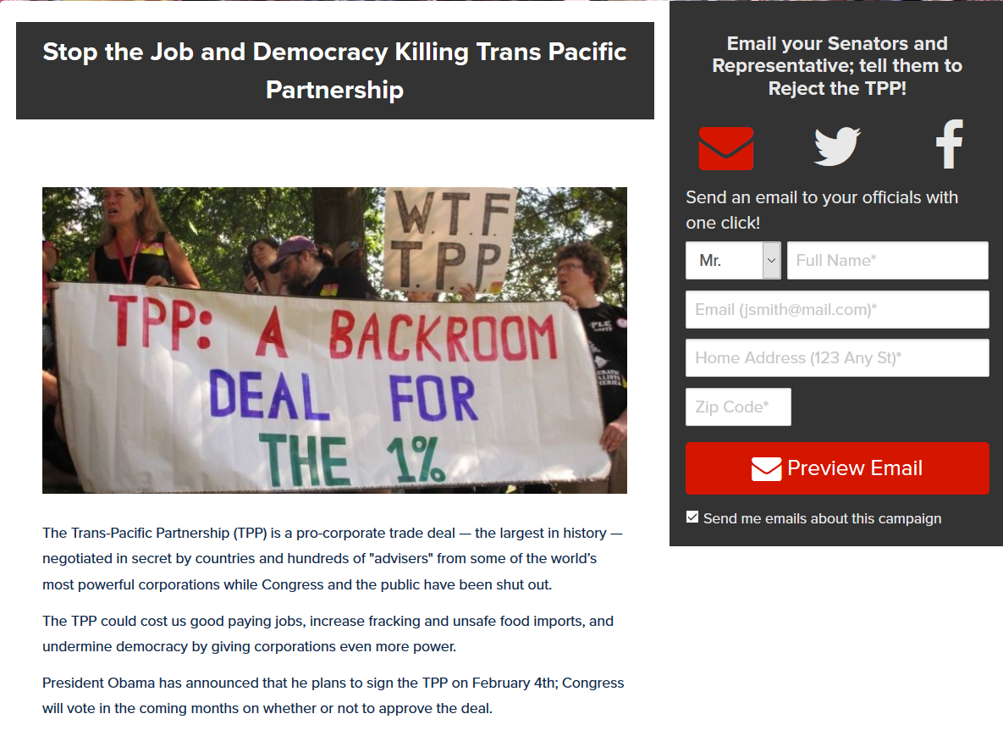
Advocacy Update
13,747 emails sent to Congress opposing the TPP
http://p2a.co/binmJFN
Letters to the Editor – 18 Letters
http://salsa.wiredforchange.com/o/6405/c/10113/letter/?letter_KEY=877

Slide 5

Call Host Team
Tom Hocking, Technical Advisor
MoveOn, PA
TWHocking@Gmail.com
*Pre/Post Call Technical Questions
*Global TPP Team Facebook Page Manager
Facebook:
https://www.facebook.com/groups/GlobalTPPTeam

Slide 6

Call Planning Team
Harriet Heywood
harrietheywood@gmail.com
Call Co-Organizer
Florida State Leader – People Demanding Action

Slide 7


Call Planning Team
Mara Cohen
Marajai51@Gmail.com
*PDA Mass Criminalization Team Leader
*Global Climate Convergence Leader (IL)

Slide 8

Chat Host/Call Planning Team
Lisa Oldendorp
MoveOn, New York
eslsk8r@optonline.net
*Chat Host
*Call Planning Team

Slide 9

Call Planning Team
Linda Brewster
LindaJBrewster@msn.com
*Call Planning
*Information and event sharing
*MoveOn Regional Organizer (WA)

Slide 10


Call Planning Team
Celeste Drake
Trade and Globalization
Policy Specialist, AFL-CIO
CDrake@AFLCIO.org

Slide 11

Emilianne Slaydon
Director, Social Media @TPP Media March
TPP Tuesday Twitter Storm
6 p.m. PST / 9 p.m. EST
TPP/TTIP Tuesday Tweets:
http://www.tiny.cc/TPPMediaMarch

Slide 12


Slide 13
@TPPMediaMarch
Twitter STORM
The most FUN & EASIEST
way to raise awareness to #StopTPP

Slide 14
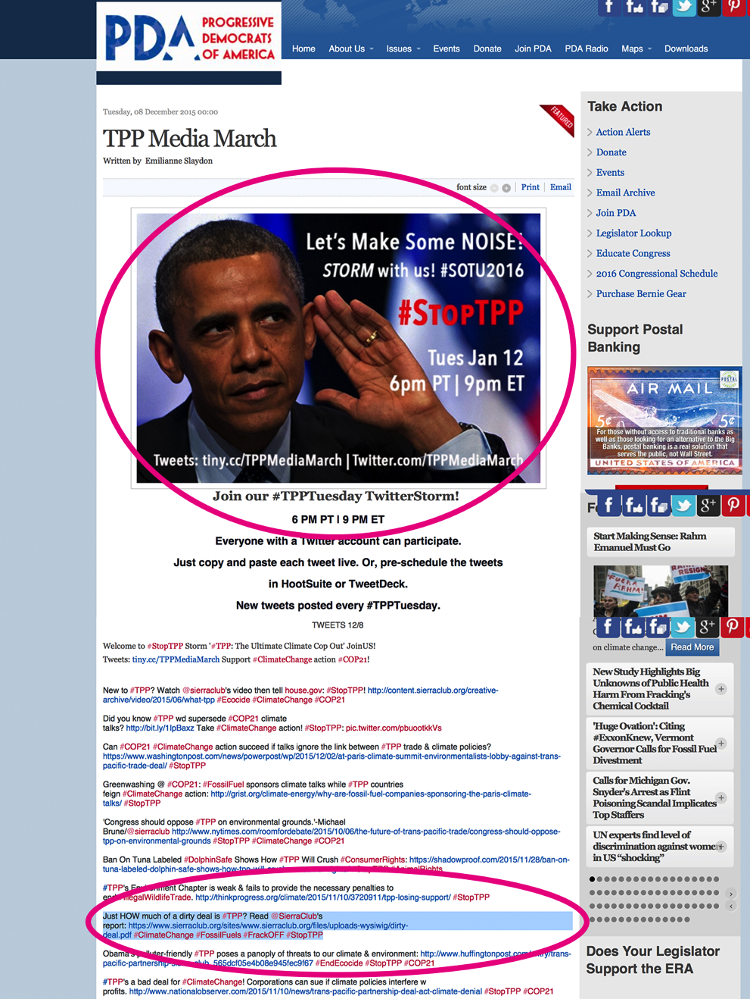
Go to: http://tiny.cc/TPPMediaMarch
BEFORE TUESDAY:
Click-n-Drag Invite to Desktop
Post Invite on Facebook
Tweet Invite on Twitter
ON TUESDAY 9 ET | 6 PT
1) Copy each tweet by highlighting it . . . then

Slide 15
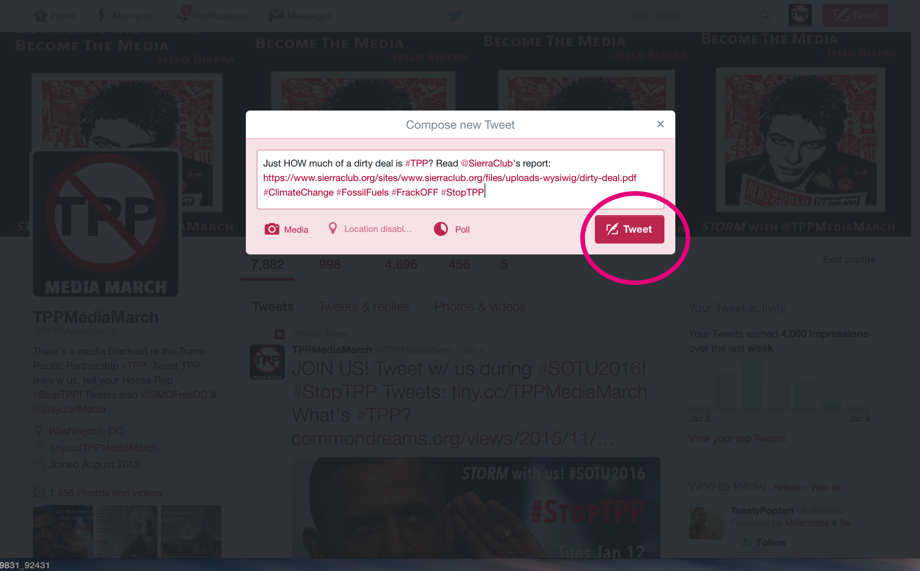
2) Paste the copied text into the tweet box on Twitter. Press Tweet. Repeat copying next tweet.

Slide 16
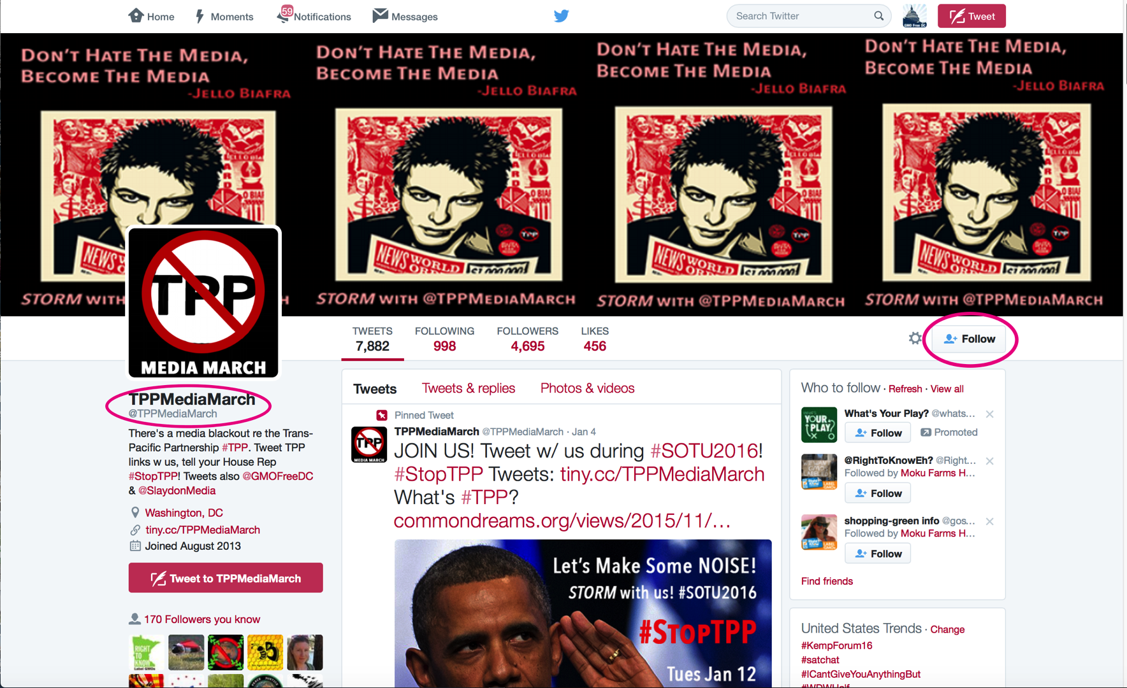
Follow: http://Twitter.com/TPPMediaMarch

Slide 17
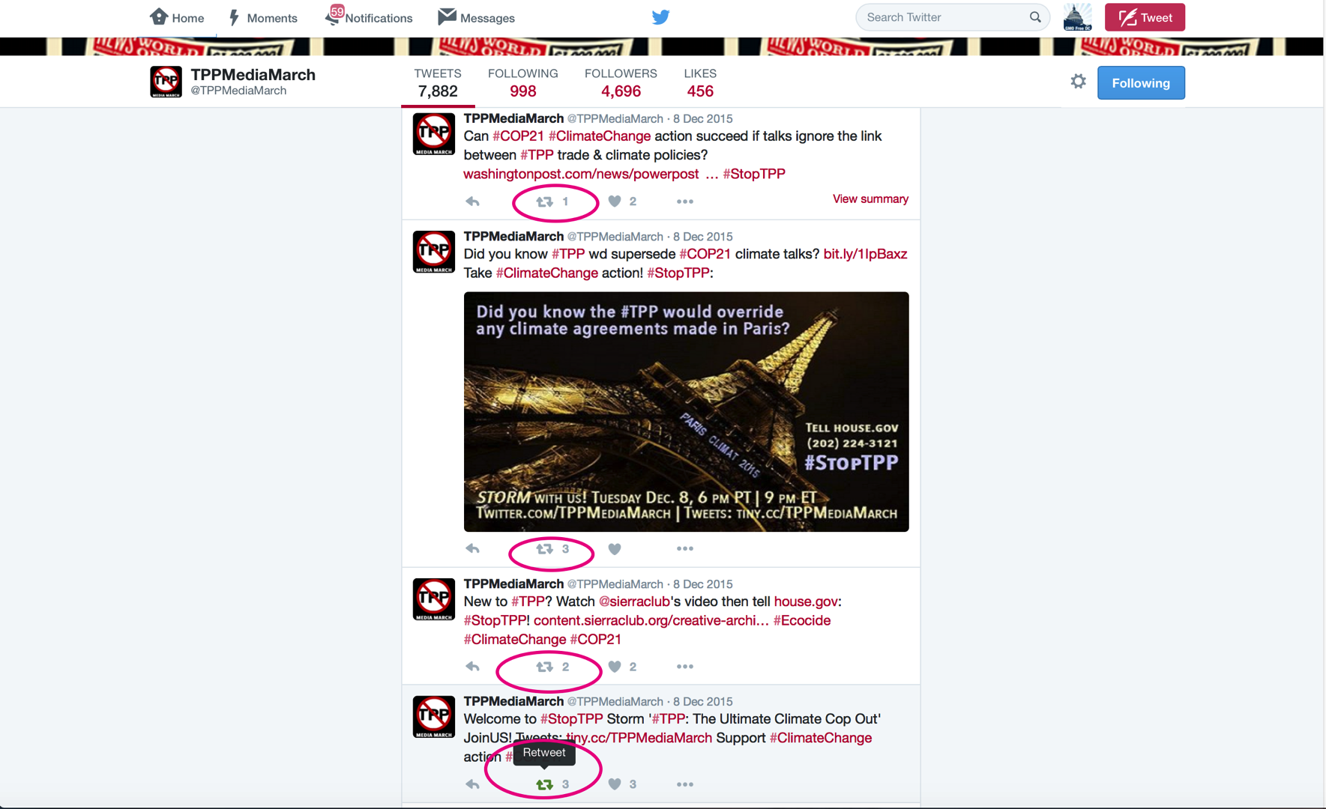
Click the Retweet Box (RT)

Slide 18

STORM with US!
#StopTPP
Thank you!

Slide 19


Call Planning Team
Adam Weissman
TradeJustice
Global Justice for Animals and the Environment
www.TRADEJUSTICE.NET
*Call Planning Team
*Speaker Recruitment
*Events, news stories and actions
http://tradejustice.net/events
http://www.tradejustice.net/news
adam@tradejustice.net

Slide 20
Q&A – Emilianne Slaydon/Adam Weissman
Emilianne Slaydon – TPP Media March
Adam Weissman – TradeJustice and Global Justice for Animals and the Environment

Slide 21
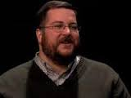
Arthur Stamoulis
Executive Director, Citizens Trade Campaign
Arthur Stamoulis is executive director of Citizens Trade Campaign, a national coalition of labor, environmental, family farm, consumer and human rights organizations working together for trade policies that promote a just and sustainable global economy. Citizens Trade Campaign was the first to publish leaked text of several of the Trans-Pacific Partnership (TPP) chapters, and organized protests and other civil society responses at each of the TPP negotiating rounds to take place in the United States.
Prior to joining Citizens Trade Campaign, Arthur directed the Oregon Fair Trade Campaign. He has also served as director of government affairs for Clean Air Council, an editor at Common Courage Press, and economics editor for Clamor Magazine.

Slide 22
Citizens Trade Campaign
Timing of TPP vote
Sign-on letter
District deliveries/activist opportunities
TransCanada ISDS suit implications

Slide 23
Citizen Trade Myth Buster
ISDS Myth: ISDS is safe because the US has never lost a case.
Reality: Why should we allow these cases that challenge democratically made decisions?
Even when countries win, they spend millions in legal fees to defend cases (average= $8 million),
and it is only a matter of time until the US loses.

Slide 24
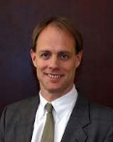

Michael Stumo
Michael Stumo is the Chief Executive Officer of the Coalition for a Prosperous America (CPA), a coalition of agriculture, manufacturing, and organized labor associations, companies and individuals. CPA works for policies to balance U.S. trade, maintain U.S. sovereignty, and to develop an effective national production and economic strategy.
Michael has a B.S. from Iowa State University in Agriculture and a law degree from the University of Iowa, graduating from both institutions with High Distinction. He is a member of the bars of Massachusetts, Nebraska and Connecticut. He is an author of law review articles and editor of a policy book entitled “A Food and Agricultural Policy for the 21st Century”.

Slide 25
CPA submitted testimony to the USITC regarding the TPP stating USITC methods are inaccurate when projecting the economic impact of only tariff reductions;
the agency needs to consider trade competitiveness and non-tariff factors in their projections, like currency, border taxes, state-owned enterprises / subsidies, etc..
USITC should focus on trade balance / exports should outweigh imports
Trade defits are major cause of job loss in US
the agency will likely find little or no growth or job creation potential
Sovereignty: Many issues are left open in the TPP, to be settled later. The TPP Commission will have the power to modify the intent of the agreement in the future on issue such as climate change, immigration and labor. Congress will have no power to stop these changes.

Slide 26
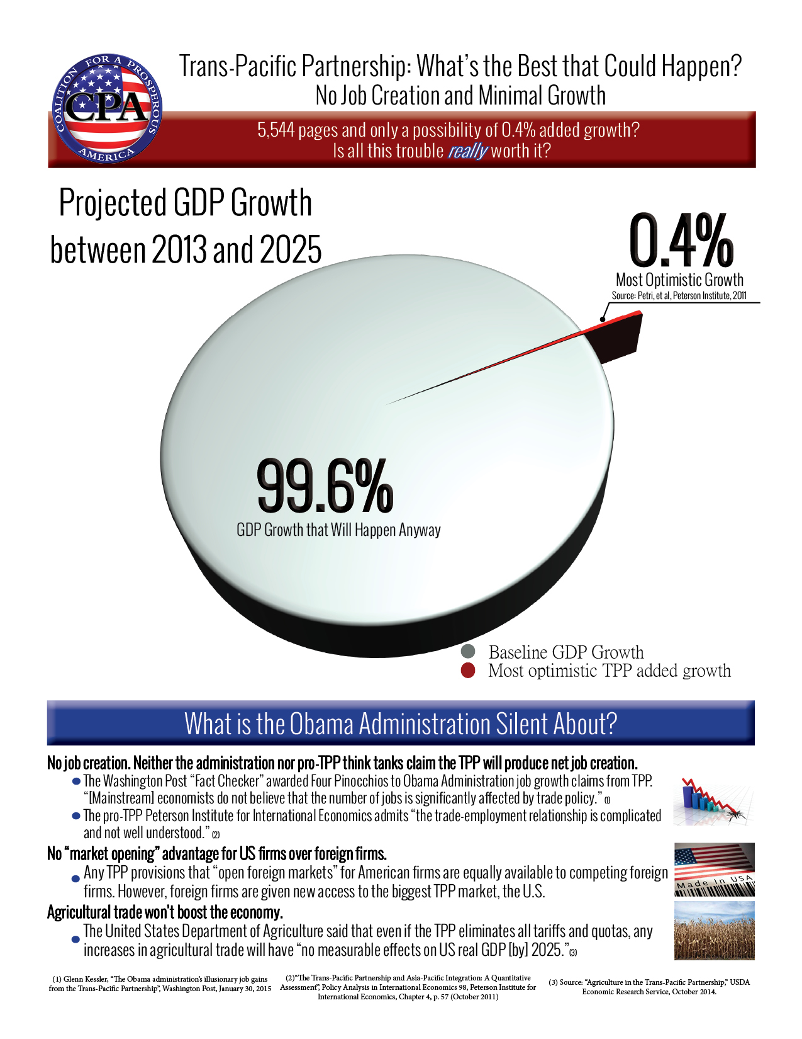
Economics- Jobs/Growth
The most optimistic growth projection for the TPP over the next 10 years is 0.4%.
That means 99.6% of growth will happen anyway.
The most pro-TPP think tanks (Peterson Institute) admit that the TPP will not result in net job creation.
The USDA found that any increase in overall TPP agricultural trade will not increase US GDP.

Slide 27
Q&A Michael Stumo/Arthur Stamoulis
Michael Stumo – Coalition for a Prosperous America
Arthur Stamoulis – Citizens Trade Campaign

Slide 28
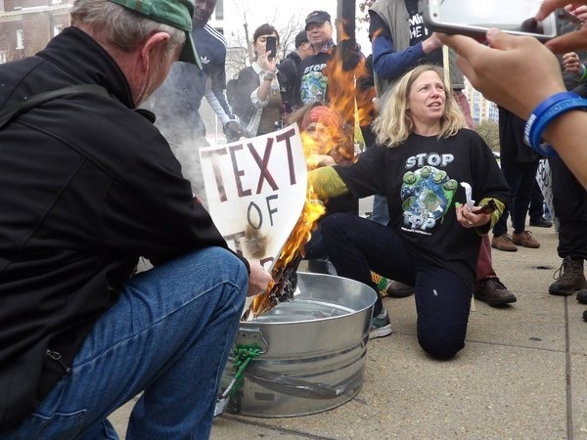
Dr. Margaret Flowers
Dr. Margaret Flowers is a pediatrician and co-chair of the Maryland chapter of Physicians for a National Health Program (PNHP).
Margaret is also Co-Director of PopularResistance.org and It's Our Economy, and Co-Organizer of Flush the TPP (flushthetpp.org).
Margaret co-organized the November #Fall Rising Days of Action in D.C.

Slide 29
Tell the USTR
What You Think About the Impacts of TPP on Employment
Official public comment period on the impacts of the TPP on employment.
Ends January 13, 2016.
Find instructions at bit.ly/telltheustr
Comments will be made public and will be used for a report to Congress

Slide 30
Reportback from the TPP Resistance Call
BuyCott for Trade Justice - visit www.FlushtheTPP.org/Buycott/
- Long term project that starts now
- Forming a working group
Media Response to SOTU - media mobilizers
- President's SOTU on Jan. 12
- Become a media mobilizer at www.flushthetpp.org/tpp-media-mobilizers- call-to-action/

Slide 31

LOCAL ACTIONS IN FEBRUARY
Contact info@popularresistance if you are interested in organizing a local action
Dates For Local Actions:
Feb 4- TPP Signing
Feb 14-21 President’s Day week of actions in district
Next TPP Resistance call Wednesday, Jan 13 at 9 pm Eastern/6 pm Pacific. Visit www.flushthetpp.org/national-tpp-resistance-calls/ for more information and to register.

Slide 32
Q&A Dr. Margaret Flowers
Popular Resistance
Flush the TPP

Slide 33
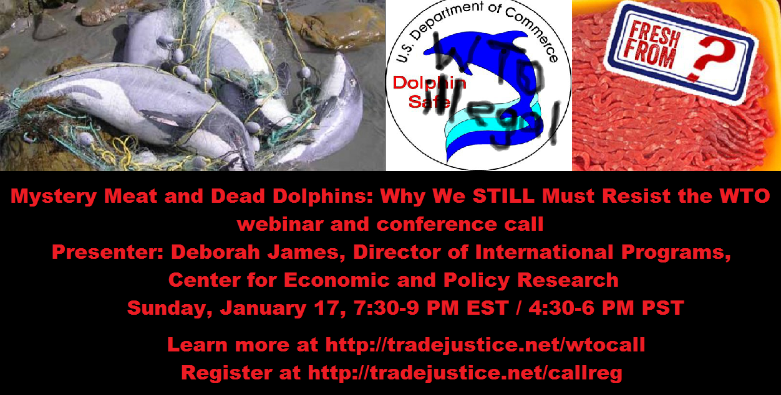
Upcoming Calls
JANUARY 17

Slide 34
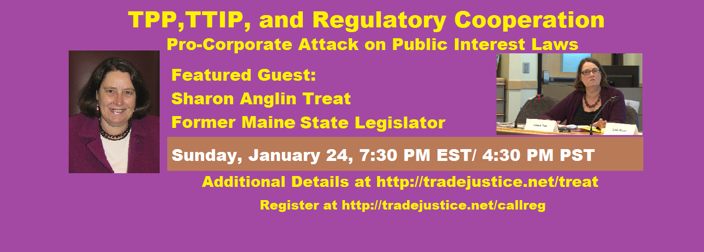
JANUARY 24

