Slide 1
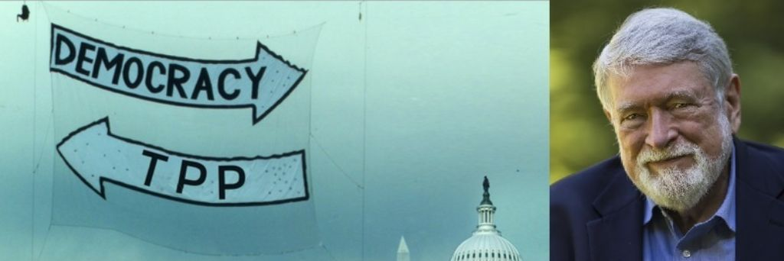
For Audio use phone or Skype
Call: 605-562-3140
PIN: 951146#

Slide 2
Speakers
David Korten, author When Corporations Rule the World;
Co-founder, YES! Magazine
Rio Tazewell, People for the American Way
Linda Brewster, MoveOn - Washington
Dr. Margaret Flowers, Co-Director Popular Resistance,
Co-Organizer Flush the TPP
Adam Weissman, Global Justice for Animals and the Environment/ TradeJustice New York/
Emilianne Slaydon, TPP Media March

Slide 3


INTRODUCTION AND WELCOME
Andrea Miller, Executive Director
People Demanding Action
andrea@peopledemandingaction.org
Call Structure and Norms:
Audio is PHONE ONLY; you must call in
Do not enable your video camera
All calls are recorded; a link is available after the call
Q & A mode: To eliminate background noise we mute everyone when we begin recording.
Press *6 (when prompted) to ask a question; say your name, your organization, if any, and location. Be courteous and brief; give others a chance to ask questions too.
Keep chat room discussions on topic and professional

Slide 4


Technical Information
Audio is available only via phone
DIAL IN: 605 562 3140 ACCESS CODE: 951146#
Meeting Room Functions
- Chat
- Share
Use the Share button in the Meeting Room:
After the call, click the unique link below to download this week's PowerPoint, recording link and other materials: http://www.peopledemandingaction.org/downloads/tpp/tpp-february-28-2016-call-materials

Slide 5

Technical Advisor/Facebook Page Manager
Tom Hocking, Technical Advisor
MoveOn, PA
TWHocking@Gmail.com
*Pre/Post Call Technical Questions
*Global TPP Team Facebook Page Manager
Facebook:
https://www.facebook.com/groups/GlobalTPPTeam

Slide 6

Chat Host/Call Planning Team
Lisa Oldendorp
MoveOn, New York
eslsk8r@optonline.net
*Chat Host
*Call Planning Team

Slide 7

Call Planning Team
Harriet Heywood
harrietheywood@gmail.com
Call Co-Organizer
Florida State Leader –
People Demanding Action

Slide 8


Call Planning Team
Celeste Drake
Trade and Globalization Policy Specialist,
AFL-CIO
Cdrake@AFLCIO.org

Slide 9


Call Planning Team
Mara Cohen
Marajai51@Gmail.com
*PDA Mass Criminalization Team Leader
*Popular Resistance Organizer
*Global Climate Convergence Leader (IL)

Slide 10
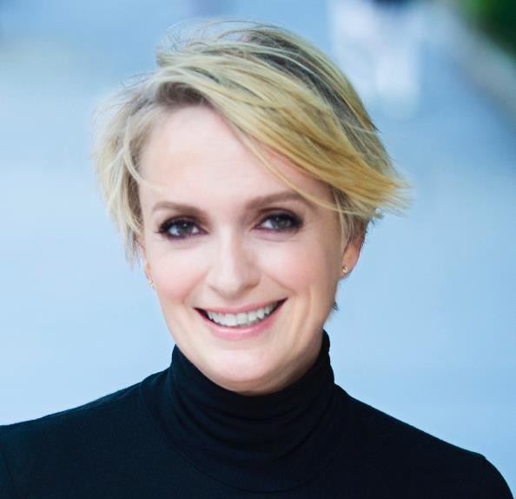
Emilianne Slaydon
Director, Social Media
@TPPMediaMarch
Twitter.com/TPPMediaMarch
Every #TPPTuesday
6pm PT | 9pm ET
Tweets:
tiny.cc/TPPMediaMarch

Slide 11

Go to:
Twitter.com/TPPMediaMarch htttp://tiny.cc/TPPMediaMarch

Slide 12
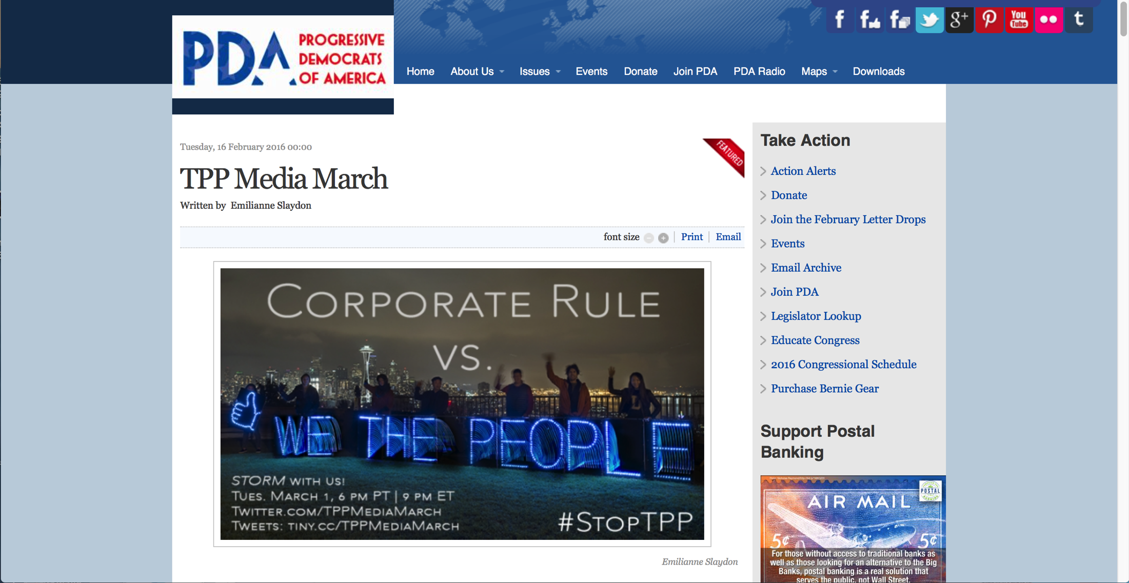
Before Tuesday:
Share Invite on FB & Twitter

Slide 13
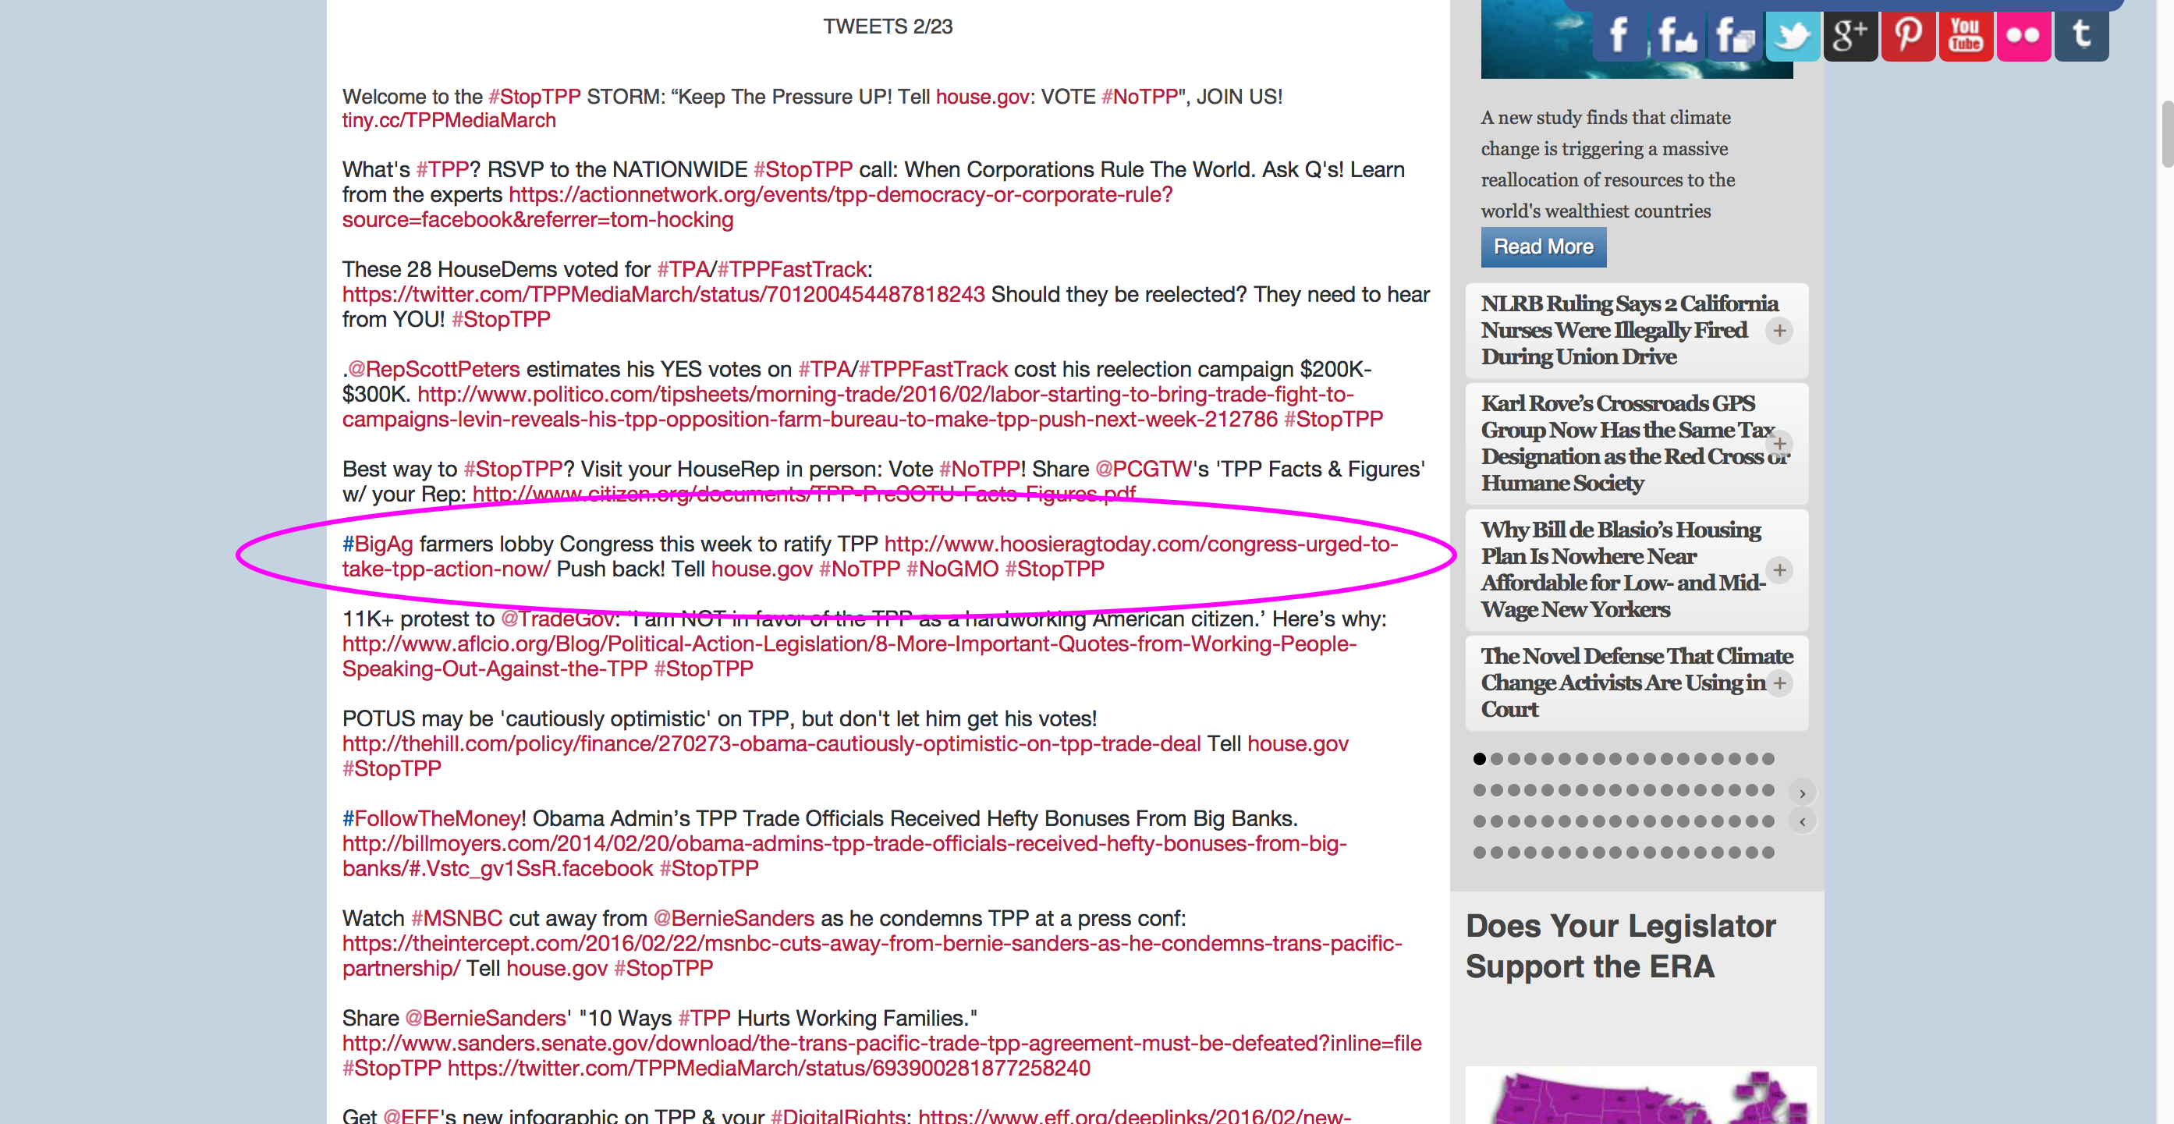
On Tuesday at 9 pm ET:
Copy-n-Paste Tweets To Twitter

Slide 14
Have a social media question? em@slaydonmedia.com
“Dear Emilianne,
How can we bring the climate movement and the No TPP movement together better?”
Great question!

Slide 15
Connect #StopTPP to:
#ClimateAction
#NoGMO
#ActOnClimate
#ClimateJustice
#BigOil
#FossilFuel
#LNG
#FrackOff
#KeepItInTheGround
#FoodSafety
#FoodSovereignty
#StopMonsanto
#SaveTheBees
#FactoryFarming
#AnimalAgriculture
#AntibioticResistance

Slide 16
Connect #StopTPP to:
@BernieSanders
@HillaryClinton
#FeelTheBern
#UsNotMe
#AmericaTogether
#BernieStrong
#VoteTogether
#LatinosForBernie
#HeWinsWeWin
#HillaryClinton
#ImWithHer
#Hillary2016
#SuperTuesday
#WhichHillary
#ImNotWithHer
#ClintonNewsNetwork

Slide 17

STORM with us! to:
#StopTPP

Slide 18

Call Planning Team
Linda Brewster
LindaJBrewster@msn.com
*Call Planning
*Information and event sharing
*MoveOn Organizer (WA)

Slide 19
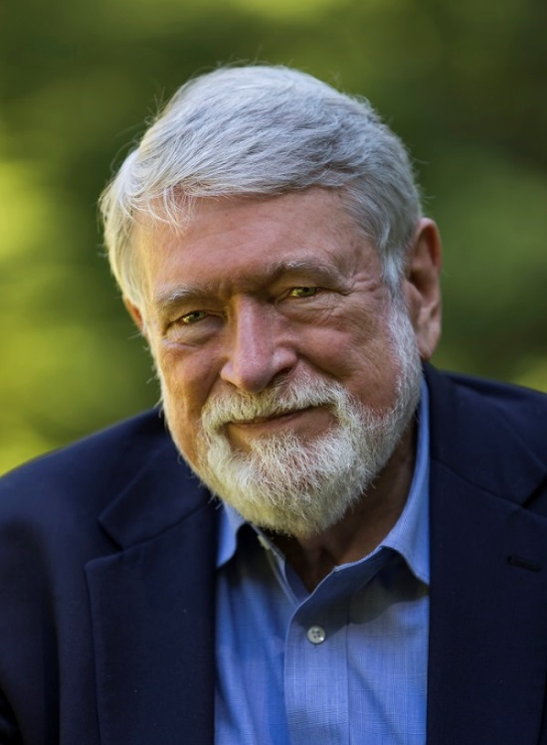
David Korten
David Korten is well known for his contributions to framing alternatives to the deep cultural and institutional forces driving the human species toward economic, social, political, and environmental collapse.
David is co-founder and board chair of YES! Magazine, co-chair of the New Economy Working Group, president of the Living Economies Forum, an associate fellow of the Institute for Policy Studies, and a member of the
Club of Rome.
He is the author of numerous books, including Agenda for a New Economy: From Phantom Wealth to Real Wealth, the international best-seller, When Corporations Rule the World (updated, third edition, June 2015), The Great Turning: From Empire to Earth Community; and, most recently, Change the Story, Change the Future: A Living Economy for a Living Earth.
David Korten holds MBA and Ph.D. degrees from the Stanford Business School, has thirty years of experience as a development professional in Asia, Africa, and Latin America and has served as a Harvard Business School professor, a captain in the US Air Force, a Ford Foundation Project Specialist, and a regional adviser to the US Agency for International Development. He lives with Fran Korten, his life partner of more than 50 years who is Executive Director/Publisher of YES! Magazine, on Bainbridge Island, WA.

Slide 20

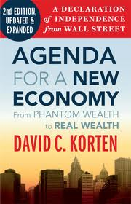


Trans Pacific Partnership (TPP)
Democracy vs. Corporate Rule
David Korten
www.LivingEconomiesForum.org

Slide 21
Trans Pacific Partnership (TPP)
Democracy vs. Corporate Rule
Foundational transpartisan political issue.
Rights of people vs. rights of corporate pools of money
Local self-reliance vs global dependence.
Big corporations = Big government
Working people vs welfare queens (social & environmental subsidies)
Living Earth vs. Dead Planet
National sovereignty
Transparency

Slide 22
Trans Pacific Partnership (TPP)
Democracy vs. Corporate Rule
Brief History
1980s WB and IMF: Corporate Rule through Debt and Structural adjustment
1994-2000. Clinton: Corporate Rule through International agreements: NAFTA, WTO, and Multilateral Agreement on Investment (MAI)
1994 - 2001 Global Civil Society: The International Forum on Globalization 1995 Riverside Church Teach-In. When Corporations Rule the World.1999 Seattle ‘99 WTO demonstration. Massive global resistance
Sept 11, 2001. GW Bush. Preferred conventional military domination
2001 – present. Civil society focus on growing a new economy.
2015. Back to international agreements: Trans Pacific Partnership and Transatlantic Trade & Investment Partnership (TTIP)

Slide 23
Trans Pacific Partnership (TPP)
Democracy vs. Corporate Rule
Trade Agreements for a Living Earth Economy
No People without Nature/No Corporations without People
Living Earth Economy
Economic and Political Democracy
Local Self-Reliance

Slide 24

Q & A With David Korten

Slide 25
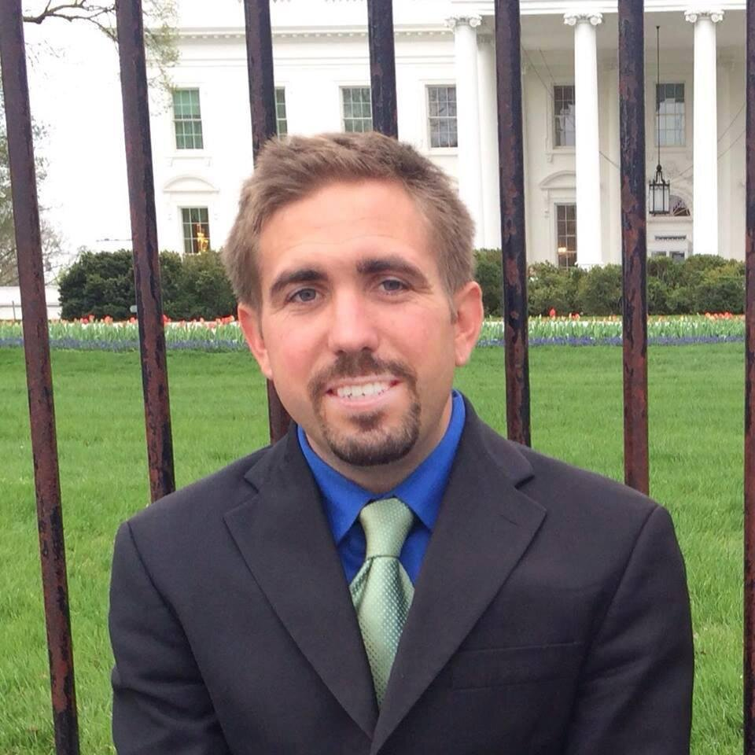
Rio Tazewell
People for the American Way, Manager of Government by the People Campaign
Democracy Awakening Organizer
www.pfaw.org
rtazewell@pfaw.org

Slide 26
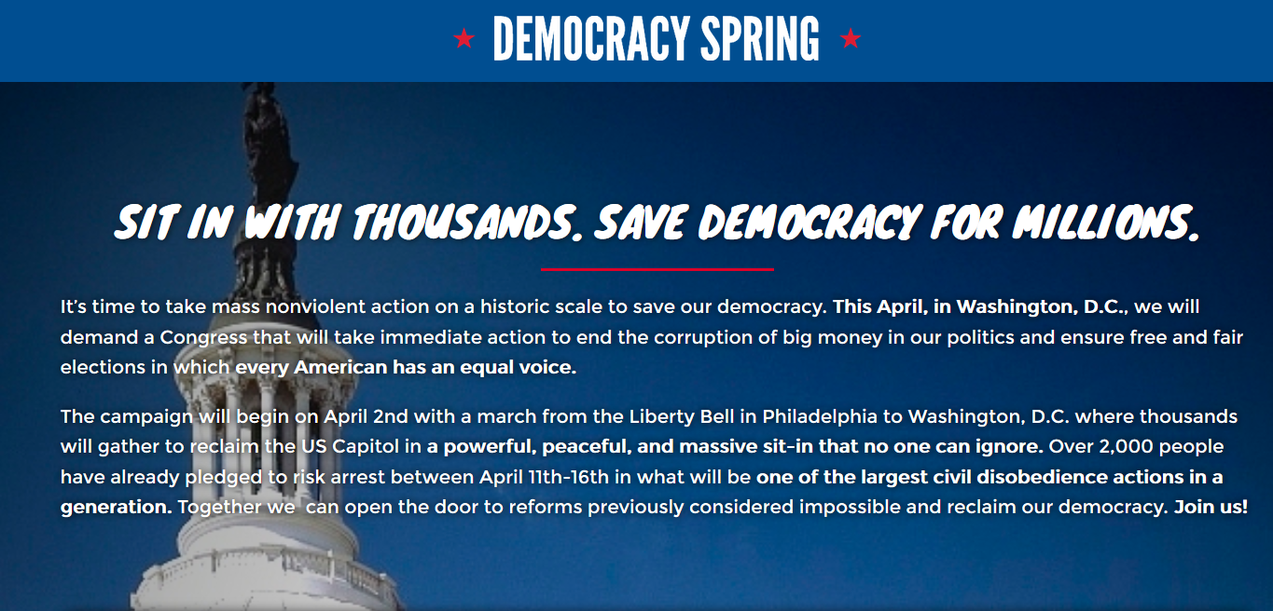
www.democracyspring.org

Slide 27

Washington, DC
April 16th to 18th
http://democracyawakening.org/

Slide 28
Events
Tele-Town Hall – Tuesday, March 1st
Register: http://democracyawakening.org/pda-2/
Teach, Learn Transform – Saturday, April 16th
Rally for Democracy – Sunday, April 17th
Congress of Conscience Day of Action – Monday, April 18th
Register: http://democracyawakening.org/pfaw/

Slide 29
Rio Tazewell – Q&A

Slide 30
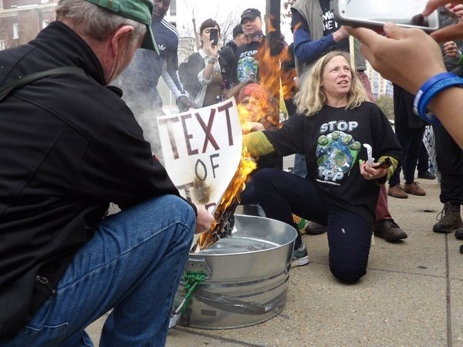
DR. MARGARET FLOWERS
Dr. Margaret Flowers is a pediatrician and co-chair of the Maryland chapter of Physicians for a National Health Program (PNHP). Margaret is also Co-Director of PopularResistance.org and It's Our Economy, Co-Organizer of Flush the TPP (flushthetpp.org).
Its Our Economy (www.itsoureconomy.US)
Popular Resistance (www.popularresistance.org
Democratize the Media / Forces of Greed
Radio: http://www.ClearingtheFOGRadio.org
TPP Campaigns: www.flushthetpp.org

Slide 31
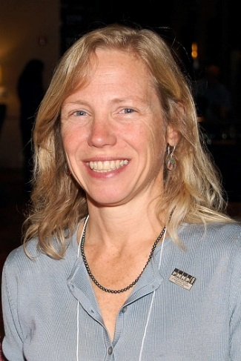
Dr. Margaret Flowers – Q&A

Slide 32
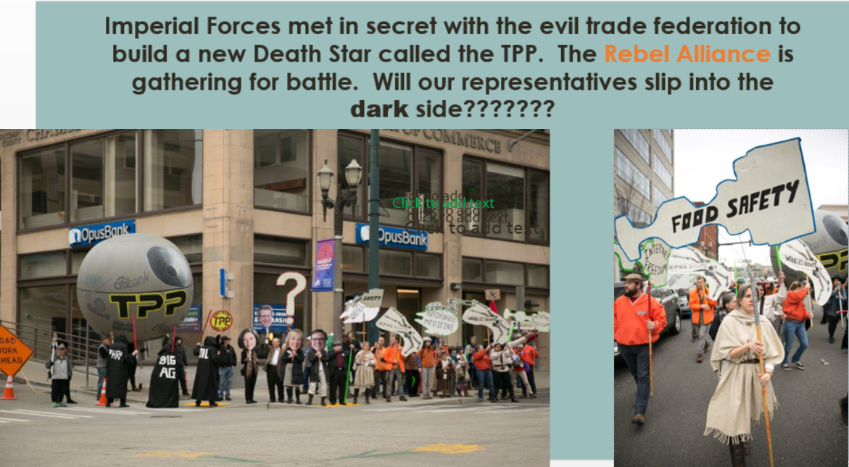

Slide 33
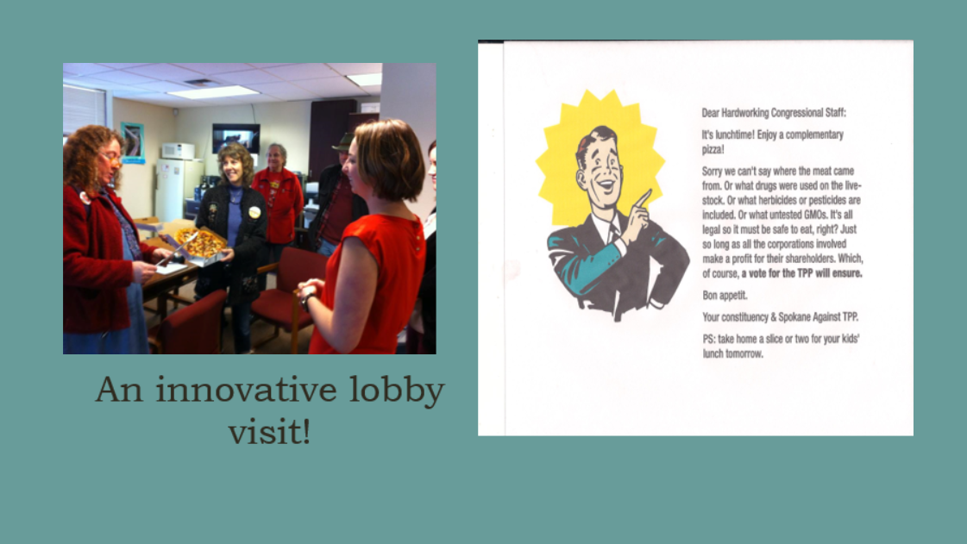

Slide 34
Action Reportbacks
Congressional actions
Rallies

Slide 35


Call Planning Team
Adam Weissman
Global Justice for Animals and the Environment
TradeJustice
www.TRADEJUSTICE.NET
*Call Planning Team
*Speaker Recruitment
*Events, news stories and actions
http://tradejustice.net/events
http://www.tradejustice.net/news
adam@tradejustice.net

Slide 36

Get Involved
Join our planning or outreach & promotion teams!
Let us know when you are available for meetings this week by taking the scheduling polls at http://tradejustice/net/tjpolls

Slide 37
Upcoming Calls
TPP Impacts on Communities of Color – March 6th
Big Ag Effects on Climate – March 20th
Women’s Issues and the TPP – April 3rd
Privatization of Water – April 17th
International Labor Rights – May 1st

