Slide 1
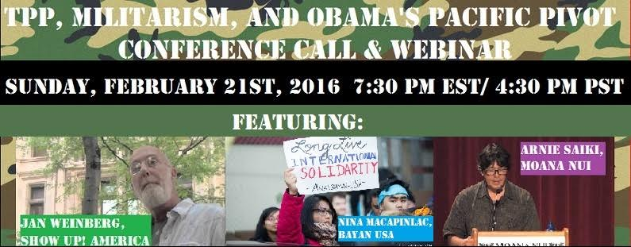
For Audio use phone or Skype
Call: 605-562-3140
PIN: 951146#

Slide 2
Speakers
Arnie Saiki, coordinator of Moana Nui Action Alliance
Jan Weinberg, Show Up! America
Nina Macapinlac, BAYAN USA
Dr. Margaret Flowers, Co-Director Popular Resistance,
Co-Organizer Flush the TPP
Adam Weissman, TradeJustice New York/ Global Justice for Animals and the Environment
Emilianne Slaydon, TPP Media March

Slide 3


INTRODUCTION AND WELCOME
Andrea Miller, Executive Director
People Demanding Action
andrea@peopledemandingaction.org
Call Structure and Norms:
Audio is PHONE ONLY; you must call in
Do not enable your video camera
All calls are recorded; a link is available after the call
Q & A mode: To eliminate background noise we mute everyone when we begin recording.
Press *6 (when prompted) to ask a question; say your name, your organization, if any, and location. Be courteous and brief; give others a chance to ask questions too.
Keep chat room discussions on topic and professional

Slide 4


Technical Information
Audio is available only via phone
DIAL IN: 605 562 3140 ACCESS CODE: 951146#
Meeting Room Functions
- Chat
- Share
Use the Share button in the Meeting Room:
After the call, click the unique link below to download this week's PowerPoint, recording link and other materials: http://www.peopledemandingaction.org/downloads/tpp/tpp-february-21-2016-call-materials

Slide 5

Technical Advisor/Facebook Page Manager
Tom Hocking, Technical Advisor
MoveOn, PA
TWHocking@Gmail.com
*Pre/Post Call Technical Questions
*Global TPP Team Facebook Page Manager
Facebook:
https://www.facebook.com/groups/GlobalTPPTeam

Slide 6

Chat Host/Call Planning Team
Lisa Oldendorp
MoveOn, New York
eslsk8r@optonline.net
*Chat Host
*Call Planning Team

Slide 7

Call Planning Team
Harriet Heywood
harrietheywood@gmail.com
Call Co-Organizer
Florida State Leader –
People Demanding Action
Upcoming Tampa Event

Slide 8

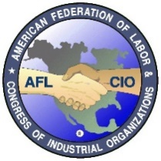
Call Planning Team
Celeste Drake
Trade and Globalization Policy Specialist,
AFL-CIO
Cdrake@AFLCIO.org
*SOTU Report
*USITC TPP Hearing

Slide 9

Call Planning Team
Linda Brewster
LindaJBrewster@msn.com
*Call Planning
*Information and event sharing
*MoveOn Regional Organizer (WA)

Slide 10


Call Planning Team
Mara Cohen
Marajai51@Gmail.com
*PDA Mass Criminalization Team Leader
*Popular Resistance Organizer
*Global Climate Convergence Leader (IL)

Slide 11

Emilianne Slaydon
Director, Social Media
@TPPMediaMarch
Twitter.com/TPPMediaMarch
Every #TPPTuesday
6pm PT | 9pm ET
Tweets:
tiny.cc/TPPMediaMarch

Slide 12
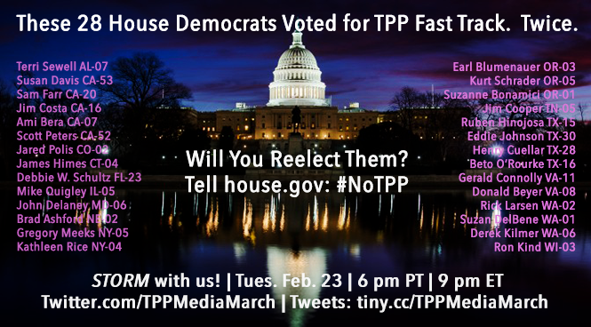

Slide 13
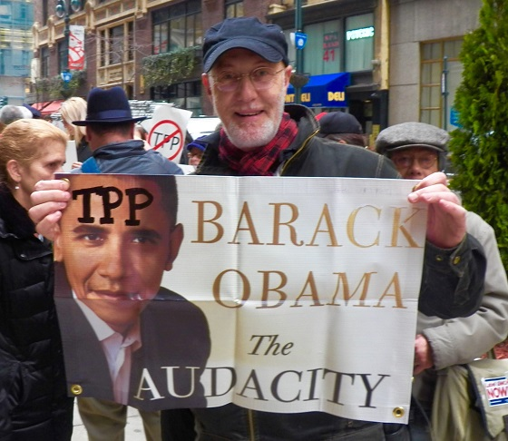
Jan Weinberg – Show Up! America
Jan Weinberg is the founder of Show Up! America, whose central focus is to educate the public on how to get involved, through civic engagement, and to affect change in government, particularly at the local level.
As a long-time, broad-based social justice activist, Jan began organizing in the late '60s as an advocate for peace during the Vietnam War, and more recently, with the Occupy Movement, Occupy Alternative Banking, the People’s Climate March, and Flush the TPP.
Jan has, more recently focused his work on the influence of the Military-Industrial Complex on free trade agreements, specifically, the "Pivot to Asia" and TPP deliberations, through his project called, “Violence Incorporated.”

Slide 14
Violence, Incorporated an expose' on
The Influence of the Military-Industrial Complex On Public Policy and the Trade Agreements
Obama’s "Pivot to Asia" and the Trans Pacific Partnership deliberations are inextricably linked.
The Obama Administration; negotiated, what might be construed as, "side agreements" - related to armament sales & “donations” - the forward deployment of U.S. Military assets and international "military-to-military exercises".
This appears to have been performed in conjunction with members of The President’s Export Council.

Slide 15
President’s Export Council/
The Business Roundtable
President Obama placed James McNerney as Chairman of the President’s Export Council while Mr. McNerney simultaneously served as the President and CEO of Boeing and as the Chairman of The Business Roundtable
The Business Roundtable is woven into the government/corporate collusion fabric.
Regarding the current political implications-some candidates for the 2016 Presidential campaign are connected with this story.

Slide 16
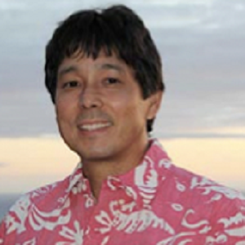
Arnie Saiki – Moana Nui Action Alliance
Arnie Saiki is coordinator of Moana Nui Action Alliance in California. Based on a series of conferences between the International Forum on Globalization and Pacific Island activists, academics and practitioners, Moana Nui addresses economic and military hegemony in the Pacific.
He was the Research Director for Statehood Hawai'i and keeps a blog, Imipono Projects. Most currently, he is participating in the World Bank Fragility, Conflict and Violence Forum in March, and working with partner groups in the Pacific on West Papua liberation and opposing Experimental Seabed Mining

Slide 17


Slide 18


Slide 19
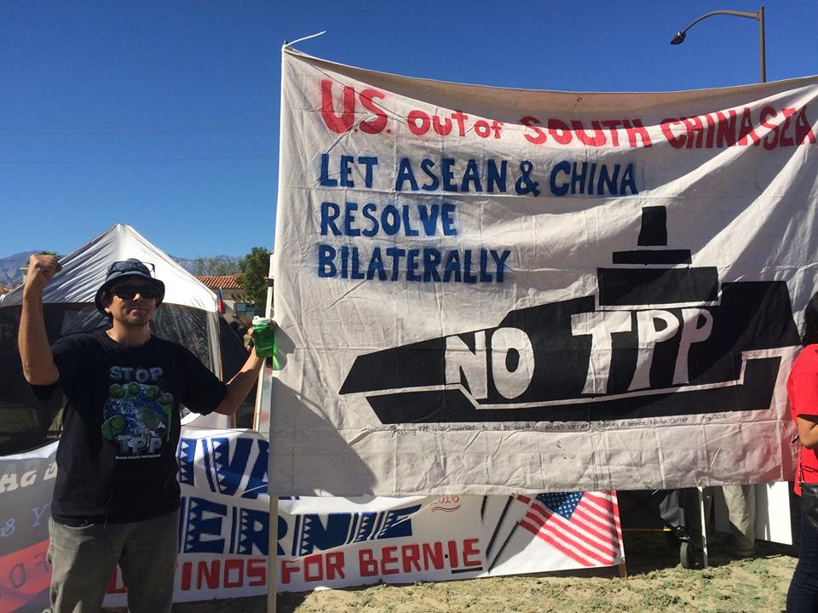
No TPP South China Sea banner

Slide 20
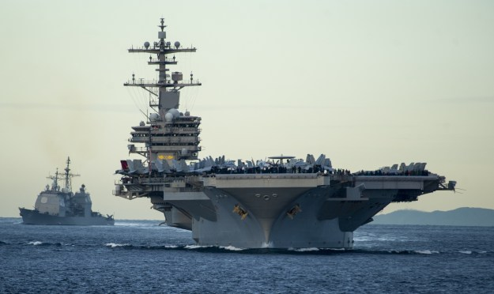
US Navy Admiral Locklear” “we needed the TPP as much as a new aircraft carrier”

Slide 21
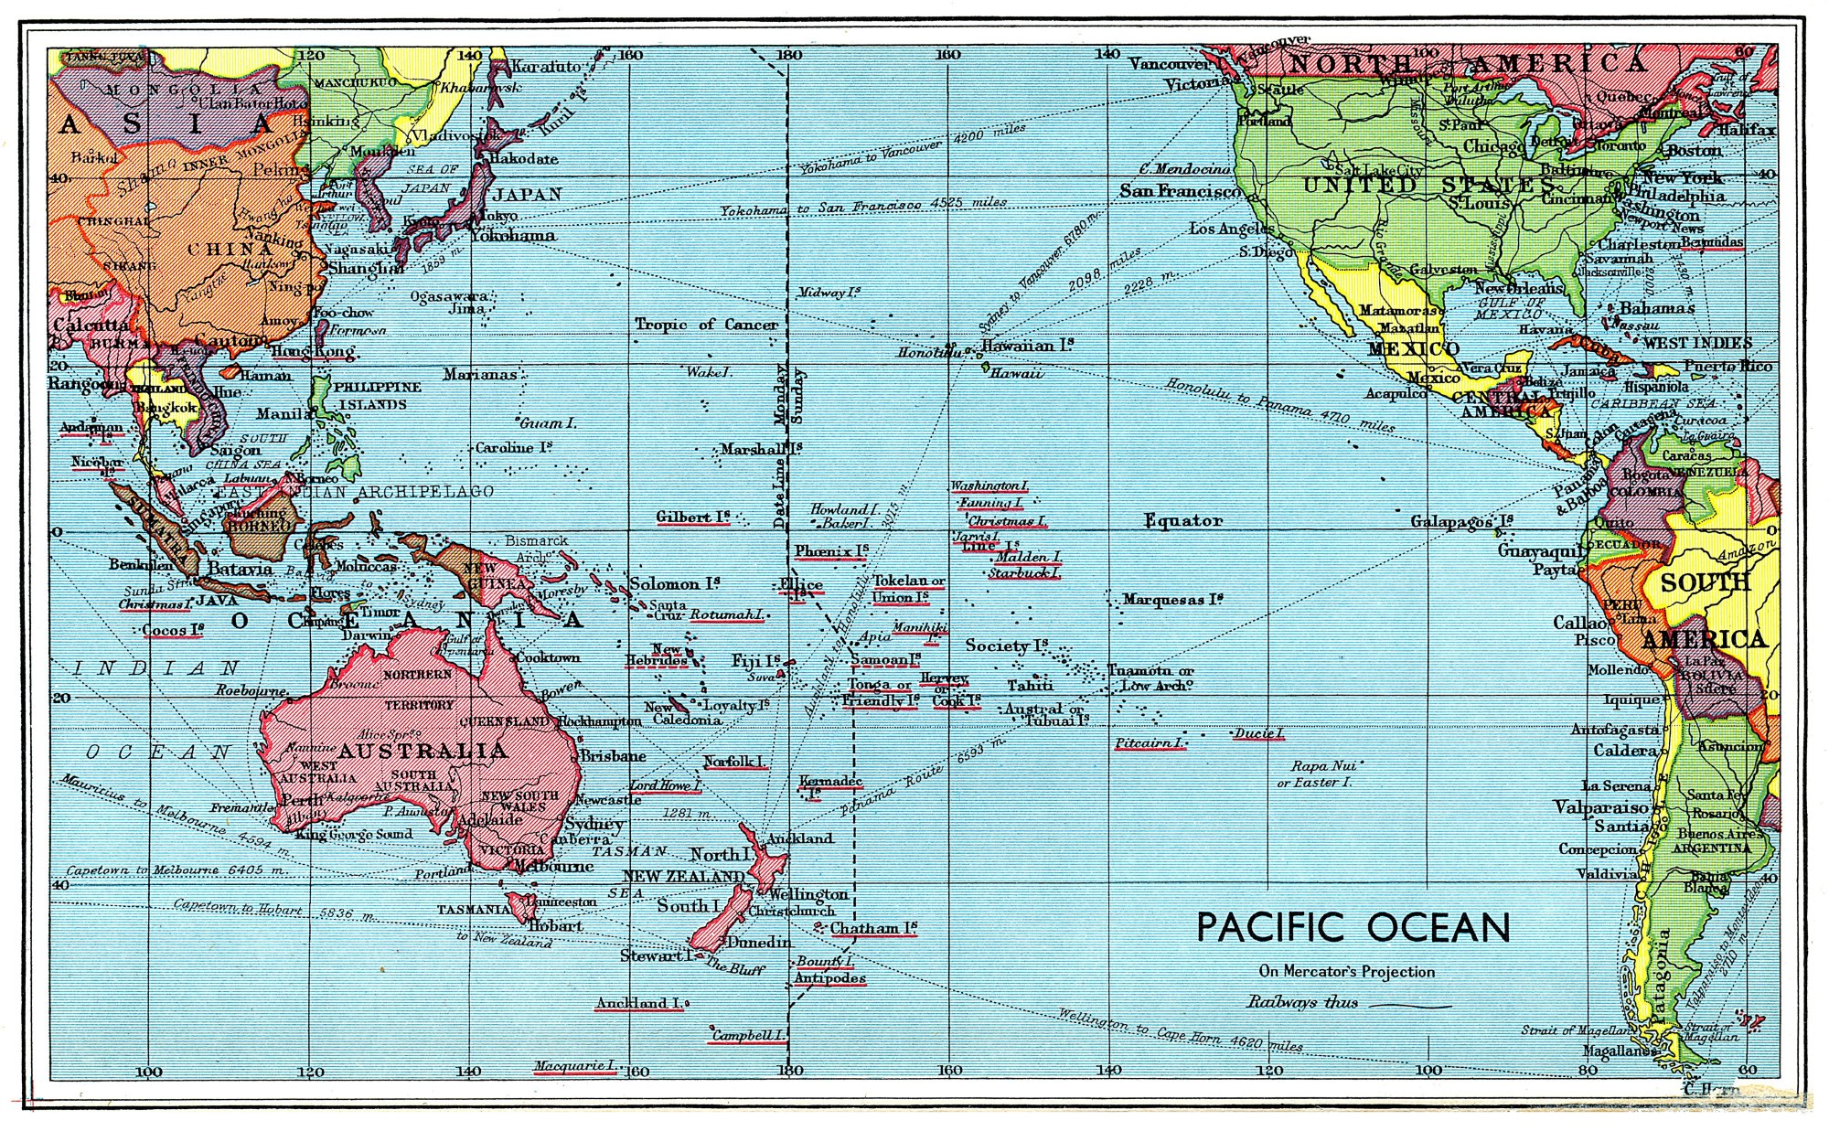
Pacific Islands

Slide 22
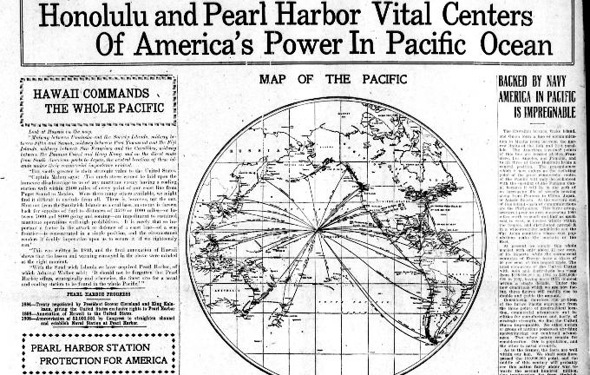

Slide 23
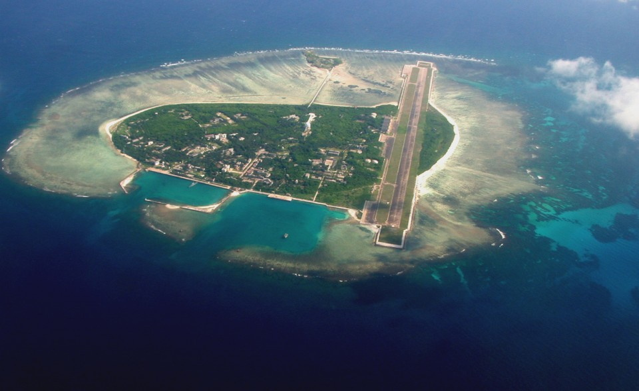
Yongxing Island in the Paracels

Slide 24
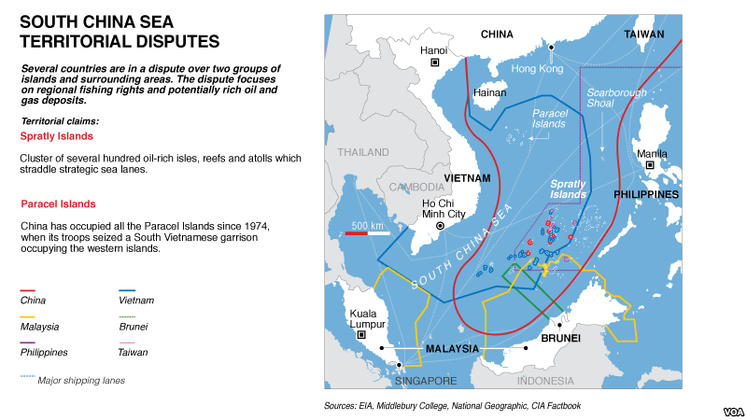
South China Sea

Slide 25
South China Sea Territory
11 dash line – US backed Kuomintang
US narrative: China seized Paracels killing South Vietnamese troops in 1974
Real world narrative: China was supporting the North Vietnamese and this was an action at the end of the Vietnam war– which the north won. North Vietnam recognized China’s claim.
9 dash line – PRC Zhou Enlai removed line between Vietnam and Hainan Island after Vietnam War
US interests in South China Sea failed with the loss of Republic of China and Republic of Vietnam.

Slide 26
Competing Interpretations of Territory
2002 Declaration on the Conduct of Parties in the South China Sea – bilateral approach
U.S. Freedom of Navigation operation-multilateral approach
UNCLOS: UN Convention on the Law of the Sea- recognizes both
Cooperation and capacity building

Slide 27
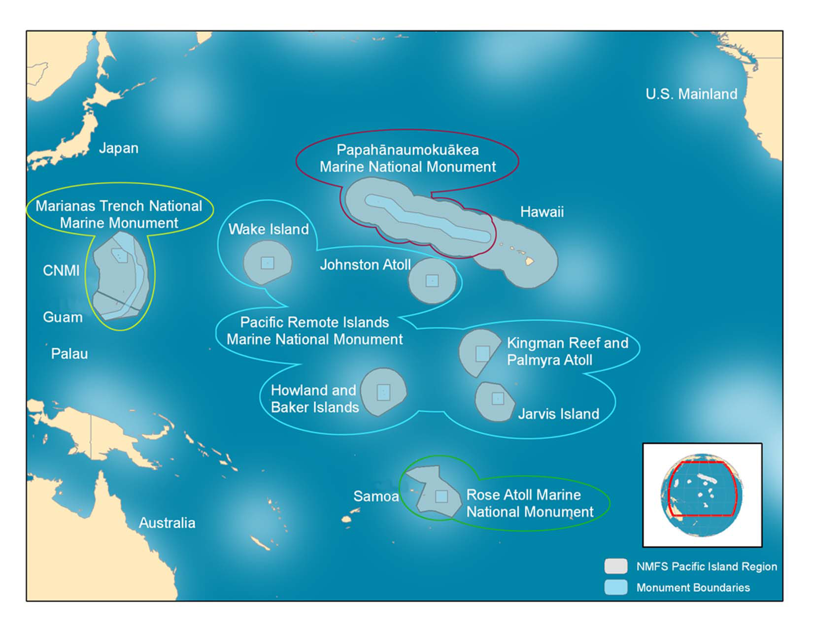
PRIMNM (Pacific Remote Island Marine National Monument)

Slide 28
TPP-BRICS
2005 TPP (Strategic-Economic) signed between Brunei, Chile, New Zealand and Singapore (pathfinder FTAAP)
2007 Bush announces joining the TPP
2008 US financial markets collapse-Emerging Market economies sustaining
2009 Obama joins TPP negotiations- First BRICS Summit
2011 “Pacific Pivot” is announced rebalancing US military and trade in the Asia-Pacific. Containment /obstruction policy inferred
2012 BRICS cooperation gets worked out, developing EEU
2014- Fortaleza Declaration. Ukraine. Article 9 of Japanese Constitution amended to allow for active military outside Japan.
2015- New Development Bank, Contingency Reserve Arrangement, Asian Infrastructure Investment Bank, Belt and Road
Tensions build as US sees itself becoming irrelevant in the region, and uses South China Sea to keep itself relevant

Slide 29
Chapter 21: Cooperation and Capacity Building
Trans-Pacific Partnership Agreement
Article 21.4:2..
“(c) initiate and undertake collaboration, as appropriate, to enhance donor coordination and facilitate public-private partnerships in cooperation and capacity building activities;
(d) invite, as appropriate, international donor institutions, private sector entities, non-governmental organisations or other relevant institutions, to assist in the development and implementation of cooperation and capacity building activities;

Slide 30
Defense Security Cooperation Agency
(DSCA) Vision 2020
October 2015
The DSCA supports and enables the synchronization of security cooperation efforts to meet U.S. and partner country customer expectations. They do so by aligning efforts to strategic priorities, enabling more responsive industry participation in security cooperation, and responding to our international partners’ requirements so as to remain a provider of choice.
The DSCA facilitates binding International Agreements
Status of Forces Agreement (SOFA) is one of them.
The SOFA generally establishes the legal framework under which DoD military and civilian personnel operate in a partner nation, addressing matters such as taxation, criminal jurisdiction, claims, drivers’ licenses, privileges and immunities. The U.S. does not pursue a SOFA with each partner nation, and a SOFA is not required before a partner nation may receive BPC program assistance.

Slide 31
White House Fact Sheet:
U.S.-Japan Bilateral Cooperation
April 25, 2014
“We are firmly committed to reaching a high-standards agreement on the Trans-Pacific Partnership (TPP), recognizing that this will support jobs and growth in both countries.”
“The two countries are developing an agreement supplementing the Status of Forces Agreement (SOFA).”

Slide 32
In Summary
The “Freedom of Navigation” proposal attempts to legally entrench its military and trade regime in the region, while obstructing China’s maritime presence.
TPP containment and obstruction strategy is making the region far more unstable by invoking a military partnership that perpetuates a policy of global corporate governance for the 1%.

Slide 33
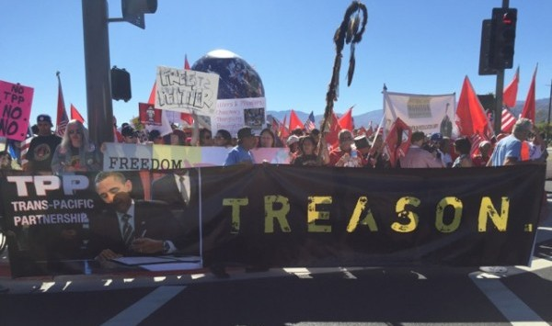
No TPP Action Obama-ASEAN1

Slide 34
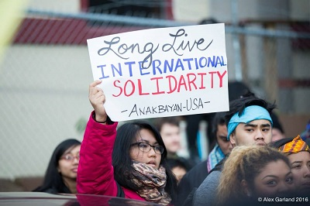
Nina Macapinlac
Nina Macapinlac is an activist with BAYAN USA, an alliance of 20 progressive Filipino organizations in the United States.
Bayan USA It is the overseas chapter of BAYAN in the Philippines which is fighting for the national liberation of the Philippines

Slide 35
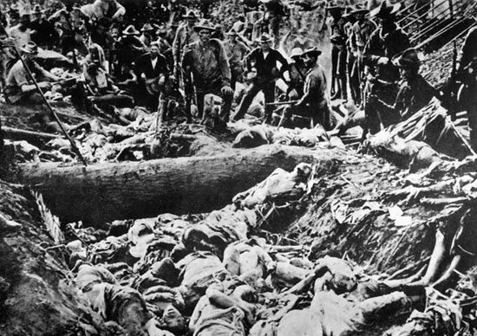

Slide 36
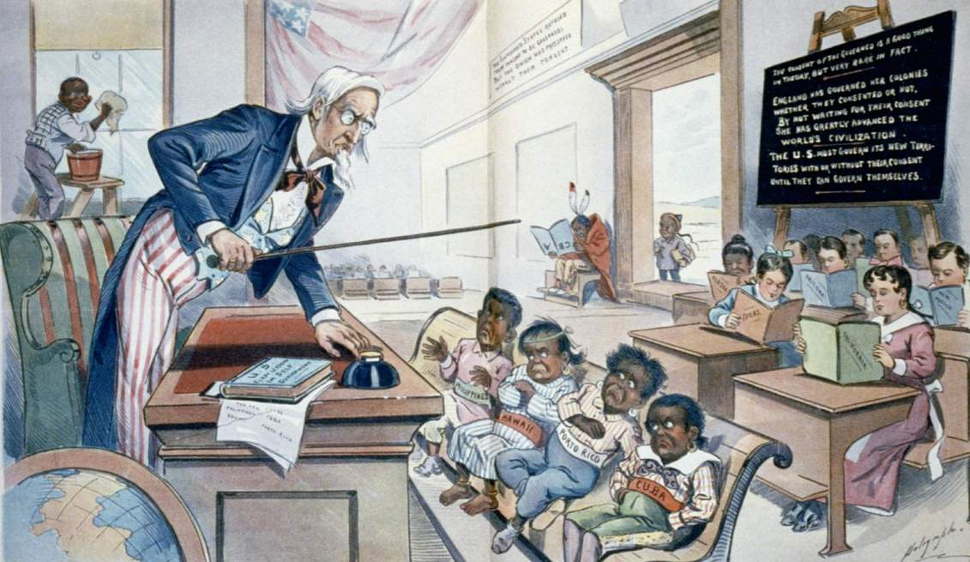

Slide 37


Claims to promote economic cooperation among countries of the Asia-Pacific region
Composed of 21 member-states/economies
Founded in 1989
It has mainly advanced the dominant interests of developed countries led by the United States and Japan
APEC Summit in November in Manila

Slide 38
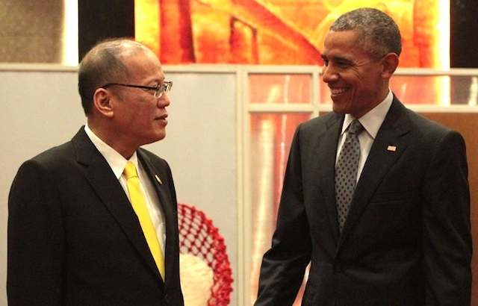
We welcome the Philippines’ interest in TPP. And we’ve directed our trade ministers to have discussions about how TPP is going to be implemented among the original 12 countries, and how we can work with the Philippines to follow through on their interest.

Slide 39
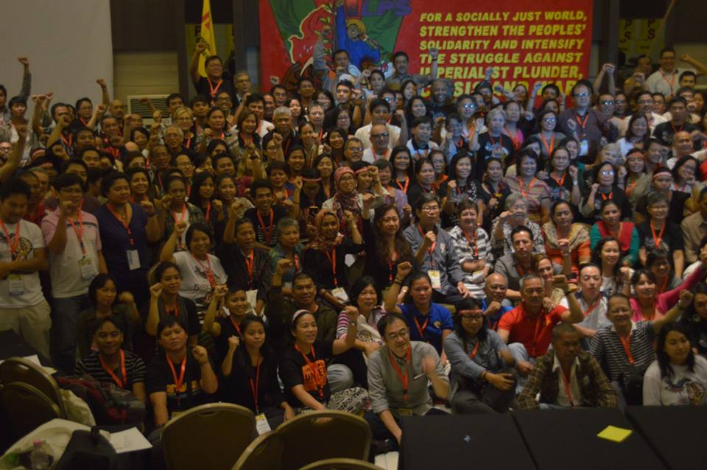


Slide 40
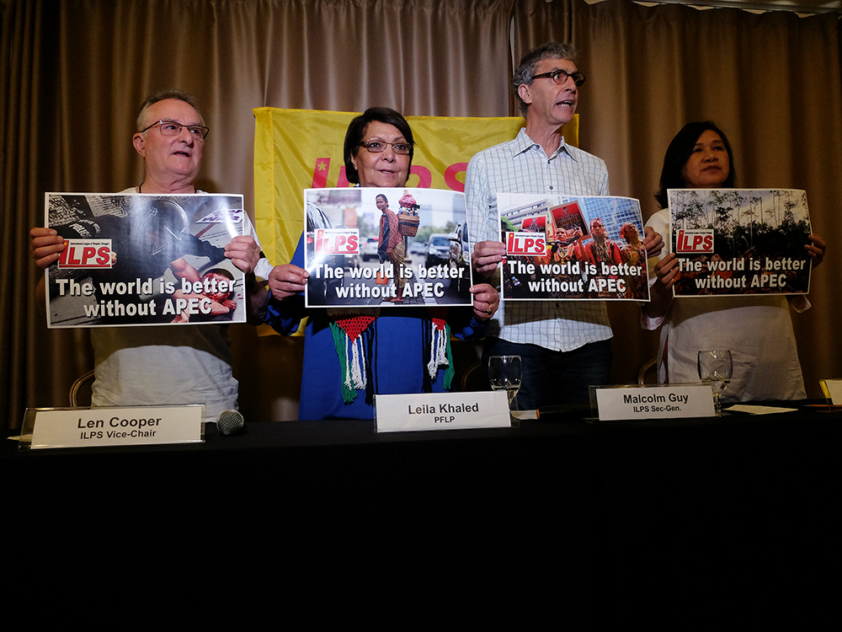
CONCERN 2:
On the socio-economic development for oppressed and exploited countries and nations and social equity for all working people
US imperialism is countermaneuvering with new “free trade agreements” such as the Trans-Pacific Partnership (TPP) and the Transatlantic Trade and Investment Partnership (TTIP). These are largely politically motivated designs to institute new rules on trade to maintain full spectrum dominance of US finance and corporate monoplies through a renewed scheme of neocolonization of emerging rivals that if successful would subject foreign governments to these monopolies.

Slide 41
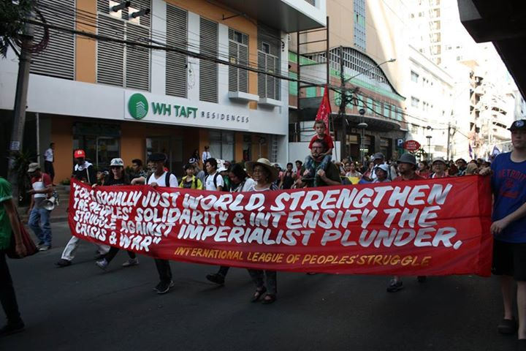
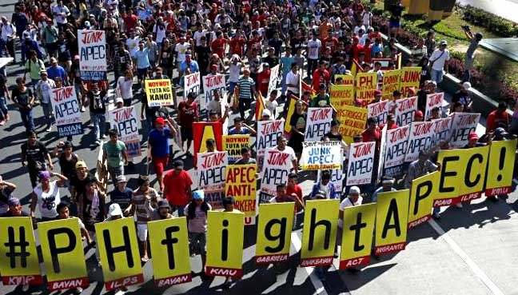

Slide 42
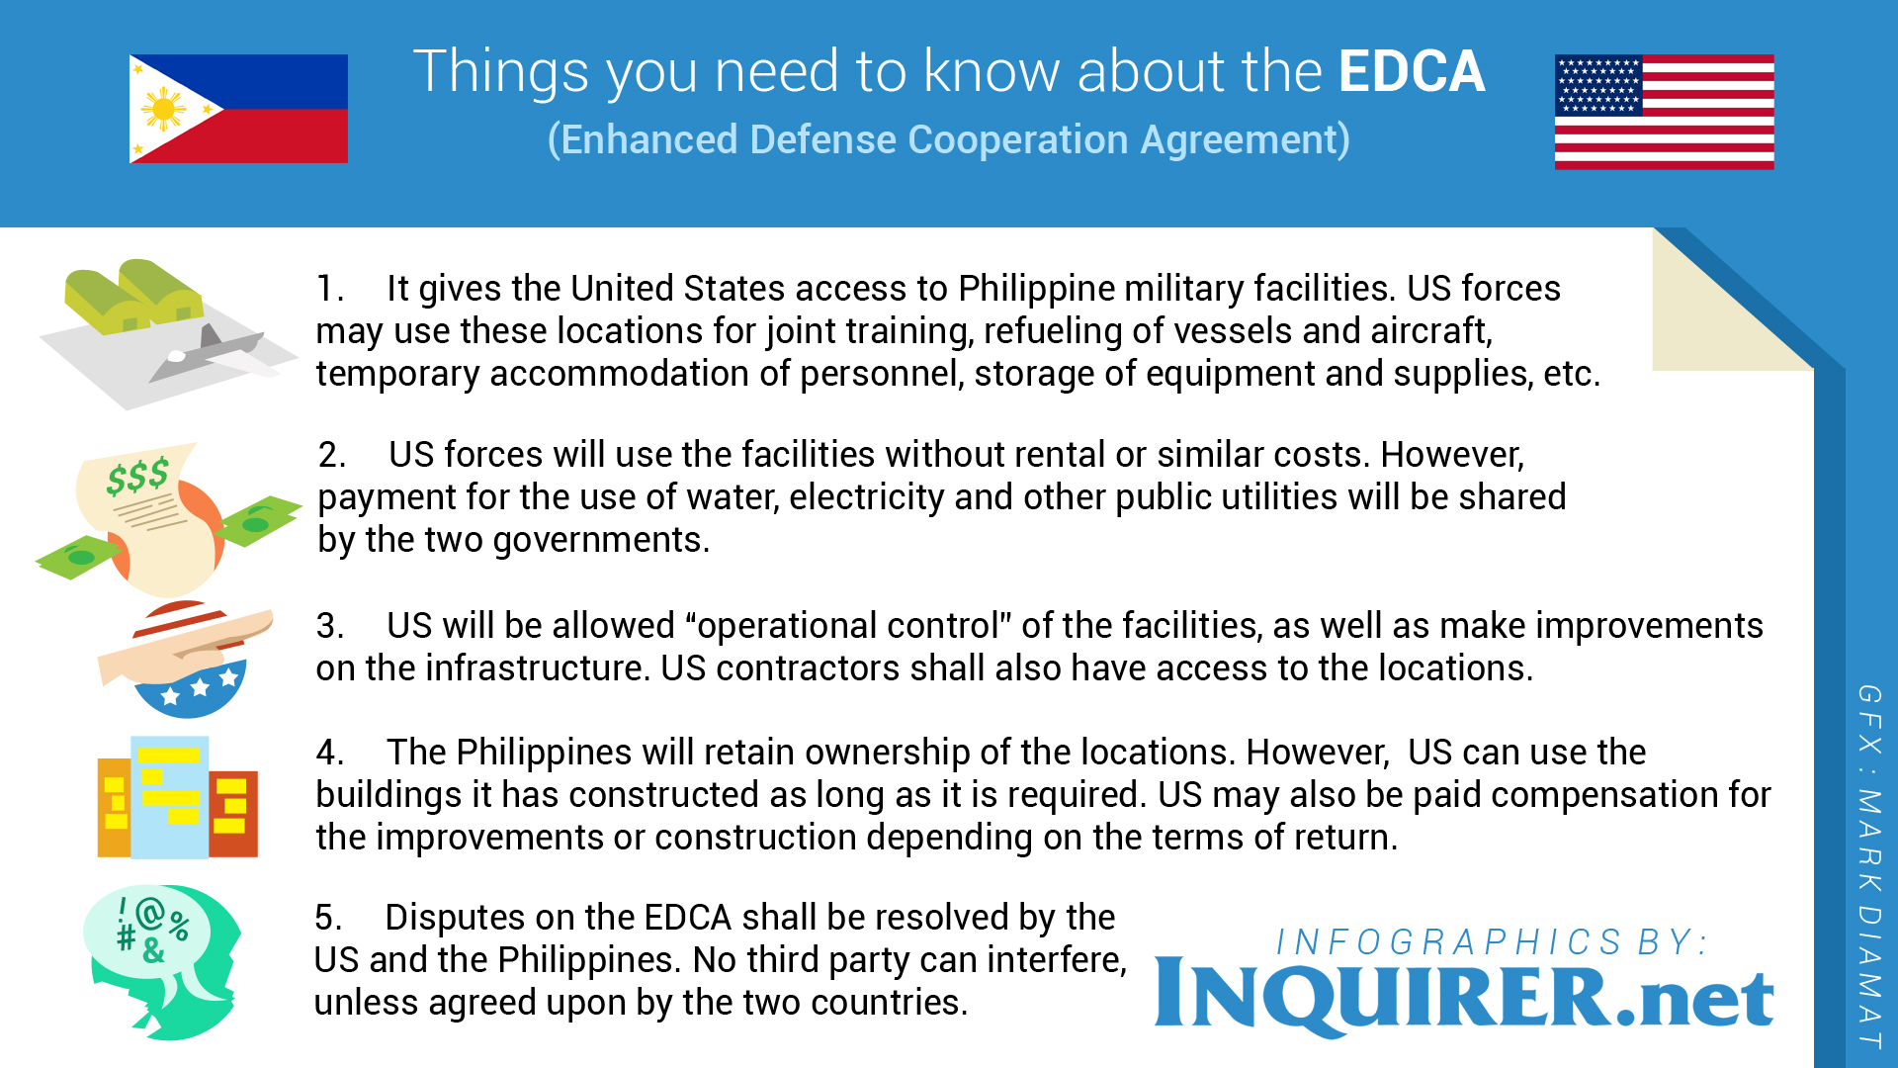

Slide 43


Slide 44
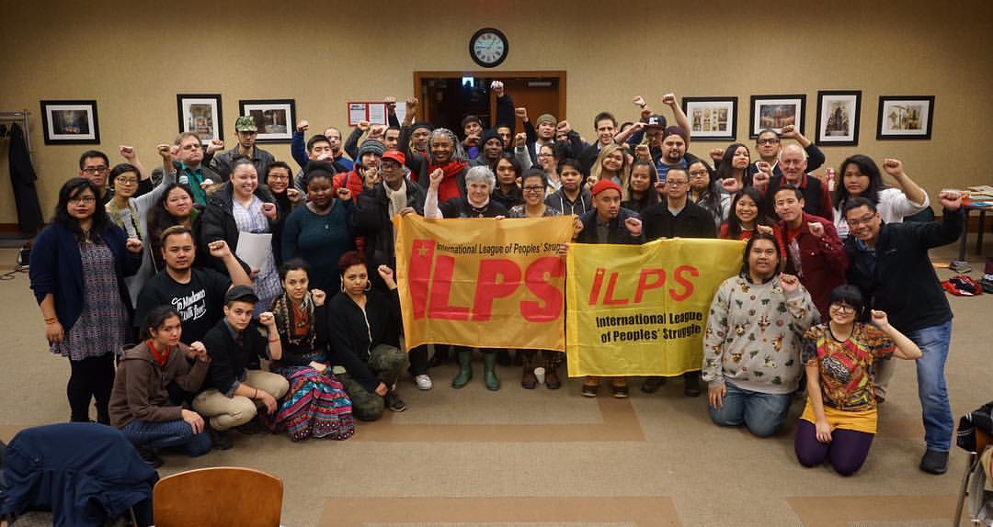
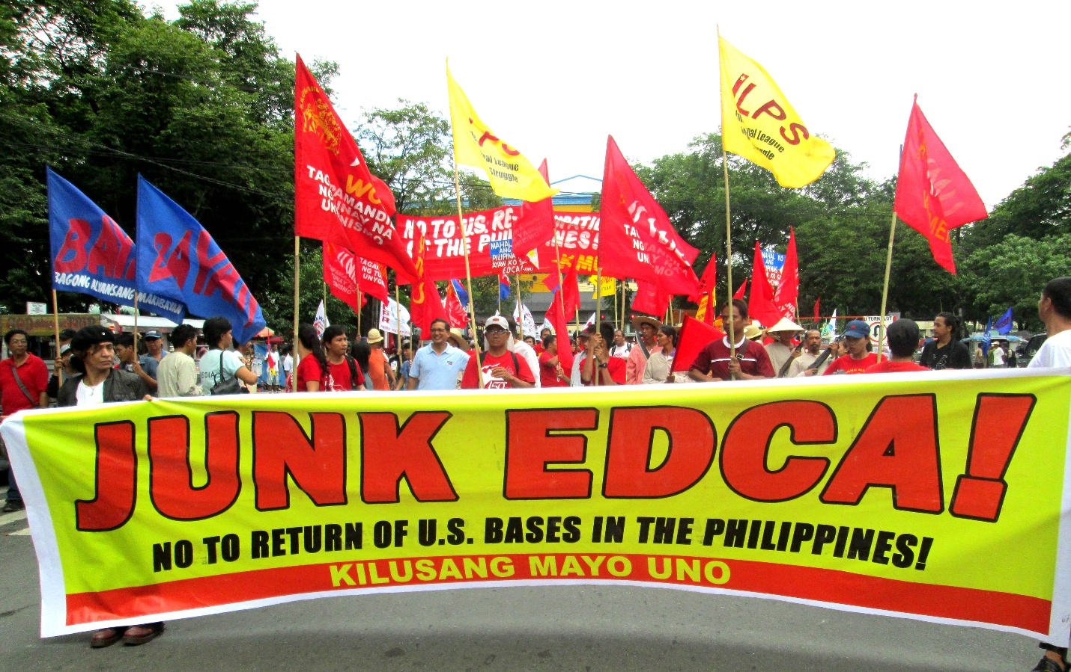
JOIN International
League of Peoples’ Struggle!
Check out ilps.info or contact Nina Macapinlac on how to join
nmacapinlac@gmail.com
DOWN WITH IMPERIALISM!
LONG LIVE INTERNATIONAL SOLIDARITY!

Slide 45
Arnie Saiki, Jan Weinberg & Nina Macapinlac Q&A

Slide 46


Call Planning Team
Adam Weissman
TradeJustice
Global Justice for Animals and the Environment
www.TRADEJUSTICE.NET
*Call Planning Team
*Speaker Recruitment
*Events, news stories and actions
http://tradejustice.net/events
http://www.tradejustice.net/news
adam@tradejustice.net

Slide 47
Adam Weissman TradeJustice.net News Reports
Peterson Institute Study Shows TPP Will Lead to $357 Billion Increase in Annual Imports (Beat the Press - Center for Economic and Policy Research, 1/26/16)
Peru gets ready to submit TPP to Congress (Agencia Peruana de Noticias, 1/12/16)
House Speaker Paul Ryan on Passing TPP: ‘I’m Not the Dictator of the House’ (CNS News, 2/15/16)
US announces TPP workshops to recruit new members (CCTV America, 2/16/16)
Sneaky Change to the TPP Drastically Extends Criminal Penalties (Electronic Frontier Foundation, 2/17/16)
Obama calls for all members to join TPP (Nikkei Asian Review, 2/18/16)
TPP Threatens Indigenous Land Rights Says the UN (Telesur, 2/18/16)
Influential Democrat on trade issues steps up opposition to TPP (Christian Science Monitor, 2/18/16)
Read these and MANY more recent TPP news and opinion articles at http://tradejustice.net/news

Slide 48

Get Involved
Join our planning or outreach & promotion teams!
Let us know when you are available for meetings this week by taking the scheduling polls at http://tradejustice/net/tjpolls

Slide 49
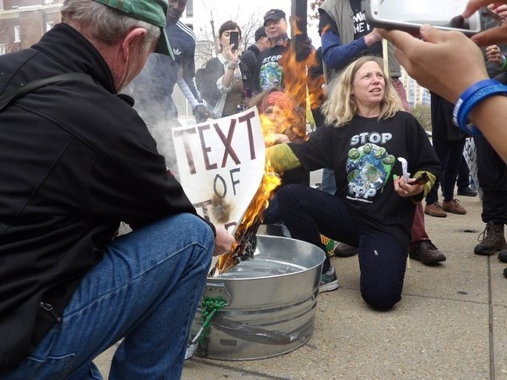
DR. MARGARET FLOWERS
Dr. Margaret Flowers is a pediatrician and co-chair of the Maryland chapter of Physicians for a National Health Program (PNHP). Margaret is also Co-Director of PopularResistance.org and It's Our Economy, Co-Organizer of Flush the TPP (flushthetpp.org).
Its Our Economy (www.itsoureconomy.US)
Popular Resistance (www.popularresistance.org
Democratize the Media / Forces of Greed
Radio: http://www.ClearingtheFOGRadio.org
TPP Campaigns: www.flushthetpp.org

Slide 50
Trade Justice News Report
UN expert urges Pacific Rim countries not to sign the TPP without committing to human rights and development (United Nations Human Rights Office of the High Commissioner, 2/2/16)
#TPP officially signed, Indonesia to amend 12 laws (The Jakarta Post, 2/5/16)
US President Barack Obama likely to promote virtues of TPP – and independence from China – during summit with Southeast Asian leaders (South China Morning Post, 2/13/16)
National Farmers Union hopes Congress will stop TPP (Crop Protection News, 2/9/16)
Speaker Ryan: Not enough votes for TPP trade deal (CBS News, 2/11/16)
More news stories at http://tradejustice.net/news

Slide 51
VOLUNTEER TO PLAN AND PROMOTE THESE WEBINARS!
Sign up to attend a planning call for our:
Call Planning Team: http://tradejustice.net/plan213
Outreach, Promotion, and Publicity Team: http://tradejustice.net/promo213

Slide 52
NY Metro Recess Actions
“BREAK UP WITH THE TPP” DANCE RIDE
Date: Monday, February 15, 2016, 3PM
Location: Meet at NYC’s NYPL Main Branch between the lions
Join NYC’s Public Space Party on a dance-bike ride to “Break Up with the TPP”. A day after Valentine’s Day tell the people of NYC we’re through, and why, with the secret corporate contract, and encourage everyone to tell our elected officials also to break up with the TPP. We’ll hand out broken-hearted valentines with information, and dance to the sound bike blasting twisting songs of heartbreak and redemption. Contact Brennan at brennan@brennancavanaugh.com for questions
DROP-IN VISITS AT CONGRESSIONAL OFFICES
Email adam@tradejustice.net for details

Slide 53
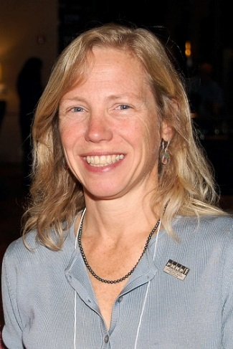
Dr. Margaret Flowers and Adam Weissman
Q&A

Slide 54
