Slide 1

Strategy to Stop the TPP from New Zealand to the US Congress
For Audio use phone or Skype
Call: 605-562-3140
PIN: 951146#

Slide 2
Speakers
Dr. Bill Rosenberg, Policy Director and economist for the New Zealand Council of Trade Unions
Elizabeth Swager, National Organizing Director, Citizen's Trade Campaign
Andrea Miller, Executive Director, People Demanding Action
Dr. Margaret Flowers, Co-organizer, Flush the TPP and Co-Director, Popular Resistance
Celeste Drake, Trade and Globalization Policy Specialist, AFL-CIO

Slide 3


INTRODUCTION AND WELCOME
Andrea Miller, Executive Director
People Demanding Action
andrea@peopledemandingaction.org
Call Structure and Norms:
Audio is PHONE ONLY; you must call in
Do not enable your video camera
All calls are recorded; a link is available after the call
Q & A mode: To eliminate background noise we mute everyone when we begin recording.
Press *6 (when prompted) to ask a question; say your name, your organization, if any, and location. Be courteous and brief; give others a chance to ask questions too.
Keep chat room discussions on topic and professional

Slide 4


Technical Information
Audio is available only via phone
DIAL IN: 605 562 3140 ACCESS CODE: 951146#
Meeting Room Functions
- Chat
- Share
Use the Share button in the Meeting Room:
After the call, click the unique link below to download this week's PowerPoint, recording link and other materials: http://www.peopledemandingaction.org/downloads/tpp/tpp-february-14-2016-national-tpp-call

Slide 5

Technical Advisor/Facebook Page Manager
Tom Hocking, Technical Advisor
MoveOn, PA
TWHocking@Gmail.com
*Pre/Post Call Technical Questions
*Global TPP Team Facebook Page Manager
Facebook:
https://www.facebook.com/groups/GlobalTPPTeam

Slide 6

Chat Host/Call Planning Team
Lisa Oldendorp
MoveOn, New York
eslsk8r@optonline.net
*Chat Host
*Call Planning Team

Slide 7

Call Planning Team
Harriet Heywood
harrietheywood@gmail.com
Call Co-Organizer
Florida State Leader –
People Demanding Action
Upcoming Tampa Event

Slide 8

Call Planning Team
Linda Brewster
LindaJBrewster@msn.com
*Call Planning
*Information and event sharing
*MoveOn Regional Organizer (WA)

Slide 9


Call Planning Team
Mara Cohen
Marajai51@Gmail.com
*PDA Mass Criminalization Team Leader
*Popular Resistance Organizer
*Global Climate Convergence Leader (IL)

Slide 10
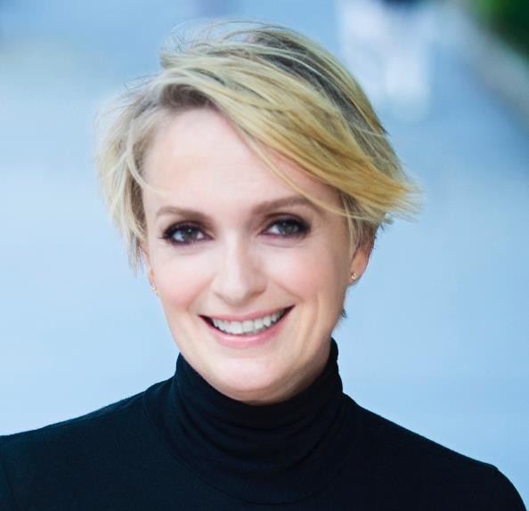
Emilianne Slaydon
Director, Social Media
@TPPMediaMarch
Twitter.com/TPPMediaMarch
Every #TPPTuesday
6pm PT | 9pm ET
Tweets:
tiny.cc/TPPMediaMarch

Slide 11
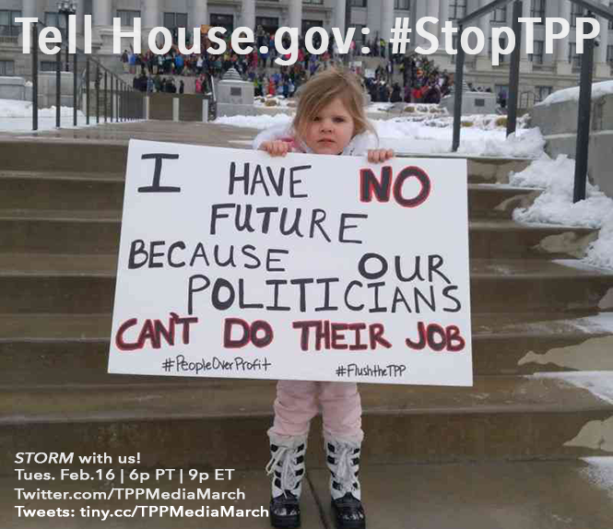

Slide 12
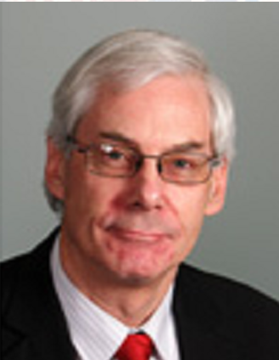

Dr. Bill Rosenberg
Dr. Bill Rosenberg is Policy Director and Economist for the New Zealand Council of Trade Unions. Bill was previously Deputy Director, for the University Centre for Teaching and Learning at the University of Canterbury, a Member of the Institute of Directors, a Commissioner on Tertiary Education Commission, and a member of the Regional Transport Committee of Environment in Canterbury.
Dr. Rosenberg is widely published on globalization, trade and e-learning and has been an active trade unionist for 30 years including the Tramways Union and Association of University Staff where he was National President for several years.
Bill holds a B.Commerce in Economics, a B.Sc. in Mathematics and a PhD in mathematical Psychology.

Slide 13
On the front lines of the TPPA:
Report from New Zealand
Great to be with you
Bill Rosenberg, Policy Director and Economist,
New Zealand Council of Trade Unions (NZCTU)

Slide 14
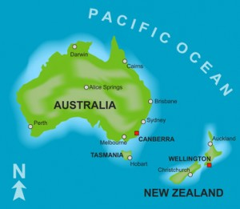
New Zealand
Population 4.7 million
Area 103,000 sq miles
Same as Colorado (have mountains too – but lots more beaches!)
Capital city Wellington
Largest city, business capital Auckland – pop. 1.4 million (like San Antonio)
Indigenous people (tangata whenua): Māori - 600,000

Slide 15
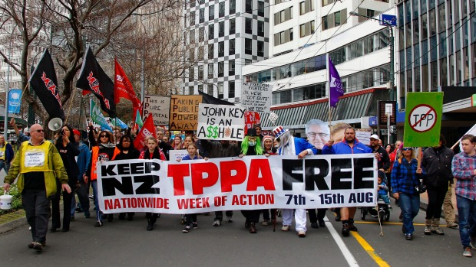

Slide 16
Opposition to TPPA in New Zealand
We call it TPPA – ain’t no Partnership!
Opposition growing over several years
Broad coalition of groups: Māori, unions, health professionals (doctors, nurses, academics), writers, artists, …
All opposition parties, breaking historical bipartisan support
Consumer NZ, Internet NZ, software companies, librarians, lawyers…
Great source of knowledge and energy in Prof Jane Kelsey
National coordination through It’s Our Future organisation
Big marches in 2014 and 2015 – 15-25,000 people in 20+ centres
Local governments passing resolutions of concern

Slide 17

Auckland 4 February: The Signing
Strong actions the weekend before in several centres:
From tiny Raglan where hundreds (about 20% of the population) jumped from Raglan footbridge in a chain bomb, or watched
  Video from main national TV network: https://www.tvnz.co.nz/one-news/new-zealand/more-than-200-tpp-protestors-turn-out-at-raglan.html
To car enthusiasts (Cars Against the TPPA)
To the capital, Wellington

Slide 18
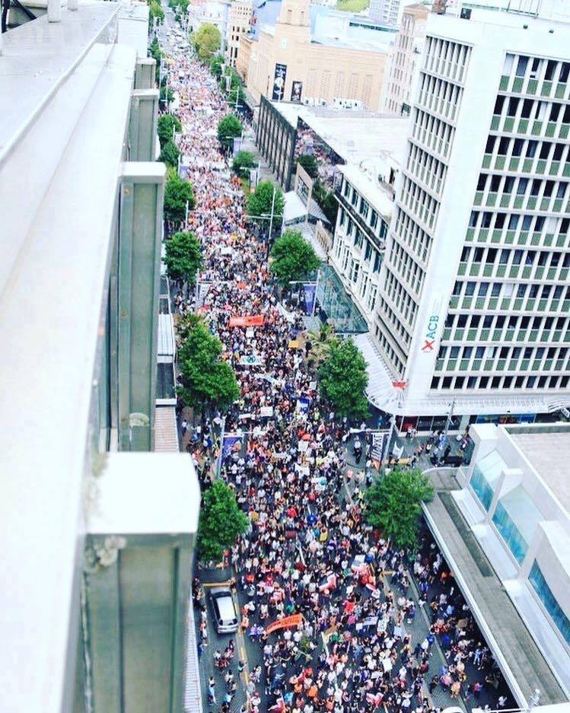
Auckland 4 February: The Signing
4 February: 15,000 march down Auckland’s main street
Led by (Māori) kapa haka groups and elders, leaders of unions, NGOs, political parties
Non-violent sit-downs on motorway ramps block central city
Pickets around signing venue (the casino!!)
Saturation coverage, all national media

Slide 19
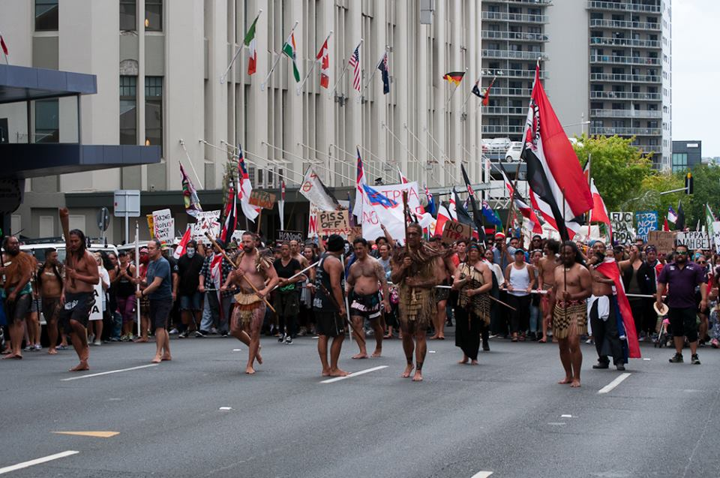
Auckland march led by Māori

Slide 20
Auckland march led by Māori
On 6 February 1840, treaty signed at Waitangi between Māori chiefs (rangatira) and representatives of the British colonial administration giving Māori sovereignty (rangatiratanga) over their land and possessions, subject to governance by the British crown: Treaty of Waitangi/Tiriti o Waitangi
Long ignored and Māori dispossessed; 40 years ago legal recognition
Treaty settlements to iwi (tribes); regrowth of Māori sovereignty, culture, confidence
See TPPA as an attack on that sovereignty – do not trust the government
Always a Māori welcome (pōwhiri) given to guests such as the Trade Ministers
Almost all Auckland iwi and kapa haka groups refused: in end only 3-4 people
TPPA big issue for annual Treaty celebrations at Waitangi two days later: in end Prime Minister refused to go due to opposition to him and TPPA

Slide 21
Where to now in New Zealand?
Government and business shocked; regrouping
Attacking opposition as not understanding, misled
Wooing Māori
National soft-sell road show
Beginning ratification process with Parliamentary hearings
Legislation this year
Ratification (by Cabinet) – timing not clear

Slide 22
International union cooperation
Many existing international union relationships
ITUC and TPPA affiliates
  Organised phone linkups – regulars from AFL-CIO, ACTU, NZCTU
  Met at some negotiating rounds – lobbying, joint statements, etc
  Developed a model Labour Chapter (based on US model)
  Issued statement opposing the final TPPA, and analysis of the Labour Chapter
  Supported online petition of New Zealand unions around time of signing
  Currently considering a campaign involving parliamentarians against TPPA
Union actions around the 4 February signing (other than US and NZ) included:
  ACTU (Australia): joint letter to MPs and press conference
  CLC (Canada): statement, declared first week of February lobbying week
  UNT (Mexico): co-organised an international forum

Slide 23

Finally…
Thanks for all your fantastic hard work.
Congratulations on your successes so far.
We count on you!

Slide 24
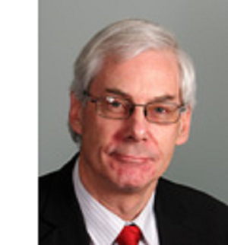
Q&A WITH DR. BILL ROSENBERG

Slide 25
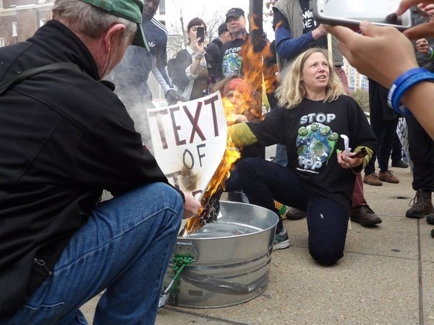
DR. MARGARET FLOWERS
Dr. Margaret Flowers is a pediatrician and co-chair of the Maryland chapter of Physicians for a National Health Program (PNHP). Margaret is also Co-Director of PopularResistance.org and It's Our Economy, Co-Organizer of Flush the TPP (flushthetpp.org).
Its Our Economy (www.itsoureconomy.US)
Popular Resistance (www.popularresistance.org
Democratize the Media / Forces of Greed
Radio: http://www.ClearingtheFOGRadio.org
TPP Campaigns: www.flushthetpp.org

Slide 26
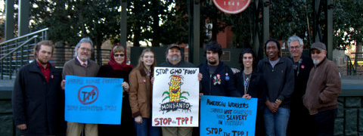
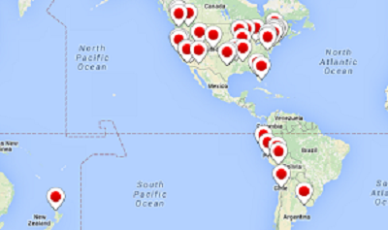
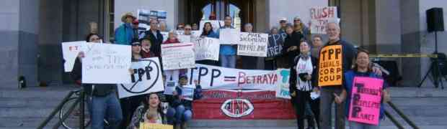
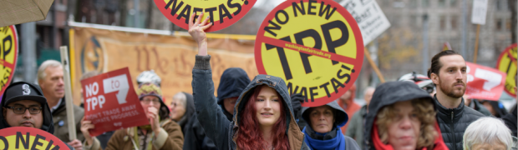
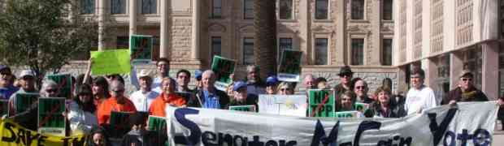
WEEK OF TPP SIGNING Reportback
TPP IS BETRAYAL EVENTS
Ole Miss Campus, Oxford, MS
Sacramento Capitol
Phoenix
Seattle

Slide 27
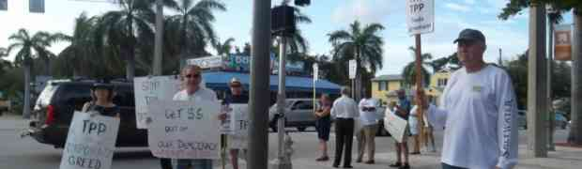
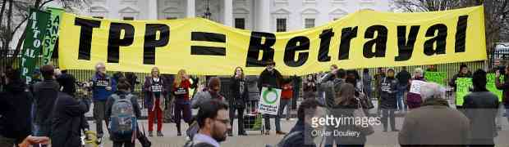

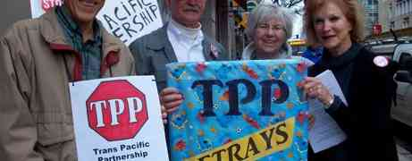
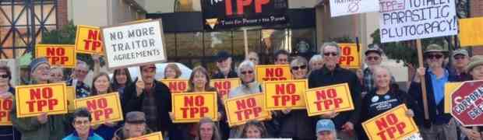
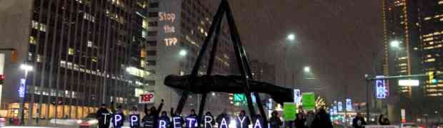
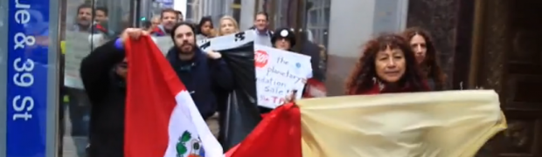
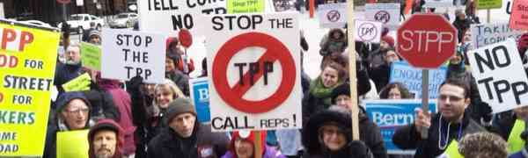
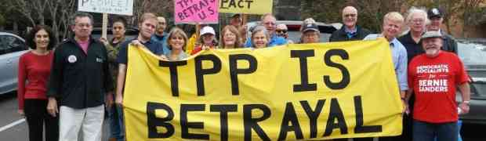
Delray Beach
Washington D.C.
Poughkeepsie
Boston
Santa Rosa
Detroit
New York
Tampa
Chicago

Slide 28
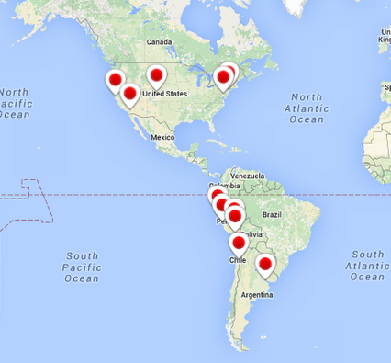
President's week/Valentine's Day actions
Upcoming mobilization
Wednesday night call
Contact: Popular Resistance (www.popularresistance.org
www.flushthetpp.org

Slide 29
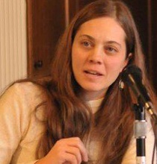
Elizabeth Swager
Elizabeth Swager is the organizing director of Citizens Trade Campaign, a national coalition of labor, environmental and human rights organizations working together to stop NAFTA-style free trade agreements.
Elizabeth's background includes:
Directing the Oregon Fair Trade Campaign, a state affiliate of CTC
Directing Sweatfree Northwest, where she led some of the most successful sweatshop-free public procurement campaigns in the nation, and Spearheading a successful union organizing drive and the first contract campaign with her co-workers at a previous employer, Free Geek in Portland, who are represented by Communication Workers of America.

Slide 30
Citizens Trade Campaign
A Fair Way Forward
The Citizens Trade Campaign (CTC) is a national coalition of environmental, labor, consumer, family farm, religious, and other civil society groups founded in 1992 to improve the North American Free Trade Agreement (NAFTA).
We are united in a common belief that international trade and investment are not ends unto themselves, but instead must be viewed as a means for achieving other societal goals such as economic justice, human rights, healthy communities, and a sound environment.
The rules which govern the global economy must reflect the views and needs of the majority of the world’s people on issues such as jobs, wages, the environment, human rights, food and consumer safety, access to essential services, and public health.
CTC is a leading advocacy vehicle in the fight for international trade policy to better serve the interests of a majority of people, rather than the agenda of multinational corporations.
We need a more balanced way to expand trade.

Slide 31
More Than 1,550 Groups Urged Congress to Oppose the TPP with a Joint Letter
Labor
Environmental
Family Farms
LGBT
Consumer
Faith
And other organizations have all escalated their campaign to defeat the (TPP).

Slide 32
“If enacted, the TPP would set rules governing approximately 40% of the global economy, and includes a “docking” mechanism through which not only Pacific Rim nations, but any country in the world, could join over time.
The questions policymakers should be asking about these rules is whether, on the whole, they would create American jobs, raise our wages, enhance environmental sustainability, improve public health and advance human rights and democracy.
After careful consideration, we believe you will agree, the answer to these questions is no.”

Slide 33
Timeline for the TPP
The TPP was signed Feb. 4th in Auckland New Zealand.
THE DEALS NOT DONE!! It would need to be ratified by Congress.
Under Fast Track the timeline for when the TPP’s implementing legislation is introduced isn’t decided by Congress, it’s in the President’s hands.
If President Obama thinks he has the votes, he can introduce it any day now.
If introduced, there needs to be a vote within 90 legislative days.
The average is 28 days, but they could drag it out. Likely, the soonest it would be introduced is just after Super Tuesday, March 1st.
**Our goal is to keep TPP from ever going for a vote before Congress by getting our Congressional leaders to publicly oppose the deal!**

Slide 34
Upcoming Congressional Recess
Members are home in district:
February 14 – 22
March 4-13

Slide 35
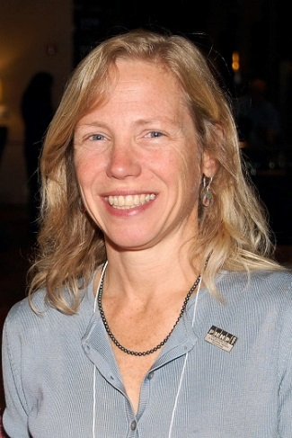

Dr. Margaret Flowers and Elizabeth Swager
Q&A

Slide 36
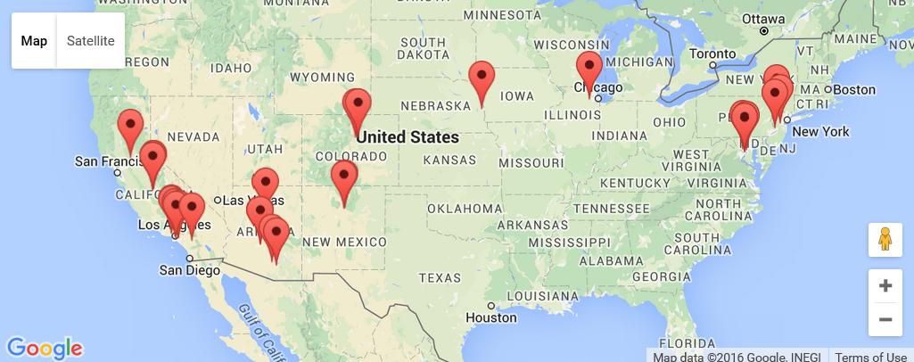
February Congressional Visits
https://actionnetwork.org/event_campaigns/february-letter-drop-oppose-the-tpp

Slide 37
Handouts – What You Leave Behind
We have written the letter
  Download the letter
  Print the letter
  Deliver the letter
Show how your recommendations can bring in votes and appeal to voters’ concerns
Give staffers actual talking points that can be used to persuade other Congress members

Slide 38
Setting Up a Meeting
Make an official request in writing and follow-up with a phone call
Ask to meet with the Representative or the appropriate Staffer
Where to Meet
  Capital Office
  District Office
Demonstrate broad base of support
  We have collected more than 1.5 million petition signatures opposing the TPP

Slide 39
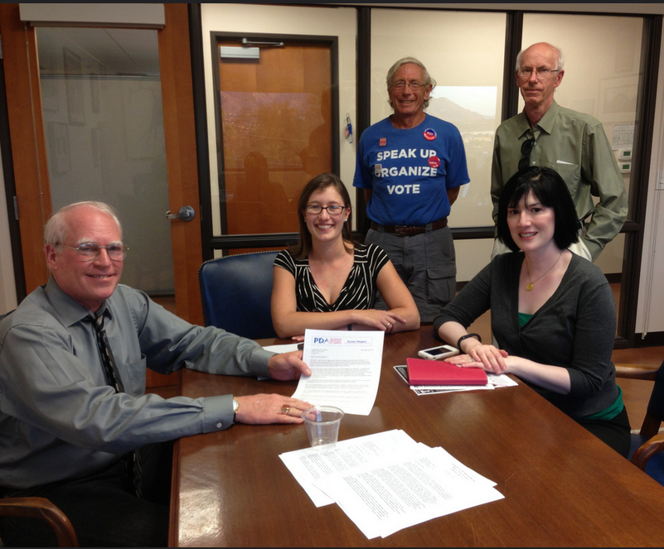
Who Should Attend?
3-5 people is ideal
  Present a diverse constituency
Be respectful
  Be early
  Look presentable
Practice – role play

Slide 40
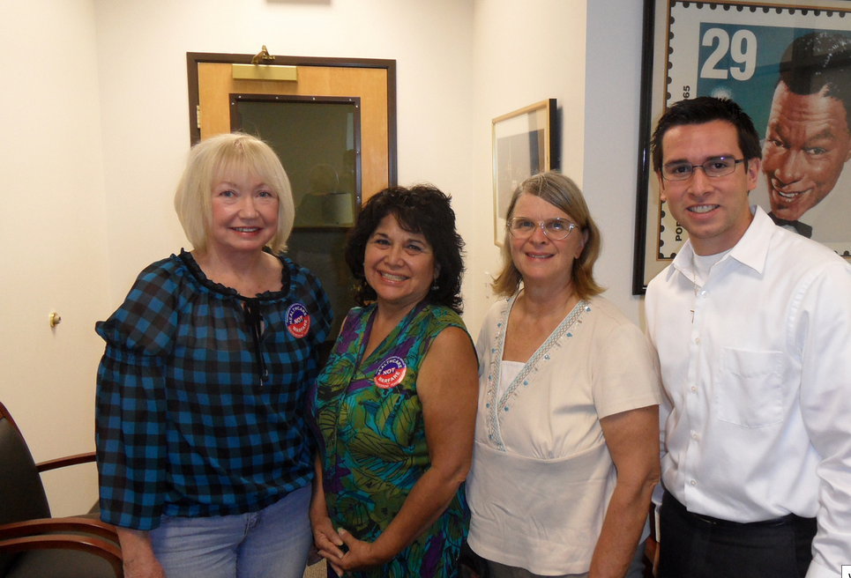
Lobby Team Roles
Facilitator – runs meeting
Storytellers (1-2) should be constituents
Asker – makes the direct ask
Educator – presents facts and info
Secretary – collect cards, write it all down and plan follow-up

Slide 41
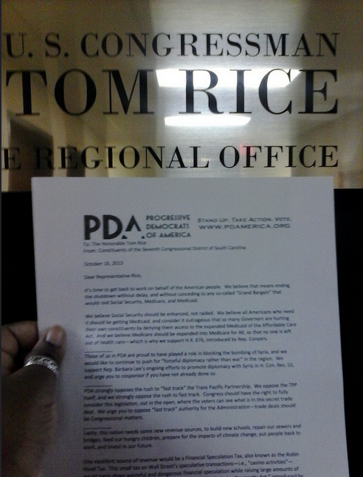
Lobby Meeting Agenda
Introductions (2 minutes)
  Names and city
Why we are here (2 minutes)
  Present petitions
  Present facts/history
Story time (2-3 minutes)
The Ask (1 minute)
Ask/Answer questions (5 minutes)
Wrap Up/Thank You (3 minutes)

Slide 42
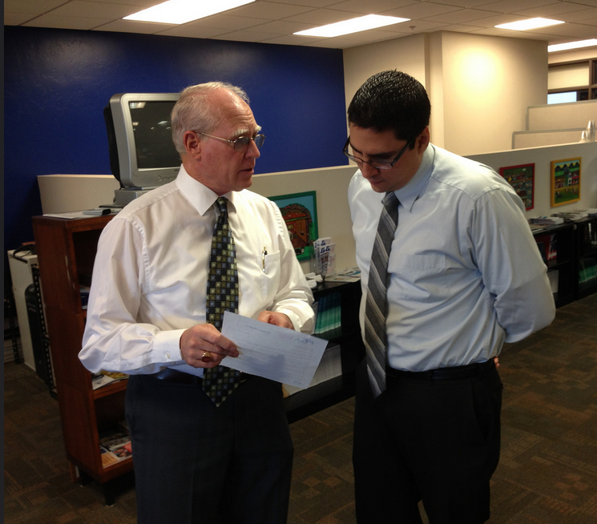
Making an Effective “Ask”
Straight to the Point
  Ask the question
  Be silent and wait for the answer
Follow-up questions – If Yes
  Who else can you bring on board?
  What is the opposition?
Follow-up questions – If No
  What will it take for you to support/oppose for this?
  What is holding you back?

Slide 43
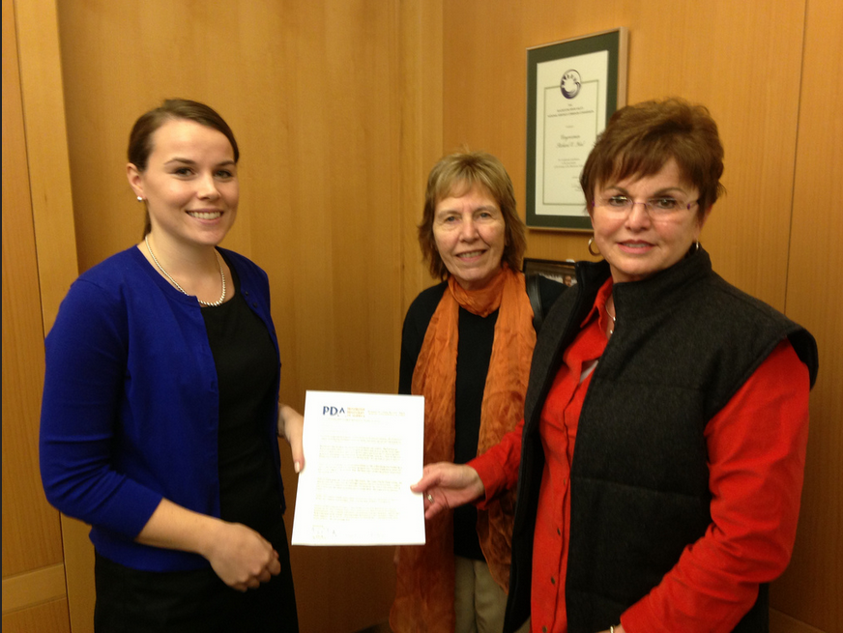
Following up
The goal is to develop a “relationship” with the Legislator/Staffer; this is a first visit; not the last
Thank the legislator
Send a written note to their office
Build support and research before the next meeting
Stay in touch – keep the relationship alive
Try to find common ground

Slide 44
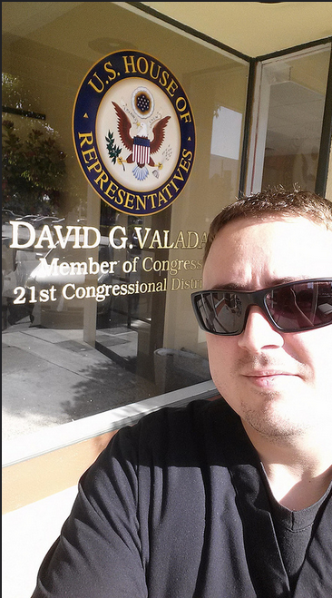
Tell Us You Delivered the Letter
Take a picture
Send it to judy@pdamerica.org
Complete the Delivery Form
https://actionnetwork.org/forms/report-your-february-letter-drop

Slide 45
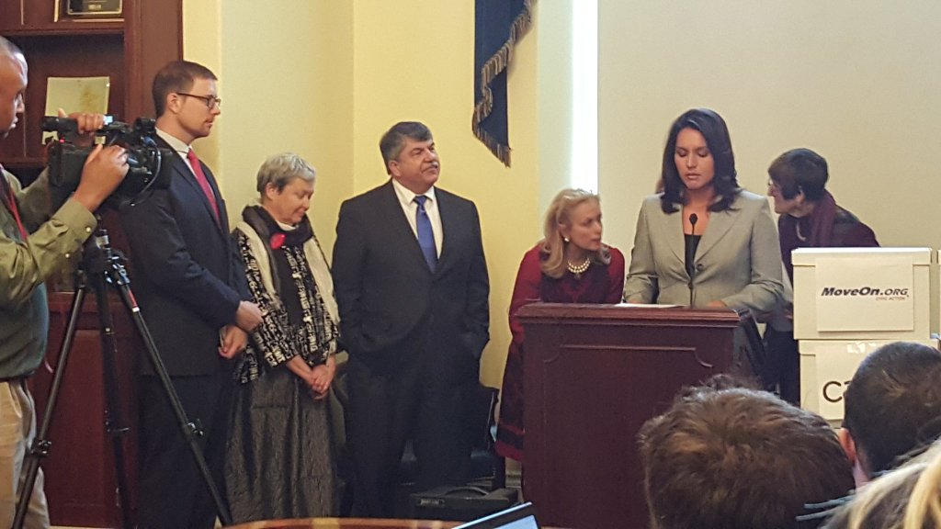
Turning Up the Pressure
Direct Pressure
  Letters, petitions, calls, Meetings, in Capital lobby days
Indirect Pressure
  Letters to the editor, op-eds, paid media, press conferences, visibility, protests, picketing, literature drops, coalition building

Slide 46


Call Planning Team
Celeste Drake
Trade and Globalization Policy Specialist,
AFL-CIO
Cdrake@AFLCIO.org
*SOTU Report
*USITC TPP Hearing

Slide 47


Call Planning Team
Adam Weissman
TradeJustice
Global Justice for Animals and the Environment
www.TRADEJUSTICE.NET
*Call Planning Team
*Speaker Recruitment
*Events, news stories and actions
http://tradejustice.net/events
http://www.tradejustice.net/news
adam@tradejustice.net

Slide 48
Trade Justice News Report
UN expert urges Pacific Rim countries not to sign the TPP without committing to human rights and development (United Nations Human Rights Office of the High Commissioner, 2/2/16)
#TPP officially signed, Indonesia to amend 12 laws (The Jakarta Post, 2/5/16)
US President Barack Obama likely to promote virtues of TPP – and independence from China – during summit with Southeast Asian leaders (South China Morning Post, 2/13/16)
National Farmers Union hopes Congress will stop TPP (Crop Protection News, 2/9/16)
Speaker Ryan: Not enough votes for TPP trade deal (CBS News, 2/11/16)
More news stories at http://tradejustice.net/news

Slide 49
VOLUNTEER TO PLAN AND PROMOTE THESE WEBINARS!
Sign up to attend a planning call for our:
Call Planning Team: http://tradejustice.net/plan213
Outreach, Promotion, and Publicity Team: http://tradejustice.net/promo213

Slide 50
NY Metro Recess Actions
“BREAK UP WITH THE TPP” DANCE RIDE
Date: Monday, February 15, 2016, 3PM
Location: Meet at NYC’s NYPL Main Branch between the lions
Join NYC’s Public Space Party on a dance-bike ride to “Break Up with the TPP”. A day after Valentine’s Day tell the people of NYC we’re through, and why, with the secret corporate contract, and encourage everyone to tell our elected officials also to break up with the TPP. We’ll hand out broken-hearted valentines with information, and dance to the sound bike blasting twisting songs of heartbreak and redemption. Contact Brennan at brennan@brennancavanaugh.com for questions
DROP-IN VISITS AT CONGRESSIONAL OFFICES
Email adam@tradejustice.net for details

Slide 51
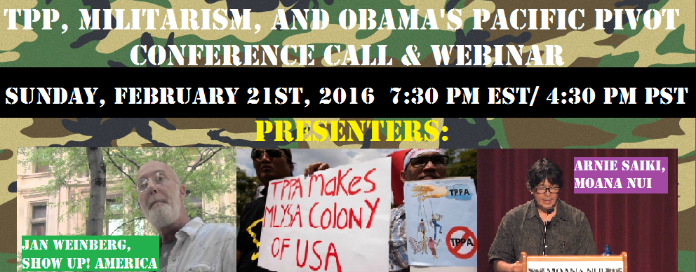

Slide 52
