Slide 1

TPP: The Ultimate Climate COP-OUT
Guests
William Waren, Friends of the Earth
Dr. Frank Ackerman, Synapse Energy Economics
Nancy Price, Alliance for Democracy
Dr. Margaret Flowers, Flush the TPP/Popular Resistance
Dial: 605-562-3140
PIN 951146#

Slide 2


INTRODUCTION AND WELCOME
Andrea Miller, Executive Director
People Demanding Action
andrea@peopledemandingaction.org
Call Structure and Norms:
All calls are recorded; a link and optional playback number are available after the call
Q & A mode: To eliminate background noise we mute everyone when we begin recording.
Press *6 (when prompted) to ask a question; say your name, your organization, if any, and location. Be courteous and brief; give others a chance to ask questions too.
Host Team and Speaker Introductions

Slide 3


TECHNICAL STUFF
DIAL IN: 605 562 3140 ACCESS CODE: 951146#
Meeting Room Functions
- Chat
- Share
Use the Share button in the Meeting Room:
After the call, click the unique link below to download this week's PowerPoint, recording link and other materials: http://www.peopledemandingaction.org/downloads/tpp/tpp-december-6-2015-call-materials

Slide 4

CALL HOST TEAM
Tom Hocking, Technical Advisor
MoveOn Regional Organizer, PA
TWHocking@Gmail.com
*Pre/Post Call Technical Questions
*Global TPP Team Facebook Page Manager
Facebook:
https://www.facebook.com/groups/GlobalTPPTeam

Slide 5

CALL HOST TEAM
Liz Amsden, MoveOn Council Organizer
Los Angeles, CA
LizAmsden@Hotmail.com
Research/Notes/Resource Vetting

Slide 6

CALL HOST TEAM
Jan Swartzendruber
Kansas
JaninKansas@gmail.com

Slide 7


CHAT HOST/CALL PLANNING TEAM
Mara Cohen
Marajai51@Gmail.com
*Chat Host
*PDA Mass Criminalization Team Leader
*Global Climate Convergence Leader (IL)

Slide 8

CHAT HOST/CALL PLANNING TEAM
Lisa Oldendorp
MoveOn, New York
eslsk8r@optonline.net
*Chat Host
*Call Planning Team

Slide 9

CALL PLANNING TEAM
Linda Brewster
LindaJBrewster@msn.com
*Call Planning
*Information and event sharing
*MoveOn Regional Organizer (WA)

Slide 10


CALL PLANNING TEAM
Celeste Drake
Trade and Globalization
Policy Specialist, AFL-CIO
CDrake@AFLCIO.org

Slide 11

CALL PLANNING/TWITTER STORM
Emilianne Slaydon
Director, Social Media @TPP Media March
TPP Tuesday Twitter Storm
6 p.m. PST / 9 p.m. EST
TPP/TTIP Tuesday Tweets:
http://www.tiny.cc/TPPMediaMarch

Slide 12
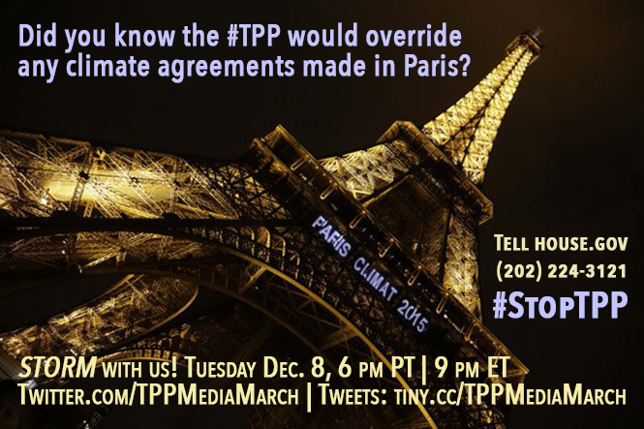

Slide 13


CALL PLANNING TEAM
Adam Weissman
TradeJustice Global Justice for Animals and the Environment
www.TRADEJUSTICE.NET
*Call Planning Team
*Speaker Recruitment
*Events, news stories and actions
http://tradejustice.net/events
http://www.tradejustice.net/news
adam@tradejustice.net

Slide 14
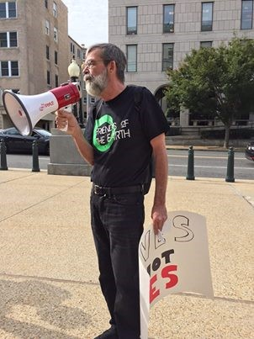
BILL WAREN
Bill Waren is Senior Trade Analyst at Friends of the Earth, U.S. He works to protect the environment from the negative impact of international trade and investment agreements.
His research, writing and advocacy focuses on pending trade deals such as the Trans-Pacific Partnership, the Transatlantic Trade and Investment Partnership and the Trade in Services Agreement, as well as litigation under existing trade and investment agreements.
Prior to joining Friends of the Earth, Bill served as Policy Director at the Forum on Democracy & Trade and as a Senior Fellow at the Harrison Institute for Public Law, Georgetown University Law Center.
A native of rural, downstate Illinois, Bill took a B.A. in politics and an M.A. in public administration at the University of Illinois, Urbana –Champaign, a J.D. at Duke Law School, and an LL.M. in public interest advocacy at Georgetown Law.

Slide 15
The Trade in Services Agreement is a climate hazard
Trade negotiators from the United States and 22 other World Trade Organization members including the European Union are seeking to craft a Trade in Services Agreement that will cover a variety of environmental services and otherwise impact environmental and climate policy.
TiSA negotiations focus on lowering regulatory “barriers” to international trade in services. Such “barriers” include climate and environmental protections, such as those related to water, energy, sanitation, public utilities, and transportation among many others.
Deregulation.In the alleged interest of making trade easier, environmental regulations are at risk of being “harmonized down” to the lowest common denominator, and public services of an environmentally- sensitive nature are in danger of being privatized.
Corporate rights. The goal of TiSA negotiations is to grant transnational corporations and trade bureaucrats expanded “rights” to challenge the policies of democratic governments before international tribunals biased in favor global capital.

Slide 16
The Leaked Annex on Environmental Services
The text of the Annex on Environmental Services for the Trade in Services Agreement, recently published by WikiLeaks along with a Friends of the Earth analysis, confirms the agreement’s potential use to roll back regulatory safeguards related to the climate and the environment generally and to inhibit the promulgation of new measures to protect people and the planet from global warming.
Coverage. The scope of environmental regulations covered and put at risk by TiSA appears to be wide. And, in terms of coverage, the leaked Annex on Environmental Services may be only the tip of the iceberg.
Corporate rights. The rules constraining government regulations in commitments on “National Treatment.,” “Market Access,” and “Most Favored Nation obligations incorporate sweeping restrictions on the capacity of democratic governments to protect the climate and environment.

Slide 17
Trade law ban on export controls
TPP and TTIP provisions on market access and trade in goods, modeled on the WTO General Agreement on Tariffs and Trade, would chill future legislative action on fossil fuel exports.
Lawyers for fossil fuel exporters argue that GATT article XI:1 on “General Elimination of Quantitative Restrictions” prohibits restrictions on the export of products, including fossil fuels, to another WTO member, other than duties, taxes or other charges.
Exceptions. The exception to protect governments’ right to regulate the supply of environmental services is largely toothless.

Slide 18
Trade in Goods provisions in TPP & TTIP:
A Threat to Climate Policy
Big Oil and dirty energy companies want to push the TPP and TTIP deals through Congress, thereby encouraging trade in oil, coal and liquefied natural gas. U.S. energy companies are seeking new liquefied natural gas terminals for export to global markets, where they can demand higher prices for LNG (a far more potent contributor to global warming than ordinary natural gas).
As the U.S. dependence on coal slackens, the coal industry is attempting to export it abroad. Meanwhile, fossil fuel giants want to ship oil overseas where they can sell it far more profitably than in the United States.
Export controls. In response to campaigns launched by climate activists to impose regulations and controls on U.S. fossil fuel exports, corporate trade lawyers are insisting that government controls on energy exports are illegal under international trade and investment law related to trade in goods.

Slide 19
Trade law ban on export controls
TPP and TTIP provisions on market access and trade in goods, modeled on the WTO General Agreement on Tariffs and Trade, would chill future legislative action on fossil fuel exports. Lawyers for fossil fuel exporters argue that GATT article XI:1 on “General Elimination of Quantitative Restrictions” prohibits restrictions on the export of products, including fossil fuels, to another WTO member, other than duties, taxes or other charges.
TTIP negotiations focus on increasing trade in fossil fuels. The TTIP, in particular would encourage increased U.S. coal, oil and gas exports to Europe that are fueling global warming.
Rollback of EU program to cut greenhouse gas emissions. In a recent report, Friends of the Earth Europe and other environmental groups reveal how U.S. negotiators at the Transatlantic Trade and Investment Partnership talks work to undermine the EU’s Fuel Quality Directive and unleash exports of dirty fuels, including tar sands oil, a highly intensive source of greenhouse gas emissions. The Directive is the linchpin of the EU’s program to cut greenhouse gas emissions from transport fuels.

Slide 20
Europe wants U.S. fossil fuel exports to replace Russian exports rather than transitioning quickly to clean energy
Leaked documents have exposed that it is the EU’s intention to increase U.S. oil and gas exports to Europe, thus hooking the EU economy for decades to come on high carbon energy -- a recipe for increased global warming and climate disaster.
EU negotiators at TTIP talks want the U.S. to scrap its current legal prohibition on crude oil exports and its licensing restrictions on natural gas exports.

Slide 21

DR. FRANK ACKERMAN
Frank Ackerman is a member of the steering committee of Economics for Equity and Environment and a member scholar of the Center for Progressive Reform. He earned his PhD in economics from Harvard University, and has taught at MIT, Tufts University, and the University of Massachusetts. Currently he is a principal economist at Synapse Energy Economics, a research and consulting firm in Cambridge, MA.
Dr. Ackerman is a widely published economist whose writings primarily focus on the economics of climate change and other environmental concerns.
He is well known for his criticism of the use of cost-benefit analysis in environmental and climate change policy-making. In addition to numerous books on these topics,
Dr. Ackerman has published many academic and popular articles, and has conducted studies for clients ranging from Greenpeace to the European Parliament. Most of his writing is available at http://frankackerman.com.

Slide 22
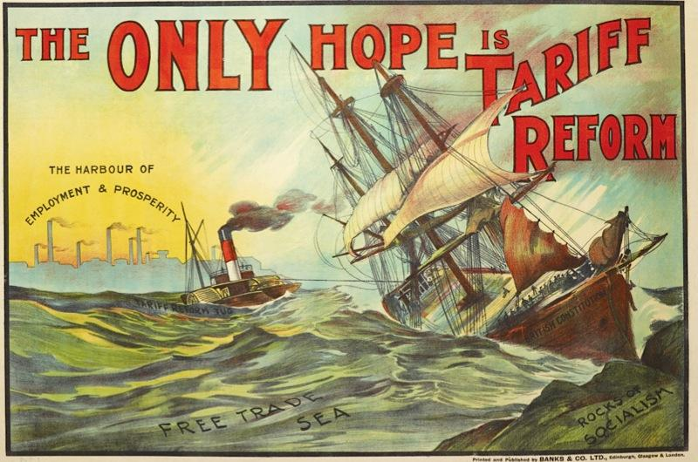
TTIP vs.
Climate policy
Frank Ackerman
December 6, 2015

Slide 23
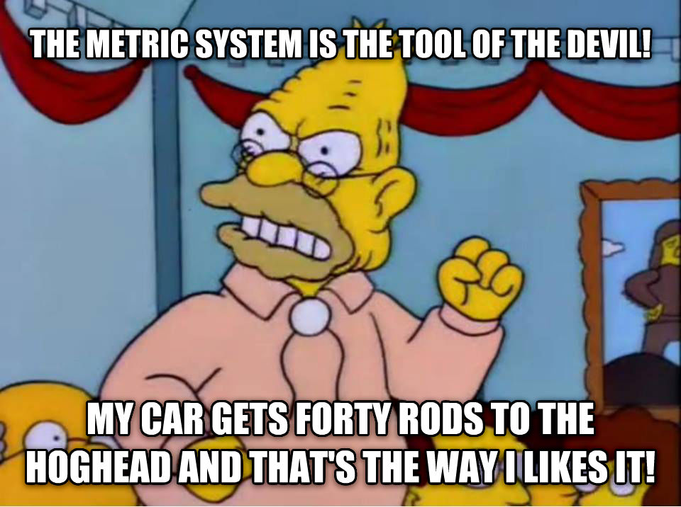
What could TTIP Accomplish?
Not tariff reduction, except in isolated cases
  Average tariffs are under 3% on US-EU trade in both directions
Not removal of technical barriers to trade in items currently traded
  Often claimed, but never shown to be important
  The biggest such barrier: US refusal to use metric system
    Not addressed by TTIP (or anyone else)
The only major goal: change the rules about what can be produced and traded
  Requires changes to existing regulations in Europe and/or America

Slide 24
TTIP vs. Renewable Energy
What counts as renewable energy?
  US Trade Representative calls EU Renewable Energy Directive a “technical barrier to trade” because US soybeans aren’t classified as a renewable source of biofuels
  EU levies anti-dumping penalties on other countries’ biodiesel and bioethanol exports
Feed-in tariffs vs. fossil fuels
  Feed-in tariffs (fixed, above-market rates paid to renewable energy generators) are the principal policies leading to the EU renewable energy boom
    Wind and solar power are more than 10% of EU electricity, much more in leading countries
  US fossil fuel companies could challenge feed-in tariffs under ISDS
    Some ISDS cases have targeted feed-in tariffs under existing treaties (within Europe)
    Vattenfall’s (successful) case against Germany’s water pollution standards for coal plants shows the way
  Some US states use feed-in tariffs, could be hit with ISDS cases
    California and a few other states have roughly “European” levels of climate / energy regulations, vulnerable to the same challenges

Slide 25
TTIP and Dirty Energy
Fracking
  Allowed in much of US, banned or likely to be banned in much of EU
  Hopes (fears) of huge fracking potential in Europe have subsided, but some companies would still like to pursue fracking in selected European locations
  ISDS challenges are possible, as in the Lone Pine case against Canada (over Quebec’s fracking rules)
Tar sands oil
  EU Fuel Quality Directive calls for reducing GHG-intensity of transport fuels
  Initially thought to prohibit tar sands oil, due to higher lifecycle emissions per unit of energy
  Intense lobbying from Canada, US, major oil companies threatened to derail TTIP (and similar Canada-EU treaty) over this issue
  EU has already backed down, agreed to pretend all oil has the same GHG intensity, regardless of production method

Slide 26
Other Energy and Climate Issues
Energy efficiency and appliance standards
  EU Energy Efficiency Directive sets standards for reducing energy demand, growing more stringent over time; could face ISDS challenges
  US Trade Representative calls EU regulation of fluorinated GHGs a “technical barrier to trade” because some US appliance manufacturers are unable to comply
Non-carbon air pollution (sulfur, particulates, mercury, etc.)
  US standards are stricter than Europe’s
    A legacy of ambitious early Clean Air Act implementation
  Could US face ISDS challenges demanding that we cut back to match Europe’s dirtier air standards?

Slide 27


Conclusion:
Why Harmonize?
Regulations are not arbitrary bureaucratic obstacles to trade
  They are democratically adopted limits on what can be sold, and how it can be produced
  Economic theory: policy to correct market failures can make everyone better off
    Stern: Climate change results from “the greatest market failure the world has ever seen”
Different countries will reach different decisions about which regulations to adopt
  No reason to think that harmonization helps anyone except a few manufacturers
US limited smoking in public, long before most of Europe
  Should we have waited for Europe before acting?
  Harmonization would be good for tobacco companies, bad for the air-breathing public
Europe has much more sensible limits on gun ownership and use
  Should they have waited for all of America to agree with their rules?
  Harmonization would be great for gun companies, not so much for innocent bystanders
Climate policy requires action and leadership, not waiting for laggards to catch up

Slide 28

Q&A
Bill Waren
Frank Ackerman

Slide 29
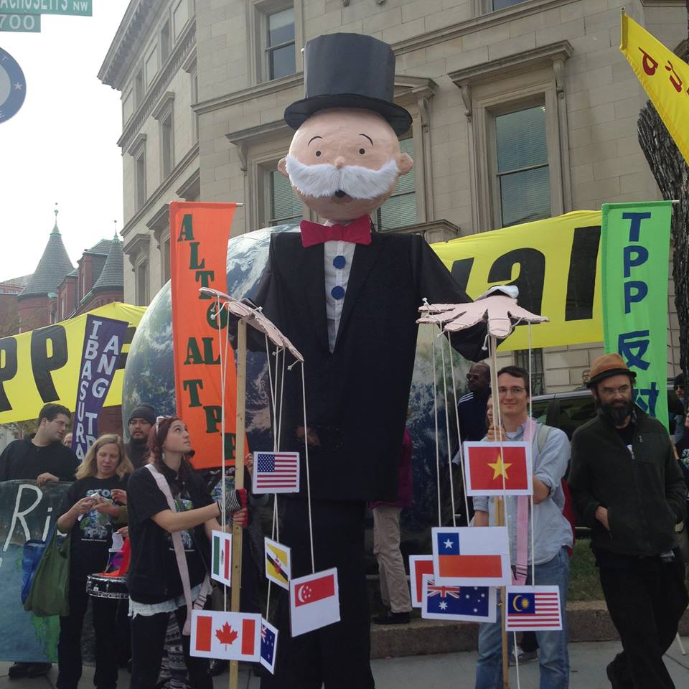
NEXT STEPS…

Slide 30
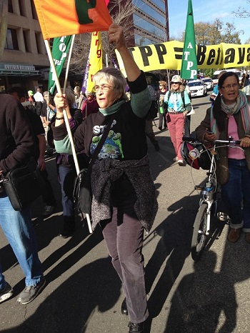
NANCY PRICE
Nancy Price is Co-Chair of the Alliance for Democracy and Western Coordinator of the Defending Water for Life Campaign, and leads on the Campaign for TPP Free Zones.
Nancy is on the Leadership Team for the Women's International League for Peace and Freedom's Save the Water Campaign.
She is also President of the California Center for Community Democracy and Board member of Friends of the River (CA).

Slide 31
“We Will Not Obey”
TPP-Free Zones
www.tppfreezones.org
www.thealliancefordemocracy.org

Slide 32

www.thealliancefordemocracy.org

Slide 33
The issue is not issues; the issue is the system
Why should your City or County Council or Town Meeting oppose the
Trans-Pacific Partnership (TPP)
The Transatlantic Trade and Investment Partnership (TTIP), and the
Trade in Services Agreement (TiSA)?
Because the TPP, TTIP and TISA …
http://www.thealliancefordemocracy.org/pdf/2015AfDlocaltrade.pdf

Slide 34
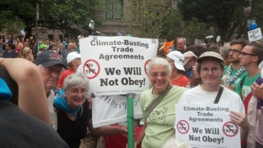
TPP, TTIP and TiSA =
Climate-busting trade agreements

Slide 35
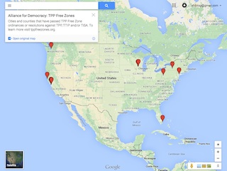
10 cities and 2 counties have passed resolutions – let’s have 90 more!
www.thealliancefordemocracy.org

Slide 36
Why TPP-Free Zones?
Passage of the TPP, TTIP and TiSA will foreclose the possibility of grassroots groups working together for local grassroots solutions for the betterment of the community.
Impacts major function of local government: land-use, zoning and planning.

Slide 37
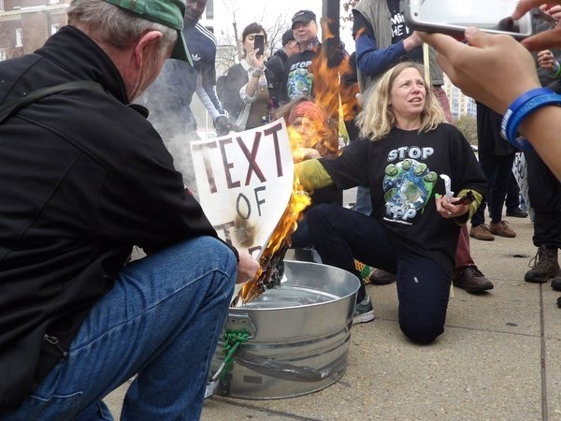
DR. MARGARET FLOWERS
Dr. Margaret Flowers is a pediatrician and co-chair of the Maryland chapter of Physicians for a National Health Program (PNHP). Margaret is also Co-Director of PopularResistance.org and It's Our Economy, and Co-Organizer of Flush the TPP (flushthetpp.org).
Margaret co-organized the November #Fall Rising Days of Action in D.C.

Slide 38
Reportback from the TPP Resistance Call:
A movement of movements: Influencing the political culture to stop the global race to the bottom. #TradeJusticeMatters
BuyCott for Trade Justice - visit www.FlushtheTPP.org/Buycott/
- Long term project that starts now
- Forming a working group
Media Response to SOTU - media mobilizers
- President's SOTU on Jan. 12
- Become a media mobilizer at www.flushthetpp.org/tpp-media-mobilizers- call-to-action/

Slide 39

LOCAL ACTIONS IN FEBRUARY
Contact info@popularresistance if you are interested in organizing a local action
Dates to be determined
Next TPP Resistance call Wednesday, Dec. 9 at 9 pm Eastern/6 pm Pacific. Visit www.flushthetpp.org/national-tpp-resistance-calls/ for more information and to register.

Slide 40
Q&A
Nancy Price
Dr. Margaret Flowers

