Slide 1
Trade Activist Report from Paris Climate Talks
Plus: Stopping the Customs Enforcement Bill
Stealth Attacks on Immigrants, the environment, and
human trafficking victims
Special Guests
Dan Mauer, Communications Workers of America
Ben Lilliston, Institute for Agriculture and Trade Policy
Chloe Schwabe, Maryknoll Office for Global Concerns
Margaret Flowers, Popular Resistance/Flush the TPP

Slide 2


INTRODUCTION AND WELCOME
Andrea Miller, Executive Director
People Demanding Action
andrea@peopledemandingaction.org
Call Structure and Norms:
Audio is PHONE ONLY; you must call in
Do not enable your video camera
All calls are recorded; a link is available after the call
Q & A mode: To eliminate background noise we mute everyone when we begin recording.
Press *6 (when prompted) to ask a question; say your name, your organization, if any, and location. Be courteous and brief; give others a chance to ask questions too.
Keep chat room discussions on topic and professional

Slide 3


TECHNICAL STUFF
Audio is available only via phone
DIAL IN: 605 562 3140 ACCESS CODE: 951146#
Meeting Room Functions
- Chat
- Share
Use the Share button in the Meeting Room:
After the call, click the unique link below to download this week's PowerPoint, recording link and other materials: http://www.peopledemandingaction.org/downloads/tpp/tpp-december-20-2015-call-materials

Slide 4

Call Host Team
Tom Hocking, Technical Advisor
MoveOn, PA
TWHocking@Gmail.com
*Pre/Post Call Technical Questions
*Global TPP Team Facebook Page Manager
Facebook:
https://www.facebook.com/groups/GlobalTPPTeam

Slide 5

Call Host Team
Liz Amsden, MoveOn Council Organizer
Los Angeles, CA
LizAmsden@Hotmail.com
Research/Notes/Resource Vetting

Slide 6
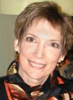
Call Host Team
Jan Swartzendruber
Kansas
JaninKansas@gmail.com

Slide 7

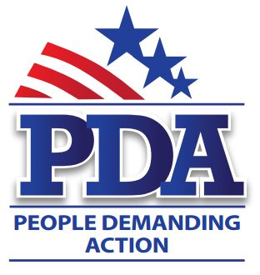
Call Planning Team
Mara Cohen
Marajai51@Gmail.com
*Chat Host
*PDA Mass Criminalization Team Leader
*Global Climate Convergence Leader (IL)

Slide 8

Chat Host/Call Planning Team
Lisa Oldendorp
MoveOn, New York
eslsk8r@optonline.net
*Chat Host
*Call Planning Team

Slide 9

Call Planning Team
Linda Brewster
LindaJBrewster@msn.com
*Call Planning
*Information and event sharing
*MoveOn Regional Organizer (WA)

Slide 10


Call Planning Team
Celeste Drake
Trade and Globalization
Policy Specialist, AFL-CIO
CDrake@AFLCIO.org

Slide 11
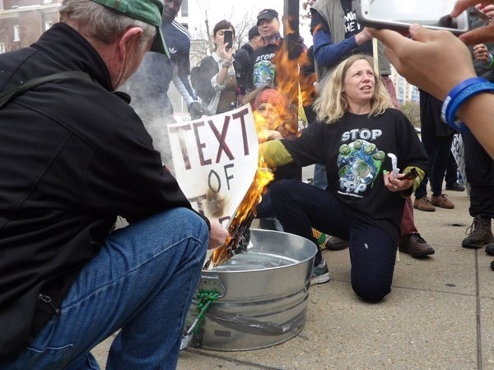
Dr. Margaret Flowers
Dr. Margaret Flowers is a pediatrician and co-chair of the Maryland chapter of Physicians for a National Health Program (PNHP).
Margaret is also Co-Director of PopularResistance.org and It's Our Economy, and Co-Organizer of Flush the TPP (flushthetpp.org).
Margaret co-organized the November #Fall Rising Days of Action in D.C.

Slide 12
Reportback from the TPP Resistance Call:
A movement of movements: Influencing the political culture to stop the global race to the bottom. #TradeJusticeMatters
BuyCott for Trade Justice - visit www.FlushtheTPP.org/Buycott/
- Long term project that starts now
- Forming a working group
Media Response to SOTU - media mobilizers
- President's SOTU on Jan. 12
- Become a media mobilizer at www.flushthetpp.org/tpp-media-mobilizers-call-to-action/

Slide 13

Local Actions in February
Contact info@popularresistance.org if you are interested in organizing a local action
Dates For Local Actions:
Feb 4- TPP Signing
Feb 14-21 President’s Day week of actions
Next TPP Resistance call Wednesday, Jan 6 at 9 pm Eastern/6 pm Pacific. Visit www.flushthetpp.org/national-tpp-resistance-calls/ for more information and to register.

Slide 14


Call Planning Team
Adam Weissman
TradeJustice Global Justice for Animals and the Environment
www.TRADEJUSTICE.NET
*Call Planning Team
*Speaker Recruitment
*Events, news stories and actions
http://tradejustice.net/events
http://www.tradejustice.net/news
adam@tradejustice.net

Slide 15


Slide 16
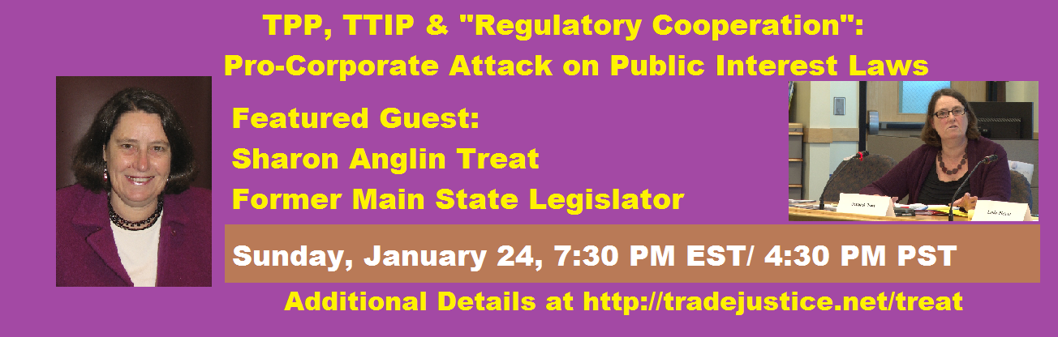

Slide 17
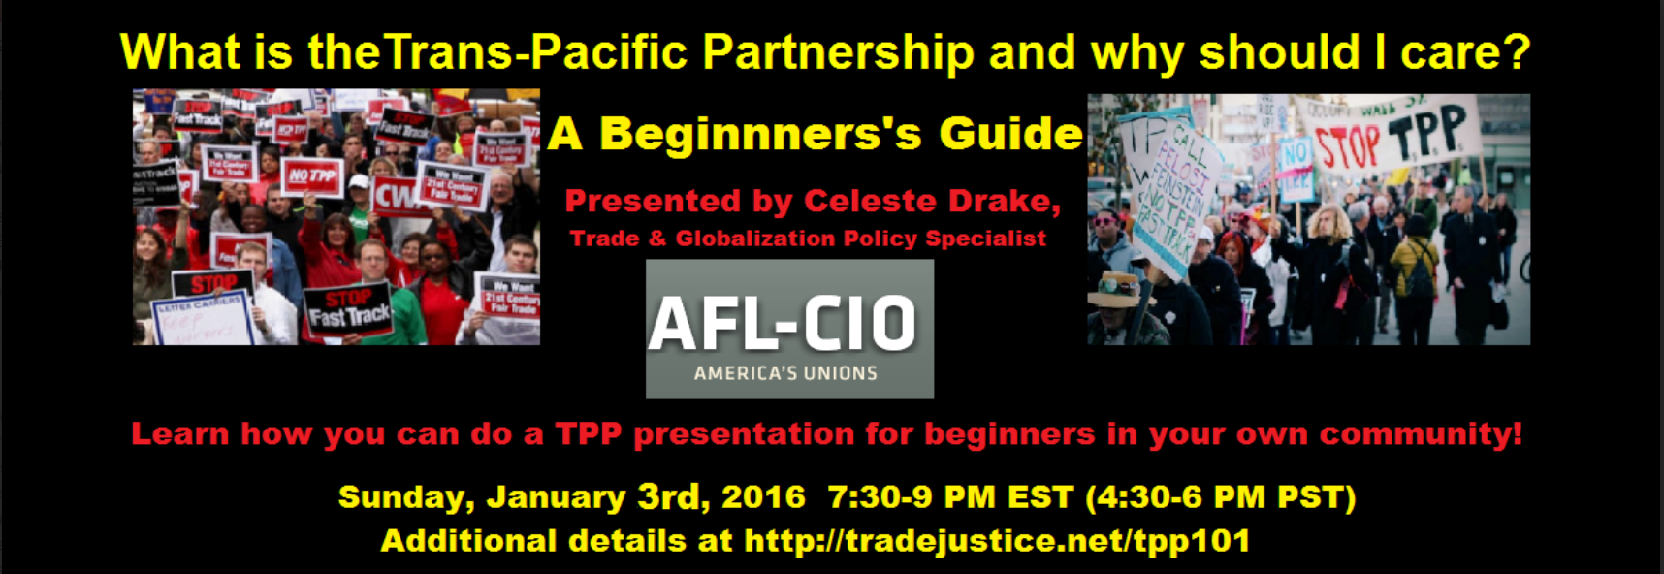

Slide 18
Q&A for Dr. Margaret Flowers and Adam Weissman

Slide 19
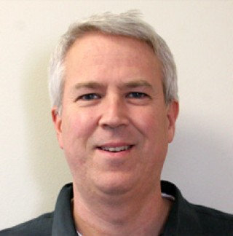

Ben Lilliston
Ben Lilliston oversees the Institute for Agriculture and Trade Policy’s climate work. He has been working and writing about international trade issues and how they intersect with U.S. agricultural and climate policy since 2000.
Mr. Lilliston recently authored a report on how the global meat industry will benefit from the Trans Pacific Partnership, and contributed to the UN Committee on Trade and Development (UNCTAD) Trade and Environmental Review 2013.
He has worked as a researcher, writer and editor at the Center for Study of Responsive Law, the Corporate Crime Reporter, and the Multinational Monitor.
Ben is a widely published writer, most recently, contributing to the book Mandate for Change (Lexington), and previously co-authored the book, Genetically Engineered Foods: A Guide for Consumers (Avalon).

Slide 20
Ben Lilliston, IATP
Trade explicitly not included in the Paris climate deal
Major political pressure from powerful industries to keep trade out
Climate not part of trade deals – from WTO to TPP

Slide 21
Bill Lilliston/IATP
How does the trade-climate disconnect impact efforts to address climate change?
How will these issues play out in the future?
Contact Info:
Email: blilliston@iatp.org
Twitter: @benlilliston
Website: iatp.org
Facebook: https://www.facebook.com/IATPiatp

Slide 22
Q&A for Ben Lilliston

Slide 23
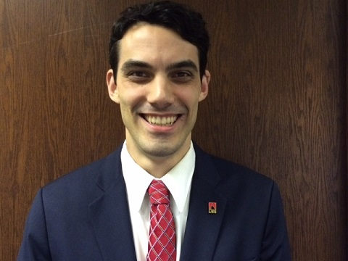

Dan Mauer
Dan Mauer is a Legislative Representative for Communications Workers of America (CWA) specializing in trade, finance and labor policy.
Mr. Mauer serves as staff liaison for IUE-CWA President Jim Clark on the Labor Advisory Committee for Trade Negotiations and Trade Policy.
He served previously as Legislative Director for former Rep. George Miller (D-CA) and as Legislative Assistant for Rep. Al Green (D-TX).
Email: dmauer@cwa-union.org
Phone: 202-434-1316
Website: www.cwa-union.org
Twitter: https://twitter.com/cwaunion
Facebook: https://www.facebook.com/CWAUnion/

Slide 24
Customs Bill—“Customs” Provisions
Generally positive provisions in bill loaded up with poison pills and gifts to the right wing
A wide range of provisions designed to make it easier to combat dumping and other unfair subsidies
Key Provision: “ENFORCE Act” increases resources for CBP, speeds investigations

Slide 25
Conference Committee Results on Customs Provisions
Most important provision—the “Level the Playing Field Act,” which makes it easier for manufacturers to bring AD/CVD cases—was already included in the Trade Adjustment Assistance bill passed this summer, so it is no longer in the bill
“Green 301” program to allow duties to be imposed on countries that harm the environment was stripped out after being included in Senate bill

Slide 26
Currency Manipulation
Long been illegal under IMF rules
Makes U.S. exports more expensive, other countries’ goods cheaper
Major threat to American jobs—EPI estimates that as many as 5.8 million jobs could be created
Problem is lack of enforcement mechanism

Slide 27
Customs Currency Provisions
Senate Bill: Allow imposition of countervailing duties (CVD) against currency manipulators
House Bill: More reporting, offer Treasury a range of tools, give Treasury a waiver if they believe acting would not be a net benefit to the U.S.’s economic or security interests
Conference Report: House provisions only—these will not be effective

Slide 28
Customs & The TPP
Customs is designed to give members cover for voting for the TPP:
  The “customs” provisions are important for “steel Republicans”
  Currency important given lack of enforceable currency provisions in TPP
  Climate and immigration provisions important for many conservative Republicans

Slide 29
Customs & The TPP (cont.)
Provisions on human trafficking would make it easier for countries with horrific labor abuses to join the TPP
Especially important for Thailand—U.S. Ambassador has said we would “welcome with open arms” Thailand’s entry to the TPP

Slide 30
State of Play
Passed House, Dec. 11th: 256-158; 3 Republicans voted no, 24 Dems voted yes
Stalled in Senate due to extraneous provision inserted in conference on taxation of Internet access
Bipartisan group of senators working to strip Internet tax provision—doing so would force the bill back to the House and could require additional horse trading

Slide 31
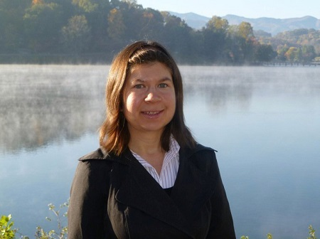
Chloe Schwabe
Chloe Schwabe is the director of the Faith-Economy-Ecology project for the Maryknoll Office for Global Concerns. For more than a decade, Chloe has lived in Washington, D.C. and worked for faith-based organizations to educate and advocate for ecological and economic justice, immigration reform, and human rights.
Chloe has worked as an activist and advocate on previous trade agreements such as the FTAA, US-Colombia and CAFTA agreements. She has spent time traveling and living throughout Latin America among economically marginalized communities. She has an M.A. in Latin American Studies from the University of Texas at Austin with a focus on political ecology and carceral geography

Slide 32
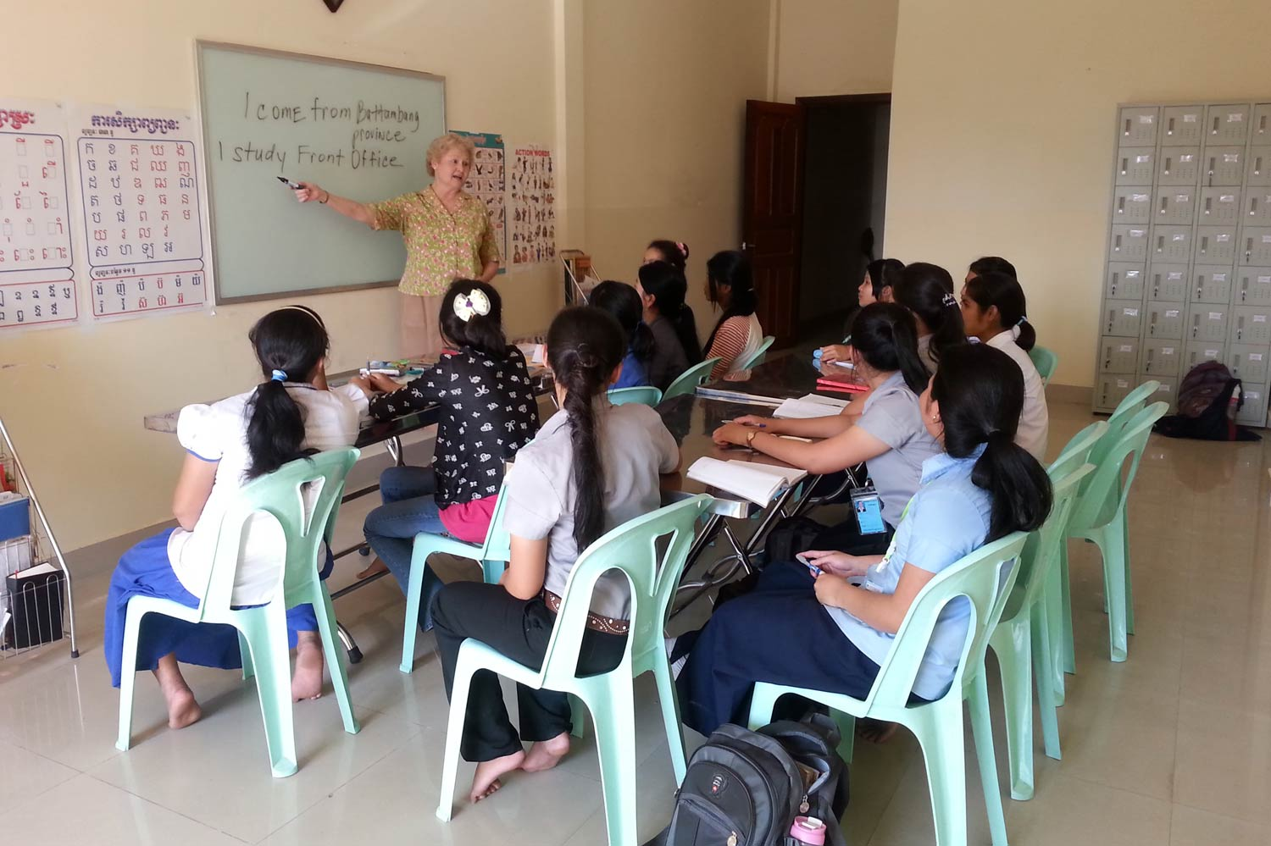
Customs bill weakens anti-trafficking language allowing president to write a letter requesting a waiver for a Tier 3 country to participate
Trafficking
Maryknoll Sister Helene O’Sullivan training trafficking survivors in Cambodia

Slide 33
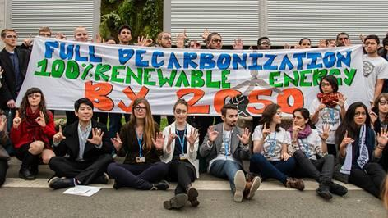
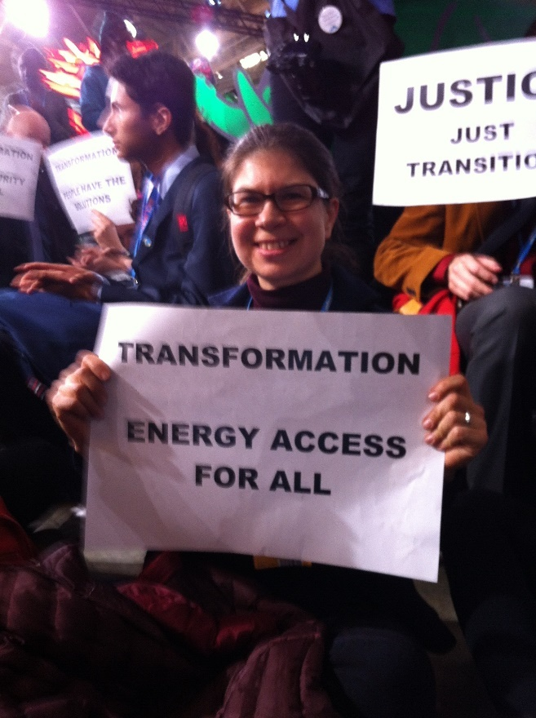
Climate
New language will prevent countries from regulating greenhouse gases under Fast Track

Slide 34
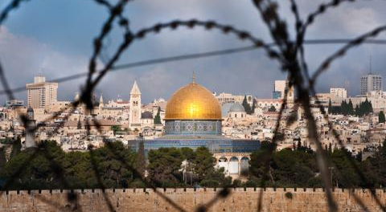
Boycott Divestment Sanctions
Prevents any country with a BDS policy from having Fast Track privileges.

Slide 35
Q&A with Dan Mauer and Chloe Schwabe

Slide 36

Call Planning Team
Harriet Heywood
harrietheywood@gmail.com
Call Co-Organizer
Organizer Florida

Slide 37

@TPPMedia March Holiday Wish List
Call your reps when they are in district
Schedule appointments
Visit Reps with fact sheets
Storm with us on the SOTU Fact Check Twitter Storm Jan 12
See You all here on the Team Call Jan 10
Fact Sheets:
https://www.sierraclub.org/sites/www.sierraclub.org/files/uploads-wysiwig/TPP-LNG_Factsheet_Updated.pdf
http://www.citizen.org/Page.aspx?pid=2106

Slide 38
Upcoming Calls
Jan 3: TPP 101 Train the Trainers Power Point Presented by Celeste Drake, Trade and Globalization Specialist, AFL-CIO special New Year gift for in-district presentations
Jan 10: Globalization 101 Series Part 1 Academic intro to globalization, Bretton Woods through NAFTA and WTO
Jan 17: Globalization 101 Series Part 2 WTO and related discussions
Jan 24: Regulatory Coherence with special guest, Sharon Treat of the National Caucus of Environmental Legislators
Jan 31: Stay tuned for more information

