Slide 1

The Trans-Pacific Partnership:
BAD for American Business
September 11, 2016 4:30 p.m. Pacific/7:30 p.m. Eastern
 | CALL-IN NUMBER: 515) 739-1020

Slide 2


Elizabeth Warren, Communications Director
People Demanding Action
Welcome and TPP Call Norms
Calls are recorded; a link is available after the call.
Q & A mode: We mute everyone when we begin recording, but you will have a chance to ask questions. You may use a mic for this call to avoid long distance charges, but a phone will produce clearer audio for you.
At the top of your screen, look for a 4-digit audio PIN in a gray box (it's not the access code—you do not need to enter the access code.) Enter the PIN on your phone when prompted, to connect your audio with the meeting room. This will allow the moderator to call on you if you wish to ask a question during Q & A.
Press *6 (when prompted by the moderator) to enter the question queue. Please state your name FIRST when we call on you, and where you live. (The state.)
Real-time chat: There is a link at the top of the page you may click on to type an instant message to either the entire group or just the moderator. Please keep your IMs on topic, and avoid discussing the election. This is a nonpartisan call.
Email: Liz@PeopleDemandingAction.org

Slide 3

Andrea Miller, Executive Director
People Demanding Action
TPP News Heard on the Hill This week:
SPECIAL EDITION Letter Drop:
Educate Congress
"TPP is BAD for Business!"
Email andrea@peopledemandingaction.org

Slide 4

Harriet Heywood, Call Host Team
Email: harrietheywood@gmail.com
Call Co-Organizer
Florida State Leader People Demanding Action

Slide 5

Mara Cohen, Call Host Team
Email: marajai51@gmail.com
End Mass Criminalization Team
Agitator Radio
Organizers’ Resource Hub
People Demanding Action

Slide 6

Tom Hocking, Call Host Team
Email: TWHocking@Gmail.com
Pre/Post Call Technical Questions
General Information
Global TPP Team Facebook
Page Administrator

Slide 7

Linda Brewster, Call Planning Team
Email: LindaJBrewster@msn.com
Call Planning
Information and event sharing
MoveOn Organizer (WA)

Slide 8


SPECIAL GUEST:
Michele Nash-Hoff
National Board Director
American Jobs Alliance

Slide 9
TPP Partner Countries
  Australia
  Brunei
  Canada
  Chile
  Japan
  Malaysia
  Mexico
  New Zealand
  Peru
  Singapore
  United States
  Vietnam
TPP is a “docking” agreement. Once in place, other countries can join without further negotiation.

Slide 10
Non-Exclusive Market Opening

Slide 11
Fast Track and the "Rubber Stamp"
  Congress in 2015 granted President Obama "Fast Track" Trade Promotion Authority, relinquishing for all practical purposes congressional control over U.S. trade policy.
  They gave themselves:
        45 days to complete all committee analysis
        Slightly more than 2 weeks to bring TPP to a floor vote
        20 hours to debate the substantive national impact of a 30-chapter legal document thousands of pages long
        The job of voting yea or nay AS IS—no amendments, no filibusters, no cloture.

Slide 12
Past Trade Agreements Have Enabled
Trade Cheating and Mercantilism
We cut tariffs and opened our markets. They didn’t.
Instead, other countries played a new trading game featuring:
  Rampant global currency devaluation (manipulation)
  Replaced tariffs with "consumption taxes" (VATs)
  Massive industrial subsidies/state-owned enterprises
  Industrial policy that favored their domestic supply chains

Slide 13
The Effect of Past "FreeTrade" Agreements
The U.S. has racked up a cumulative trade deficit of $12 trillion in goods—about $500 billion each year—since 1994.
We've lost an estimated 3.4 million service and call center jobs since 2000.
China joining the WTO cost the U.S. 3.2 million manufacturing jobs between 2000 and 2010.
Between 2008 and 2013, we also lost some 700,000 public sector jobs.
NAFTA sent about 600,000 U.S. manufacturing jobs beyond our borders.
And the Korea-U.S. Agreement has claimed 60,000 jobs since 2012

Slide 14
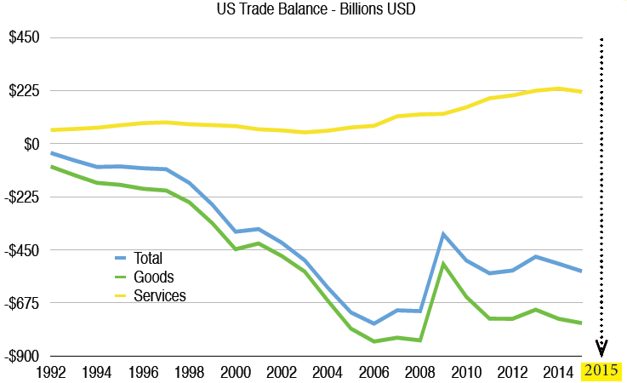
The Worst Trade Deficit in U.S. History

Slide 15
Industries Lost
LCDs for monitors, TVs, and handheld devices like mobile phones' electrophoretic displays
Lithium ion, lithium polymer and NiMH batteries
Advanced rechargeable batteries for hybrid vehicles
Crystalline and polycrystalline silicon solar cells
Inverters and semiconductors for solar panels, desktop computers, notebooks and netbooks
Compact fluorescent lighting
Fabless chips
Low-end servers
Hard-disk drives
Consumer networking gear: routers, access points, and home set-top boxes
Advanced composites used in sporting goods and other consumer gear
Advanced ceramics and integrated circuit packaging.

Slide 16
Free Trade for who? At what real cost?
The TPP is not free trade. It is the opposite: state-sanctioned global governance.
Of the TPP's 30 chapters, only five address trade.
The remaining 25 seek to manage domestic regulation, food and product safety, financial services, immigration law, Intellectual Property, the environment, labor standards and more.
The TPP is so overreaching on non-trade issues that it would control many aspects of everyday life that we consider personal. Digital interaction, for example, could be where the rights to privacy and profits collide when protecting a content owner's intellectual property forces internet service providers to routinely comb through every email, text, and social media post—the digital equivalent of opening every piece of U.S. mail in transit to check it for possible stolen merchandise.

Slide 17
Korea Free Trade Agreement: A One Way Street
Passed by Congress in 2011, the law went into effect March 16, 2012.
Proponents promised it would create 70,000 new jobs and $10 billion in exports
The Korea—U.S. trade deficit was $14.7 billion that year.
By the end of 2015 the trade deficit had nearly doubled to $28.4 billion.
More than 60,000 U.S. jobs have been lost in 4 years.
The deal placed a ceiling—15,000—on the number of cars the U.S. could export to Korea.
There is no limit on Korean auto exports to the U.S.

Slide 18
TPP Would Accelerate U.S. Job Loss
A projected loss of 91,500 U. S. auto jobs to Japan with reduction of 225,000 automobiles produced in U. S. (Center for Automotive Research)
A projected loss of 522,000 jobs in U. S. textile and related sectors to Vietnam (National Council of Textile Industries)
More service sector and call center jobs will be lost because of new benefits and rights awarded under the TPP to companies that invest offshore.

Slide 19
Offshoring: proven threat to National Security
While some argue that globalization is inevitable, the U.S. military and defense industries must remain domestic in the event of conflict.
The printed circuit board industry is very much at risk. The U.S. and other industrialized nations recently had to challenge China in the WTO when the Chinese government—which mines and controls most of the rare earth minerals used to make high end electronics—set an unexpected and very low ceiling on exports in an effort to drive up the price.
Rare earth minerals are a 21st century industrial staple—used to make everything from submarines, missiles and drones—to electric car batteries and wind turbines.

Slide 20
TPP Will Drive Down U. S. Wages
U. S. wages have been stagnant for decades, growing by just about 2% per year since 2008.
Wage loss due to trade has averaged 5.5% for full-time workers without college degrees.
The average wage in Vietnam is 55 cents/hour (U.S. DOL Comparative Wages in Selected Countries, Feb. 2016)
Trade has increased wage inequality at all income levels—from low to high wage earners.

Slide 21
TPP is a Threat to U.S. Independence
TPP threatens U.S. sovereignty by making America subject to the decisions of a foreign panel of attorneys under the authority of the World Bank and the United Nations.
The president is empowered to unilaterally draft “implementing legislation” that could force changes to U.S. laws and regulations to ensure compliance with the agreement.
Clauses in TPP may overrule prior acts of Congress without new legislation being passed by Congress.

Slide 22
TPP creates a parallel legal universe—and a home court disadvantage for U.S. businesses
  TPP would allow foreign investors to bypass the legal system that governs U.S. citizens and domestic businesses, and would create a special offshore court just for investors—where all decisions are final.
  Foreign companies could file lawsuits under TPP against the U.S. or our state or local governments if they believe our laws inhibited their "expected future profits."
  International panels of private attorneys, not the U.S. courts, would decide these lawsuits.
  The panel could award unlimited damages to foreign investors—paid with our tax dollars.
  The U.S. has no right to appeal.

Slide 23
Buy American Act made null and void
          All companies operating in partner countries would be provided access equal to domestic firms to bid on government procurement contracts.
          Buy American, “Made in USA,” and “Buy Local” programs could be ruled “illegal trade barriers” under TPP.
          Could constrain how state and national governments use tax dollars in construction projects and the purchase of goods.
          The U.S. procurement market is 7 times the size of current TPP partner countries (+$550B vs. $55-70B)

Slide 24
The TPP Changes Intellectual Property Rules
Digital policies benefit international corporations at the expense of small vendors and the American public
TPP rewrites the Global Rules on IP enforcement, but not all TPP partner nations will enforce these rules equally, based on the "IP scores" of TPP partner nations. The U.S. is among the strictest already in terms of enforcing patents and copyrights. Other TPP countries have poor records for enforcement.
Stricter expected IP enforcement in the U.S. under TPP could hurt much of what is now considered fair use here, interfering with private communication and unnecessarily inhibiting the creative community and digital media industries—with little likelihood of preventing real piracy.
TPP extends the copyright term from the life of an author + 50 years, to life + 70 years, and 70 years after publication or creation for corporate owned works. Given the explosive growth of independently produced online content shared via Creative Commons, this opens a Pandora's box of potential litigation.
TPP criminalizes Investigative Journalism, Security Research, and Whistleblowing
TPP provides international legal protections for corporate patents on "biologics"– plant and animal life, granting companies ownership and sole access to these building blocks of life.

Slide 25
The TPP is 2,000+ pages long.
What could possibly be missing?
The TPP doesn’t address the "predatory mercantilist" actions of trading partners:
  Currency manipulation: Japan, Singapore and Malaysia—there are no enforceable provisions
  “Border adjustable" taxes (aka Value-Added Taxes or VATs) are simply tariffs by another name
  Government subsidies to State-Owned Enterprises (which kill competition)
  “Product dumping"

Slide 26
Currency Manipulation
Currency manipulation is trade cheating because it is both an illegal tariff AND a subsidy.
Foreign governments intervene in foreign exchange markets by buying up U.S. dollars.
Three TPP countries engage in currency manipulation right now: Japan, Singapore, and Malaysia
Fixing the problem would create 2.8M to 5.3M jobs with no government spending.
“In five minutes, exchange rates can wipe out what it took trade negotiators ten years to accomplish.” Paul Volcker, Federal Reserve

Slide 27
Border Adjustable Taxes (aka VATs)
159 countries have VATs, including all TPP partner countries
Rates range from 12% to 24% - average is 17%
Value-Added Taxes (VATs) are:
    - Hidden foreign export subsidies whenever exporters receive a government tax rebate upon export.
    - Hidden tariffs—because U.S. goods pay this 17% (average) tax when entering the foreign country.
U.S. exports are double taxed: once here and once upon arrival on a foreign country's shores.

Slide 28
TPP Partners' Government Subsidies
Reduced or no Corporate Taxes: Vietnam waived all corporate taxes on the first four years of Intel’s operations there, and offered big discounts thereafter. Yet President Obama wants to invest U.S. tax dollars to help Vietnam with worker training.
Free land: Singapore and South Korea frequently offer free land.
Low or no interest loans: South Korea routinely offers companies tax-free and interest-free loans.

Slide 29
What exactly IS Product Dumping?
Exporting goods at prices lower than the home-market price or below the actual cost to produce.
China is the biggest offender of product dumping.
Some examples:
    Photovoltaic cells (solar panels)
    Steel
    Titanium
    Shrimp

Slide 30
The TPP will Increase Trans Shipping
Trans shipping is when a product made in a non-trading partner country is shipped to a trading partner country, changed in some way, and then shipped to a partner country to avoid tariffs.
Recent examples—produced in China and shipped through Korea:
        Steel
        Titanium
        Aluminum

Slide 31
The TPP and Immigration
TPP increases “the number of L1 visas and the number of tourist visas, which can be used for business purposes.”
Any service provider (phone service, security, engineers, lawyers, architects or any company providing a service) can enter into a TPP partner country and provide that service.
Companies don’t have to hire Americans or pay American wages—they can bring in workers from another country and pay them less than the U.S. minimum wage.

Slide 32
The TPP Will Reduce Reshoring
The bleeding has stopped. Offshoring and reshoring leveled off in 2015.
But TPP will reduce tariffs, making the "total cost of ownership" argument more difficult—and less likely to lead to reshoring.
The value of the U.S. dollar—measured against the index basket of the most liquid foreign currencies—is at its highest level in several years, adding to U. S. costs.
A combination of the high USD and TPP, will reduce the rate of reshoring by an estimated 20 to 50%.“- Harry Moser, Founder, Reshoring Initiative

Slide 33
TPP Economic Projections
No Net Exports
  - $356B more imports
  $356B more exports
Allows currency misalignment
Allows Border Taxes to replace tariffs
No impact on Agricultural Trade
Source: Peterson Institute for International Economics, January 2016

Slide 34


SPECIAL GUEST:
Michael Stumo, CEO
Coalition for a Prosperous America

Slide 35
TPP's Goal of Globalizing Supply Chains
Spells Kiss of Death for U.S. Manufacturing
The goal of the TPP is to create a completely globalized supply chain.
TPP and other "free trade" deals incentivize imports from low wage and subsidized foreign countries
When offshoring is so richly rewarded, American suppliers have little choice but to watch as contracts go out the door and across the ocean.
The effect this has on businesses' market share, pricing power, and ability to grow and create more jobs, can trigger the collapse of entire industries
Loss of contracts
Loss of market share
Loss of pricing power
Lost growth opportunities

Slide 36
Domestic supply chain ecosystems are the lifeblood of an economy, producing:
The U.S. became the world's largest economy through the development
of diverse domestic supply chains.
Jobs
Innovation
Value Added Growth

Slide 37

Offshoring crucial supply chains puts a stranglehold on economic growth and job creation, squeezing the life out of communities and putting the security of entire nations at risk.

Slide 38
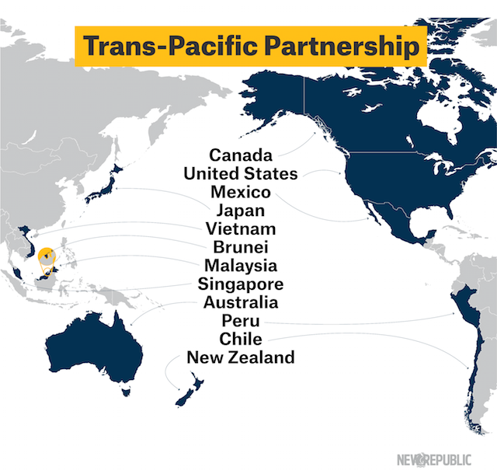
TPP offers little increased access to six TPP partner countries—Mexico, Canada, Peru, Chile, Australia and Singapore—that already have trade deals with the United States.
Of the remaining five who would be "new" trading partners, four—Brunei, Vietnam, New Zealand and Malaysia—are very small.
Japan, the largest, has already cut tariffs by more than 2.5% over the course of a few decades. Though Japan imposes no tariffs on auto imports, the combined market share of foreign cars sold in Japan represents just 6% of all cars sold there. That number has remained steady for 30 years.

Slide 39
USITC Report: No Economic Upside to the TPP
The U.S. International Trade Commission, a government agency, recently released a survey report in which they concluded that by 2032, TPP would not measurably increase the GDP, would cause virtually no income growth, and would have even less impact on jobs.
.15% increase to GDP by 2032 with TPP
.23% - Negligible income growth by 2032 with TPP
120,000 jobs in 15 years = No job growth

Slide 40
USITC: Manufacturing Supply Chains will decline
By 2032, the USITC concluded, TPP would increase the manufacturing trade deficit, reduce manufacturing output, and drive the decline of manufacturing supply chains.
Through 2032 Mfg. Trade Deficit to grow $24 billion/yr. with TPP
Manufacturing output will decline by $10 billion
TPP would cause an increase in manufacturing unemployment in virtually every market sector.

Slide 41
USITC Projections: Agriculture
Only modest growth expected in the food and Ag trade balance—less than $4.5 billion/yr.
There will be clear winners and losers in the industry.
Losers: sugar, rice, wheat, corn, seafood.
Winner: beef.

Slide 42
USITC Projections: Service Sector
Service sector jobs outnumber manufacturing in every country.
The number of "tradeable services" is inconsequential, relative to the whole.
Services include tourism (hospitality and food service), business services, and royalties and licensing fees.
Others include financial, communications, and wholesale/retail

Slide 43
USTIC: When the State gets involved
Government subsidies: China subsidizes it's industries, making it impossible or U.S. companies to compete.
Vietnam: follows the China model. More than 33% of Vietnam's companies are state-owned businesses, subsidized to gain an advantage in domestic and international markets.
Bending the rules (of origin): free-riders gain unfair market access by routing products through trading partner nations with only minor changes—receiving the privileges of a trading partner without making concessions.
Tariff cuts v. trade performance: USTR Michael Froman talks of 18,000 tariff cuts, yet no substantive proof exists to support his assertion that the net impact will be positive for the U.S.

Slide 44
The U.S. is "writing the rules on trade"
Non-quantifiable assertion by USTR Michael Froman.
U.S. did not write TPP, but made many concessions to get it completed.
Russia and China both joined the U.S.-driven WTO but don't follow the rules.
All TPP countries are subject to WTO rules.

Slide 45
The TPP threatens U.S. National Security
Not one of TPP's 30 chapters addresses national security.
The U.S. has mutual defense treaties with some of the TPP countries.
Fast Track Trade Promotion Authority explicitly states that promoting global supply chains is a goal, and TPP delivers.
Globalizing supply chains (offshoring production) is dangerous.
Domestic supply chains provide our jobs and military industrial technology.
A Pentagon report spotlights the crisis in domestic sources' military technology due to a shrinking manufacturing base here.
Brigadier General John Adams (ret.) wrote in the Hill that globalizing supply chains via TPP is a direct threat to national security.

Slide 46
The goal for now, and later
Stop Congressional approval of TPP
Work toward sustained economic growth through strong domestic supply chains that engage businesses of all sizes as stakeholders.
Develop and implement a national strategy to win the international competition to keep jobs and profits here in the U.S.

Slide 47

Michael Stumo
Coalition for a Prosperous America
Q & A
Michele Nash-Hoff
American Jobs Alliance

Slide 48
Thanks and
Wrap-Up

Slide 49
Stopping TPP in the Lame Duck
Keeping the TPP at bay this fall will require a Herculean effort—but it's not impossible. The more the president talks about what a sure thing it is, the more convinced I am that he's worried. And he should be.
Consider this strategy as one to add to your arsenal for the upcoming fight: With only a simple majority needed to pass TPP, we must leave no stone unturned. Who knows what Congress is thinking? This is not a typical September. Maybe hearing from a contingent of local business owners would make a difference in the current climate.
Reach out to your local businesses, business groups, fraternal organizations and churches. Explain what's at stake. I've found people who work in manufacturing, B2B sales or supply chain management are more informed about TPP than people might realize. Even if by some chance they haven't heard about TPP, if you stick to economics and don't preach social justice, most people are curious enough to engage.
Ask a local business leader for a time slot at an event, so you can share information to refute what they may have heard about TPP from the National Chamber of Commerce, the Business Roundtable, USTR Michael Froman, Commerce Secretary Penny Pritzker, and President Obama on their latest round of TPP selling tours
Talk to conservatives, moderates, and the politically apathetic. We need all hands on deck. ☺
In Solidarity, - LW

