Slide 1
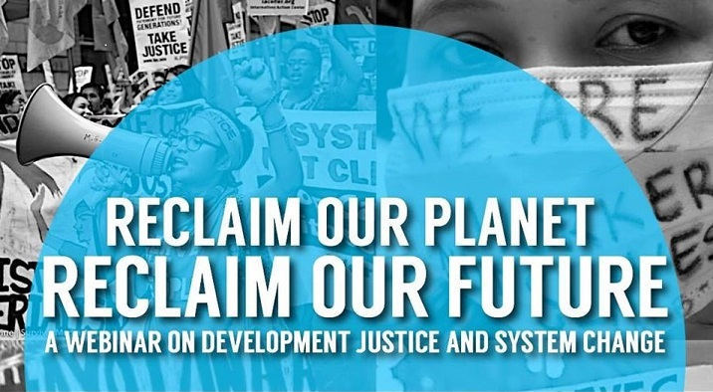
Time for Justice/
Time for System Change
Phone: 605-562-3140 PIN: 951146#
Speakers:
Paul L. Quintos, IBON International; Celeste Drake, AFL-CIO
Mackenzie McDonald Wilkins, Popular Resistance,
Adam Weissman, TradeJustice; Harriet Heywood, MoveOn, FL

Slide 2


Introduction and Welcome
Elizabeth Warren
Director of Communications
People Demanding Action
tpp@peopledemandingaction.org
Welcome!
Call Structure and Norms
Introduction of Host Team and Guest Speakers

Slide 3


Technical Stuff
DIAL IN: 605-562-3140
PIN: 951146#
Meeting Room Functions
Chat
Share
DOWNLOAD THE POWERPOINT:
www.peopledemandingaction.org/downloads/tpp
Use the Share button in the Meeting Room
Andrea Miller
Executive Director, PDAction

Slide 4

Call Host Team
Tom Hocking
Technical Advisor
Call Planning Team
MoveOn Regional Organizer (PA)
Pre/Post Call Technical
Questions
Global TPP Team Facebook Page
Manager
Facebook
https://www.facebook.com/groups/GlobalTPPTeam

Slide 5

Planning Notes
Liz Amsden
lizamsden@Hotmail.com
Call Planning Team
Call Reports/Notes/ Resource
Vetting
MoveOn Regional Organizer (CA)

Slide 6
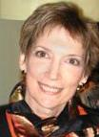
Planning/Notes
Jan Schwartendruber
janinkansas2@gmail.com
National Team Co-Organizer
Campaign Updates/ Call Notes
MoveOn Regional Organizer (KS)

Slide 7

Chat Hosts
Mara Cohen
marajai51@gmail.com
OFF THIS WEEK
Chat Host
PDA Mass Criminalization Team
Leader
Global Climate Convergence Leader (IL)

Slide 8

Chat Hosts
Lisa Oldendorp
oldendorpl@gmail.com
Chat Host
MoveOn Regional Organizer
(NY)

Slide 9

Call Planning Team
Linda Brewster
lindabrewster@msn.com
Call Planning Team
MoveOn Regional Organizer
(WA)

Slide 10

Call Planning Team
Celeste Drake
Cdrake@aflcio.org
Call Planning Team
Trade and Globalization Policy Specialist, AFL-CIO
Legislative Actions
TPP Negotiation Updates

Slide 11
Call Planning Team
UN Human Rights Report condemns ISDS
TPP negotiation dates over the next 2 weeks:
  September 21-5 TPP market access talks between US, Japan, Canada, Mexico, in San Francisco
  September 26-30: if market access agreed, TPP negotiators meet in Atlanta, Georgia-POSSIBLY NY
  September 30-October 4: TPP trade Ministers meet in Atlanta to finalize the deal-POSSIBLY NY

Slide 12
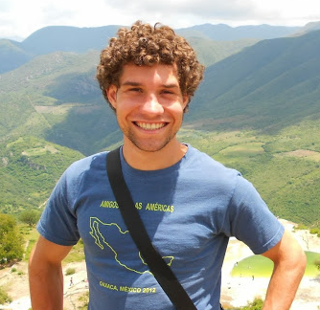
Mackenzie McDonald Wilkins
Climate and Trade Justice Activist
Popular Resistance
Flush the TPP
www.popularresistance.org
www.flushthetpp.org
Mackenzie@popularresistance.org

Slide 13
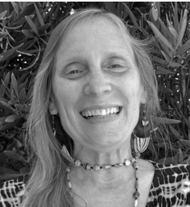
Susie Chasnoff
TPP Media Mobilizers
TPP/TTIP/TISA Twitter Storm
susiechasnoff@gmail.com
Tuesday's Storm: Global Days of Action for Justice & System Change
#FallRising 2 #StopTPP
Twitter Storm @ 9pm Eastern: tiny.cc/TPPMediaMarch
Facebook: https://www.facebook.com/StopTPP.TTIP.TiSA
Website: http://tpp.intoxvs.info/

Slide 14
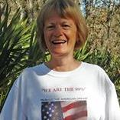
Call Planning Team
Harriet Heywood
harrietheywood@gmail.com
Call Co-Organizer
MoveOn Regional Organizer
(FL)
Update on the Miami TTIP Campaign

Slide 15


Call Planning Team
Adam Weissman
adam@tradejustice.net
www.tradejustice.net
Call Planning Team
Trade Justice/Global Justice
for Animals and the
Environment
Upcoming Events: http://tradejustice.net/events

Slide 16
Days of Action for Justice and System Change
Mobilize for the UN's Sustainable Development Goals Summit
-- expose how the US and other global north nations are pushing neoliberalism and rotten trade deals, not sustainable development!
Tuesday, September 22: TPP Tuesday Night Twitterstorm to Support the Global Days of Action for Justice and System Change
Thursday, September 24: TradeJustice Thursday on Event Horizons Radio w/ Robin Falkov and Adam Weissman w/ special guest organizers from the Global Days of Action for Justice and System Change
Thursday, September 24: Speak Out for Climate Justice

Slide 17
Days of Action for Justice and System Change
Friday, September 25: Park Slope Food Coop International Trade Education Squad Public Forum
Friday, September 25 - Saturday, September 26: International Tribunal of Conscience on Human Rights, Immigrant Justice, and the Impact of US Policy in Mexico and Central America
Saturday, September 26: March Against Forced Migration and Displacement
Sunday, September 27: People's General Assembly
Monday, September 28: Dialogues for Justice and the Common Good: From the Margins to the Frontlines

Slide 18
TPP News
Obama Confident in Getting TPP Deal Completed in 2015
http://www.mintpressnews.com/obama-confident-in-getting-tpp-deal-completed-in-2015/209609
US Rice Industry Opposes Emerging TPP Deal with Japan
http://oryza.com/23782/us-rice-industry-opposes-emerging-tpp-deal-japan
Senators: Address China Currency Manipulation in TPP
http://blogs.rollcall.com/wgdb/senators-address-china-currency-manipulation-in-tpp/?dcz=

Slide 19
TTIP
TTIP: EU Commission Unveils Replacement for Controversial ISDS
https://www.theparliamentmagazine.eu/articles/news/ttip-eu-commission-unveils-replacement-controversial-isds
Trade policies are undermining UK aid efforts Fairtrade Foundation warns
http://home.bt.com/news/uk-news/trade-policies-are-undermining-uk-aid-efforts-fairtrade-foundation-warns-11364004650007

Slide 20
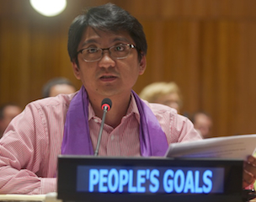
Paul L. Quintos
Paul L. Quintos is a Programme Manager of IBON International, an international non-governmental organization that promotes new development thinking for economic and social justice through capacity development of people’s movements around the world. Before joining IBON, Mr. Quintos was an organizer and educator in the progressive labor movement in the Philippines for over a decade. He obtained his MSc. in Development Studies from the London School of Economics and Political Science, and has held positions in the academe, in government and in various NGOs.

Slide 21
2015
Time for Justice
Time for System Change
IBON International
2015 Sept. 6

Slide 22
UN SG Banki-moon on the “2030 Agenda for Sustainable Development”
“Transforming our World: The 2030 Agenda for Sustainable Development” encompasses a universal, transformative and integrated agenda that heralds an historic turning point for our world. This agreement results from a truly open, inclusive and transparent process. This is the People’s Agenda, a plan of action for ending poverty in all its dimensions, irreversibly, everywhere, and leaving no one behind. It seeks to ensure peace and prosperity, and forge partnerships with people and planet at the core.”

Slide 23
Income Distribution
Amidst multiple crisis of global capitalist system
  Economic: massive unemployment, underemployment; “vulnerable employment” now 48%
  Social: widening inequalities
  Environmental: climate crisis; 3 of 9 planetary boundaries already breached
  Increasing monopoly capitalist competition for control of labor, resources, markets (e.g. US Pivot to Asia)
Notes:
15,000 people still die every day and 17 infants under the age of five die every minute mostly due to preventable causes such as the lack of basic health services
Yop 1% own 40%, next 9% own 45%
3 of 9 planetary boundaries already breached: climate; nitrogen, biodiversity loss (at the level of a 6th mass extinction)

Slide 24
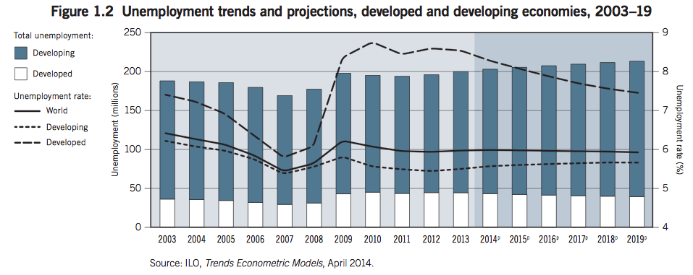
Protracted Economic Crisis

Slide 25
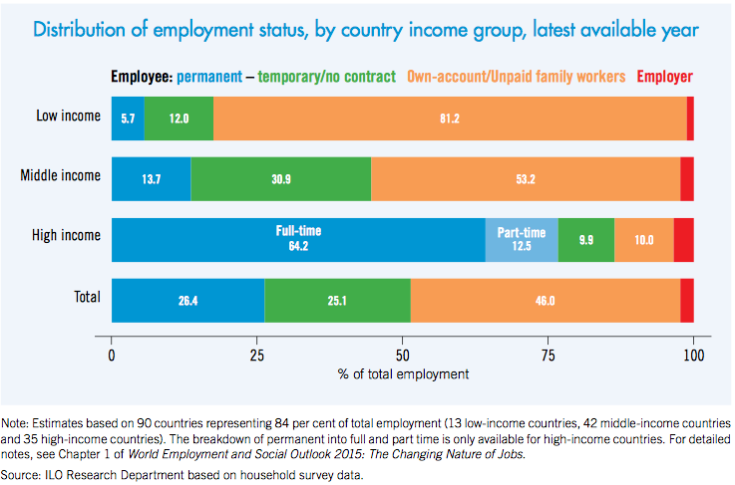
Income Distribution

Slide 26
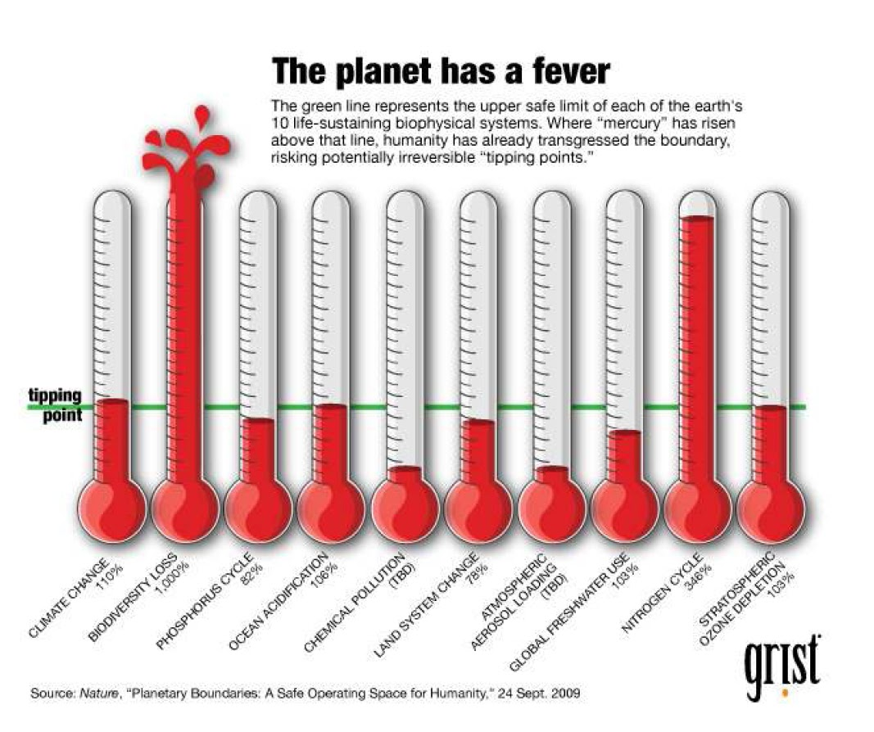
Ecological crisis: breaching planatery boundaries
Notes:
The climate crisis is just one although certainly the most serious of environmental crises we are facing.
We are approaching 400ppm when safe space is 350ppm for CO2. James Hansen, director of NASA's Goddard Institute for Space Studies in New York, says we passed the danger threshold more than 20 years ago, we haven't yet experienced all the warming from that amount of CO₂, not by a long chalk.
Every degree of warming caused directly by CO₂ is amplified by feedback processes.
They put the current extinction rate at more than 100 extinctions per million species per year, and rising. That compares with a natural "background" extinction rate of around 0.3. Up to 30 per cent of all mammal, bird and amphibian species will be threatened with extinction this century. Current rates may even mirror those of the "big five" mass extinctions of the past half-billion years, including the meteorite strike that did for the dinosaurs.
Grabbing too much nitrogen from the atmosphere for industrial fertilizers and poisoning our rivers and soils with it

Slide 27
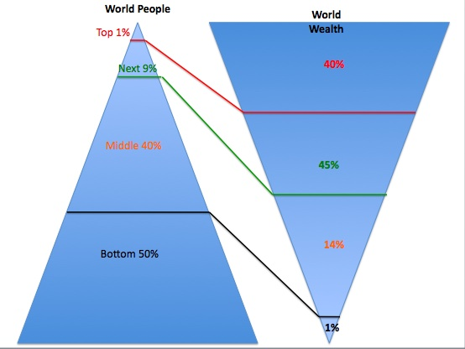
Social crisis:
Deepening inequalities

Slide 28
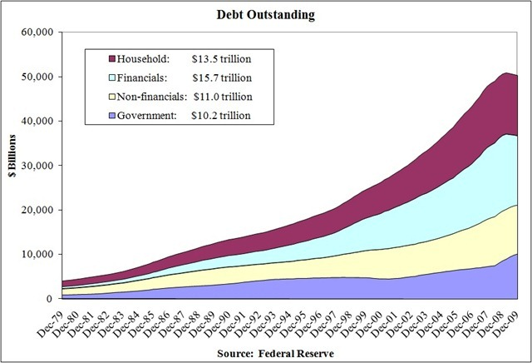
Growing indebtedness

Slide 29
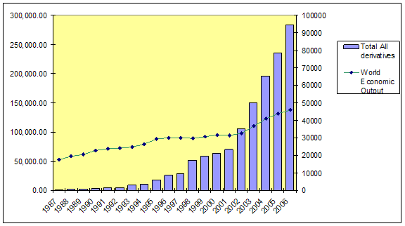
Increasing financialization
More profits from financial speculation
Notes:
Along with credit default swaps and other exotic instruments, the total notional derivatives value is about $1.5 quadrillion – about 20% more than in 2008, beyond what anyone can conceive, let alone control if unexpected turmoil strikes.

Slide 30
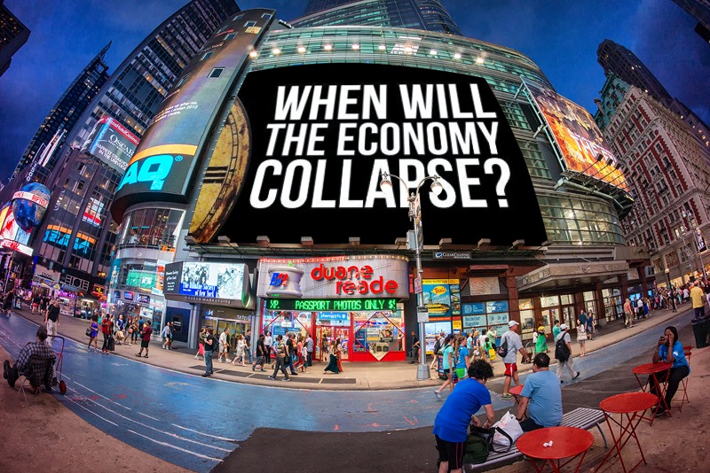
A new global financial crisis in the offing
Bursting of “emerging markets” including China
Decline of commodity markets
Currency devaluations

Slide 31
Growing fascisation: Rise of the national security state
Exposes on NSA surveillance, CIA torture
Joint AI-HRW report: US drone killings as war crimes
Police abuses vs unarmed civilians, homeless, undocumented immigrants, minorities
New and more repressive laws vs protest/dissent
Shows rising fascist trend, effect on client states
Notes:
The growth of the national security state
Continuing backlash of Assange (Wikileaks) and Snowden (NSA) exposés, other whistleblowers
US Senate report on CIA torture, which is especially damning because Obama wants to whitewash it to avoid expanding the Senate investigation to include his own killer-drone program (also run by the CIA)
Joint report by Amnesty International, HRW says US drone killings could be classified as war crimes
Growing issue of killings of unarmed civilians by police
Recent report of UN Commission on Human Rights on human rights situation in the US: criminalization of homelessness
New repressive anti-protest laws in the guise of anti-terrorism, national security: recent US legislation; Gag Law (Ley Mordaza) in Spain
Exposé of mainstream media as ruling-class propaganda tool
In response to global criticism, US ruling elite insists on “American exceptionalism”
Emergency rule (period-delimited, indefinite) in developing countries – Egypt, Thailand

Slide 32
Increasing militarism and armed conflicts
Increasing US military presence worldwide
Gigantic military spending by big powers
Wars of aggression, proxy wars, armed upheavals
  Ukraine
  Syria, Libya, Yemen, Turkey
  Somalia, Sudan, Nigeria, Egypt, Chad, Kenya
  Palestine
  Afghanistan and Iraq
US Pivot to Asia
Notes:
Increasing US military presence worldwide
In Africa: US Special Forces in Nigeria. AFRICOM expanding its stealthy presence in Niger, Mali, South Sudan, Ethiopia, CAR, etc.
Continuing pivot to East Asia
Trends in military spending as of 2013
Total global military expenditure in 2013: $1747 billion.
Military spending fell in the West—North America, Western and Central Europe, and Oceania, but increased in all other regions
The five biggest spenders in 2013: US, China, Russia, Saudi Arabia, France.
Wars of aggression, proxy wars
In 248 documented armed conflicts after World War II, the US started 201, killing 30 million, the bulk of them children (more that what the Nazis killed during Third-Reich Europe.)
Imperialist use of mercenary armies (e.g. in Syria, Ukraine)
Increasing factors for world war
Increasing polarization between US-EU (NATO) and Russia-China (SCO)
Increasingly bellicose talk by US-NATO vs its adversaries (esp Russia)
Movement towards deployment of tactical nukes in Europe
Flashpoints: Ukraine, Middle East (Syria, Iran, Israel-Palestine), East Asia (Korean peninsula, territorial disputes), proxy wars and internal civil strife in Africa

Slide 33
Clearly the MDGs have failed to deliver “development” for the people
Set of goals ostensibly intended to focus government efforts to solving poverty, hunger, etc.
The real intent was to sugarcoat “neoliberalism”; to make pretenses that the world capitalist system was humane even as the rapacity of imperialist exploitation and plunder remains the reality;
to divert people's attention away from the real roots of the problems that these goals are supposed to solve: colonial and neocolonial domination and monopoly capitalist exploitation
propaganda offensives to push back the advance of the progressive forces against imperialist globalization
avowed obligation of the advanced capitalist countries to provide more development aid, debt relief, access to markets, medicines and new technology for the underdeveloped countries in the name of "global partnerships for development." But in fact, these are the very same instruments by which imperialists exploit and keep backward countries dependent.
Thus the MDGs, have served to perpetrate the exploitative relations between the imperialist powers and the client countries

Slide 34
The new Sustainable Development Goals (SDGs)
(1) End poverty in all its forms everywhere;
(2) End hunger, achieve food security and improved nutrition, and promote sustainable agriculture;
(3) Ensure healthy lives and promote well-being for all at all ages;
(4) Ensure inclusive and equitable quality education and promote life-long learning opportunities for all;
(5) Achieve gender equality and empower all women and girls;
(6) Ensure availability and sustainable management of water and sanitation for all;
(7) Ensure access to affordable, reliable, sustainable, and modern energy for all;

Slide 35
The new SDGs
(8) Promote sustained, inclusive and sustainable economic growth, full and productive employment and decent work for all;
(9) Build resilient infrastructure, promote inclusive and sustainable industrialization and foster innovation;
(10) Reduce inequality within and among countries;
(11) Make cities and human settlements inclusive, safe, resilient and sustainable;
(12) Ensure sustainable consumption and production patterns;
(13) Take urgent action to combat climate change and its impacts ("Acknowledging that the UNFCCC is the primary international, intergovernmental forum for negotiating the global response to climate change ...");

Slide 36
The new SDGs
(14) Conserve and sustainably use the oceans, seas and marine resources for sustainable development;
(15) Protect, restore and promote sustainable use of terrestrial ecosystems, sustainably manage forests, combat desertification, and halt and reverse land degradation and halt biodiversity loss;
(16) Promote peaceful and inclusive societies for sustainable development, provide access to justice for all and build effective, accountable and inclusive institutions at all levels.
(17) Strengthen the means of implementation and revitalize the global partnership for sustainable development

Slide 37
Goal 2. End hunger, achieve food security and improved nutrition, and promote sustainable agriculture
2.1 by 2030 end hunger and ensure access by all people, in particular the poor and people in vulnerable situations including infants, to safe, nutritious and sufficient food all year round
2.2 by 2030 end all forms of malnutrition, including achieving by 2025 the internationally agreed targets on stunting and wasting in children under five yeat·s of age, and address the nutritional needs of adolescent girls, pregnant and lactating women, and older persons
2.3 by 2030 double the agricultural productivity and the incomes of small-scale food producers, particularly women, indigenous peoples, family farmers, pastoralists and fishers, including through secure and equal access to land, other productive resources and inputs, knowledge, financial services, markets, and opportunities for value addition and non-farm employment

Slide 38
Goal 2. End hunger , achieve food security and improved nutrition, and promote sustainable agriculture
2.4 by 2030 ensure sustainable food production systems and implement resilient agricultural practices that increase productivity and production, that help maintain ecosystems, that strengthen capacity for adaptation to climate change, extreme weather, drought, flooding and other disasters, and that progressively improve land and soil quality
2.5 by 2020 maintain genetic diversity of seeds, cultivated plants, farmed and domesticated animals and their related wild species, including through soundly managed and diversified seed and plant banks at national, regional and international levels, and ensure access to and fair and equitable sharing of benefits arising from the utilization of genetic resources and associated traditional knowledge as internationally agreed

Slide 39
Goal 2. End hunger , achieve food security and improved nutrition, and promote sustainable agriculture
2.a increase investment, including through enhanced international cooperation, in rural infrastructure, agricultural research and extension services, technology development, and plant and livestock gene banks to enhance agricultural productive capacity in developing countries, in particular in least developed countries
2.b. correct and prevent trade restrictions and distortions in world agricultural markets including by the parallel elimination of all forms of agricultural export subsidies and all export measures with equivalent effect, in accordance with the mandate of the Doha Development Round
2.c. adopt measures to ensure the proper functioning of food commodity markets and their derivatives, and facilitate timely access to market information, including on food reserves, in order to help limit extreme food price volatility

Slide 40
The question is “how ”?
What would be the policies and measures implemented to achieving these goals and targets?
Vigorous debate on the question of balance in terms of obligations and burden-sharing (application of the CBDR principle)
But consensus among member states puts emphasis on role of private sector as drivers of innovation and development, and
private finance as fuel for development, leveraged by public finance

Slide 41
The business perspective on Goal 2
“Businesses are taking part through development of new crops and training of farmers in new technologies. Provision of affordable and quality inputs such as seeds, fertilizers, pesticides, farm equipment, water-conserving irrigation systems, processing or re-cycling of waste to reduce greenhouse gas emissions, and bins and containers for fragile crops such as vegetables all play an important role in helping farmers increase the scale of their operations and incomes. There is mutual advantage in integrating geographically and economically isolated, smallholder farmers – many of whom are women - into national, regional and global enterprises and their value chains.”
- UN Global Compact
Notes:
So from the business point of view, this goal is about integrating geographically and economically isolated small farmers, many of whom are women, into the global value chains of transnational corporations (TNCs). TNCs like Nestle for instance would go from country to country contracting with small farmers for the production and supply of coffee or soy. The terms and conditions are typically determined unilaterally by the TNC: what seed variety to use; what inputs are going to go into the land; when crops are going to be delivered; what production methods are used; how much will be paid, and so on, often in very detrimental terms and conditions for smallholder farmers. As a result, many small farmers’ gross incomes are increasing but their net incomes are decreasing because of rising costs of seeds and production inputs supplied by other TNCs. Just three companies control over half of global commercial sales of seeds, of which about a quarter are sales of genetically engineered seeds.

Slide 42
implications of this business perspective…
Greater control of MNCs over production and markets through their “value-chains”
Greater dependence of small farmers on corporate-controlled seeds, pesticides, production inputs, etc.
Increasing gross incomes of small farmers but declining net incomes

Slide 43
Tapping private finance as fuel for development
Instead of plugging the leaks which rob us of public resources (illicit financial flows, tax evasion and tax avoidance, tax competition, unfair trade, unjust debt, etc.), MOI/FFD discussions overwhelmingly emphasize the various ways of enticing private sector investments
“blended finance” or the practice of linking grants, provided by official development assistance (ODA), with loans from publicly owned institutions or commercial lenders.
Public-private partnerships (PPP) that take the form of agreements that shift the risks associated with private investments to the public sector.
Infrastructure, social and environmental projects packaged as “new asset classes” for sale to institutions investors

Slide 44
Problems with relying on private finance
Private finance is profit-oriented which results in inequitable provision of public goods and social services.
Socializing risks while privatizing profits.
publicly-subsidized private finance and PPPs tend to go to well-performing sectors anyway and thus have questionable development additionality.
The World Bank’s Independent Evaluation Group (IEG) points to major problems with PPPs, namely: a) increased costs to the public purse; b) lack of transparency and accountability; and c) high-risks which end up shouldered by the public.

Slide 45
Need to examine SDGs in the context of broader policy trends
New wave of privatization with the aim of capturing sectors that were previously public domain, such as water and sanitation services, education, health, pension systems, etc. (e.g. PPPs)
Investment deregulation by facilitating foreign direct investments, speculative capital, and systematic undervaluation of currencies of the South (e.g. TISA)
Notes:
OWG talks about right to water; and improving access to services. But there is ongoing trends towards more privatization of social services; cutbacks in social spending both in North and the South. E.g. the remaining specialized public hospitals being privatized
OWG talks about a global partnership for development but unequal and unfair trade rules prevail and are being expanded and reinforced by the WTO and so-called 21st century trade agreements. Bali agreement produced deal on trade facilitation that eases entry of imports from rich countries in the south

Slide 46
Need to examine SDGs in the context of broader policy trends
Empowering corporations with new privileges and rights to attack nations by forbidding states from interfering in economic affairs and reducing their role to narrow police functions (e.g. TPP)
Subjecting nature to the laws of the market and enclosure of the global commons by the corporate sector (e.g. Green economy; green growth)
Notes:
OWG and all other reports stress the role and contribution of PS in sus dev but trend of investment deregulation ongoing, e.g. destruction caused by mining and extractive industries still go on with impunity
Related to this is the growing trend of TNCs suing states, e.g. Philip Morris versus Uruguay health regulation
Payment for ecosystem services

Slide 47
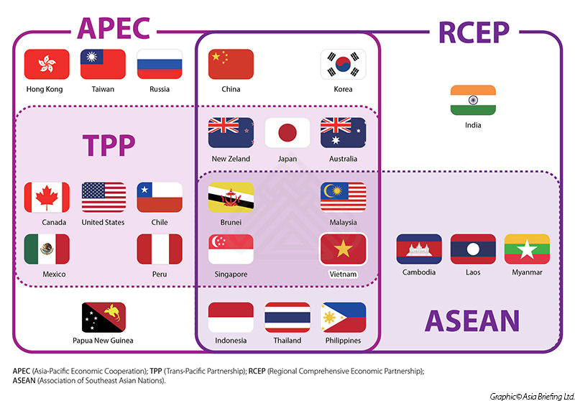
New neoliberal globalization offensives
Global Corporate Rule (e.g. ISDS)
Deregulation (e.g. RIA, “regulatory cooperation”)
Privatization (SOEs, public services)
IPR (evergreening of pharma patents; stricter and invasive copyright enforcement)
Trade Liberalization (lowering tariffs, lock-in)
Notes:
Para maigpawan ang crisis,….

Slide 48
So what is the emerging post-2015 development agenda?
An expanded and revamped MDGs
A vehicle for expanding and strengthening multinational corporate power, neocolonial exploitation and plunder
A strategy for reviving and legitimizing the global capitalist growth model
Sugarcoating for more imperialist globalization
Notes:
…by making it appear that capitalist growth is possible and reconcilable with equality and environmental sustainability

Slide 49
Q & A
Guest Speaker:
Paul L. Quintos
iboninternational.org

