Slide 1
TPP: Toxic Trade and Slavery at Home
Shameful Price for Corporate Profit
August 16, 2015
7:30 PM Eastern/4:30 PM Pacific
Call In: 605-562-3140
PIN: 951146#
Backup: 559-726-1300

Slide 2
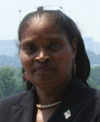
Introduction & Welcome
Andrea Miller, Executive Director,
People Demanding Action
EMAIL: andrea@peopledemandingaction.org
Call Norms
Meeting Room Functions
Website: www.peopledemandingaction.org
Download:
www.peopledemandingaction.org/downloads/tpp

Slide 3

TPP Call Host Team
Tom Hocking
  National Call Technical Advisor
  National Call Planning Team
  MoveOn Regional Organizer (PA)
  Pre and Post Call Technical Questions
  Global TPP Team Facebook Page Manager
  Facebook: https://www.facebook.com/groups/GlobalTPPTeam

Slide 4
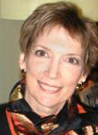
Call Planning/Notes/Information
Liz Amsden
  National Call Planning Team
  Call Reports/Notes/Resource Vetting
  MoveOn Regional Organizer (KS)
  EMAIL: janinkansas2@gmail.com

Slide 5

Call Planning/Notes/Information
Jan Schwartengruber
  National Team Co-Organizer
  Campaign Updates/Call Notes
  MoveOn Council Organizer (CA)
  EMAIL: lizamsden@Hotmail.com

Slide 6

Nationall TPP Call Chat Hosts
Mara Cohen
  National Call Planning Team Chat Host
  PDA Mass Criminalization Team Leader
  Global Climate Convergence Leader (IL)
  EMAIL: marajai51@gmail.com

Slide 7

National TPP Call Chat Hosts
Lisa Oldendorp
  National Call Planning Team Chat Host
  MoveOn Regional Organizer (NY)
  EMAIL: eslsk8r@optonline.net

Slide 8


National Call Planning Team
Harriet Heywood
  National Call Team Co-organizer
  MoveOn Regional Organizer (FL)
  EMAIL: harrietheywood@gmail.com
Linda Brewster
  National Call Planning Team
  MoveOn Regional Organizer (WA)
  EMAIL: lindajbrewster@msn.com

Slide 9
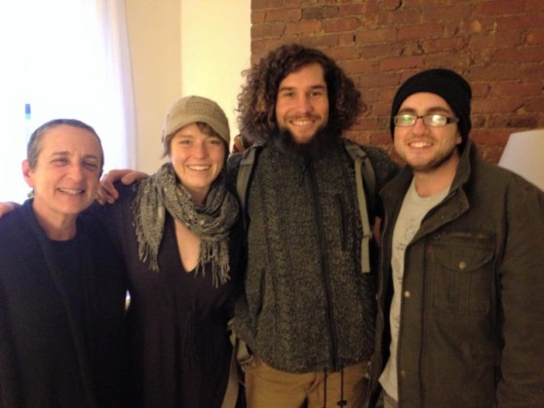
MacKenzie McDonald Wilkins
  Climate and Trade Justice Activist
  Popular Resistance
  Flush the TPP
  EMAIL: Mackenzie@popularresistance.org
  WEBSITE: www.popularresistance.org
  www.flushthetpp.org

Slide 10
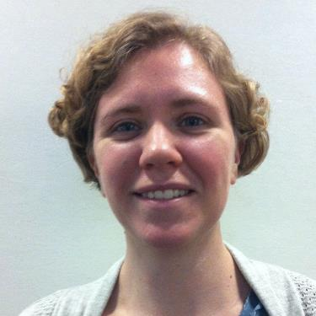
Kathryn Johnson
Kathryn Johnson is a Field Organizer for Public Citizen’s Global Trade Watch where she educates and mobilizes constituents for national campaigns. Previously, she served as Assistant Director of the Guatemala Human Rights Commission/USA.
Email: kjohnson@citizen.org

Slide 11
TPP: Where Are We Now?
TPP Negotiations: Where are they and what’s next
International Week of Action Against the TPP, TTIP and CETA Oct. 10-17th
Other things you can do in your district to stop the TPP
Want to know how your Rep. voted on Fast Track? Go to http://clerk.house.gov/evs/2015/roll362.xml

Slide 12

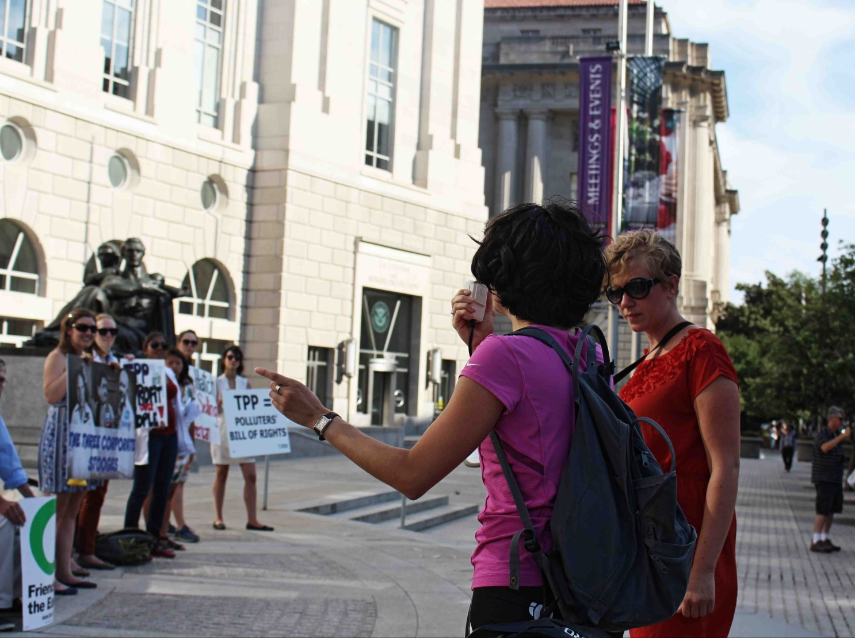
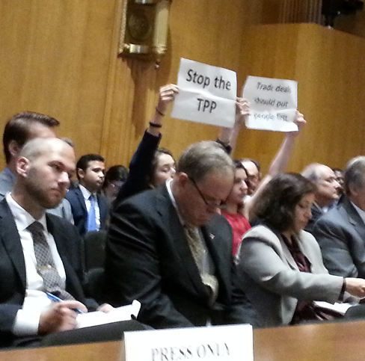

Slide 13
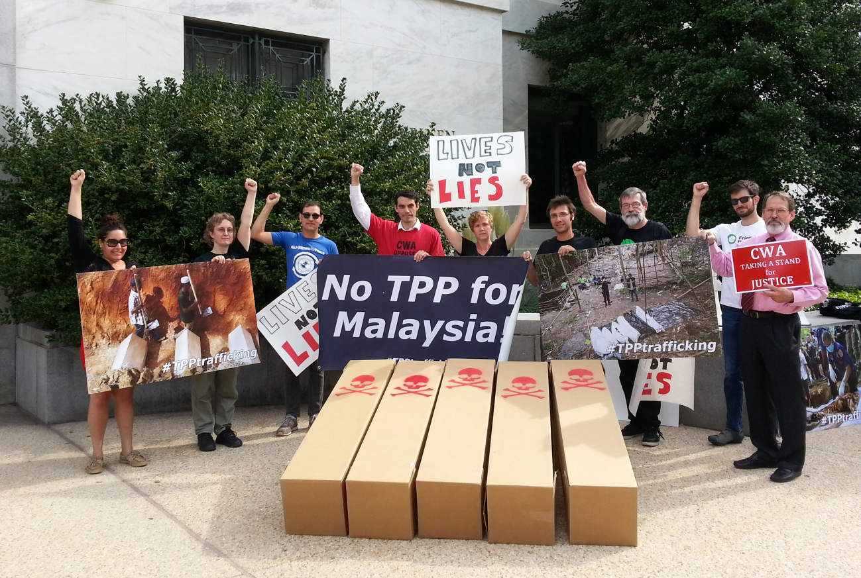
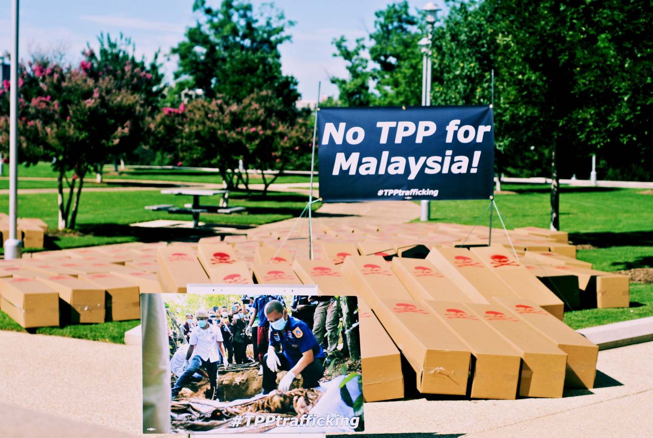

Slide 14

National Call Planning Team
Adam Weissman
  Trade Justice/Global Justice for Animals and the Environment
Upcoming Events/Actions
  www.tradejustice.net/?page=Events
  General Information/Articles: www.tradejustice.net
  EMAIL: adam@tradejustice.net

Slide 15
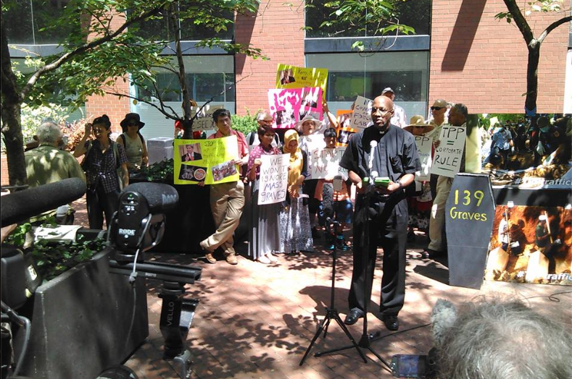
Whitewash of Human Trafficking in Malaysia for TP – 8/4 Press Conference

Slide 16
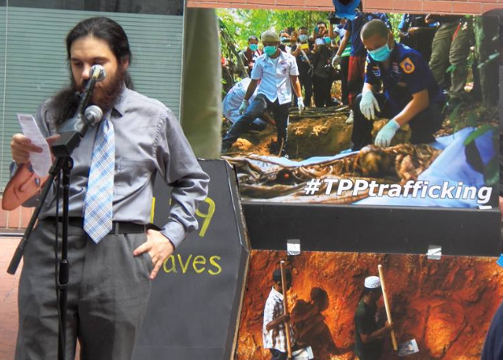
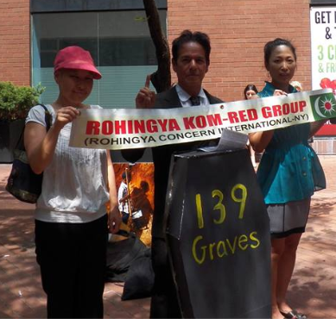
Whitewash of Human Trafficking in Malaysia for TP – 8/4 Press Conference

Slide 17
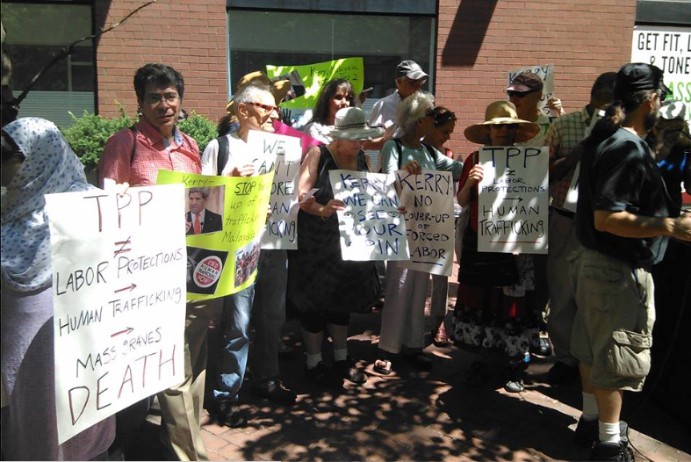
Whitewash of Human Trafficking in Malaysia for TP – 8/4 Press Conference

Slide 18
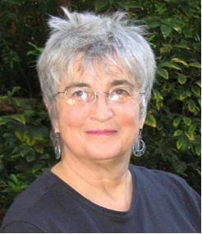
Nancy Price
Nancy Price is Co-chair, Alliance for Democracy, Leadership Team, Women's International League for Peace and Freedom's Save the Water Campaign. Nancy currently is spearheading the campaign for TPP Free Zones.

Slide 19
“We Will Not Obey”
TPP-Free Zones
www.tppfreezones.org
www.thealliancefordemocracy.org

Slide 20


Slide 21
The issue is not issues; the issue is the system
Why should your City or County Council or Town Meeting oppose the
Trans-Pacific Partnership (TPP), ●
The Transatlantic Trade and Investment Partnership (TTIP), and the
Trade in Services Agreement (TiSA)?
Because the TPP, TTIP and TISA …
http://www.thealliancefordemocracy.org/pdf/2015AfDlocaltrade.pdf

Slide 22
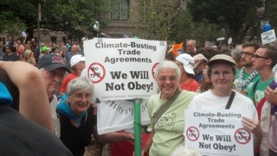
TPP, TTIP and TiSA
Climate-busting trade agreements

Slide 23
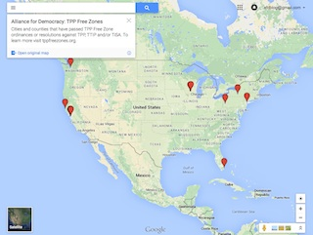
10 cities and 2 counties have passed resolutions – let’s have 90 more!

Slide 24
Why TPP-Free Zones?
Passage of the TPP, TTIP and TiSA will foreclose the possibility of grassroots groups working together for local grassroots solutions for the betterment of the community.
Impacts major function of local government: land-use, zoning and planning.

Slide 25
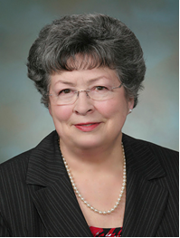
WA State Senator Maralyn Chase
Maralyn Chase is a Democratic member of the Washington State Senate, representing the 32nd district since 2011. Before her election to the Senate, she served in the Washington State House of Representatives from 2002 to 2011. Senator Chase serves as the ranking member, economic development and trade committee in the Washington state senate.

Slide 26
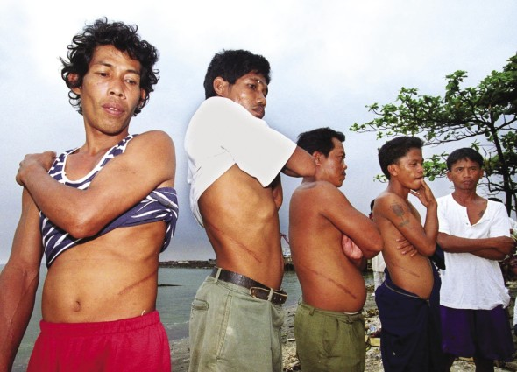
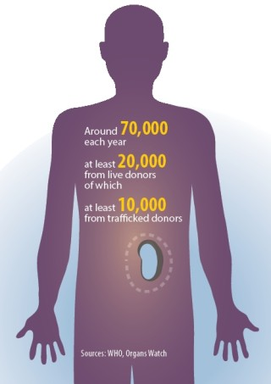
TRAFFICKING IN HUMAN ORGANS

Slide 27
Trafficking young girls in the United States
Traffickers target mostly young girls who average between 12 and 14 years in age and are usually from low-income homes where one or both parents are absent.
Many of the girls are already victims of child abuse and neglect, and many are struggling with drug and alcohol abuse.

Slide 28
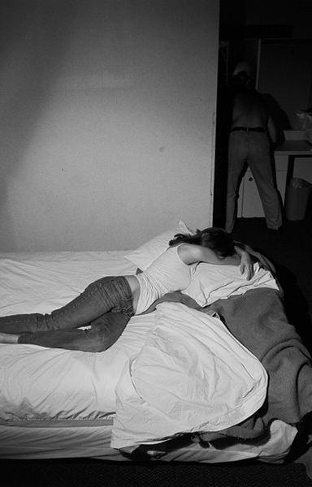
Sex Trafficking of
Americans
The Girls Next Door
There are basically two business models: manipulating girls through violence – that is called “gorilla pimping – and controlling them with drugs.
Human trafficking – the commercial sexual exploitation of American children and women, via the Internet, strip clubs, escort services, or street prostitution – is on its way to becoming one of the worst crimes in the U.S.

Slide 29
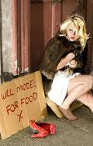
New Study from Fordham Measures Human Trafficking and its Link to Homelessness
The study highlights the role of homelessness in forcing young people into “survival sex,” or the trading of sex acts—such as prostitution or stripping—for basic needs such as food or shelter.
Out of 174 homeless youth between 18 and 23 years old who were surveyed, nearly one-quarter—or 23 percent—had been trafficked or had engaged in survival sex.

Slide 30

Missing & Murdered Indigenous Women in Canada
Indigenous women and girls in Canada have been murdered or have gone missing at a rate four times higher than the rate of representation of indigenous women in the Canadian population which is 4.3%.
The most comprehensive numbers available were collected by the non-profit organization Native Women’s Association of Canada (NWAC) through an initiative financed by the governmental entity Status of Women Canada.
New report by Interamerican Commission on Human Rights

Slide 31
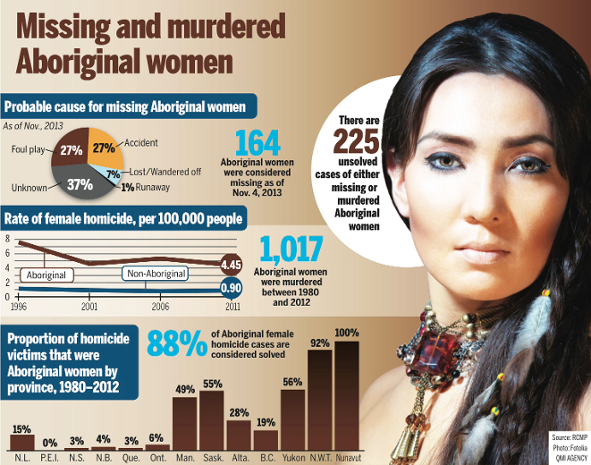
Missing & Murdered Aboriginal Women

Slide 32
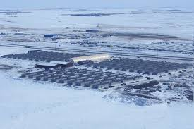
Man Camps in North Dakota
“They treat Mother Earth like they treat women... They think they can own us, buy us, sell us, trade us, rent us, poison us, rape us, destroy us, use us as entertainment and kill us. I’m happy to see that we are talking about the level of violence that is occurring against Mother Earth because it equates to us [women]. What happens to her happens to us... We are the creators of life. We carry that water that creates life just as Mother Earth carries the water that maintains our life.”
Read more at: http://indiancountrytodaymedianetwork.com/2013/08/28/brave-heart-women-fight-ban-man-camps-which-bring-rape-and-abuse-151070

Slide 33
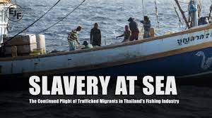

Slide 34
Child Slaves May Have Caught the Fish in Your Freezer
In reality, vulnerable individuals are sold to fishing boat captains for a huge profit, and must then work off several thousand dollars of “debt.” Thai immigration and law enforcement officials are often complicit in these deals. Prosecution of perpetrators is rare. Many migrants get sold from boat to boat and don’t see land for years, sleeping in the open and forced to take bizarre amphetamine cocktails to stay awake for days on end.

Slide 35
GATS Mode-4 Trading in People
Legalized Trafficking
Described as the creation of a 21st century system of indentured servitude
Gives employers the flexibility to cut labor costs by firing their own workers and contracting with a labor supplier who can bring in foreign workers at lower pay (with very few legal rights)
Guestworkers will be contractually bound to an employer
Workers will not enjoy the customary legal rights they are entitled to in their home countries or that native-born workers in the host country have

Slide 36
GATS Mode 4 Legalized Trafficking
Lack physical access to labor unions, legal services, human rights organizations, and courts in their own country
The jurisdiction of the courts in most cases will not apply because the abuse will have occurred outside the territory of the worker’s home country
The movement of workers under Mode 4 will typically be from poorer countries to wealthier countries thus, setting up a “brain drain” scenario

Slide 37
GATS Mode 4 LABOR MOBILITY
Costs of transportation on borrowed money with high interest rates
Labor Agencies – recruitment processes
  Holding travel documents from trafficked individual
  No requirement from home country to guarantee travel home

Slide 38
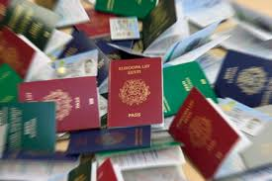
Retention or Confiscation of Identity Documents
Passports, work permits, certificates of qualification or travel documentation, typically affects international migrants.
Restrictions on workers’ freedom of movement, ties them to particular employers or jobs, forcing them to do work in fear of losing their documents.

Slide 39
GATS Mode 4 Impact on Women
International Women’s Day
Women will fare even worse than men
United Nations Development Fund for Women (UNIFEM), women constitute 50 percent or more of migrant workers in Asia and Latin America and they significantly outnumber men in countries such as Indonesia, the Philippines, and Sri Lanka.

Slide 40
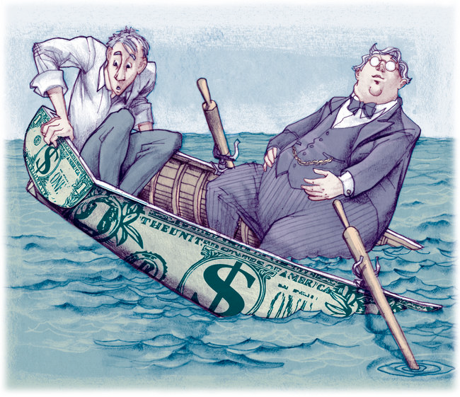
Trade agreements and the 99%
Lopsided income growth in the United States 1979-2012
Over this period, the average income of the bottom 99 percent of U.S. taxpayers grew by 18.9 percent. Simultaneously, the average income of the top 1 percent grew over 10 times as much—by 200.5 percent.

Slide 41
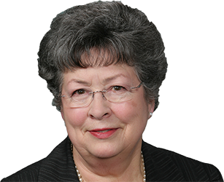
Q & A with
Senator Maralyn Chase

Slide 42
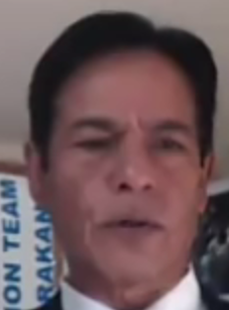
Mohiuddin M.Yusof
President of the World Rohingya Organization
Facebook: https://www.facebook.com/uwro.org
Website: http://rci-info.blogspot.com/

Slide 43
THANKS
AND WRAP-UP
Upcoming speakers
AND Tentative Topics:
Watch your Email for more details and registration information:
Labor Call, Currency Manipulation,

