Slide 1

PH:
605-562-3140
AC:
951146#
MAYDAY, MAYDAY!
Workers at Risk!
NATIONAL TPP CALL
May 3, 2015
7:30 p.m. EDT
4:30 p.m. PDT

Slide 2
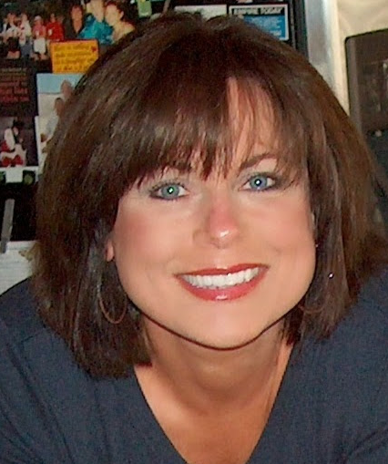

WELCOME!
• Meeting room functions
• Call Norms
• Host Team Introductions
Elizabeth Warren
Director of Communications and Campaign Outreach
People Demanding Action
Email: TPP@PeopleDemandingAction.org
Website: www.peopledemandingaction.org
TPP News and Tools: http://www.peopledemandingaction.org/campaigns/stop-tpp-fast-track

Slide 3



National Call Planning Team
Harriet Heywood
National Call Team Co-organizer
National Call Program Coordinator
MoveOn Regional Organizer FL
Email: Harrietheywood@gmail.Com
Linda Brewster National Call Planning Team
MoveOn Regional Organizer WA
Email: LindaJBrewster@msn.com

Slide 4




National TPP Call Chat Hosts
  Mara Cohen
  National Call Planning Team/Chat Host
  PDA Mass Criminalization Team
  Global Climate Convergence Leader, IL
  Email: McMoveOn@gmail.com
  Lisa Oldendorp
  National Call Planning Team/Chat Host
  MoveOn Regional Organizer, NY
  Email: eslsk8r@optonline.net

Slide 5
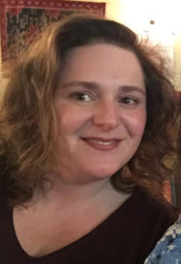

Welcome our newest Chat Host:
Jeanne Marie Dauray
National Issue Teams Coordinator
Progressive Democrats of America
Email: Jeanne@PDAmerica.org

Slide 6
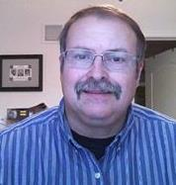
YOUR TPP CALL HOST TEAM
Tom Hocking
National Call Technical Adviser
National Call Planning Team
MoveOn Regional Organizer, PA
Email: twhocking@gmail.com
●Pre and Post-Call Technical Questions
●Global TPP Team Facebook Page Manager
Website: https://www.facebook.com/groups/GlobalTPPTeam

Slide 7

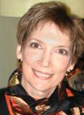
National Call Planning Team
Liz Amsden
National Call Team Co-Organizer
Campaign Updates
MoveOn Council Organizer CA
Email: Lizamsden@hotmail.Com
Jan Swartzendruber
National Call Planning Team
Call Notes/Resource Vetting
MoveOn Regional Organizer KS
Email: Janinkansas2@gmail.Com

Slide 8
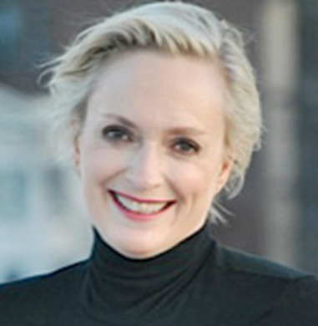
National Call Team Social Media
Emilianne Slaydon
Director, Social Media @TPP Media March
TPP Tuesday Twitter Storms
6 p.m. PST / 9 p.m. EST
TPP/TTIP Tuesday Tweets:
http://www.tiny.cc/TPPMediaMarch
Email: eslaydon@mac.com

Slide 9


Slide 10


Adam Weissman
TradeJustice/Global Justice for Animals and the Environment
Email: adam@tradejustice.net
UPDATE: Events and Actions http://tradejustice.net/?page=Events
Protest at NYC TTIP Negotiations: TradeJustice https://www.facebook.com/media/set/?set=oa.10152812703897155&type=1
Information/Articles: http://tradejustice.net
National Call Planning Team

Slide 11
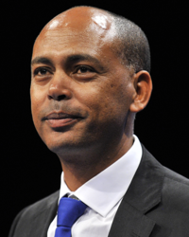

Tefere Gebre
Executive Vice President AFL-CIO
●Trade hasn't solved rule of law or violence problems
● Hasn't created work
● Has contributed to forced migration
Links to AFL-CIO trade-related content: http://www.aflcio.org/Blog/Political-Action-Legislation/AFL-CIO-CLC-Denounce-Corporate-Power-Grabs-Like-ISDS-in-Trade-Deals http://www.aflcio.org/Press-Room/Press-Releases/CAFTA-Is-a-Broken-Trade-Agreement-that-Duplicates http://www.aflcio.org/content/download/147761/3770791/file/Honduras.PDF
Website: http://www.aflcio.org/Issues/Trade

Slide 12
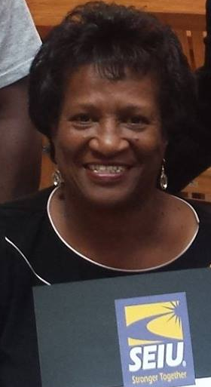

Jean Hervey
Regional Director
Workers United SEIU Texas
One Worker's Story
Facebook: https://www.facebook.com/pages/SWRJB-Workers-United-aw-SEIU/691164464231589
Website: http://www.seiu.org

Slide 13
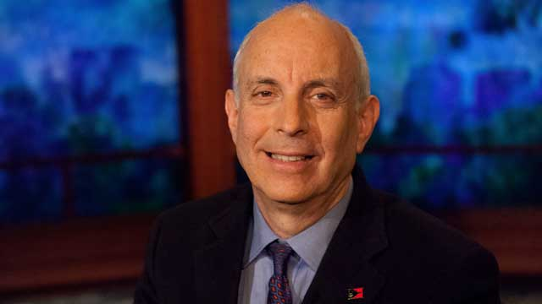

Larry Cohen, President
Communications Workers of America
●Analysis of Fast Track for TPP
● Q & A
Stop Fast Track/Save Jobs petition: http://petitions.moveon.org/sign/tell-congress-we-cant?source=homepage
Website: http://www.cwa-union.org
CWA Organizing Toolkit: http://www.StopFastTrack.com

Slide 14
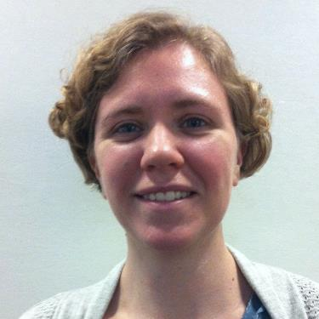

National Stop Fast Track Allies
Kathryn Johnson
Field Organizer, Public Citizen's Global Trade Watch
Stop Fast Track D.C. Update:
- Yes. there will probably be a Senate Vote
- Stopping Fast Track in the House – May Recess Crunch Time!
- Yessir, that's my Abe – an update on the Japanese PM's visit
- Beware of Sneaks Bearing Gifts—Report on a successful action!
Email: kjohnson@citizen.org Website: http://www.tradewatch.org
TPP Resources: http://www.exposethetpp.org
Our blog: http://www.EyesOnTrade.org

Slide 15
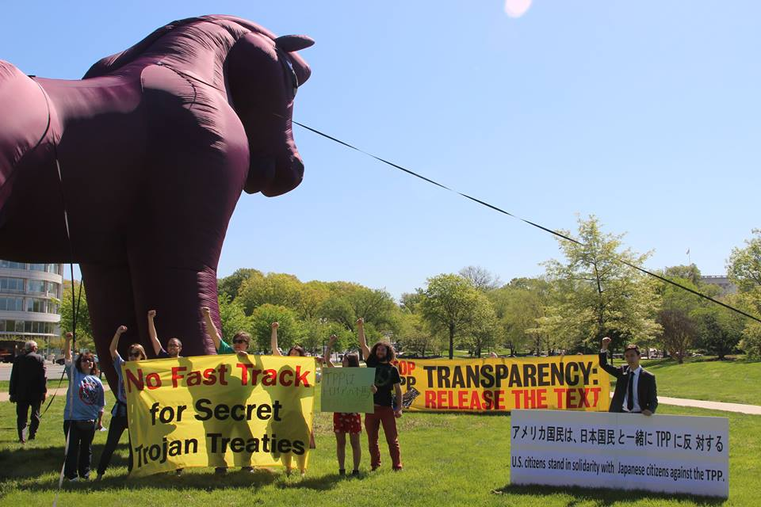
D.C. Rally
Trojan
Horse
Photo Credit:
Flush the TPP

Slide 16

Celeste Drake
Trade And Globalization
Policy Specialist AFL-CIO
●Fast Track—what now
●Activist Q & A
Twitter: @Cdrakefairtrade
Email: Cdrake@aflcio.Org
Website: http://www.aflcio.org/Issues/Trade

Slide 17
Q & A
Website: http://www.tradewatch.org
Kathryn Johnson
Celeste Drake
Website: http://www.aflcio.org/Issues/Trade

Slide 18
Upcoming Calls:
Register today—space is limited!
May 17: Jim Hightower
America's Voice for Common Sense—on why TPP makes NO sense
http://www.anymeeting.com/PIID=EB58DD81874738 – Click to sign up!
May 31: TPP and Human Rights
A Faith-Focused Perspective on "Free Trade" and Human Rights
http://www.anymeeting.com/PIID=EB58DD88804B30 – Click to sign up!
June 14: TBA Stay tuned for updates!
June 28: TBA Stay tuned for updates!

