Slide 1

TPP's THREAT TO GLOBAL HEALTH
Dr. Erik Monasterio, New Zealand
and
Sephanie Burgos, Oxfam America National TPP Conference Call
PLUS: FAST TRACK UPDATE April 26, 2015 7:30 p.m. Eastern/4:30 Pacific
with
Kathryn Johnson, Public Citizen Call-in: 605-562-3140 PIN: 951146

Slide 2

Welcome!
Andrea Miller
Executive Director
People Demanding Action
• Meeting room functions
• Call Norms
PDAction TPP Page: www.peopledemandingaction.org/campaigns/stop-tpp-fast-track
PowerPoints, Meeting Notes, Documents: www.PeopleDemandingAction.org/downloads/TPP
Email: TPP@PeopleDemandingAction.Org

Slide 3

YOUR TPP CALL HOST TEAM
Tom Hocking
National Call Technical Adviser
National Call Planning Team
MoveOn Regional Organizer, PA
Email: twhocking@gmail.com
●Pre and Post-Call Technical Questions
●Global TPP Team Facebook Page Manager
Website: https://www.facebook.com/groups/GlobalTPPTeam

Slide 4


National TPP Call Chat Hosts
  Mara Cohen
  National Call Planning Team/Chat Host
  PDA Mass Criminalization Team
  Global Climate Convergence Leader, IL
  Email: McMoveOn@gmail.com
  Lisa Oldendorp
  National Call Planning Team/Chat Host
  MoveOn Regional Organizer, NY
  Email: eslsk8r@optonline.net

Slide 5


National Call Planning Team
Liz Amsden
National Call Team Co-Organizer
Campaign Updates
MoveOn Council Organizer CA
Email: Lizamsden@hotmail.Com
Jan Swartzendruber
National Call Planning Team
Call Notes/Resource Vetting
MoveOn Regional Organizer KS
Email: Janinkansas2@gmail.Com

Slide 6


National Call Planning Team
Harriet Heywood
National Call Team Co-organizer
National Call Program Coordinator
MoveOn Regional Organizer FL
Email: Harrietheywood@gmail.Com
Linda Brewster National Call Planning Team
MoveOn Regional Organizer WA
Email: LindaJBrewster@msn.com

Slide 7

Adam Weissman
TradeJustice/Global Justice for Animals and the Environment
Upcoming Events and Actions: http://TradeJustice.net/315
General Information/Articles: http://tradejustice.net
Email: adam@tradejustice.net
National Call Planning Team

Slide 8

National Call Planning Team
Emilianne Slaydon
Director, Social Media
@TPP Media March
TPP Tuesday Twitter Storms
6 p.m. PST / 9 p.m. EST
TPP/TTIP Tuesday Tweets:
http://www.tiny.cc/TPPMediaMarch
Email: eslaydon@mac.com

Slide 9
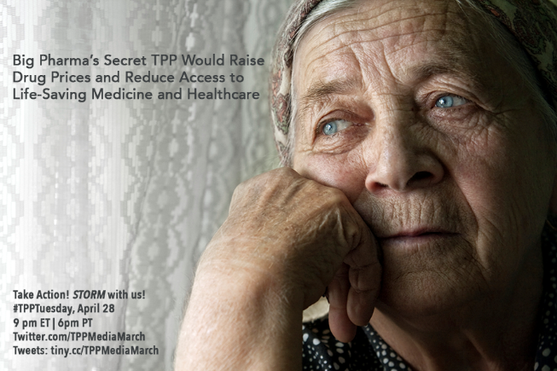

Slide 10
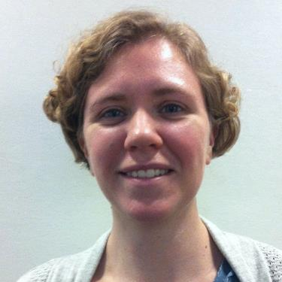

National Stop Fast Track Allies
Kathryn Johnson
Field Organizer, Public Citizen's Global Trade Watch
Stop Fast Track Update From the Hill:
-Senate Finance Committee & House Ways and Means Committee
-Possible Scenarios for the next few weeks
-Plans for the next Congressional Recess (May 4-11) Let’s keep up the momentum!
Email: kjohnson@citizen.org
Website: http://www.tradewatch.org
TPP Resources: http://www.exposethetpp.org
Facebook: www.facebook.com/GlobalTradeWatch
Our blog: http://www.EyesOnTrade.org

Slide 11
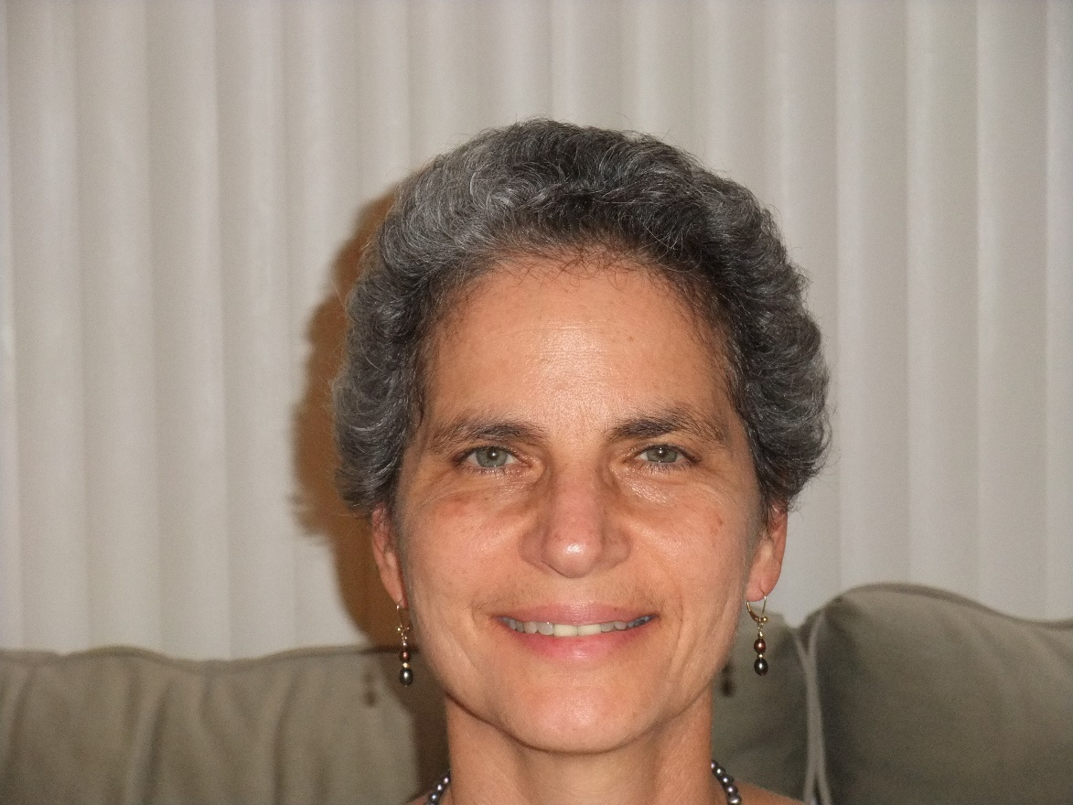

Stephanie Burgos
OXFAM America
STEPHANIE BURGOS, Senior Policy Adviser
Oxfam America, Washington, DC
Email: sburgos@oxfamamerica.org
Skype: svburgos Website: www.oxfamamerica.org
facebook.com/oxfamamerica
twitter.com/oxfamamerica

Slide 12
TPP: a threat to public health
How intellectual property provisions would undermine access to affordable medicines
Stephanie Burgos
April 26, 2015

Slide 13
What is intellectual property (IP)?
IP is not physically tangible, and it’s not a public good
IP protection is a public policy, NOT a right
IP protection = monopoly power
Need BALANCE:
  protection (incentivize innovation) vs. public access

Slide 14
What does more monopoly power do?
Fails to promote needed innovation
  10% of world R&D is spent on diseases that affect 90% of world population
Keeps prices high
  New Hep C meds: $84,000 for 12-week treatment course – affects 3.2 million people in the US (12-35% of prisoners)
  Cancer meds: $10,000 is average monthly price (doubled over last 10 years)

Slide 15
Generic Competition
The only proven means of reducing medicine prices in a sustainable way:
      Drug prices fall 30-70% when generics come onto the market
      86% of prescriptions are filled with generics in the US, saving $1bn every other day ($1.5 trillion saved in healthcare costs in past decade)
More IP protection = restricting generic competition
Governments need flexibility to use policy tools to enable generic competition

Slide 16
IP (for pharmaceuticals) in TPP
Step backward for public health
Reverses positive step taken in May 10th Agreement (2007)
Provisions go far beyond prior FTAs, protections grant much greater monopoly power

Slide 17
IP provisions revised under May 10th
Patent-term extension: made voluntary → required in TPP
Patent-registration linkage: made voluntary → required in TPP
Data exclusivity: period and provisions more flexible → monopoly strengthened in TPP

Slide 18
Patent term extension
Grants companies extensions on the patent monopoly period to compensate them for “unreasonable delays” in granting patents and for delays in granting marketing approval
Punishes countries that face increased volumes of applications and have inadequate resources and staff to process applications quickly
Pressures examiners and regulators to approve applications quickly, without thorough examination, in order to avoid having to grant extensions, thus leading to issuance of undeserved patents or less thorough regulatory review of dossiers
Keeps medicine prices high for longer by delaying generic competition, which ultimately punishes patients

Slide 19
Patent – registration linkage
    Prohibits registration of any medicine that is alleged to infringe a patent, and puts in place systems to alert patent holders when applications are submitted to register similar products
    Conflates regulatory authority activities with those of the patent office, turning a country’s FDA into a sort of ‘patent police’
    Results in diversion of regulatory staff, whose primary role is to ensure medicines are safe, of quality, and effective, to monitor patent status
    The mere existence of a patent – not its validity – prevents registration of a safe & effective medicine by the Drug Regulatory Authority
    Creates incentives for companies to file numerous frivolous patents in order to block registration of competitors’ products, leading to undue delays in generic competition, which harms consumers

Slide 20
Data Exclusivity (DE)
A barrier (separate from the patent) that confers monopoly power - registration can trigger a period of DE that blocks generic competition even where a medicine is not patented
Oxfam study found that medicine prices in Jordan rose 20% as a result of DE provisions in the US-Jordan FTA
Delays generic market entry by blocking regulatory approval for generics until DE period expires. It’s unethical and prohibitively expensive for generics companies to replicate clinical trial data, so no alternative to get generics to market
Additional periods of DE for secondary applications enable companies to extend their monopolies without innovating—companies can benefit from multiple 3-year extensions of DE for secondary applications

Slide 21
New Provisions in TPP
Expanded scope of patentability → evergreening
  Broadens the definition of what can be patented to include new forms, uses, or methods of existing products, even without any increase in efficacy
  Enables companies to extend the term of patent protection for existing medicines, including multiple times in connection with multiple minor modifications, thereby delaying generic competition
  ↑ monopoly, ↓ generic competition, ↑ prices - despite no improved patient outcome

Slide 22
New Provisions in TPP
Biologics → restrict generic competition
Biologics are made from living organisms, used to treat diseases from cancer and AIDS to rheumatoid arthritis and diabetes
Provisions lock in policies that would put these very expensive drugs and vaccines beyond the reach of patients and public health systems
        Excessive data/marketing exclusivity period
        Patent-registration linkage obligation → goes beyond US law

Slide 23
Pharmaceutical pricing provisions
Establish “procedural fairness” requirements → enables corporate involvement in government decisions re inclusion of medicines, as well as their prices, on reimbursement lists
Adverse public health effects:
  Enhance pharmaceutical industry power under the guise of “transparency” in government programs through which the price of pharmaceuticals is reimbursed
  Tie hands of governments seeking to manage prices in order to ensure sustainability of public health programs, thus threatening public health
  Restrict countries from pursuing best practices in management of drug prices

Slide 24
Proposal for transition period: Unacceptable
USTR proposal for developing countries (still under negotiation):
Creates 2 tiers of countries – one tier gets X time to transition to the higher level of IP protection
But:
Options for determining which countries are included in which tier & transition period granted for those in the lower tier to take on the higher standards → inadequate to give developing countries the flexibility they need
Transition only applies to the three May 10th provisions
Harmful new provisions (evergreening, biologics) are required immediately of all countries → no transition

Slide 25
Negotiating Process
All of these IP issues are very controversial, most not yet agreed in the text
US was entirely isolated in its position for these strong IP protections from the beginning
US pressure, strong-arming other countries has had some, though limited, success
Differences over IP provisions will only be resolved by political leaders at the final hour of negotiations
Political leaders tend to concede on final differences in order to close the deal, which often means selling out their health ministry officials and technical experts on IP

Slide 26
In Conclusion
IP and pharmaceutical pricing provisions in TPP are designed for the benefit of special interests, namely one segment of the pharmaceutical industry, to the detriment of the public interest.
These provisions will only undermine public health and access to affordable medicines.

Slide 27
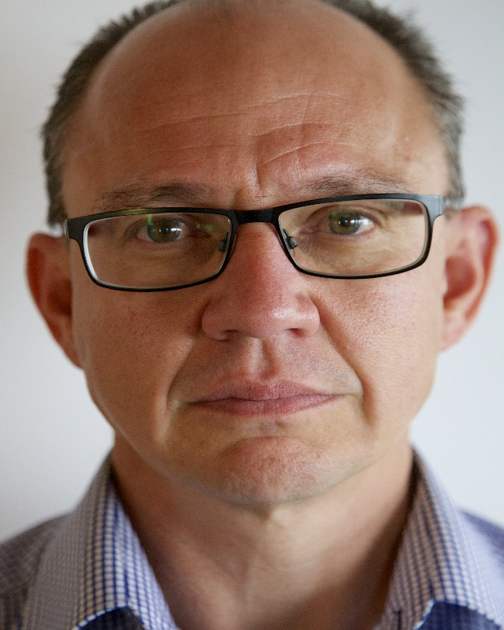
TPP's threat to
New Zealand's Health
(and other things…)
Dr. Erik Monasterio
Deputy Clinical Director
Consultant, Forensic Psychiatry
Hillmorton Hospital, Christchurch, NZ Senior Clinical Lecturer
Christchurch School Of Medicine

Slide 28
NZ has good public healthcare…for now
●New Zealand has a very good public, government funded healthcare system, which markedly outperforms the US system despite only spending 12% of our GDP cf. almost 20% in the US.

Slide 29
The Future of our Healthcare is at Risk
●The autonomy and success
of our healthcare system—and
our government's sovereignty—
are at risk from the TPP

Slide 30
The Big 3 – What you don't know CAN cost…
● Three (3) principle areas of TPP concern for us are:
Intellectual Property (IP)
Investor State Dispute Settlement (ISDS)
Certification

Slide 31
Bye Bye Generics, Hello High Drug Costs
Our national drug procurement body, PHARMAC, has been consistently criticized by the Pharmaceutical Industry because its bargaining power keeps the price of medicine low relative to the U.S., Australia and other Western countries.
New Zealand pays 1/2 to 1/3 as much for these meds as other countries do, and we reinvest the savings in health programs. The TPP will disempower Pharmac and the money that is now being spent on healthcare will go to corporations.

Slide 32

Upcoming Calls:
May 3: Larry Cohen, Communications Workers of America
John Logan, Labor Historian (and one other guest)
"Mayday, Mayday! American Workers at Risk!" (Honoring May Day)
May 17: Jim Hightower - America's Voice for Common Sense
May 31: TPP and Human Rights – A Faith-Focused Perspective
Stay tuned for updates!
Watch your email for links to register for upcoming calls!

