Slide 1

National TPP Team Call
TPP v. Planet Earth: The Fight IS ON!
Special Guests:
Ilana Solomon, Sierra Club
William Waren, Friends of the Earth
Emergency Fast Track Bill Update:
Kathryn Johnson, Public Citizen
April 19, 2015
7:30 p.m. Eastern/4:30 p.m. Pacific
Call-in#: 605-562-3140
PIN: 951146#
Back-up#: 559-726-1300

Slide 2
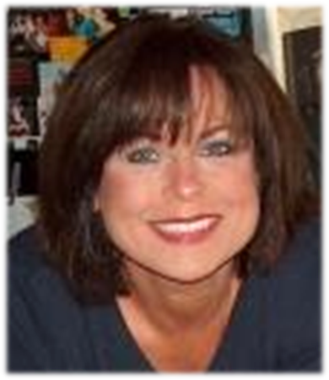

Introduction & Welcome
Elizabeth Warren, National TPP Team Coordinator
Director of Communications/Campaign Outreach
People Demanding Action
Email: Liz@PeopleDemandingAction.org
    Call Norms
    Meeting Room Functions
Website: http://www.PeopleDemandingAction.org
Download this PowerPoint: http://www.peopledemandingaction.org/downloads/tpp

Slide 3

YOUR TPP CALL HOST TEAM
Tom Hocking
National Call Technical Adviser
National Call Planning Team
MoveOn Regional Organizer, PA
Email: twhocking@gmail.com
●Pre and Post-Call Technical Questions
●Global TPP Team Facebook Page Manager
Website: https://www.facebook.com/groups/GlobalTPPTeam

Slide 4

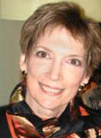
National Call Planning/Notes/Information
Liz Amsden
National Team Co-Organizer
Campaign Updates/Call Notes
MoveOn Council Organizer CA
Email: Lizamsden@hotmail.Com
Jan Swartzendruber
National Call Planning Team
Call Reports/Notes/Resource Vetting
MoveOn Regional Organizer KS
Email: Janinkansas2@gmail.Com

Slide 5


  National TPP Call Chat Hosts
  Mara Cohen
  National Call Planning Team/Chat Host
  PDA Mass Criminalization Team
  Global Climate Convergence Leader, IL
  Email: McMoveOn@gmail.com
  Lisa Oldendorp
  National Call Planning Team/Chat Host
  MoveOn Regional Organizer, NY
  Email: eslsk8r@optonline.net

Slide 6


National Call Planning Team
Harriet Heywood
National Call Team Co-organizer
National Call Program Coordinator
MoveOn Regional Organizer FL
Email: Harrietheywood@gmail.Com
Linda Brewster
National Call Planning Team
MoveOn Regional Organizer WA
Email: LindaJBrewster@msn.com

Slide 7

National Call Planning Team
Adam Weissman
TradeJustice/Global Justice
for Animals and the Environment
Upcoming Events and Actions:
http://TradeJustice.net/315
General Information/Articles: http://tradejustice.net
Email: adam@tradejustice.net

Slide 8

TPP Tuesday Twitter Storms
Emilianne Slaydon
Director, Social Media
@TPP Media March
TPP Tuesday Twitter Storms
6 p.m. PST / 9 p.m. EST
TPP/TTIP Tuesday Tweets: http://www.tiny.cc/TPPMediaMarch
Email: eslaydon@mac.com

Slide 9
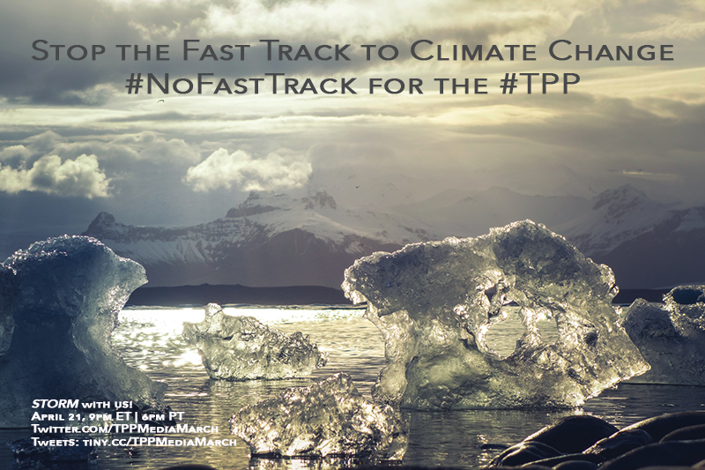

Slide 10
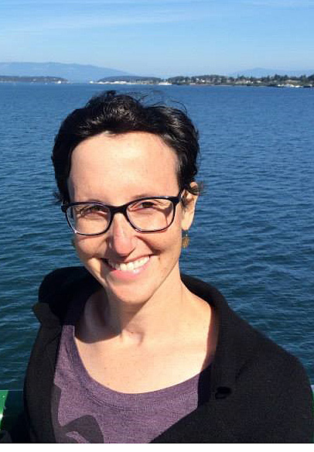

Ilana Solomon, Director Responsible Trade Program Sierra Club
-TPP, the Environment, and fighting back against Fast Track Trade Authority
-What do we do now that there's a bill?
Website: http://sierraclub.org/
Email: Ilana.Solomon@sierraclub.org

Slide 11
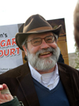

William Waren, Trade Policy Analyst
Friends of the Earth
.
Website: http://www.foe.org/
Twitter : https://twitter.com/foe_us
Facebook: https://www.facebook.com/foe.us?fref=ts
http://www.foe.org/news/news-releases/2015-04-hatch-wyden-introduce-same-old-fast-track-model

Slide 12
Investment tribunals: an across the board threat to the environment. The TPP and TTIP would allow corporations to sue governments for millions or billions in money damages if environmental or health regulations interfere with profits. This is a gift to polluting industries.^{[ii]}Foreign investors could bypass domestic courts and bring suit before special international tribunals where they would enjoy greater property and due process rights than in those provided in the U.S. Constitution.
Worse, the arbitrators are often biased. An arbitrator may serve as “judge” in one case and as corporate counsel in the next. Damage awards can run into the millions or billions of dollars. ^{[ii]} It is unnecessary to provide for investor-state arbitration in TTIP in particular. The U.S. and E.U have well-developed and generally fair court systems to resolve allegations of property rights and due process violations resulting from environmental and public health violations.
The same is generally true of TPP countries with respect to commercial transactions. The exceptions are the communist dictatorship of Vietnam and the Sultanate of Brunei, which is ruled under a harsh form of Sharia law. And, it has to be asked why we want to make a deal with those two countries before they clean up their human rights records.

Slide 13
Trade in Goods provisions: a threat to climate policy. Big Oil and dirty energy companies want to push the TPP and TTIP deals through Congress using Fast Track, thereby encouraging trade in oil, coal and liquefied natural gas. In response to campaigns launched by climate activists to impose regulations and controls on U.S. fossil fuel exports, corporate trade lawyers are insisting that government controls on energy exports are illegal under international trade and investment law related to trade in goods.

Slide 14
Q & a
with our Guest speakers
William Waren Ilana Solomon
Friends of the Earth Sierra Club

Slide 15
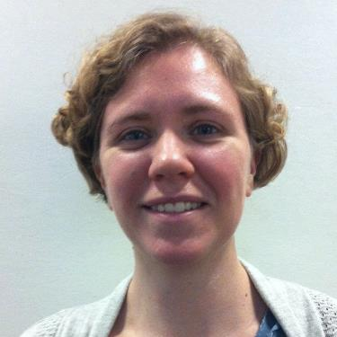

Kathryn Johnson
Field Organizer
Public Citizen's Global Trade Watch
Stop Fast Track Update
Email: kjohnson@citizen.org
Website: http://www.tradewatch.org
TPP Resources: http://www.exposethetpp.org
Facebook: www.facebook.com/GlobalTradeWatch
Our blog: http://www.EyesOnTrade.org

Slide 16
The Fast Track bill introduced on Thursday would revive the same old unacceptable Fast Track process. It would delegate away Congress’ constitutional trade authority and give blank-check powers to whoever may be president during the next 3-6 years for any agreements he or she may pursue.

Slide 17
Fast Track for the Trans-Pacific Partnership (TPP) will make it easier for corporations to offshore American jobs, and will undermine our wages by forcing Americans to compete with Vietnamese workers making less than 60 cents an hour.

Slide 18
This is almost identical to the Fast Track that was dead on arrival in the House last year.

Slide 19
We need a new form of trade authority that is appropriate for 21st century trade agreements. Fast Track was designed in the 1970s when trade negotiations were narrowly focused on cutting tariffs and quotas, not the sweeping range of non-trade policies implicated by today’s agreements.

Slide 20
Even though the TPP is almost complete, and the administration dismissed bicameral, bipartisan majority demands that the TPP include disciplines against currency cheating, Congress is now being asked to delegate away its constitutional trade authority over the TPP.

Slide 21
Q & a
Kathryn J0hnson
Field Organizer
Public Citizen's Global Trade Watch
Email: kjohnson@citizen.org
Website: http://www.tradewatch.org
TPP Resources: http://www.exposethetpp.org
Facebook: www.facebook.com/GlobalTradeWatch
Our blog: http://www.EyesOnTrade.org

Slide 22
THANKS AND WRAP-UP
Elizabeth Warren, National TPP Team Coordinator
Director of Communications/Campaign Outreach
People Demanding Action
Email: Liz@PeopleDemandingAction.org
Upcoming Calls:
April 26: Dr. Erik Monasterio, Stephanie Burgos, OXFAM America
TPP, Patents, ISDS and the Global Health Crisis
May 3: Larry Cohen, Communications Workers of America
John Logan, Labor Historian (plus one other guest)
"Mayday, Mayday! American Workers at Risk!" (Honoring May Day)
May 17: TBA
May 31: TBA
Stay tuned for updates

