Slide 1
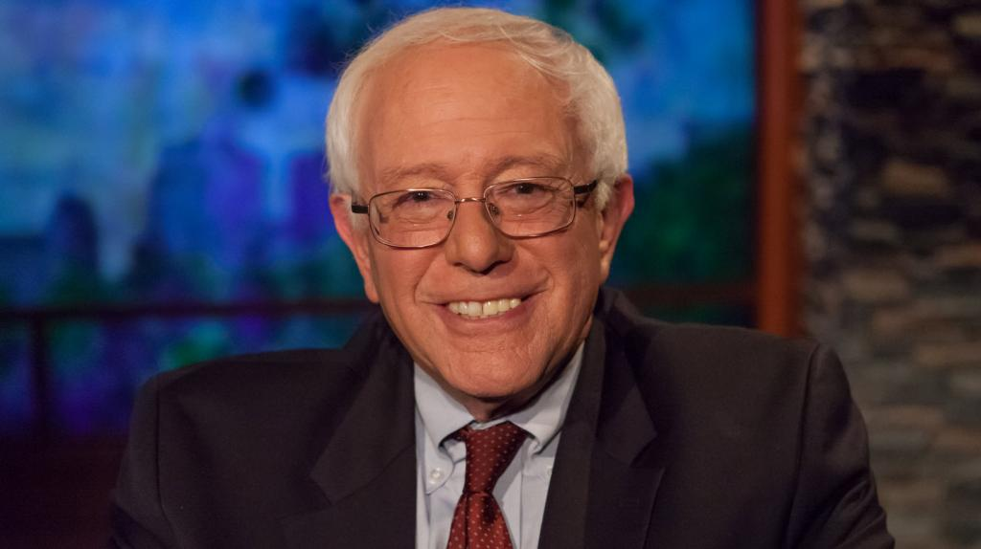
National TPP Team Call
April 12, 2015 4:30 p.m. Pacific/ 7:30 p.m. Eastern
This is it! Stopping the TPP Fast Track Bill
Special Guest: Senator Bernie Sanders
Fast Track Status Report and April 18 Day of Actions:
Arthur Stamoulis, Executive Director, Citizens Trade Campaign
Legislative and Action Updates:
Celeste Drake, Trade and Globalization Policy Specialist, AFL-CIO
Call-in number: 605-562-3140 PIN: 951146#

Slide 2

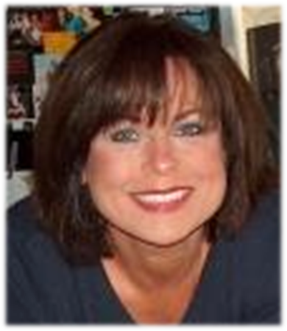
National TPP Team Coordinator
Elizabeth Warren
Director of Communications and Campaign Outreach
People Demanding Action
• Call Norms and meeting room functions
• Coming soon: Updated LTE paragraphs!
• Special PDAction Fast Track Educate Congress Letter Drop: Sign up here to deliver one to your representative
Email: Liz@PeopleDemandingAction.org
Website: http://www.PeopleDemandingAction.org
Download this PowerPoint: http://www.peopledemandingaction.org/downloads/tpp

Slide 3
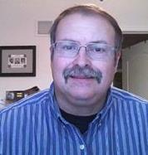
YOUR TPP CALL HOST TEAM
Tom Hocking
National Call Technical Adviser
National Call Planning Team
MoveOn Regional Organizer, PA
Email: twhocking@gmail.com
●Pre and Post-Call Technical Questions
●Global TPP Team Facebook Page Manager
Website: https://www.facebook.com/groups/GlobalTPPTeam

Slide 4


National TPP Call Chat Hosts
  Mara Cohen
  National Call Planning Team/Chat Host
  PDA Mass Criminalization Team
  Global Climate Convergence Leader, IL
  Email: McMoveOn@gmail.com
  Lisa Oldendorp
  National Call Planning Team/Chat Host
  MoveOn Regional Organizer, NY
  Email: eslsk8r@optonline.net

Slide 5

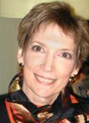
National Call Planning Team
Liz Amsden
National Call Team Co-Organizer
Campaign Updates
MoveOn Council Organizer CA
Email: Lizamsden@hotmail.Com
Jan Swartzendruber
National Call Planning Team
Notes/Resource Vetting
MoveOn Regional Organizer KS
Email: Janinkansas2@gmail.Com

Slide 6


National Call Planning Team
Harriet Heywood
National Call Team Co-organizer
National Call Program Coordinator
MoveOn Regional Organizer FL
Email: HarrietHeywood@Gmail.Com
Linda Brewster National Call Planning Team
MoveOn Regional Organizer WA
Email: LindaJBrewster@msn.com

Slide 7

Adam Weissman
TradeJustice/Global Justice for Animals and the Environment
Upcoming Events and Actions list: http://TradeJustice.net/315
General Information/Articles: http://tradejustice.net
Email: adam@tradejustice.net
National Call Planning Team

Slide 8
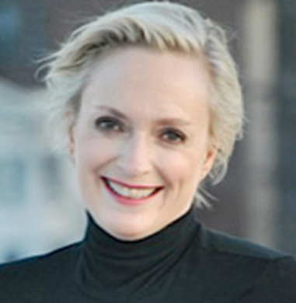
National Call Planning Team
Emilianne Slaydon
Director, Social Media
@TPP Media March
TPP Tuesday Twitter Storms
6 p.m. PST / 9 p.m. EST
TPP/TTIP Tuesday Tweets:
http://www.tiny.cc/TPPMediaMarch
Email: eslaydon@mac.com

Slide 9


Slide 10
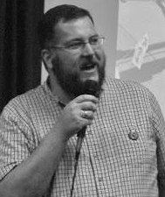

Arthur Stamoulis
Executive Director
Citizens Trade Campaign
Rapid Response to
Fast Track's Reintroduction
Twitter: @citizenstrade
Website: http://www.citizenstrade.org
Email: arthur@citizenstrade.org

Slide 11

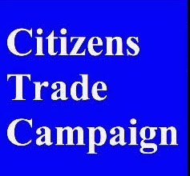
Timing:
Senator Hatch & Rep. Ryan want Fast Track reintroduction this Monday, April 13

Slide 12
Rapid Response:
●Organizational Sign-on Letter
● Template Email Blast
● Talking Points & Fact Sheet
● Day of Action

Slide 13
National Day of Action
Against Fast Track
● Saturday, April 18th
● http://www.stopfasttrack.com
● #FastTrackDOA https://www.globaltradeday.org/

Slide 14
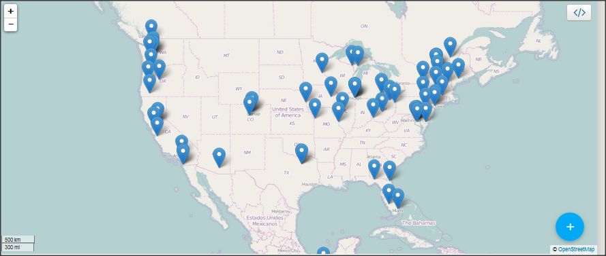
Stop fast track Actions Map: dozens more actions being added

Slide 15
Organizer Toolkit
●Online at: tinyurl.com/FastTrackDOAToolkit
● How-To's
● Talking Points & Fact Sheets
● Press Materials
● Chant Sheets

Slide 16


Email: April18@citizenstrade.org
Twitter: @citizenstrade
#FastTrackDOA

Slide 17


National Call Planning Team
Stop Fast Track Allies
Celeste Drake
Trade And Globalization
Policy Specialist, AFL-CIO
●Legislative and Actions Update
Twitter: @Cdrakefairtrade
Email: Cdrake@aflcio.Org

Slide 18
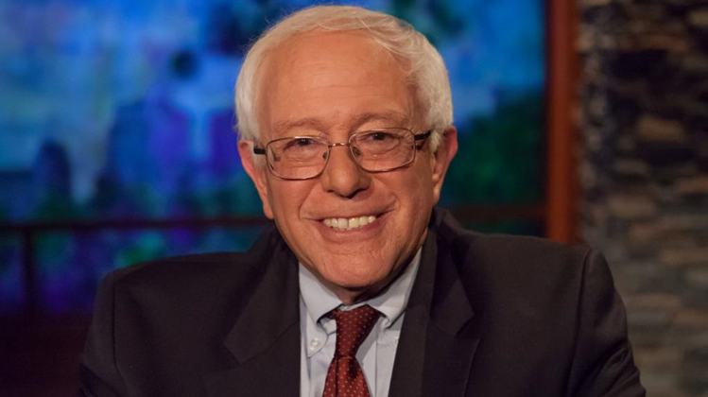
Senator Bernie Sanders
● Fast Track for TPP – what it could mean
● What's happening in the Senate next week
Website: http://www.sanders.senate.gov/about
Twitter: @SenSanders
Facebook: https://www.facebook.com/senatorsanders

Slide 19
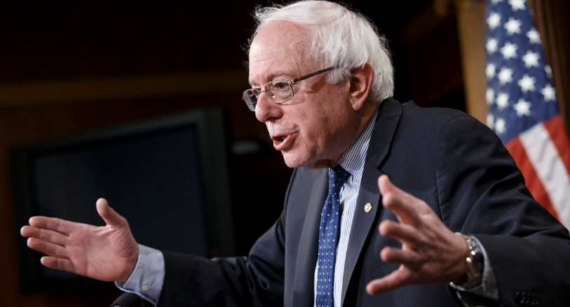
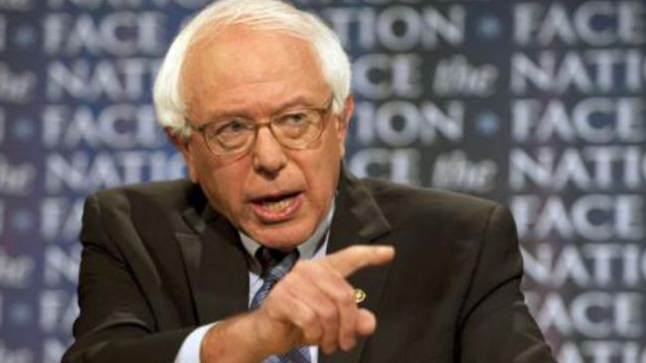
Q & a
With Senator Bernie Sanders http://www.peopledemandingaction.org/downloads/tpp/35-senator-bernie-sanders-the-trans-pacific-partnership-trade-agreement-tpp-must-be-defeated
Website: http://www.sanders.senate.gov/about
Twitter: @SenSanders
Facebook: https://www.facebook.com/senatorsanders

Slide 20
THANKS AND WRAP-UP
Elizabeth Warren
PDAction; National TPP Team Coordinator
Email: Liz@PeopleDemandingAction.org
Upcoming Calls
April 19: William Waren, Friends of the Earth, Ilana Solomon, Sierra Club,
Nancy Price, Alliance for Democracy
Free-Traders v. the Environment – (In honor of Earth Day)
April 26: Dr. Erik Monasterio, Stephanie Burgos, OXFAM America
TPP, Patents, ISDS and the Global Health Crisis
May 3: Larry Cohen, Communications Workers of America
John Logan, Labor Historian
"Mayday, Mayday! American Workers at Risk!" (In honor of May Day)

