Slide 1

National TPP Team Conference Call
Deconstructing the Corporate Case
for Fast Track Trade Authority
With Special Guest:
Dave Johnson
Campaign for America’s Future
February 8, 2015
Call-in #: 605-562-3140 PIN: 951146

Slide 2

WELCOME!
Elizabeth Warren
National TPP Team Coordinator
Email: liz.Moveon@earthlink.Net
• Call structure and norms
• Meeting room functions
Global TPP team page: http://on.Fb.Me/o76pxm
●PowerPoint ●Report ●Tools ●Downloads

Slide 3


Your TPP call host team:
Tom Hocking – FB Global TPP Page
National Call Technical Adviser
MoveOn Regional Organizer, PA email: twhocking@gmail.com
Lisa Oldendorp – Chat Notes
National Call Team Chat Host
MoveOn Regional Organizer, NY email: eslsk8r@optonline.net

Slide 4


Post-Meeting Report+
Liz Amsden
National Call Team Co-Organizer
Call Notes/Campaign Updates
Moveon Council Organizer CA
Email: Lizamsden@hotmail.Com
Jan Swartzendruber
National Call Planning Team
Call Notes/Post-call Report
Moveon Regional Organizer KS
Email: Janinkansas2@gmail.Com

Slide 5


National TPP Call Planning Team
Harriet Heywood
National Call Team Co-organizer
Moveon Regional Organizer FL
Email: Harrietheywood@gmail.Com
Mara Cohen
National Team Core Group
PDA Mass Criminalization Issue Team
Global Climate Convergence Organizer IL
National TPP Team Chat Host
Email: McMoveOn@gmail.com

Slide 6

National Stop Fast Track Allies
Adam Weissman
TradeJustice and GJAE
Post NY Trade Talks Update
Recess Actions
General information/Articles:
http://tradejustice.net
Email: adam@tradejustice.net

Slide 7


National Stop Fast Track Allies
Beth Allen
Communications Workers of America (CWA)
- New Petition - MoveOn and CWA!
- Fast Track Messaging Updates
- Recess Week Plan
Twitter: @CWABeth
Email: ballen@cwaunion.org
Website: http://www.cwa-union.org
Coalition Page Tools: http://www.StopFastTrack.com
President Cohen's Stop Fast Track/Save Jobs petition: http://petitions.moveon.org/sign/tell-congress-we-cant?source=homepage

Slide 8

National Call Planning Team
Stop Fast Track Allies
Celeste Drake
Trade And Globalization
Policy Specialist AFL-CIO
- The Climate in Washington
- Presidents Day Recess Actions
Twitter: @Cdrakefairtrade
Email: Cdrake@aflcio.Org
President Trumka's recent Op-Ed: http://blog.thenewstribune.com/letters/2015/02/04/tpp-will-undermine-economic-recovery/#storylink=cpy

Slide 9

National Call Planning Team
Emilianne Slaydon
Director, Social Media
@TPP Media March
TPP Tuesday Twitter Storms
#StopFastTrack
6 p.m. PST / 9 p.m. EST
TPP/TTIP Tuesday Tweets:
http://www.tiny.cc/TPPMediaMarch
Email: eslaydon@mac.com

Slide 10
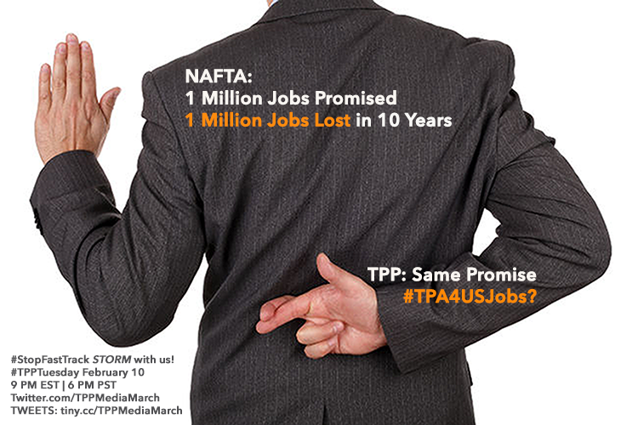

Slide 11

National Call Planning Team
Stop Fast Track Allies
Andrea Miller
Executive Director People Demanding Action
Co-Executive Director Progressive Democrats Of America
News and Tools: http://www.pdaction.org
Fast Track Map: http://www.pdamerica.org/tpp
Email: andrea@pdamerica.org
Fast Track Letter To The Editor Tool: http://salsa.wiredforchange.com/o/6405/c/10113/letter/?letter_key=865

Slide 12
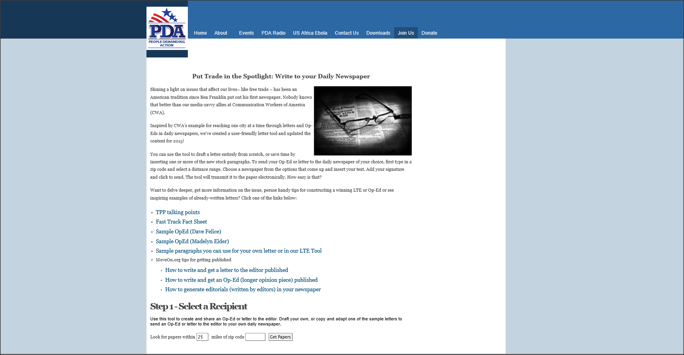
Letter to the Editor Tool includes:
click to paste stock content; writing samples
and helpful links
to walk you through
how to craft
a compelling
Letter
to the Editor
or Op-Ed…
and get it published!

Slide 13
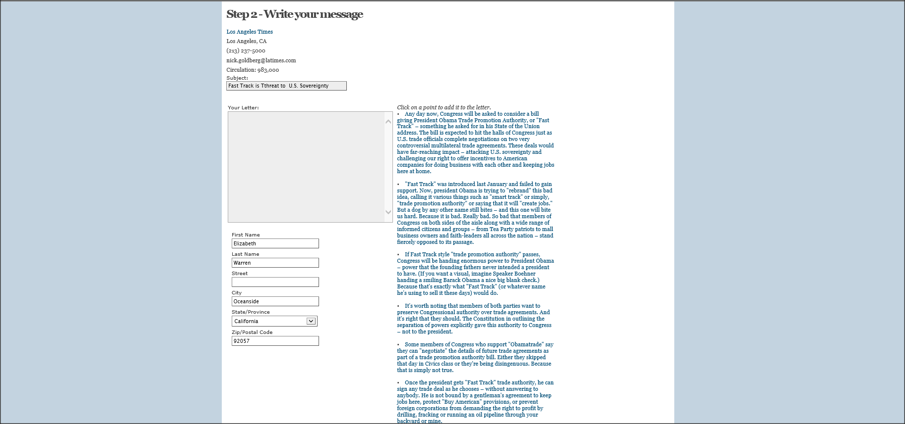
Search for your desired newspaper by zip code.
When the tool opens, type directly into the text box to draft your letter from scratch. Or
click on any of the copy blocks to insert one or more stock paragraphs. Or combine the two!
When you’re finished composing, add your contact information
and click to send your letter electronically!

Slide 14


Special Guest Speaker:
Dave Johnson
Fellow, Campaign for America's Future
Links: http://www.ourfuture.org http://www.seeingtheforest.com/about-us http://www.huffingtonpost.com/dave-johnson/lets-take-apart-the-corpo_b_6575180.html http://ourfuture.org/20150206/a-comment-on-public-investment-jobs-and-dreams

Slide 15
LET'S TAKE APART
THE CORPORATE CASE
FOR FAST TRACK
These corporate arguments (you can see them in this Chamber of Commerce slide show "Ten Reasons Why America Needs Trade Promotion Authority") just make me more skeptical
of what they are selling. – Dave Johnson

Slide 16
TAKING APART ARGUMENT #1
“95 percent of the world’s markets are outside the U.S.”
REALITY:
This is a “look over there at that shiny object” argument.
Saying that 95 percent of the world’s markets are outside the U.S. implies that we need TPP and other agreements because we are currently not selling goods to 95 percent of the world.
This is patently false.
We sell goods and services around the world already.
In fact, it contradicts other corporate arguments
for these agreements like, “More than 38 million
American jobs already depend on trade.”

Slide 17
TAKING APART ARGUMENT #2
USTR Froman told the Senate in January we need new agreements because:
The U.S. has low tariffs and barriers to entry
Many trading partners have high tariffs and barriers to entry.
REALITY:
Wait, back up: USTR says other countries have high tariffs and barriers to entry, but U.S. lets their goods in with low tariffs and few barriers? This:
- Undermines our country
- Costs badly needed revenue
- Enables offshoring of jobs and factories
- Is a recipe for imbalance, causes job loss, huge trade deficits

Slide 18
TAKING APART ARGUMENT #3:
We need to increase exports. (That's all that matters.)
REALITY:
Nobody mentions imports and trade deficits. Imports exceeding exports cause net losses:
- Jobs, technology, manufacturing, living standard
- Trade imbalances over time throw the entire world’s economy out of balance:
- Enable 80 people to have as much wealth as half of the world’s population;
- Enable 1 percent of the world to have more wealth than all of the rest combined
- We can't know if balanced trade provision exists in text
to prevent lost jobs; industries
- Fast Track doesn't allow time to find out
what's in the deal, or to fix it.

Slide 19
TAKING APART ARGUMENT #4:
Corporate advocates say “more than 38 million American jobs already depend on trade. This is one in every five jobs across the country.”
REALITY:
If we're doing great, why do we need new deals?
- Nobody's talking about lost jobs
- Diversion: "trade is good" claim distracts
- Only five of 29 chapters deal with trade
- TPP is about protecting multinationals
from government interference

Slide 20
TAKING APART ARGUMENT #5:
97 percent of American companies that export are small businesses.
Reality: Misleading
- USTR can't support assertion with facts
- Trade Agreements reinforce monopolies and support multinationals
- Expand copyright and patent dominance
- Designed to limit competition
The Fix:
- Contents of TPP agreements must be made public
- Stakeholders must be part of process
- Congress and the public need time to analyze and discuss implications
- Congress should be able to fix problems; bring trade deals in line with the public interest

Slide 21
q & a with our Guest Speaker
Dave Johnson
Campaign for America's Future
Links: http://www.ourfuture.org http://www.seeingtheforest.com/about-us http://www.huffingtonpost.com/dave-johnson/lets-take-apart-the-corpo_b_6575180.html http://ourfuture.org/20150206/a-comment-on-public-investment-jobs-and-dreams

Slide 22
Upcoming Speakers/Topics:
Robert Kuttner
Economic Policy Institute
Michael Stumo
Coalition for a Prosperous America
Thanks and Wrap-Up

