Slide 1

Understanding The People’s Budget
The People’s Budget Campaign American Friends Service Committee
Campaign for America’s Future
Coalition on Human Needs
Daily Kos
Friends of the Earth
National Alliance of HUD Tenants
National Priorities Project
NETWORK Lobby
Peace Action
People Demanding Action
Progressive Congress
Progressive Democrats of America
Social Security Works
Social Solutions
US Labor Against the War
Win Without War

Slide 2


Introduction and Welcome
Andrea Miller, Executive Director
People Demanding Action
andrea@peopledemandingaction.org
Call Structure and Norms:
Audio is PHONE ONLY; you must call in
Do not enable your video camera
All calls are recorded; a link is available after the call
Q & A mode: To eliminate background noise we mute everyone when we begin recording.
Press *6 (when prompted) to ask a question; say your name, your organization, if any, and location. Be courteous and brief; give others a chance to ask questions too.
Download this Presentation: https://actionnetwork.org/campaigns/the-peoples-budget-campaign

Slide 3
Speakers
Dr. Gabriela Lemus, Executive Director, Progressive Congress
Isaiah Poole, Campaign for America’s Future
Debbie Weinstein, Coalition for Human Needs
Cole Harrison, Peace Action
Michael Kane, National Alliance of HUD Tenants
Ed Lucas, National Alliance of HUD Tenants
Lukas Ross, Friends of the Earth
Paul Shannon, American Friends Service Committee

Slide 4


Technical Information
Audio is available only via phone
DIAL IN: 605 562 3140 ACCESS CODE: 781761#
Meeting Room Functions
- Chat
- Share
Use the Share button in the Meeting Room:
After the call, click the unique link below to download this week's PowerPoint, recording link and other materials: http://www.peopledemandingaction.org/campaigns/the-people-s-budget

Slide 5
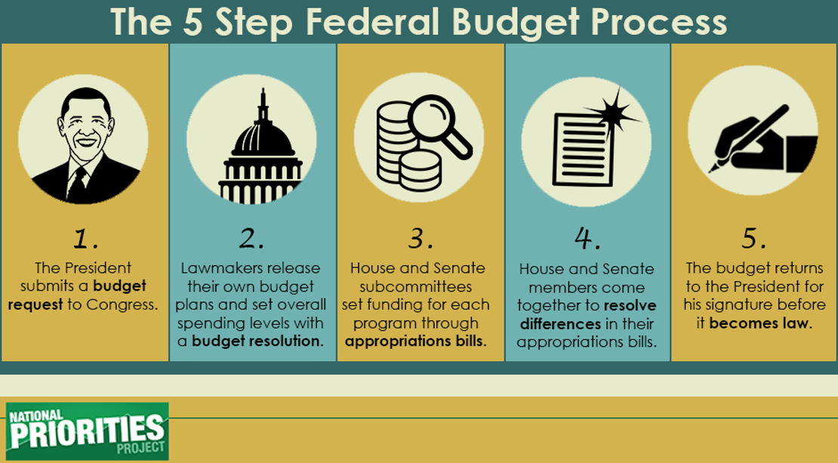
The 5 Step Federal Budget Process

Slide 6
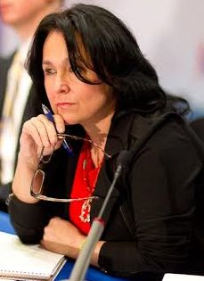
Dr. Gabriela Lemus, Progressive Congress
Since September 2013, Dr. Gabriela D. Lemus has served as the President of Progressive Congress. Dr. Lemus served as Senior Advisor to Secretary of Labor Hilda L. Solis and was Director of the Office of Public Engagement from July 2009 until August 2013. Prior to her appointment, she was the first woman to hold the position of Executive Director at the Labor Council for Latin American Advancement (LCLAA) from 2007-2009, and the first woman to chair the National Hispanic Leadership Agenda (NHLA) from 2008-2009. During her tenure at LCLAA, she helped co-found the National Latino Coalition on Climate Change (NLCCC) and was a Commissioner for the Commission to Engage African-Americans on Climate Change (CEAAC). She served 3-year terms on the advisory boards of both the Washington Office on Latin America (WOLA) from 2005-2008 and the United States Labor Education in the Americas Project (USLEAP) from 2006-2009. In January 2013, she was confirmed by the DC Council to sit on the Board of Trustees of the University of the District of Columbia.

Slide 7
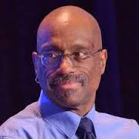

Isaiah Poole
Isaiah J. Poole has been the editor of OurFuture.org since 2007. Previously he worked for 25 years in mainstream media, most recently at Congressional Quarterly, where he covered congressional leadership and tracked major bills through Congress.
Most of his journalism experience has been in Washington as both a reporter and an editor on topics ranging from presidential politics to pop culture. His work has put him at the front lines of ideological battles between progressives and conservatives. He also served as a founding member of the Washington Association of Black Journalists and the National Lesbian and Gay Journalists Association.

Slide 8
$1 Trillion Plan for Infrastructure in the People’s Budget
Where We Are Today:
20 percent of major roads in the United States are considered to be in poor condition.
United States ranks 16th globally for quality of infrastructure, according to the World Economic Forum.
Interstate 10 bridge collapse in July 2015 in Coachella Valley, California latest example of our tens of thousands of structurally deficient or functionally obsolete bridges
Deferred maintenance forced a 30-hour midweek shutdown earlier this year of nation’s second largest transit system.

Slide 9
$1 Trillion Plan for Infrastructure in the People’s Budget
BUT Republicans propose to respond by …
Cutting federal support for public transportation and intercity rail
Shift resources away from programs that promote sustainable energy, conservation and smart growth
Shift responsibilities to already strapped state and local governments
Not leveraging federal resources to promote jobs and rebuild the economy

Slide 10
$1 Trillion Plan for Infrastructure in the People’s Budget
The People’s Budget would:
Make a $1 trillion commitment to infrastructure rebuilding over 10 years
Create 3.6 million new jobs and boost gross domestic product (GDP) by 3 percent
Designates funding for addressing lead water crisis in Flint, Mich., and elsewhere
Support research and development of clean energy technologies
Includes funding to support transition to a smart energy grid
Would finance a balanced transportation network
Impose a per-barrel tax on oil to help finance transportation needs, plus would reform our tax code to have the wealthy pay their fair share
Would allow for strategies such as an infrastructure bank to attract other sources of infrastructure financing

Slide 11
$1 Trillion Plan for Infrastructure in the People’s Budget
What we could face in 2017 or 2018:
Type “global recession coming” into a search engine
The Republican presidential candidates all advocate policies that would make a recession worse
Bernie Sanders has already proposed a plan comparable to the Progressive Caucus. Who will have Hillary Clinton’s ear?

Slide 12
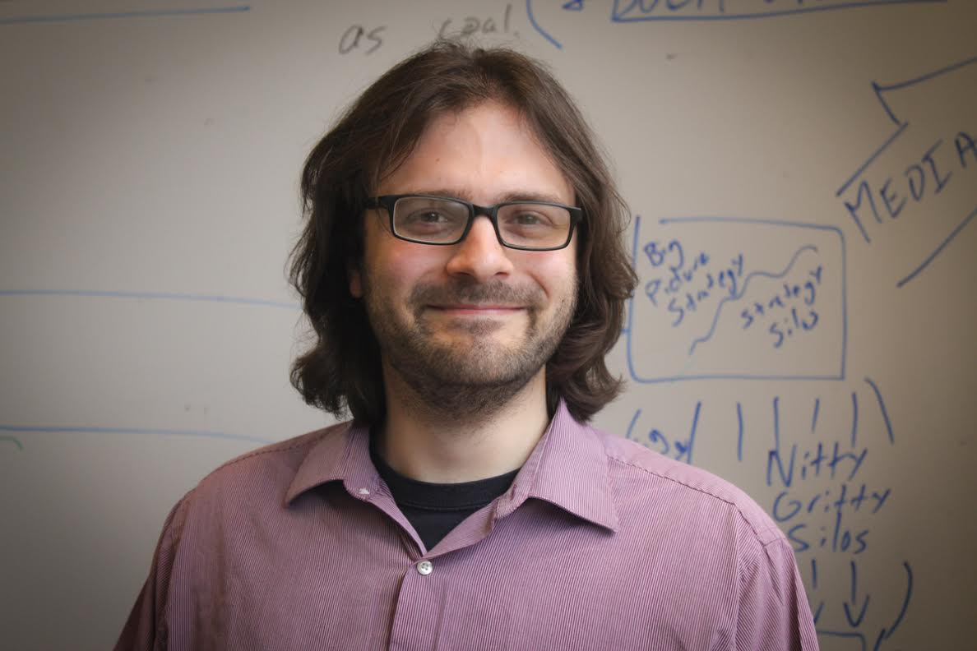
Lukas Ross
Lukas Ross has been a climate and energy campaigner at Friends of the Earth since 2014. His areas of expertise are tax policy and fossil fuel leasing on our public lands and waters. He works on greening the federal budget and ending subsidies for polluting industries. Previously he was a research fellow at the Oakland Institute, a California-based think tank where he covered financial sector investment in US farmland and biofuels policy.

Slide 13
Protecting Our Environment
“The only budget in Washington that truly accepts the urgency of the climate crisis.” Lukas Ross, Friends of the Earth
Impose a Price on Carbon Pollution
Eliminate Corporate Welfare for Oil, Gas and Coal Companies
Helping Communities Adapt
Reinstate Superfund Taxes
Crop Insurance Subsidies

Slide 14
Eliminate Corporate Welfare for Oil, Gas and Coal Companies
The CPC Budget repeals approximately $135 billion in fossil fuel subsidies over 10 years. The fossil fuel industry enjoys dozens of permanent subsidies thanks to decades of successful lobbying. Just one of these loopholes, the “percentage depletion allowance,” will cost taxpayers $17 billion over the next decade. Researchers at the International Monetary Fund found that in 2015 fossil fuel subsidies (including both tax breaks and the cost of health and environmental externalities) cost $5.3 trillion – or $10 million a minute.

Slide 15

Impose a Price on Carbon Pollution
The People’s Budget implements a $25 per ton price on carbon dioxide emitted by polluters (increasing at 5.6 percent a year) and rebates 25 percent of all revenues to protect low income families from any rising energy costs via refundable credits. Revenue from this carbon price will be used to fund renewable energy and energy efficiency development and deployment. The Energy Information Administration found that a similar proposal would result in carbon emissions reductions of 26 percent below 2005 levels by 2020. This will go a long way toward setting the United States on a path to minimize the dangers of climate change, particularly when combined with air pollution control measures, increased energy efficiency and renewable energy deployment.

Slide 16
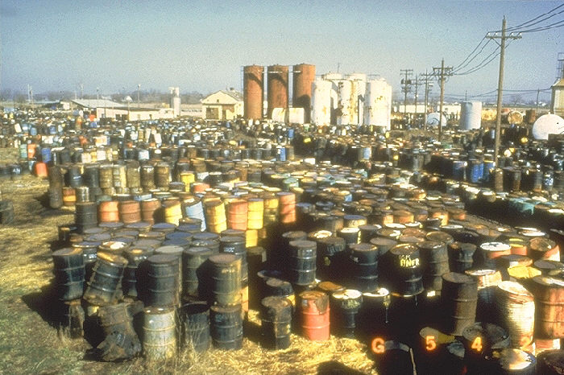
Reinstate Superfund Taxes
Our budget reinstates the Superfund excise taxes that expired in 1995. The Environmental Protection Agency’s Superfund program, once largely funded by dedicated taxes, is now funded primarily by general revenue. Having a stable source of funding, rather than relying on year-to-year appropriations, will provide $22 billion more for cleanup of hazardous and contaminated land, often located in disadvantaged communities.

Slide 17
Helping Communities Adapt
The People’s Budget increases funding for EPA climate adaptation programs and FEMA climate resiliency initiatives. It also incorporates the job training and economic development funding outlined in the President’s POWER plus plan to assist displaced fossil fuel workers and communities impacted by changing energy policies.

Slide 18

Crop Insurance Subsidies
The CPC Budget reduces the federal government’s subsidy from 60 percent to 40 percent premiums, on average. Insurance policies purchased through the program are sold and serviced by private insurance companies, which are reimbursed by the federal government. In 2013 the Congressional Budget Office predicted that crop insurance will cost taxpayers about $90 billion over the course of a decade.

Slide 19
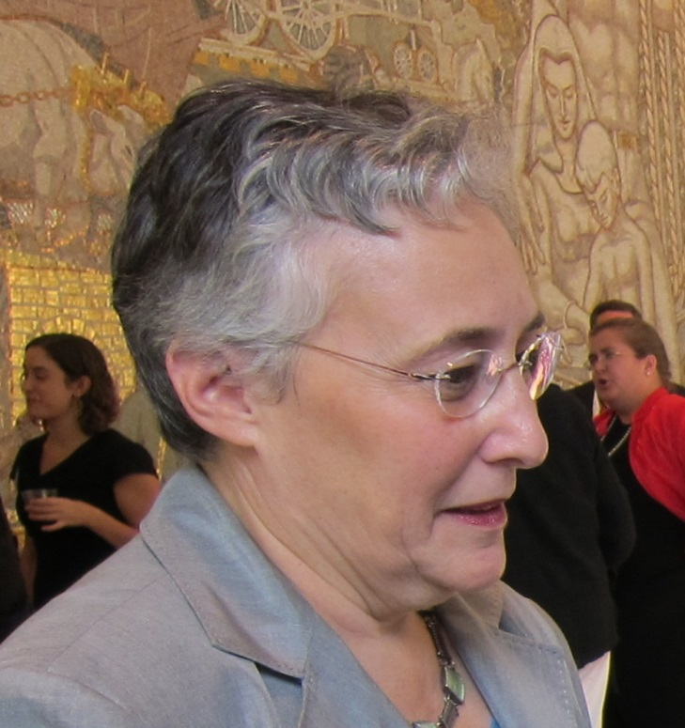

Deborah Weinstein
Executive Director,
Coalition on Human Needs,
www.chn.org
  an alliance of national organizations working together to promote public policies which address the needs of low-income and other vulnerable people.

Slide 20
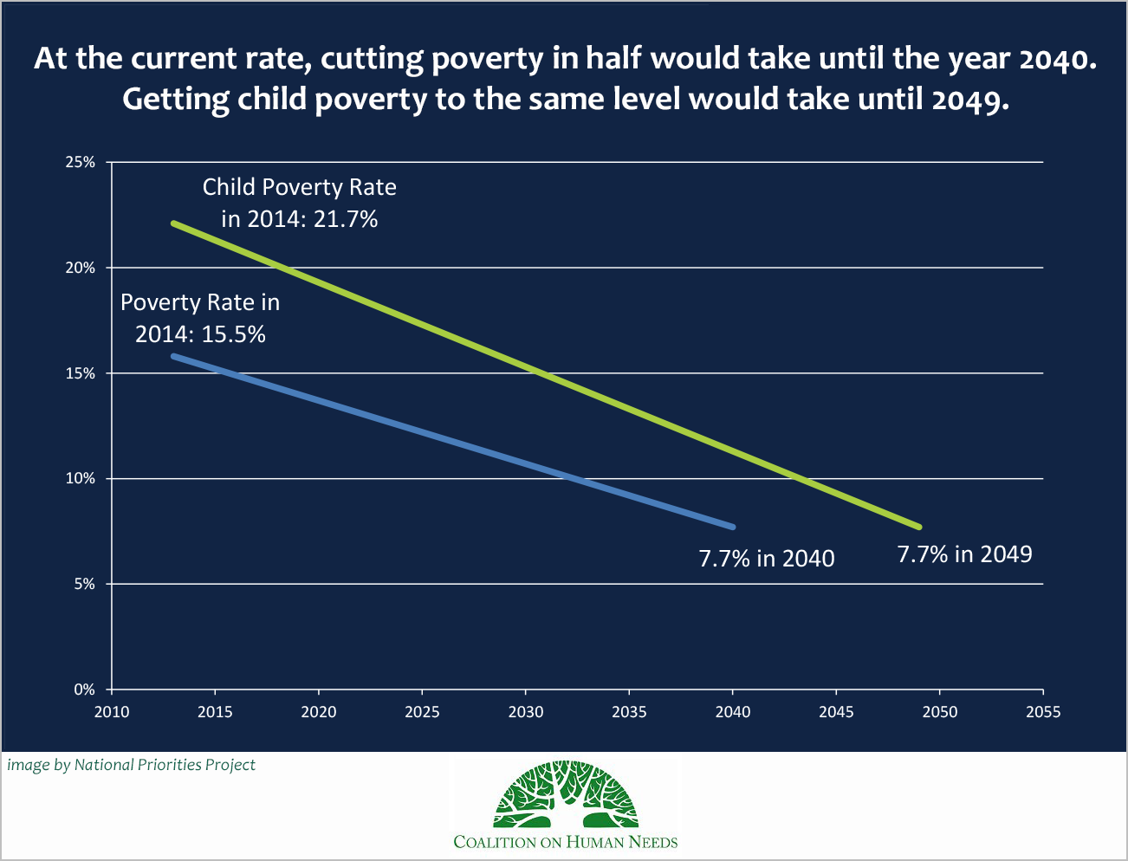

Slide 21
Cut Poverty in Half in Ten Years
Employment:
  3.6 million jobs created
  Raise minimum wage
  7 days of paid sick leave
Tax Fairness:
  Expands Earned Income Tax Credit for workers without dependent children
  Hard Work Tax Credit
Food:
  Restores average $216 cut in SNAP (food stamps) benefits
  Increases child nutrition funding
Housing:
  $11 billion rental housing investment to end family homelessness

Slide 22
Cut Poverty in Half in Ten Years
Education:
  $80b increase for child care for babies & toddlers
  Universal pre-k, full funding for Early Head Start
  Debt-free college
Health:
  Maintains Affordable Care Act; adds public insurance option within health insurance marketplaces
  Increases funding for mental health, substance abuse treatment
  Clean drinking water: $150b to replace pipes; $765m for Flint, MI families

Slide 23
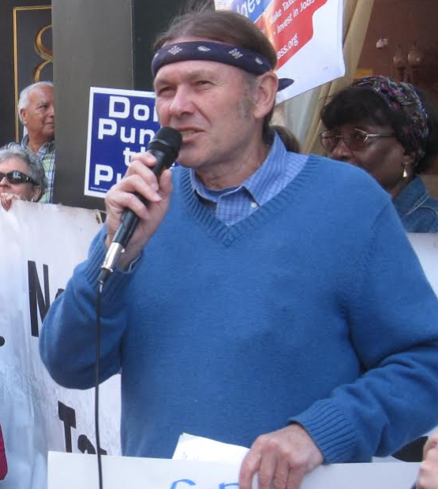

Paul Shannon
Paul Shannon is on the staff of the American Friends Service Committee in Cambridge, Massachusetts and a Coordinator of the Massachusetts Budget for All Coalition

Slide 24
Military spending in the Peoples Budget
The Peoples Budget makes far deeper and more significant cuts in Pentagon spending than any other budget
Its strongest feature is that it cuts $761 Billion from the Overseas Contingent Operations (OCO) war slush fund over the next 10 years while also funding the orderly and safe withdrawal of the thousands of U.S. ground troops now in Afghanistan
The OCO account has been used to fund numerous American wars which have helped turn the Middle East and South Asia into a seething cauldron of suffering and death: Iraq, Afghanistan, Pakistan, Libya, Syria, Somalia, Yemen and now in Iraq again

Slide 25
Military spending in the Peoples Budget
The Peoples’ Budget also provides significant funding for middle east refugee re-settlement programs, diplomacy, and humanitarian assistance to war shattered areas
It also provides for cuts in Pentagon base budget
  Establishing a “responsible approach” toward a sustainable defense budget
  Reducing the use of private contractors that has led to big cost-overruns
  The de-commissioning of cold war era nuclear weapons
  Reducing procurement and R&D my making “smarter” procurement choices
  Creating a “leaner” military with fewer military personnel which is focused on modern security threats instead of cold war weapons and contracts
  Auditing the Pentagon

Slide 26
Why the Peace Movement Should Support The People’s Budget
We should support of the Peoples’ Budget for 2 reasons:
First, its Pentagon cuts are larger and more significant in terms of stopping wars than in any other budget proposal. Pentagon cuts is the most difficult section of the People’s Budget for CPC members to “sell” to other members of Congress and even to CPC members. If we in the peace movement want deeper cuts, it is up to us to create the conditions that make deeper cuts politically feasible
This CPC budget can serve as a vehicle that allows us to work on a common project with climate, social and racial justice movements who should be attracted to its bold increases in funding for all the programs the country needs

Slide 27
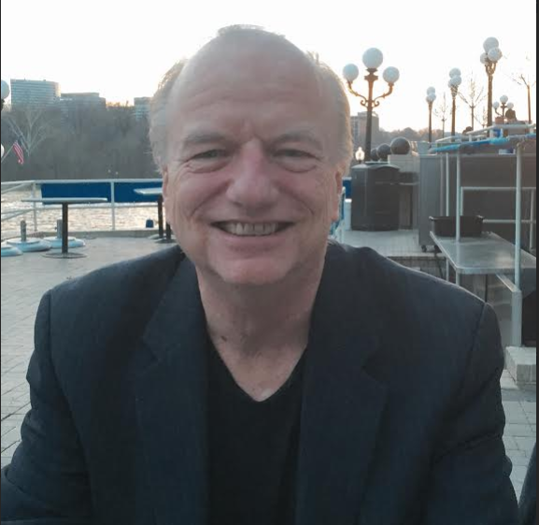
Michael Kane, National Alliance of HUD Tenants
Michael Kane has served as the Executive Director of the National Alliance of HUD Tenants since 1994. NAHT is the national union representing the 1.7 million tenants in privately-owned, HUD subsidized multifamily housing, and is the only national tenants union in the US. Kane has also organized HUD tenants in Massachusetts with the Mass Alliance of HUD Tenants since 1983, helping tenants save 12,200 apartments as affordable housing, one building at a time, through tenant organizing. Kane also served on the Board of the Habitat International Coalition (HIC), the leading global housing rights network, from 2004 through 2014, including a term as Vice President.

Slide 28
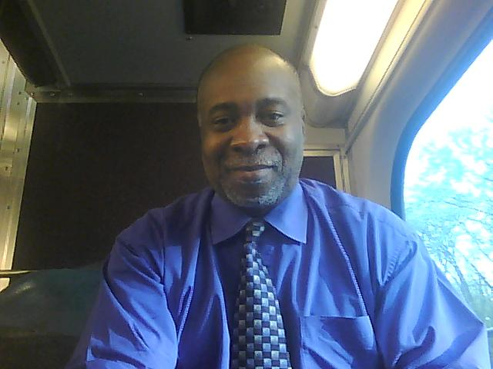
Ed Lucas, National Alliance of HUD Tenants
Edgar P. Lucas, Jr. is the Executive Director and one of the founders of the Renacer Westside Community Network, Inc. Ed has served as the Executive Director for the past 20 years. Renacer is a Community Based Organization which assists underserved communities in Chicago with a specific focus on Housing issues. He is a member of the Northwest Tower Residents Association, a resident owned Project Based Section 8 property.
Ed was just re-elected to his third term as one of the Region 5 representatives for the National Alliance of HUD Tenants (NAHT) and currently serves as President.
Ed is a veteran of the U.S. Marine Corps, attended Truman College and Chicago State University where he received undergraduate degrees. He is a Building Performance Institute (BPI) Certified Building Analyst and a member of the United Nations Association, Chicago Chapter.

Slide 29
Affordable Housing
Expand affordable housing through increased Community Development Block Grant and HOME funding
Provides resources for Public, Elderly and Disabled Housing
Restores 70,000 Section 8 Vouchers
Provides new Vouchers to reduce wait lists

Slide 30
Affordable Housing
Funds 25,000 new supportive and 8,000 rapid rehousing units for the homeless
Supports President Obama’s $11 billion request to end family homelessness by 2020
Provides robust funding for Low Income Heating Assistance

Slide 31

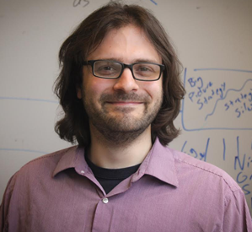
Q&A – Endorsing Organizations
Peace Action
National Alliance of HUD Tenants
Coalition for Human Needs
Friends of the Earth
Campaign for America’s Future

Slide 32


Cole Harrison
Cole Harrison Move the Money coordinator for Peace Action. He is also Executive Director of Massachusetts Peace Action. He is on the coordinating committee of Budget for All Massachusetts campaign, and co-coordinates the People's Budget Campaign.

Slide 33
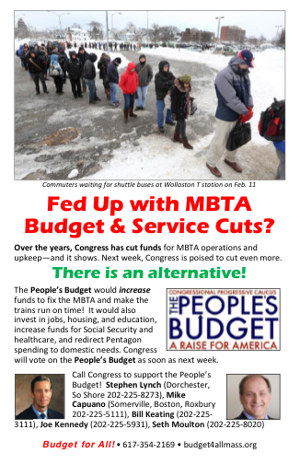
Budget Issues Are Grassroots Issues
The People's Budget connects multiple progressive constituencies
It received 96 votes in 2015 yet is not taken seriously by the media - so we have to organize our own campaign
We need to break down the budget and bring it to the grassroots
We need to campaign on the PB all year around

Slide 34
Why a People's Budget Campaign?
Activate the progressive grassroots on a comprehensive cross-issue platform
Link the PB to campaigns over component issues (for ex, debt-free college; climate change; military appropriations; shutdown threat)
Build bridges between social justice movements, promote cross-movement solidarity and collaboration
Make the PB a serious "player" each year; Increase Congressional support for the PB in annual vote

Slide 35
How to organize for the People's Budget
Bring more national organizations into the People's Budget Campaign
Subject matter is complicated: Communication and research resources are important
Online campaigning: Link the People’s Budget to topical issues throughout the year
Move more progressive Democrats to support the budget who have not yet done so
  Target gettable reps who can be moved
  Build a local coalition to campaign for the member's attention
  Link federal budget issues with locally resonant issues in those districts

Slide 36
Can You Visit/Call These Reps?
Rep. Eric Swalwell(CA15)
Rep. Julia Brownley (CA26)
Rep. Brad Sherman (CA30)
Rep. Rosa DeLauro (CT03)
Rep. John Larson (CT01)
Rep. Stanford Bishop (GA02)
Rep. Tulsi Gabbard (HI02)
Rep. Tammy Duckworth (IL08)
Rep. Joseph Kennedy (MA04)
Rep. Dutch Ruppersberger (MD02)
Rep. Steny Hoyer (MD05)
Rep. Chris Van Hollen (MD08)
Rep. Bill Pascrell (NJ09)
Rep. Steve Israel (NY03)
Matt Cartwright (PA17)
Rep. Jim Langevin (RI02)
Rep. Beto O’Rourke (TX16)
Rep. Joaquin Castro (TX20)

Slide 37
When will the People’s Budget be Voted On?
Republican House leadership is in a standoff with the Freedom Caucus
Budget has been postponed twice already because of this
Republican Caucus meets on April 12 will decide whether they will advance a budget
If yes, the vote on multiple budgets including the People’s Budget could happen that week or the following week
If no, there might be no budget votes at all this year; the process would then proceed with votes on individual appropriations bills

Slide 38
Blog Posts on The People’s Budget
Flint, MI Water Crisis Is Proof Positive That We Need Better Infrastructure and a Progressive Budget By Olivia Alperstein, Progressive Congress and Jonathan Alan King, Massachusetts Budget for All Campaign
Investing in People Matters: A Black Man’s perspective on The People’s Budget by Marc Carr, Social Solutions
Why we need the People's Budget and its $1 trillion infrastructure jobs plan by Isaiah Poole, Campaign for America’s Future
The Peoples’ Budget and Pentagon Spending: A Start in the Right Direction by Paul Shannon, American Friends Service Committee

Slide 39
Blog Posts on The People’s Budget
The People’s Budget is the Greenest Option in Washington by Lukas Ross, Friends of the Earth
Five Reasons to Support The People’s Budget by National Priorities Project
The Pro-Social Security Congressional Progressive Caucus Budget by Nancy Altman, Social Security Works
The People’s Budget: Pushing Us Toward a Peace Economy by Miriam Pemberton, Institute for Policy Studies

Slide 40
Blog Posts on The People’s Budget
Flint and Beyond by Deborah Weinstein, Coalition for Human Needs
Stoke Job Growth Or Choke It? The GOP Makes The Wrong Choice Again by Isaiah Poole, Campaign for America’s Future
Prioritizing People, Not the Pentagon, with the People’s Budget by Jasmine Tucker, National Priorities Project
The People’s Budget Quenches Thirst for Big Ideas That Work by Richard Kirsch, Roosevelt Institute
A Federal Budget That Connects the Dots and Works for All by Deborah Weinstein, Coalition for Human Needs

Slide 41
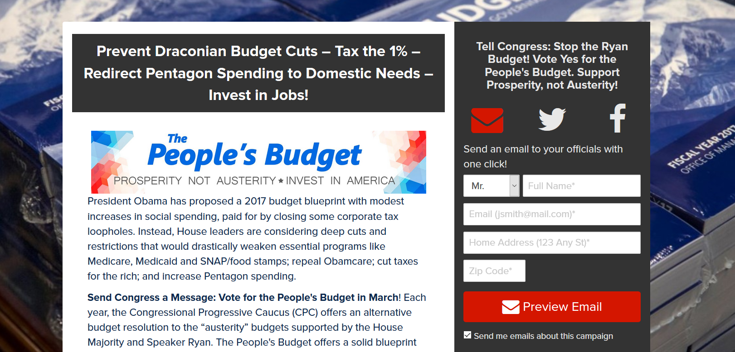
Next Steps - Working with Congress
Email your House Member and ask them to support The People’s Budget
  We have sent more than 5,300 emails to House members
  We need to send more than 30,000 emails

Slide 42

Working with Congress
Participate in the Daily Kos Mega-Petition
  22 participating organizations
  170,000 people have signed on to become a Citizen Cosponsor of The People’s Budget

Slide 43
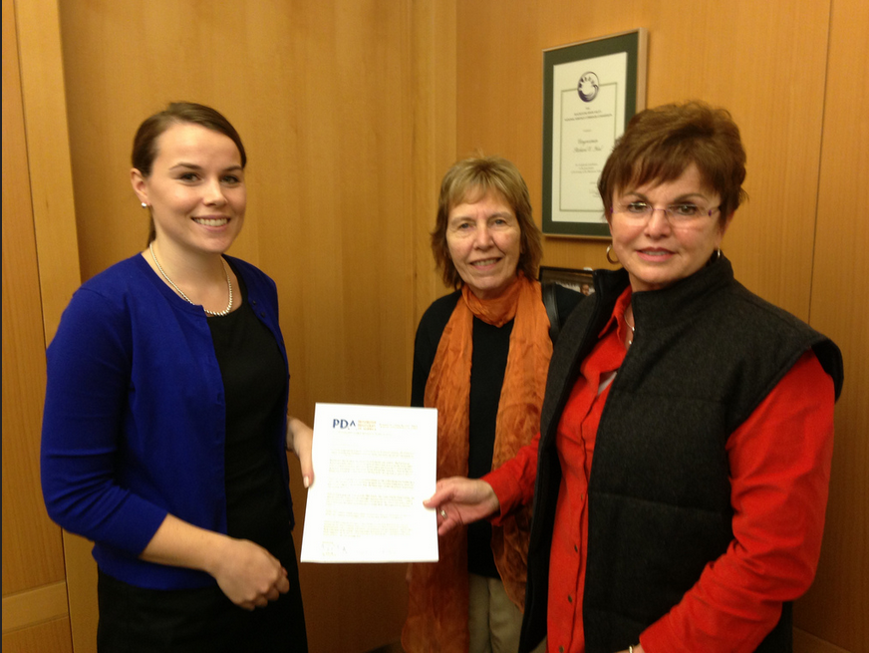
Working with Congress
Deliver a letter to your House Member asking them to support The People’s FY 2017 Budget
PDAction delivered 94 letters on Capitol Hill and 27 In District letters.
https://actionnetwork.org/event_campaigns/building-congressional-support-for-the-peoples-budget

Slide 44
Informing Your Community
Write a Letter to the Editor - http://salsa.wiredforchange.com/o/6405/c/10113/letter/?letter_KEY=881
Share our Blog Posts from Daily Kos, Huffington Post and Common Dreams
Join our Thunderclap and help spread the word - https://www.thunderclap.it/projects/39840-support-the-people-s-budget?locale=en
Host a Town Hall Meeting (for FY2018 People’s Budget) – Summer
Find Resources at: http://www.peopledemandingaction.org/campaigns/the-people-s-budget

Slide 45
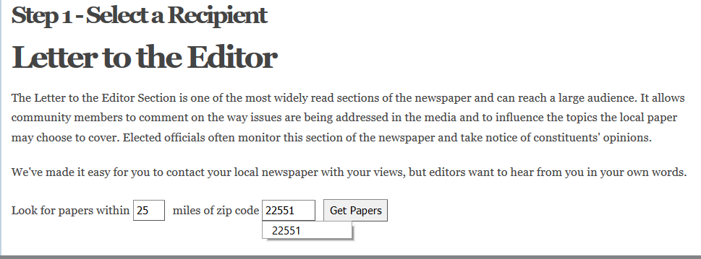
Letter to the Editor Tool
Enter your zip code
Click Get Papers

Slide 46
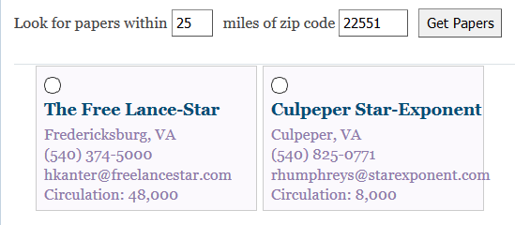
Letter to the Editor
Choose one Newspaper

Slide 47
Letter to the Editor
Choose one Newspaper
If you don’t get any newspapers, enter a larger number for radius from zip code

Slide 48
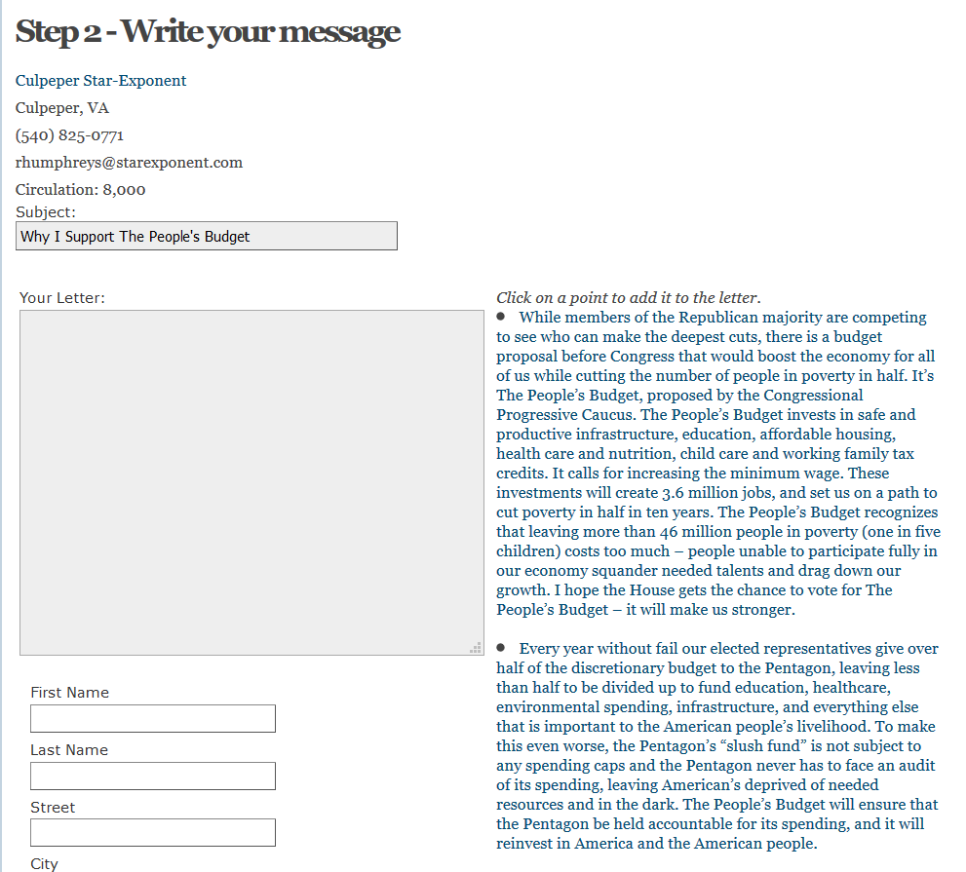
Letter to the Editor
Write your letter
Or
Click on any paragraph to add it to the letter (feel free to change the order)
Add your information at the bottom
Click Send Message

Slide 49
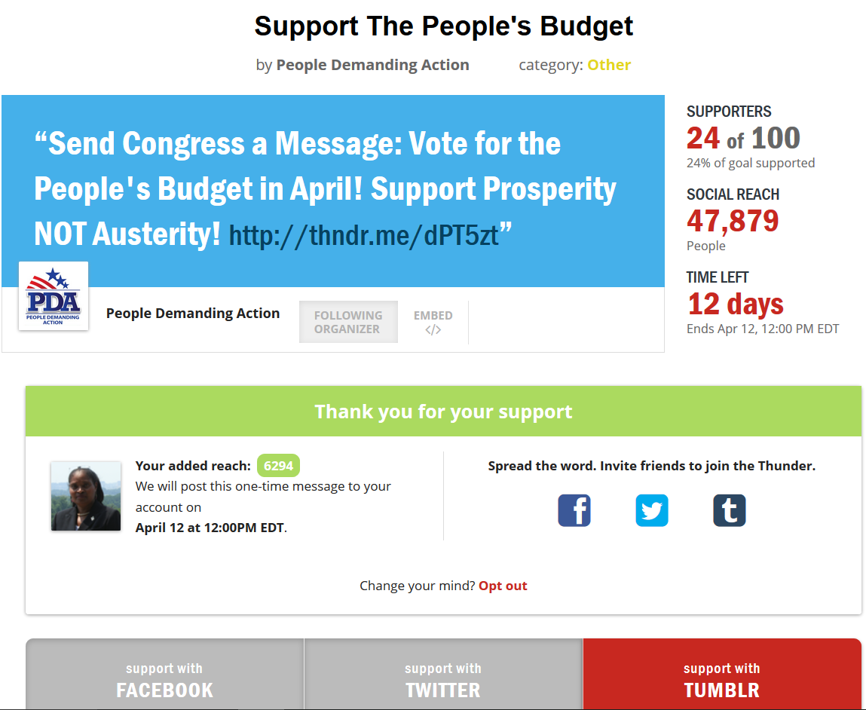
Join Our Thunderclap
Bank your Facebook, Twitter and Tumblr followers.
On April 12th at noon our Facebook post/Tweet will appear on their page.
This is a one time authorization
We need 100 people to do this; right now we need 76 more
https://www.thunderclap.it/projects/39840-support-the-people-s-budget?locale=en

