Slide 1
Pentagon 101
Politics and the Pentagon:
How we can stop waste, fraud and rampant militarism
Lindsay Koshgarian
Research Director
National Priorities Project
March 8, 2016

Slide 2
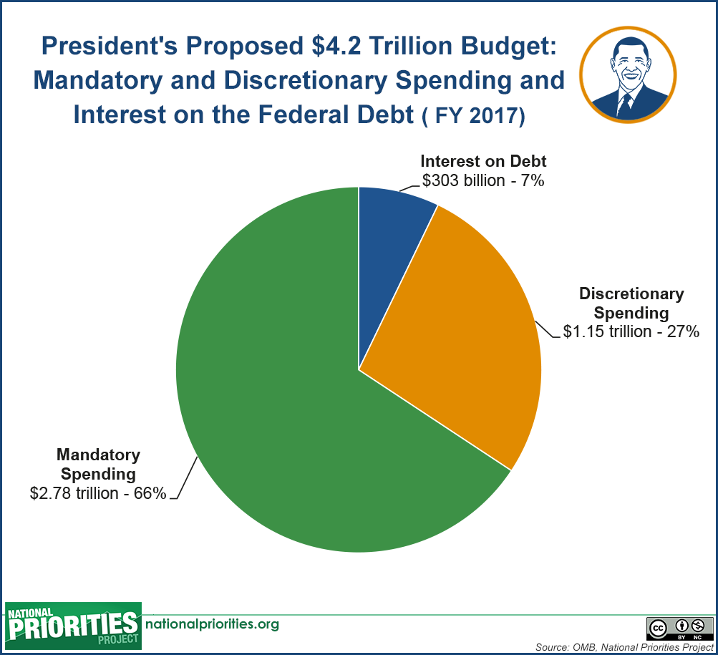

Slide 3
What are Mandatory and Discretionary Spending?
MANDATORY
Depends on eligibility rules and permanent or multi-year “authorization” of funds
Funded primarily by trust funds and payroll taxes, as well as other sources
Includes:
Social Security
Medicare
Medicaid
Unemployment Insurance
Retirement for federal employees
Student loans
DISCRETIONARY
Depends on annual budget process and “appropriations” of funds
Funded primarily by income taxes (individual and corporate)
Includes:
Pentagon
Education
Transportation
Housing Veterans’ Benefits
Science

Slide 4
President’s Budget Highlights
Follows the Bipartisan Budget Act of 2015 (December’s budget deal)
$4.2 trillion in total spending
  4% more than FY 2016

Slide 5
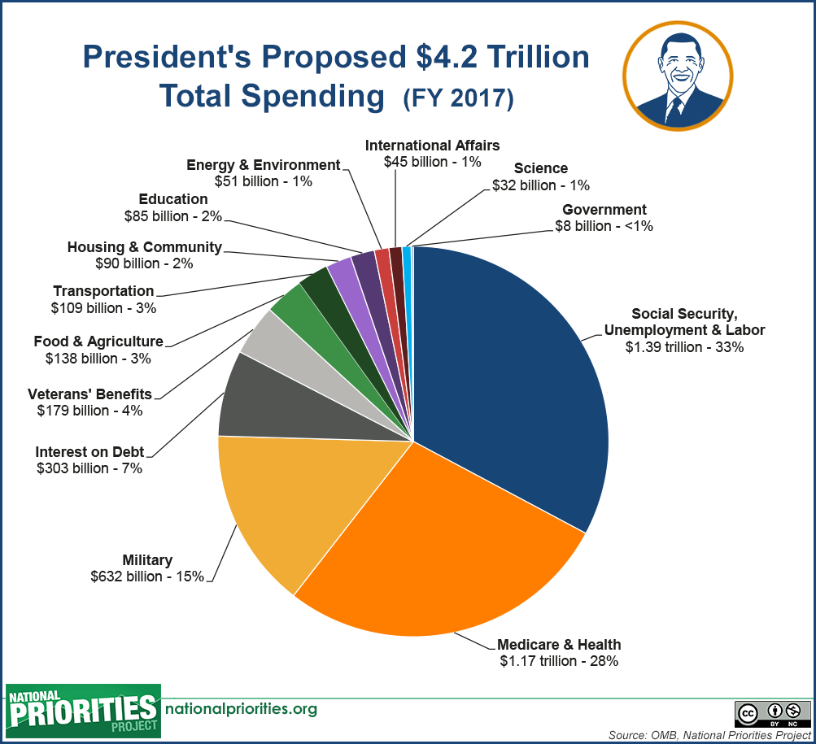

Slide 6
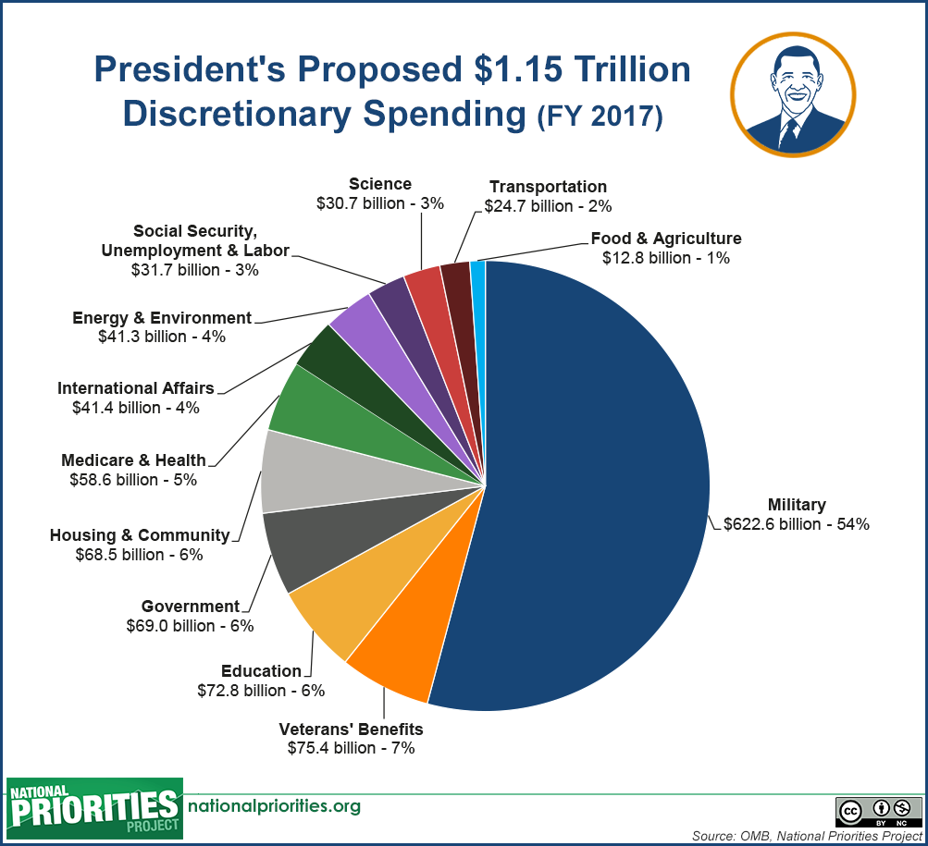

Slide 7
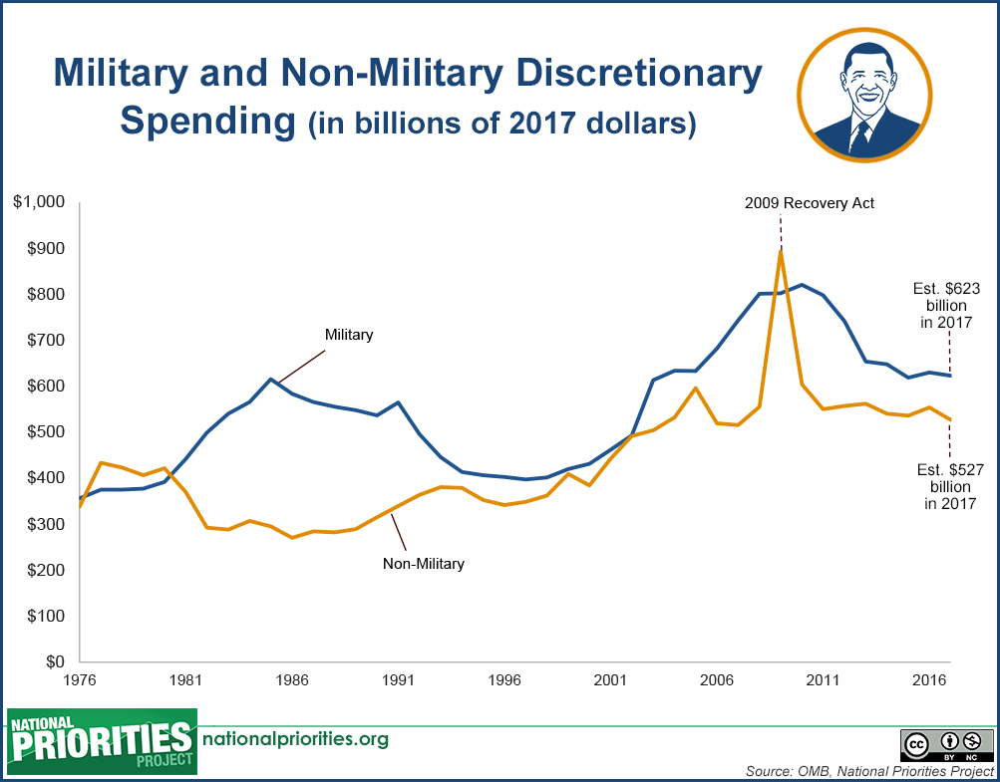

Slide 8
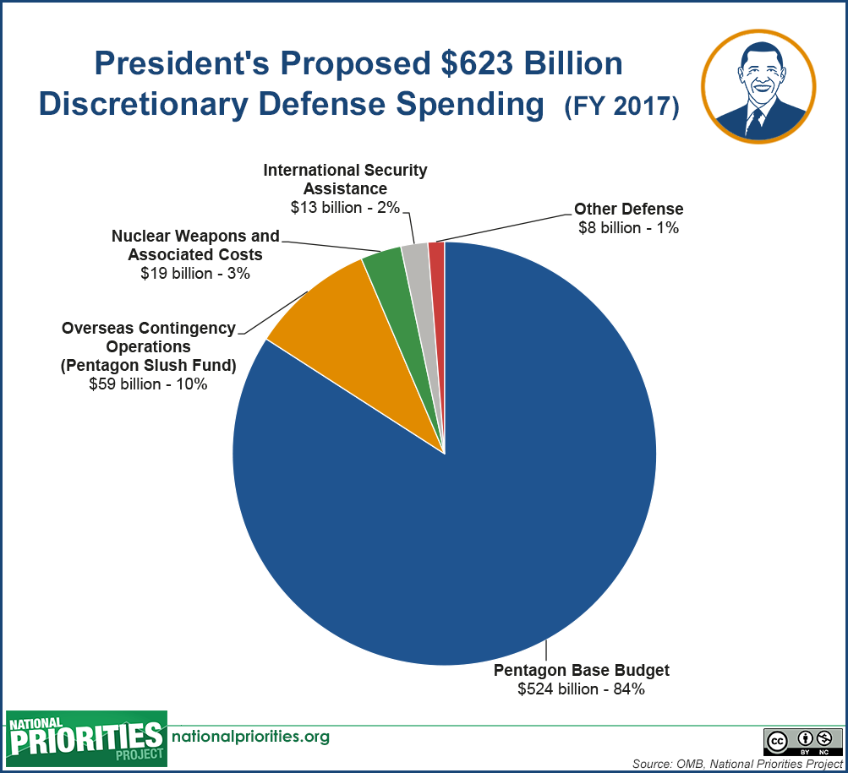

Slide 9
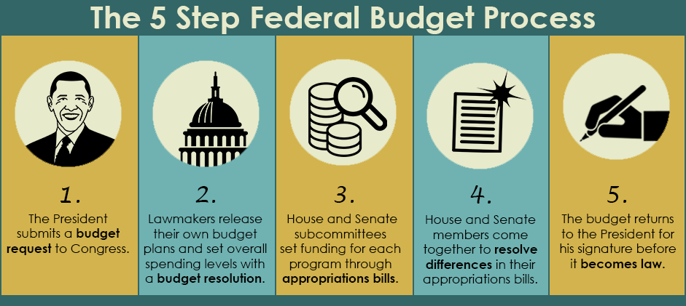
Step 1 in the Budget Process

Slide 10
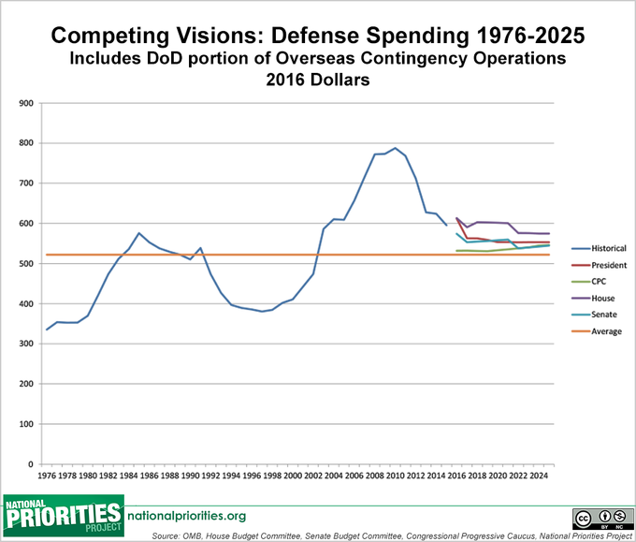
FY2016 Proposals:
The People’s Budget spent less on the Pentagon than any other proposal.

Slide 11
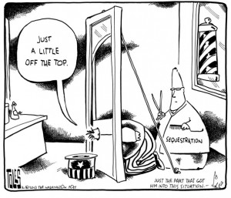
Sequestration
President’s budget keeps to spending levels agreed to in Bipartisan Budget Act of 2015
People’s Budget immediately does away with sequestration
House Budget: Wait and see!

Slide 13
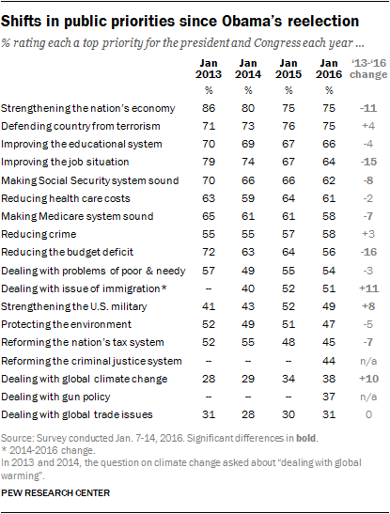
Public’s Policy Priorities for 2016
Economy – 75%
Terrorism – 75%
Education – 66%
Jobs – 64%
Social Security – 62%
Health Care Costs – 61%
Medicare – 58%
Reducing Crime – 58%
Budget Deficit – 56%
Poor and Needy – 54%
Immigration – 51%
Notes:
% rating each a top priority for the president and Congress this year

Slide 14
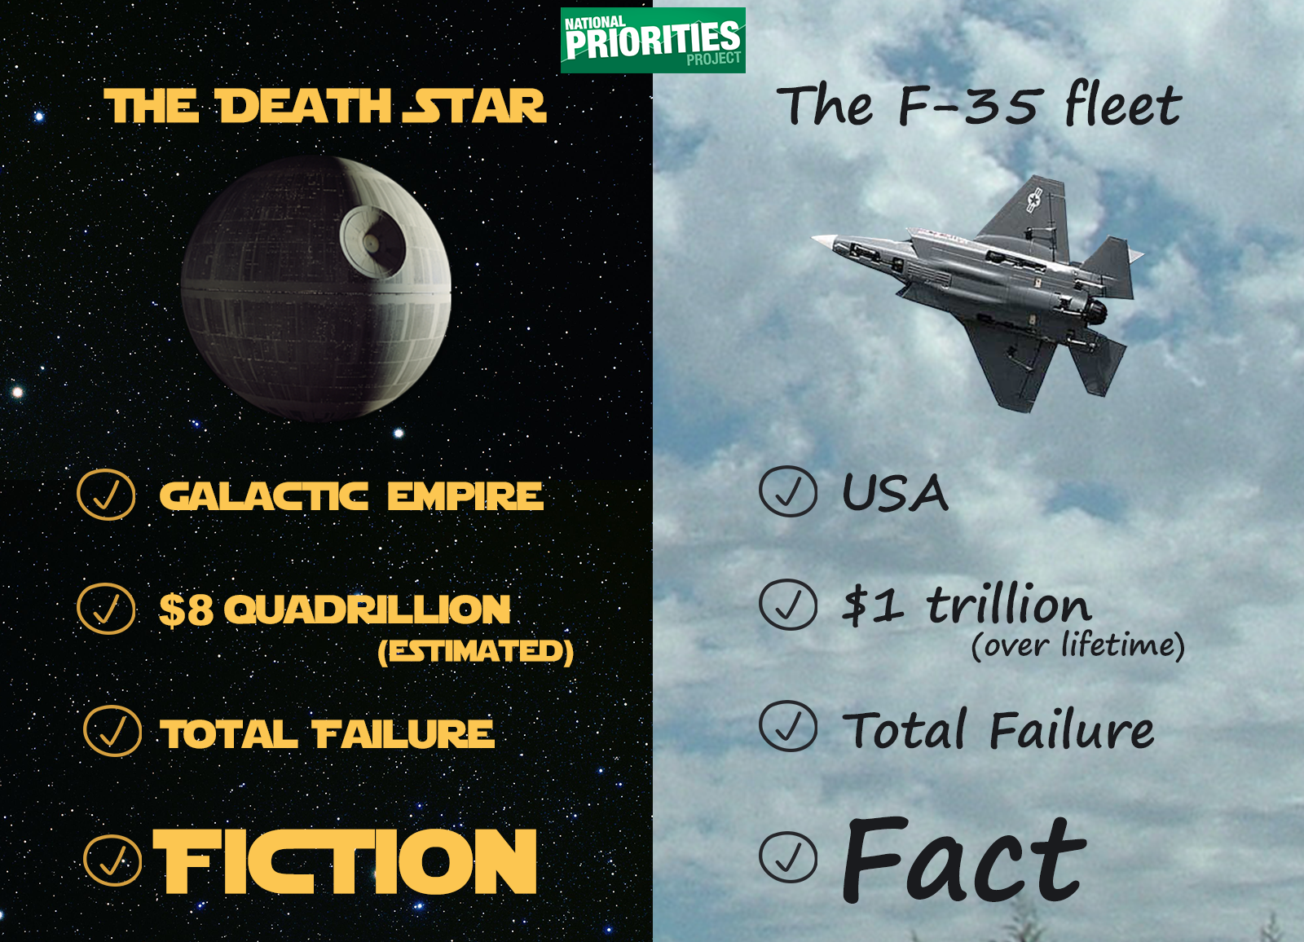

Slide 15
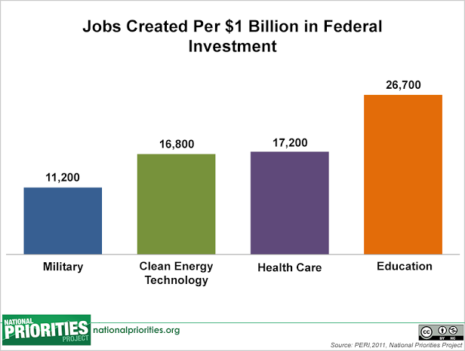

Slide 16
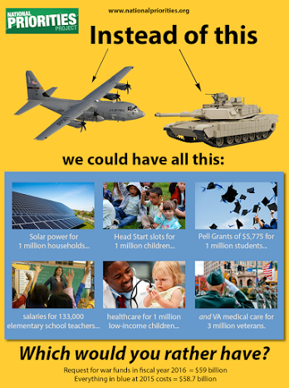

Slide 17
Ways to Take Action:
Today: Ask your member of Congress to support the People’s Budget’s reasonable reduction in Pentagon spending. Sign the petition!
Next week: Keep an eye out for competing budget proposals. Oppose those that increase or maintain wasteful Pentagon spending.
This summer/fall: Congress will begin to consider specifics. Keep an eye out for “unfunded priorities” (sign up with NPP to stay informed).
Always: Question the Pentagon’s priorities. Are they keeping us safe? Share information with friends via Facebook, Twitter, etc.

Slide 18
Questions?
www.nationalpriorities.org
Jasmine Tucker
jtucker@nationalpriorities.org

